Slide 1
Problem Statement

Slide 2
A grant claim is an evidence problem, not an arithmetic one
▸ EDB funds the research headcount. The Economic Development Board co-funds the salaries of qualifying research staff hired for approved research projects — a material amount to the organisation, claimed across 18 participating entities and a three-year qualifying period.
▸ Preparing it is manual, and repeats every claim. HR re-keys the same people out of three separate workbook contracts — an internal checklist/timesheet per entity, a payroll register, an ECMF-validated researcher list — into EDB's official template, by hand, per person, per month.
▸ The audit is the real constraint. An ACRA-registered Public Accountant performs SSRS 4400 agreed-upon procedures and samples at least 85% of the claimed value against the Statement of Expenditure. Almost every claim row must be able to show where its number came from.
▸ So evidence cannot be reconstructed afterwards. It has to be captured at the moment a value is read out of a workbook and carried all the way to the submission — file, sheet, cell.
▸ And the answer must not move. Determinism is an audit property: a re-run during the audit window has to produce the same figures, or the claim is not defensible.
Out of scope by design: equipment and other cost categories, claims for foreign staff (flagged, never claimed), live HR/payroll integration, and anything that replaces the auditor's own procedures.

Slide 3
Solution

Slide 4
An agentic system HR can trust with a financial number
▸ An agentic document-verification system for HR. Upload the HR records and the system reads them, tracks what is missing, applies EDB's rules person by person and month by month, and produces the filled submission pack.
▸ Harness engineering, because the subject is money. The intelligence is wrapped in guardrails: schema-constrained calls at temperature 0, a cache-and-replay log, and a hard boundary the model cannot cross.
▸ The model proposes; the engine disposes. Every claim figure is computed in plain, auditable Python. The LLM only proposes extractions and judgements for HR to confirm — three tests assert that the calculation modules cannot even import the LLM layer.
▸ Grounded retrieval for the assistant. Figure questions are answered by exact SQL over the rows the pipeline actually computed; scheme questions are answered from a curated knowledge base; "fetch the evidence for <name>" returns the source documents and cells, so HR can satisfy a re-verification request on the spot.
▸ Evidence threaded from the parser. 312 evidence references are live in the store — any figure on screen is one click from the cell it came from, and the same trail is exported for the Practitioner.
▸ Both methods, and the disagreement between them. EDB's monthly pro-ration is what gets submitted; the internal hours-ratio method runs beside it as a second opinion, with a variance report — because the ruling on which governs every edge case is still pending.
Fully local: salary data is processed on the machine it was uploaded to. There is no external API call on claim data at any point.

Slide 5
Mental Model

Slide 6
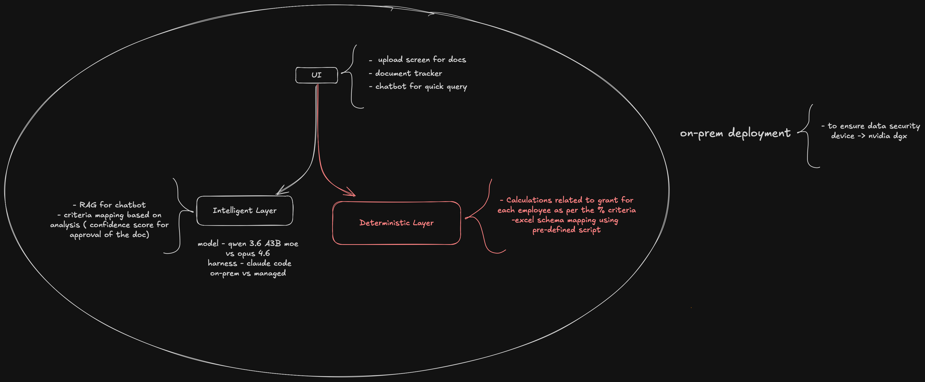
One identity, three rules that never bend
Hold this and the rest of the system follows: the claim is a sum over person-months, and everything else exists to prove each term of it.
▸ Arithmetic is Python. No model, no spreadsheet formula, no cell reference we cannot re-derive. Same inputs, same figures, every run.
▸ The model proposes, the engine disposes. The LLM may suggest a reading or flag a borderline designation. It never writes a number.
▸ Every figure has a cell. A value that cannot name its source workbook, sheet and cell does not belong in a claim.
▸ Nothing is silently dropped. Excluded people leave with a reason and an authority. Low-confidence answers are shown with the reason they are low — never discarded.
# the whole claim, in one line
claim = support_rate × Σ over claimable months
min(basic_salary, 20_000)
× month_fraction # weekdays worked / weekdays in month
× time_on_project # % from the timesheet
# and the constants that decide who is in the sum
support_rate = 0.60 CONFIRMED — EDB Support Package
salary_floor = 5_000 below it the person is EXCLUDED, not clamped
salary_cap = 20_000 above it the salary is clamped, person retained
hours_per_day = 8.8 weekdays only — no public-holiday adjustment
# effective ceiling per person: 0.60 × 20,000 = $12,000 / month
The two floors are different animals and the distinction is worth $12,000: the S$5,000 floor is an eligibility gate that removes a person; the S$20,000 cap is arithmetic that keeps them.

Slide 7
Overall Workflow

Slide 8
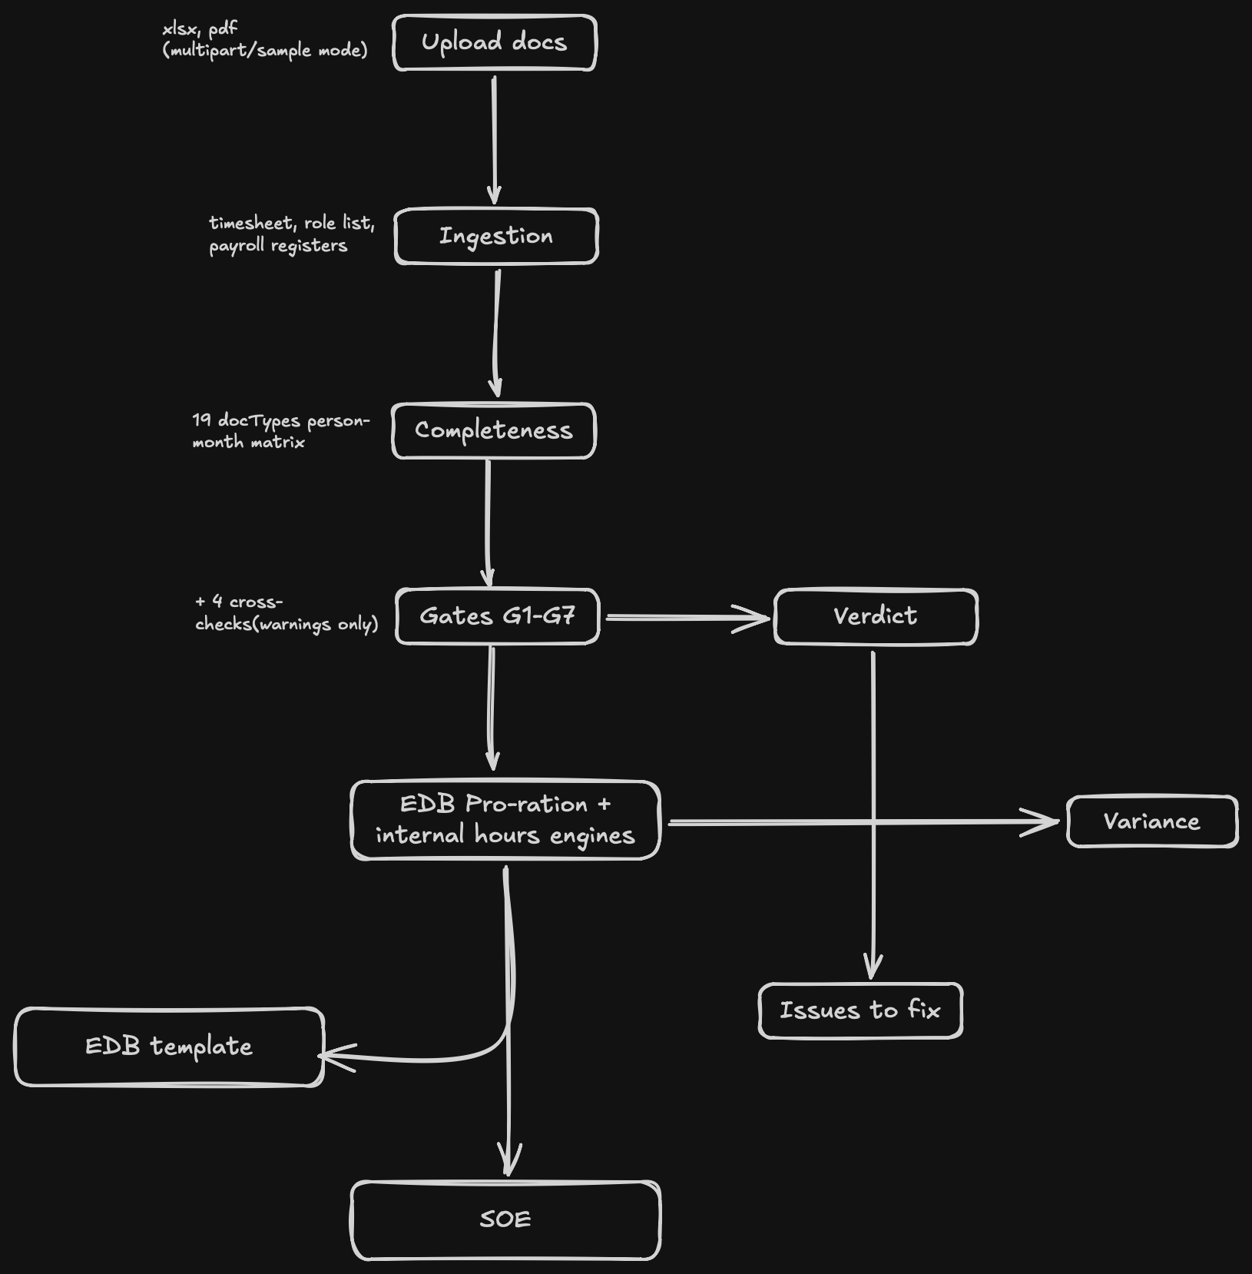
How a claim flows — five guided stages
1 · Upload documents
internal timesheet workbooks
ECMF RSE list · payroll register
supporting evidence ticked
2 · Document check
FR-2 completeness matrix
19 doc types, scoped
per person and per month
3 · Eligibility
gates G1–G7 + 4 cross-checks
verdict per person:
QUALIFIES / BLOCKED / EXCLUDED
4 · Claim amount
Method A — submitted
Method B — cross-check
every month shown in full
5 · Submission pack
one click, three workbooks
every figure carries its cell
if anything is missing
Fix or acknowledge
Continue stays disabled until
the document is re-uploaded or
the gap is signed off
Excluded / blocked
reason + authority + source cell
reported, never dropped
Variance A vs B
Δ$ · Δ% · New-Hire isolation
surfaced before the auditor sees it
EDB template · SOE · Issues
official RIS(C) v1.1 export,
the Practitioner's evidence pack,
HR's action list
Grant & Verification Assistant — on every screen
figures answered by exact SQL over the computed rows · scheme questions answered from the knowledge base · "fetch the evidence for <name>" returns files and cells · read-only, and every answer is groundedness-checked before it is shown
Every stage is reversible and nothing is silently dropped: the doc check blocks until the gap is fixed or explicitly acknowledged, and anyone excluded leaves with a reason and a source cell.

Slide 9
Architecture

Slide 10
Module map and the sealed core
app/main.py
Streamlit shell · 1,356
webui/
React 18 + Vite + Tailwind · 2,764
/api
api/
FastAPI server 399 · serialize 240
app/pipeline.py — run_pipeline()
the single orchestration seam · 631 lines
domain/
models 324
calendar_utils 113
ingest/
timesheet 648
salary 451
rse_list 223
validate/
completeness 856
gates 455
crosschecks 338
verdict 135
calc/
method_a 245
method_b 269
variance 149
output/
soe 307
edb_writer 164
reports 86
db/
schema 379 · store 842
16 tables · vec0 provisioned
proposals only
eval/
harness 277 · groundedness 320 · questions 146
HARD BOUNDARY — nothing in calc/ or output/ may import llm/ · enforced by 3 subprocess import tests, not by convention
llm/
client 335 · qa 630 · extract 287 · reconcile 224 · designation 178 · cache 169 · advisories 123
Arrows point the way dependencies flow. Both front-ends converge on one seam, app/pipeline.py:538 run_pipeline(). Line counts are real.

Slide 11
Data flow — one upload to a submission pack
Upload
xlsx · multipart
or sample mode
Ingest ×3
timesheet · rse_list
payroll register
Completeness
19 DocTypes
person-month matrix
Gates G1–G7
+ 4 cross-checks
(warnings only)
Verdict
EXCLUDED >
BLOCKED > QUALIFIES
calc/ — both engines, every claim
Method A · EDB pro-ration -> SUBMITTED
Method B · internal hours ratio -> CROSS-CHECK ONLY
Variance
Δ$ · Δ%
New-Hire B>A flag
>1% material
EDB template
official RIS(C) v1.1
formulas + hidden cols kept
SOE
6 sheets · evidence trail
for the Practitioner
Issues to fix
everyone not yet
claimable, with reasons
SQLite
persist_result()
best-effort, never fatal
A parse failure never aborts the run: explain_ingest_error() classifies it and returns an HR-readable why+fix into PipelineResult.errors.

Slide 12
The LLM proposes, the deterministic engine disposes
llm/ — PROPOSES
DETERMINISTIC — SEALED
extract.py
FR-9 payslip fields
+ confidence + location
ingest/ + validate/
accepts ADVISORIES
· mismatch flags
· needs_review marks
· HR confirmation queue
never a figure
calc/
method_a · method_b · variance
ALL arithmetic happens here
designation.py
FR-10 G5 judging
borderline only
reconcile.py
FR-11 name variants
exact-ID auto-accepts
output/
edb_writer · soe · reports
ALL figures written here
qa.py
FR-12 audit Q&A
router + groundedness
reads only
NO IMPORT PATH
GUARDRAILS temperature = 0.0 · response_format = json_schema, strict: True · sha256(prompt, model, schema) cache-and-replay · call() never raises into the pipeline · cache-replay is the determinism guarantee — not temperature (GPU is not bit-exact)
The boundary is a test, not a docstring: three tests import calc/ and validate/ in a subprocess and assert no edb_claim.llm* module ever reaches sys.modules.

Slide 13
DB Schema

Slide 14
One local SQLite file, employee_id as partition key
Table
Purpose
Live rows
employee
roster identity, designation, hire type, citizenship
34
employee_identifier
(id_type, id_value) → employee_id; NRIC, alias, email
21
employee_document
the FR-2 completeness matrix, persisted
387
person_month
(employee, year, month) basic_salary + hours
0
gate_result
one row per (employee, gate) with reason + ref_id
238
verdict
status + failed_gates JSON + reasons JSON
34
calc_result
(employee, method) — 34 people × Method A and B
68
evidence_ref
UNIQUE(employee_id, figure_key) — the FR-7 spine
312
document / doc_blob / doc_link
metadata split from bytes so scans skip content
3 blobs
llm_log
prompt, raw response, parsed, confidence, run_id
0
run_manifest
config_hash, support_rate, code_version
0
chunk / chunk_vec
vec0 virtual table, FLOAT[384] — sqlite-vec active
0

Slide 15
Evaluation

Slide 16
How we check the system is right
Eight checks run on every build, against a synthetic staff list built to fail in known ways. Each one either passes or names what it found — and no score is reported without saying what that score covers.
What we check
How we check it
Where it stands
The money is right
Compared to EDB's own published example, and to hand calculations
Matches to the cent
Every planted mistake is caught
13 deliberate problems seeded in the staff list, one per person
All 13 caught and labelled
Nobody is set aside quietly
Each exclusion carries its reason, the rule, and the cell behind it
Checked on every run
Same documents, same answer
The claim is recalculated and the results compared figure by figure
Identical every time
The assistant invents nothing
33 set questions; every number in an answer must match a calculated one
33 of 33, none invented
Nothing is hidden from HR
Unsure answers are still shown, with a plain reason for the doubt
Built in, always on
Every figure traces to its source
Follow any number to the file, the sheet and the cell it came from
312 references, all resolve
Payslips, job titles, names
The three remaining checks in the plan, on the same staff list
Set up, not yet scored
▸ The 13 planted cases: salary under the minimum · salary above the ceiling · a foreigner · someone not on the approved researcher list · someone already on another grant · an HR job title · an unclear job title · a mid-month joiner · a mid-month leaver · a new hire with no hours logged · a missing payslip · hours above what the month allows · one person's name spelled two different ways
What the 33 questions do and do not prove: they ran with no model attached, so they show the system will not put an unsupported number in front of HR — they do not grade how well a model writes. Grading that needs our own server's model connected. Nine of the 13 planted cases have their own automated test; the other four are covered by the end-to-end checks.

Slide 17
Models used & why

Slide 18
Provider-agnostic, schema-constrained, replay able
▸ The honest determinism claim. Temperature 0 maximises stability but GPU inference is not bit-exact. The cache-and-replay log is the actual determinism guarantee — and because source_ref is outside the cache key, the same question about the same figure replays identically regardless of which document surfaced it.
▸ Graceful degradation is a feature, not a fallback. The deterministic pipeline is the product; the model is an assistant on top of it. test_no_endpoint_still_replays_cache pins that.
▸ Four schemas, no prompt files. _EXTRACT_SCHEMA, _JUDGE_SCHEMA, _MATCH_SCHEMA, _ANSWER_SCHEMA. Prompts are inline functions, versioned with the code that depends on them.
# llm/client.py
def call(self, prompt, *, schema=None, source_ref=None,
confidence_hint=None) -> LLMResult
cache_key = sha256(canonical_json(prompt, model, schema))
# source_ref persisted but EXCLUDED from the key
transport: injected (tests) > openai (enabled) > None
no transport -> typed 'unavailable'. call() NEVER raises.
temperature = 0.0
response_format = json_schema, strict: True

Slide 19
Deployment

Slide 20
On-prem deployment — offline-capable by design
ST ENGINEERING ON-PREM HOST — SALARY DATA NEVER LEAVES THE MACHINE
HR browser
React 18 SPA
same origin, relative /api
/api
uvicorn + FastAPI · 127.0.0.1:8010
run_web.sh — serves webui/dist at /
NDJSON progress stream on /api/analyze
run_pipeline()
the deterministic core
no network calls, ever
edb_claim.db
one SQLite file · 16 tables
312 evidence refs · 238 gate results
EDB_DB_PATH
xlsx artifacts
EDB template · SOE
Issues to fix
written to disk, never uploaded
optional · temperature 0
vLLM · OpenAI-compatible · :8000
Qwen 3.6 35B A3B on the NVIDIA DGX
EDB_LLM_BASE_URL · EDB_LLM_MODEL
36 responses cached from this endpoint
Offline is a supported mode
unset EDB_LLM_BASE_URL and the pipeline
is unchanged — every figure is Python.
The assistant still answers from stored rows
EVERYTHING ABOVE IS SHIPPED AND RUNNING — everything below is hardening we would add for a production pilot
PROPOSED — not shipped in the POC
systemd unit or container image for restart-on-boot · nightly copy of the single .db file · reverse proxy + SSO if the app is ever opened beyond localhost
Shipped as scripts, not containers: run_web.sh builds webui/dist and serves it from the same uvicorn process as /api, so the SPA is same-origin and no claim data ever leaves the host. The db carries a vec0 table for future semantic retrieval; today retrieval is lexical (T23 open).

Slide 21
Impact of the solution

Slide 22
What changes for HR, and for the auditor
Manual today
With this system
▸ Weeks of spreadsheet work per claim, repeated per entity and per month.
▸ The rate, the S$20,000 cap or an exclusion is easy to mis-apply — and hard to notice afterwards.
▸ Evidence is assembled at audit time, by hand, from whatever files can still be found.
▸ "Where did this number come from?" is a research task.
▸ A missing payslip is discovered late, by the auditor.
▸ Two calculation methods disagree quietly, in someone's working copy.
▸ Upload to audit-ready submission pack in minutes, and repeatable on demand.
▸ The scheme rules are encoded once, in config, and applied to every person identically.
▸ 312 evidence references are captured as the workbooks are parsed — the pack is assembled, not reconstructed.
▸ Any figure is one click from its file, sheet and cell — the same trail the Practitioner samples.
▸ The document check blocks the claim until the gap is fixed or explicitly acknowledged.
▸ Method A is submitted, Method B cross-checks it, and the variance is reported before the auditor sees it.
Verified on the running system: 131 automated tests across 15 files · Method A pinned to EDB's own published worked example to the cent · $492,934.55 total claim across 14 qualifying staff on the synthetic dataset at the 60% support rate · 33/33 assistant probes emitted zero unsupported figures.

Slide 23
Demo Video

Slide 25
Scope of improvement

Slide 26
What we would build next, in order
▸ Semantic retrieval (T23). The store already carries a sqlite-vec vec0 table sized for 384-dimension embeddings; today the narrative path is lexical over a curated knowledge base. Computing embeddings turns it semantic without changing the figure path, which stays exact SQL.
▸ The remaining three eval scorers (T24). Groundedness is implemented and scores 33/33; extraction, designation and reconciliation are registered as explicit stubs, so completing them is an addition rather than a refactor.
▸ Run manifest and a determinism harness (T13). Persist config hash, support rate and code version per run so a re-run can be proven identical rather than assumed identical.
▸ Widen what is persisted. Per-month salary rows and the LLM call log are schema-complete but not yet written on the API path.
▸ Roll out across all entities. The POC runs two synthetic entities; the config carries all 18. Next is a real entity's FY2026 H1 data end to end.
▸ Read from the source systems. Replace workbook upload with an HR/payroll feed, so the re-keying disappears rather than being validated.
▸ Harden the deployment. A systemd unit or container image, a backup of the single database file, and a live-model evaluation run once the DGX endpoint is reachable again.
Two scheme questions are still open with EDB and the auditor, and are carried in config rather than decided in code: which method governs every edge case, and whether public holidays reduce working days.

Slide 27
Learnings

Slide 28
What building this actually taught us
▸ A boundary has to be a test, not a docstring. "The LLM never computes a figure" is only true if something enforces it — so three tests import the calculation and validation packages in a subprocess and assert no LLM module ever reaches sys.modules.
▸ Temperature 0 is not determinism. GPU inference is not bit-exact. The real guarantee is the cache-and-replay log keyed on a hash of prompt, model and schema — so the same question replays identically.
▸ Replicate the source system's quirks; do not fix them. The internal sheet gives new hires 100% time and labels a monthly figure "annual". Reproducing both is what makes reconciliation meaningful — the variance report is where the disagreement belongs.
▸ Anchor to someone else's answer. EDB publishes a worked example. Pinning Method A to it to the cent caught more real bugs than any hand-written expectation would have.
▸ Low confidence is information, not noise. Surfacing a weak answer with a plain-language reason keeps a financial system out of black-box territory; discarding it hides the very case a human should see.
▸ Design for the auditor, not the demo. "Show me where this came from" shaped the data model far more than any UI decision did — evidence is threaded from the parser because it cannot be recovered later.

Slide 29
Conclusion

Slide 30
A POC that is finished, honest about its edges, and ready to pilot
VERIFIED END TO END
OPEN — DECISIONS, NOT MISSING CODE
NEXT
▸ 131 tests across 15 files
▸ Method A pinned to EDB's published worked example, to the cent
▸ $492,934.55 claimed across 14 qualifying staff on the synthetic set
▸ 312 evidence references, each one click from its cell
▸ 33/33 assistant probes with zero unsupported figures
▸ Runs on-prem, offline, with no external call on claim data
▸ Which method governs every edge case (EDB ruling pending)
▸ Whether public holidays reduce working days
▸ The auditor's confirmed document list
▸ Both are carried in config and reported, never silently resolved
▸ Pilot on one real entity's FY2026 H1 data
▸ Semantic retrieval and the three remaining eval scorers
▸ Run manifest for provable re-runs
▸ Rollout across all participating entities
Upload to audit-ready submission — deterministic, evidence-complete, and entirely on-prem.

