Slide 1
EDB SUPPORT PACKAGE FOR AI COE · RESEARCH INCENTIVE SCHEME RIS(C)
Grant claim preparation
as a deterministic pipeline
Architecture, calculation engines, LLM guardrails and evaluation
Application No. S26-10249-RIS(C) | Qualifying period 01 Jan 2026 – 31 Dec 2028 | ST Engineering AI Centre of Excellence
Engineering deep-dive · ST Engineering HR · Confidential

Slide 2
THE PROBLEM
An audit requirement, not an arithmetic problem
▸ The arithmetic is easy. Monthly pro-ration of a capped salary. A spreadsheet does it. That is not what makes this hard.
▸ The audit is the constraint. An ACRA-registered Practitioner performs SSRS 4400 agreed-upon procedures and samples at least 85% of claimed value against the Statement of Expenditure. Nearly every claim row must have its evidence retrievable on demand.
▸ So evidence cannot be reconstructed at export. It has to be threaded from the parser forward. EvidenceRef{file, sheet, cell_or_row, label} is attached at the moment a value is read out of a workbook, and survives all the way to the pack.
▸ Three workbook contracts, re-keyed by hand. An internal Checklist/Timesheet per entity per month, a payroll register, an ECMF-validated RSE list — reconciled into EDB's official RIS(C) v1.1 template.
▸ Determinism is an audit property. The same inputs must produce byte-identical outputs, or a re-run during the audit window changes the answer.
Non-goals: equipment/other cost categories, Manpower_Foreigners claims (foreigners are flagged, never claimed), live HR/payroll integration, and replacing the auditor's procedures.
EDB RIS(C) Grant Claim Automation · ST Engineering HR · S26-10249-RIS(C) · Technical deep-dive

Slide 3
CONFIGURATION
Scheme rules are config, not code
edb_claim/config.py is a frozen dataclass; domain rules are deliberately NOT env-overridable. Only 6 knobs read the environment. Every ASSUMED row is a decision waiting on EDB or the auditor — the code carries the open question rather than silently picking a side.
Constant
Value
Role
Status
support_rate
0.60
× qualifying cost — the co-funding rate
CONFIRMED
salary_floor
5,000
exclusion GATE G4 — person is EXCLUDED
CONFIRMED
salary_cap
20,000
arithmetic CLAMP min(salary, cap), person retained
CONFIRMED
hours_per_day
8.8
monthly capacity = weekdays × 8.8
CONFIRMED
weekdays_only
True
Mon–Fri; NETWORKDAYS replica
CONFIRMED
public_holiday_adjustment
False
holidays do NOT reduce working days
ASSUMED (Q5)
max_grant_amount
42,000,000
manpower/salary only ceiling
CONFIRMED
disbursement_threshold_pct
0.70
70% released, 30% held to completion
CONFIRMED
upskill_max_months
9
existing staff to PL3; new hires uncapped
CONFIRMED
upskill_cap_anchor
first_qualifying
which 9 months — vs training_start
ASSUMED
confidence_cutoff
0.85
SURFACING threshold — never a discard threshold
ASSUMED
variance_material_pct
1.0
|Δ%| > 1 reported as materially divergent
ASSUMED (Q1)
final_submission_days
183
final Audited Claim after QP end
CONFIRMED
Effective ceiling per person: 60% × 20,000 = $12,000/month. claim_is_audited is False in the POC, so the Details sheet always writes 'UnauditedClaim' — the rate being confirmed is tracked separately from the claim being audited.
EDB RIS(C) Grant Claim Automation · ST Engineering HR · S26-10249-RIS(C) · Technical deep-dive

Slide 4
ARCHITECTURE
Module map and the sealed core
app/main.py
Streamlit shell · 1,356
webui/
React 18 + Vite + Tailwind · 2,764
/api
api/
FastAPI server 399 · serialize 240
app/pipeline.py — run_pipeline()
the single orchestration seam · 631 lines
domain/
models 324
calendar_utils 113
ingest/
timesheet 648
salary 451
rse_list 223
validate/
completeness 856
gates 455
crosschecks 338
verdict 135
calc/
method_a 245
method_b 269
variance 149
output/
soe 307
edb_writer 164
reports 86
db/
schema 379 · store 842
16 tables · sqlite-vec
proposals only
eval/
harness 277 · groundedness 320 · questions 146
HARD BOUNDARY — nothing in calc/ or output/ may import llm/ · enforced by 3 subprocess import tests, not by convention
llm/
client 335 · qa 630 · extract 287 · reconcile 224 · designation 178 · cache 169 · advisories 123
Arrows point the way dependencies flow. Both front-ends converge on one seam, app/pipeline.py:538 run_pipeline(). Line counts are real.
EDB RIS(C) Grant Claim Automation · ST Engineering HR · S26-10249-RIS(C) · Technical deep-dive

Slide 5
ARCHITECTURE
Data flow — one upload to a submission pack
Upload
xlsx · multipart
or sample mode
Ingest ×3
timesheet · rse_list
payroll register
Completeness
19 DocTypes
person-month matrix
Gates G1–G7
+ 4 cross-checks
(warnings only)
Verdict
EXCLUDED >
BLOCKED > QUALIFIES
calc/ — both engines, every claim
Method A · EDB pro-ration -> SUBMITTED
Method B · internal hours ratio -> CROSS-CHECK ONLY
Variance
Δ$ · Δ%
New-Hire B>A flag
>1% material
EDB template
official RIS(C) v1.1
formulas + hidden cols kept
SOE
6 sheets · evidence trail
for the Practitioner
Issues to fix
everyone not yet
claimable, with reasons
SQLite
persist_result()
best-effort, never fatal
A parse failure never aborts the run: explain_ingest_error() classifies it and returns an HR-readable why+fix into PipelineResult.errors.
EDB RIS(C) Grant Claim Automation · ST Engineering HR · S26-10249-RIS(C) · Technical deep-dive

Slide 6
INGEST
Parsers that fail loudly and locate precisely
Layout is a contract, not a guess
A bad file degrades, it does not abort
▸ Pinned offsets. TS_HEADER_ROW=18, TS_DATA_START=19, SC_HEADER_ROW=14, SC_DATA_START=15, entity in G3. Missing sheet raises LayoutError.
▸ Header synonyms + positional fallback. Emp No / Staff ID / Employee ID; Salary / Basic Pay / Base Salary. If headers are unrecognisable it falls back to column position rather than silently returning nothing.
▸ Period inference. 5 regexes over a Period / Pay Date / Pay Month column — a real date, '2024-01', or 'Jan 2024' — or from the filename (payslip-E001-2026-01.xlsx).
▸ Basic salary only. EXCLUDED_COMPONENTS drops CPF, bonus, AWS, allowances, COLA and airfare at the parser, so a non-qualifying component cannot leak downstream into a figure.
▸ explain_ingest_error(). Classifies the exception — missing sheet, no Basic Salary column, unreadable period, duplicate row, not-a-zip — and returns an HR-readable why + fix into PipelineResult.errors.
▸ Multi-file merge. Every payroll file is parsed then de-duplicated to one row per (employee_id, year, month), first wins. 27 individual payslip files produce the same total as one consolidated register.
▸ Evidence at read time. Every parsed field carries its source_refs. This is the FR-7 hook and it is asserted by test_every_field_has_evidence_ref.
timesheet.py 648 · salary.py 451 · rse_list.py 223 lines
EDB RIS(C) Grant Claim Automation · ST Engineering HR · S26-10249-RIS(C) · Technical deep-dive

Slide 7
DOMAIN
Frozen models and an Excel-faithful calendar
12 frozen dataclasses carry the contracts between layers. The calendar is a deliberate replica of Excel's NETWORKDAYS, because the EDB worked example and the internal workbook both depend on that exact convention.
▸ Why replicate rather than import. The internal workbook computes capacity with NETWORKDAYS(join, left) × 8.8. Any divergence in the weekday convention shows up as a cent-level mismatch against the EDB oracle.
▸ 15 calendar tests pin it against Excel: partial months (13/23 Jan 2018), leap February, a weekend-only span returning 0.
▸ Public holidays are the open question. public_holiday_adjustment=False is ASSUMED (PRD §10 Q5). If the auditor rules otherwise it is a one-line config change, not a refactor — which is exactly why it is config.
# models.py — the evidence pointer, threaded everywhere
@dataclass(frozen=True)
class EvidenceRef:
file: str # 'internal_ANS.xlsx'
sheet: str # 'Time Sheet'
cell_or_row: str # 'G19'
label: str # 'monthly hours, Mar'
# calendar_utils.py — weekdays only, no PH adjustment
def worked_weekdays(start, end) -> int
def weekdays_in_month(year, month) -> int
def networkdays(start, end) -> int # Excel replica
def month_fraction(y, m, claim_start, claim_end) -> float
EDB RIS(C) Grant Claim Automation · ST Engineering HR · S26-10249-RIS(C) · Technical deep-dive

Slide 8
VALIDATION
Seven gates, each with a reason and a cell
Gates run per person-month. Every gate returns a grounded reason AND an EvidenceRef — never generic error text, because 'not eligible' with no cell reference is useless to both HR and the auditor.
Gate
Rule
Authority
On failure
G1
Local — SG citizen or PR
RSE list + Time Sheet col E
EXCLUDED
G2
ECMF-validated RSE
RSE list + Time Sheet col H
EXCLUDED
G3
Not enjoying another government cash grant
Time Sheet col I
EXCLUDED
G4
Basic monthly salary ≥ S$5,000
Payslip
EXCLUDED / BLOCKED*
G5
Designation not in a non-qualifying category
Time Sheet col G
EXCLUDED
G6
Involvement period overlaps the claim period
Staff Costs C1/C2
EXCLUDED / BLOCKED*
G7
Payslip evidence exists for the month
Document check
BLOCKED
▸ G5 is deterministic keyword logic, not the LLM. A whole-word hit on one of the 7 non-qualifying categories — Marketing, Finance, Sales, HR, Admin, Facilities Mgmt, Legal — hard-fails. A _TECH_TERMS hit passes. Anything else passes provisionally and is marked needs_review. The model only ever judges the needs_review set, and never overrides the gate.
* G4 and G6 are CONDITIONAL blockers: they block only when source_ref is None, i.e. the rule could not be evaluated. A salary of 4,800 is a substantive EXCLUSION; a missing salary is a fixable BLOCK. Conflating the two would either hide an ineligible person or make a re-upload look like an appeal.
EDB RIS(C) Grant Claim Automation · ST Engineering HR · S26-10249-RIS(C) · Technical deep-dive

Slide 9
VALIDATION
Verdict algebra — exclusion beats block
Three statuses, strict precedence. The ordering matters: a person who is both ineligible and missing a document must read as EXCLUDED, or HR would chase a payslip for someone who can never be claimed.
▸ The floor is a gate; the cap is a clamp. Treating the 20,000 cap as an exclusion would drop the most senior researchers from the claim entirely. ANS-004 at $23,000/month qualifies and claims on 20,000.
▸ Cross-checks never change a verdict. 4 kinds — ECMF flag conflict, hours over capacity, payslip basic vs Staff Costs [A], payslip coverage vs dates. Each warning carries BOTH conflicting values so HR can adjudicate.
▸ Nothing is ever silently dropped. test_outputs.py asserts every person with not qualifies appears in the Issues-to-fix sheet. Amber = fixable BLOCKED, red = EXCLUDED, confirm the reason.
# validate/verdict.py
EXCLUDED > BLOCKED > QUALIFIES
_ALWAYS_BLOCKER_GATES = {G7} # missing payslip
_CONDITIONAL_BLOCKER_GATES = {G4, G6}
# ^ blocks ONLY when source_ref is None
# two-layer salary rule — different kinds of thing
salary < 5,000 -> GATE G4 fails -> EXCLUDED
salary >= 5,000 -> min(salary, 20_000) -> RETAINED, clamped
EDB RIS(C) Grant Claim Automation · ST Engineering HR · S26-10249-RIS(C) · Technical deep-dive

Slide 10
VALIDATION
Document completeness as a matrix
19 DocTypes, scoped and graded
Re-upload is purity, not patching
▸ Three scopes. PERSON_MONTH (a payslip for a claimed month), PERSON (CPF/bank statement), ENTITY (the ECMF RSE list, the internal workbook, the EDB template).
▸ Four blockers, fifteen warnings. BLOCKER: payslip, ECMF RSE list, internal workbook, EDB template. Everything else degrades the claim without stopping it.
▸ Cells, not booleans. Each employee × month × doc cell is present / missing / inconsistent, rolled up to EmployeeRollup then EntityRollup.
▸ Severities are ASSUMED. Pending the auditor's confirmed document list (PRD §10 Q4). The wider HR checklist — LoA, PL3 confirmation, daily clocking, AI artifacts — is presence-checked only, never parsed.
▸ build_completeness recomputes from scratch. There is no incremental mutation path, so 'only the affected cells flip' is a property of the design rather than a behaviour that has to be tested into existence.
▸ The UI gate is real. Results.tsx:1031 — gated = step === 0 && blockers.length > 0 && !acknowledged. Continue is disabled until HR either re-uploads the document or explicitly acknowledges the gap, in which case the affected people are excluded from the claim.
▸ DoD-2. Fix the missing-payslip case by re-upload and the blocker clears without redoing anything else.
completeness.py is 856 lines — the largest module in the codebase, and the one with no dedicated test file. Coverage is indirect, via the three test_real_* end-to-end gate tests.
EDB RIS(C) Grant Claim Automation · ST Engineering HR · S26-10249-RIS(C) · Technical deep-dive

Slide 11
CALCULATION — METHOD A
EDB monthly pro-ration: the submitted figure
Method A is EDB's official method and the only number that goes on the submission. Full precision throughout; exactly one rounding step.
▸ The cent rule. Per-month costs and the running total are never pre-rounded. The single round() mirrors the template's own I = ROUND(G×H, 2). Pre-rounding monthly figures drifts against the hand-calc control by cents — which is precisely what an auditor sampling to the cent would find.
▸ time_contribution is clamped, [D3] is not. Method A caps time at 100%; the internal sheet's ratio can exceed it. That asymmetry is one source of the A-vs-B variance.
▸ 9-month upskill cap. _apply_upskill_cap keeps the earliest qualifying months for UPSKILLED/RESKILLED only. New hires and unknown hire types are never capped; the result carries months_capped so the truncation is visible.
# calc/method_a.py
qualifying_cost = Σ over months m of:
capped_salary(m) × month_fraction(m) × time_contribution(m)
capped_salary(m) = min(basic_salary(m), 20_000)
month_fraction(m) = worked_weekdays / weekdays(m)
# 1.0 for a whole month
time_contribution(m) = min(1.0, hours(m) / (weekdays(m) × 8.8))
claim = round(qualifying_cost_total × 0.60, 2) # ONLY round()
EDB RIS(C) Grant Claim Automation · ST Engineering HR · S26-10249-RIS(C) · Technical deep-dive

Slide 12
CALCULATION — METHOD A
Pinned to EDB's own worked example
The template ships a sheet, 'Salary Pro-ration E.g.', containing EDB's authoritative worked example. It is the non-negotiable oracle: if this figure moves, the engine is wrong.
$7,310.87
13 / 23
$24,369.56…
11
EDB worked example
January month_fraction
qualifying cost
Method A tests
9,500 · 15 Jan–31 Mar 2018 · @ 30%, THEIR rate
asserted exactly, not approximately
carried unrounded — no pre-rounding drift
oracle, cap clamp, joiner fraction, upskill cap
# tests/test_method_a.py:74 — the rate is pinned deliberately
# EDB's published example is at their stated 30% support; pin it explicitly
# so this method check stays independent of our scheme's confirmed 60% rate.
settings_30 = replace(settings, support_rate=0.30)
assert compute_method_a(...).claim_amount == 7310.87
Verified live: docs/demo/verify_calcs.py re-derives every Method A figure independently and reports ALL CHECKS PASSED, including ANS-004 capped every month, ANS-005 → $0.00, and ANS-002's 14/22 joiner fraction.
EDB RIS(C) Grant Claim Automation · ST Engineering HR · S26-10249-RIS(C) · Technical deep-dive

Slide 13
CALCULATION — METHOD B
The internal sheet, replicated quirks and all
Method B reproduces HR's Staff Costs sheet so its figures can be reconciled. Its four quirks are PRESERVED AS FLAGS, never corrected — 'fixing' them would silently disagree with the workbook HR is looking at.
# calc/method_b.py
[B] = 'N/A' if salary < 5_000 else min(salary, 20_000)
[D1] = NETWORKDAYS(date_join, date_left) × 8.8 # full employment span
[D2] = total project hours; New Hire -> 'N/A'
[D3] = 1.0 if New Hire else [D2] / [D1] # NOT clamped
[E] = [B] × [D3] # 'N/A' propagates
claim_amount = round([E] × support_rate, 2)
Flag on MethodBDetail
The quirk being preserved
new_hire_forced_100
New Hire gets [D3]=100% with no timesheet evidence at all
b_annual_labelled_but_monthly
the header says 'annual'; the formula yields a monthly figure
b_below_floor_na
below the floor, [E] is the STRING 'N/A' — not zero
d3_over_100
the hours ratio is unclamped and can exceed 100%
[D1] uses NETWORKDAYS(join, left) × 8.8, not the header's C2 − C1. reconcile() compares the recomputed [E] against the workbook's surfaced [E] at 1e-6, handling both-N/A, blank and mixed cases distinctly.
EDB RIS(C) Grant Claim Automation · ST Engineering HR · S26-10249-RIS(C) · Technical deep-dive

Slide 14
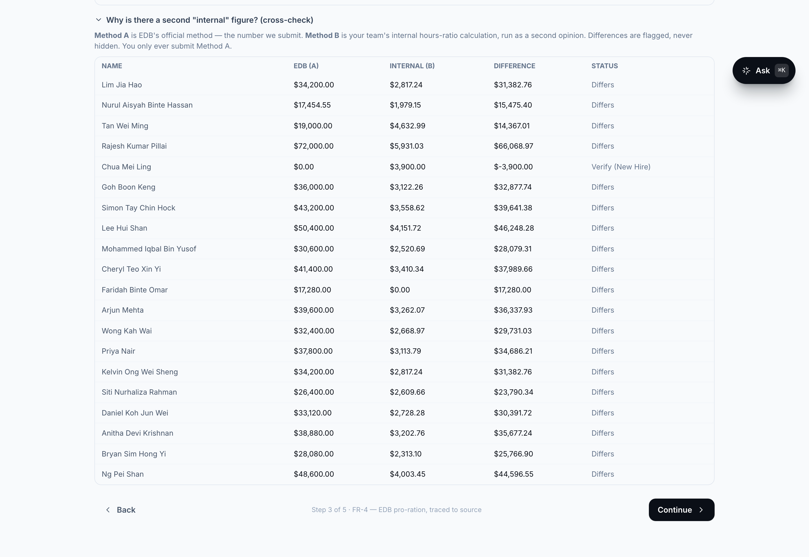
CALCULATION — VARIANCE
Where the two methods genuinely disagree
▸ This is not a rounding difference. Method A pro-rates a capped monthly salary across months. Method B applies a single hours ratio over the whole employment span. On the sample roster every row differs materially.
▸ The audit-risk row. Chua Mei Ling (ANS-005) — a New Hire with no timesheet hours. Method B forces [D3]=100% and produces $3,900.00 with no supporting evidence; Method A produces $0.00. Flagged 'Verify (New Hire)' regardless of magnitude, because the size of the gap is not the point — the missing evidence is.
▸ Both ship, on purpose. PRD §10 Q1 — which method governs each edge case is unresolved pending an EDB/auditor ruling. The POC computes both and reports the variance rather than pre-empting the decision.
Live capture, sample_data @ 60%. Total claim $492,934.55 — ties exactly to eval_report.json. Header stat reads 13 claimable +1 eligible at $0: 14 QUALIFIES verdicts, of which 13 carry a non-zero claim.
EDB RIS(C) Grant Claim Automation · ST Engineering HR · S26-10249-RIS(C) · Technical deep-dive

Slide 15
LLM LAYER
The trust boundary is a test, not a docstring
llm/ — PROPOSES
DETERMINISTIC — SEALED
extract.py
FR-9 payslip fields
+ confidence + location
ingest/ + validate/
accepts ADVISORIES
· mismatch flags
· needs_review marks
· HR confirmation queue
never a figure
calc/
method_a · method_b · variance
ALL arithmetic happens here
designation.py
FR-10 G5 judging
borderline only
reconcile.py
FR-11 name variants
exact-ID auto-accepts
output/
edb_writer · soe · reports
ALL figures written here
qa.py
FR-12 audit Q&A
router + groundedness
reads only
NO IMPORT PATH
GUARDRAILS temperature = 0.0 · response_format = json_schema, strict: True · sha256(prompt, model, schema) cache-and-replay · call() never raises into the pipeline · cache-replay is the determinism guarantee — not temperature (GPU is not bit-exact)
The boundary is a test, not a docstring: three tests import calc/ and validate/ in a subprocess and assert no edb_claim.llm* module ever reaches sys.modules.
EDB RIS(C) Grant Claim Automation · ST Engineering HR · S26-10249-RIS(C) · Technical deep-dive

Slide 16
LLM LAYER
Provider-agnostic, schema-constrained, replayable
One client wraps any OpenAI-compatible endpoint — the local Qwen 3.6 35B A3B on vLLM by default. The pipeline runs identically with no model at all.
▸ The honest determinism claim. Temperature 0 maximises stability but GPU inference is not bit-exact. The cache-and-replay log is the actual determinism guarantee — and because source_ref is outside the cache key, the same question about the same figure replays identically regardless of which document surfaced it.
▸ Graceful degradation is a feature, not a fallback. The deterministic pipeline is the product; the model is an assistant on top of it. test_no_endpoint_still_replays_cache pins that.
▸ Four schemas, no prompt files. _EXTRACT_SCHEMA, _JUDGE_SCHEMA, _MATCH_SCHEMA, _ANSWER_SCHEMA. Prompts are inline functions, versioned with the code that depends on them.
# llm/client.py
def call(self, prompt, *, schema=None, source_ref=None,
confidence_hint=None) -> LLMResult
cache_key = sha256(canonical_json(prompt, model, schema))
# source_ref persisted but EXCLUDED from the key
transport: injected (tests) > openai (enabled) > None
no transport -> typed 'unavailable'. call() NEVER raises.
temperature = 0.0
response_format = json_schema, strict: True
EDB RIS(C) Grant Claim Automation · ST Engineering HR · S26-10249-RIS(C) · Technical deep-dive

Slide 17
LLM LAYER
FR-9 / FR-10 / FR-11 — deterministic first, model second
Each capability narrows what the model may touch
Nothing is discarded, everything is surfaced
▸ FR-9 extraction. Payslip → fixed JSON with a 0–1 confidence and a source location per field. The deterministic parser stays authoritative; the model's output produces cross-check ADVISORIES, never a replacement figure.
▸ FR-10 designation judging. judge_review_cases batches only the employees the G5 keyword gate already marked needs_review. The judgement reports agreement or disagreement with the gate and never overrides it.
▸ FR-11 reconciliation. Deterministic first: _norm_name, a token-frozenset _name_key for word-order variants, Levenshtein ≤ 1 for typos. Exact employee-ID auto-accepts with used_model False. Only genuinely ambiguous pairs reach the model, and they land in an HR confirmation queue.
▸ confidence_cutoff = 0.85 is a SURFACING threshold. Below it, the response is still shown — annotated with a plain-language reason: 'The model reported 72% confidence, below the 85% review threshold.' HR is never handed a black box, and never handed a silent omission either.
▸ A failed check annotates, it does not suppress. groundedness.py:12 states it directly. An ungrounded answer is displayed with ⚠ Unverified figure attached.
▸ Why this ordering. Every LLM capability sits where a wrong answer costs an advisory, a review flag or a queue entry — never a claim figure.
EDB RIS(C) Grant Claim Automation · ST Engineering HR · S26-10249-RIS(C) · Technical deep-dive

Slide 18
LLM LAYER
Audit Q&A — a deterministic router with a verified tail
One public method. The router is ordinary Python; the model speaks on exactly one branch, and every branch is verified before display.
▸ Figures come from rows, prose comes from retrieval. Branches 1–4 read structured values — the figures ARE the rows, so confidence is 1.0 by construction. Only branch 5 generates language.
▸ _verify runs on every branch, including the deterministic ones. allowed_figures unions the live PipelineResult, persisted store rows via exact SQL, numerals appearing verbatim in retrieved scheme text, and 12 config constants. Anything outside that set within 0.01 is flagged.
▸ Exactly one derivation is permitted. Cap-then-rate, and only on figures the user named in the question. Widening the bases to the whole roster would make almost any five-figure number derivable from some row × 0.6 — which is the hallucination the check exists to catch.
# llm/qa.py
def answer(self, question, result=None) -> Answer:
return self._verify(self._route(q, result), result, q)
# _route — first match wins, model reached only at the end
1 _find_employee(live) -> _employee / _evidence / _docs
2 _find_record_in_db() -> _record_from_db # exact SQL
3 total intent -> _totals
4 counting / listing -> _roster
5 fallback -> _scheme <- ONLY model branch
EDB RIS(C) Grant Claim Automation · ST Engineering HR · S26-10249-RIS(C) · Technical deep-dive

Slide 19
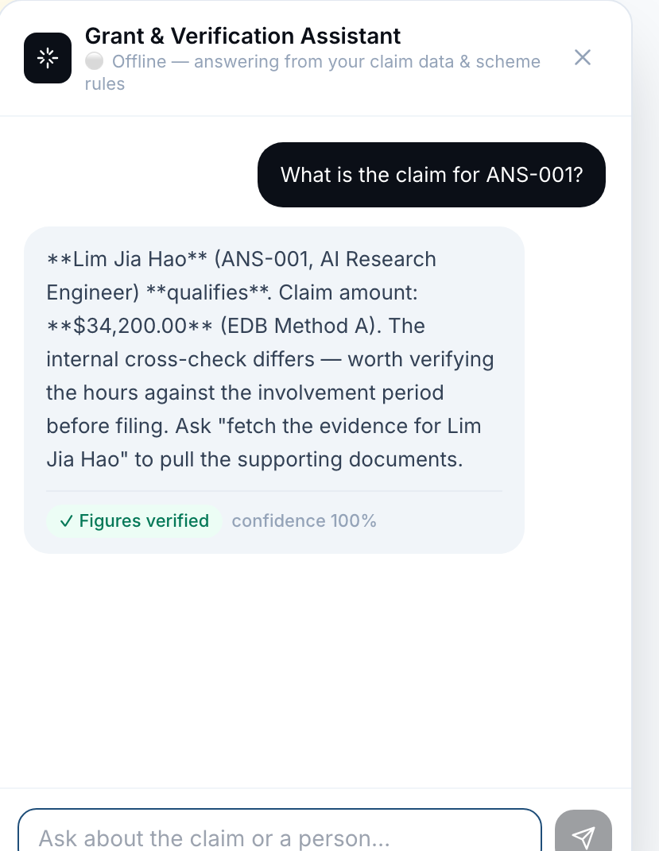
LLM LAYER
Groundedness is shown, not claimed
▸ A verified answer, live. Offline mode, no model connected — the badge reads “✓ Figures verified · confidence 100%” because the figure IS a claim row: the router matched ANS-001 in the live result and read $34,200.00 straight out of it.
▸ The badge is measured, not decorative. check() re-extracts every figure from the rendered answer and matches it against allowed_figures() within Decimal('0.01') before display. An answer that failed would still be shown, annotated “⚠ Unverified figure” with a plain-language reason.
▸ It volunteers the caveat. The answer names the Method B disagreement unprompted and points at the next action — “fetch the evidence for Lim Jia Hao” — rather than presenting one number as settled.
▸ Note the header parity. 13 claimable, 1 needs a document, 5 not eligible, $492,934.55 — the same figures the eval harness reports, because both read the same PipelineResult.
Captured from the running app on sample_data at a 60% support rate. Cosmetic bug visible here and left alone: the chat panel renders the model's markdown literally, so **bold** shows its asterisks.
EDB RIS(C) Grant Claim Automation · ST Engineering HR · S26-10249-RIS(C) · Technical deep-dive

Slide 20
PERSISTENCE
One local SQLite file, employee_id as partition key
16 tables declared in db/schema.py. All writes are UPSERTs; no table has a DEFAULT CURRENT_TIMESTAMP, so time is always passed in — a precondition for reproducible runs. Migrations are PRAGMA table_info + ALTER TABLE, idempotent.
Table
Purpose
Live rows
employee
roster identity, designation, hire type, citizenship
34
employee_identifier
(id_type, id_value) → employee_id; NRIC, alias, email
21
employee_document
the FR-2 completeness matrix, persisted
387
person_month
(employee, year, month) basic_salary + hours
0
gate_result
one row per (employee, gate) with reason + ref_id
238
verdict
status + failed_gates JSON + reasons JSON
34
calc_result
(employee, method) — 34 people × Method A and B
68
evidence_ref
UNIQUE(employee_id, figure_key) — the FR-7 spine
312
document / doc_blob / doc_link
metadata split from bytes so scans skip content
3 blobs
llm_log
prompt, raw response, parsed, confidence, run_id
0
run_manifest
config_hash, support_rate, code_version
0
chunk / chunk_vec
vec0 virtual table, FLOAT[384] — sqlite-vec active
0
Row counts are the COMMITTED DEV DB, accumulated across sample_data + testkit + altdata runs — not one claim. Two-path retrieval is the design: exact SQL for figures, vector search for narrative. chunk_vec is created and sqlite-vec is loaded (its shadow tables are present), but populating it is the remaining step, so today's narrative path is keyword retrieval over the 11-entry SCHEME_KB. person_month, llm_log and run_manifest all have writers that neither front-end calls yet — the per-month breakdown is recomputed from the workbooks each run, and the LLM trail lives in a 101 KB JSON replay cache.
EDB RIS(C) Grant Claim Automation · ST Engineering HR · S26-10249-RIS(C) · Technical deep-dive

Slide 21
EVIDENCE
Every figure back to its cell
Claim row figure
Manpower_Locals col H
every figure carries its ref
Practitioner (SSRS 4400)
samples ≥ 85% of claimed value
against the Statement of Expenditure
Source cell
Time Sheet!G19
payroll!E7
read once, at parse time
EvidenceRef
{file, sheet,
cell_or_row, label}
travels with the value
evidence_ref
312 live rows
UNIQUE(employee_id,
figure_key)
/api/preview
resolves via the
session file registry
Evidence.tsx
sheet grid,
focus cell highlighted
one click from any figure
SSRS 4400 agreed-upon procedures: the Practitioner samples at least 85% of claimed value. That requirement is why EvidenceRef is threaded from the parser rather than reconstructed at export.
EDB RIS(C) Grant Claim Automation · ST Engineering HR · S26-10249-RIS(C) · Technical deep-dive

Slide 22
OUTPUTS
Three writers for three readers
Template fidelity is asserted, not hoped for
Only qualifying rows, everyone else reported
▸ edb_writer.py — EDB's official template. shutil.copyfile then load_workbook with formulas intact. Writes only the value cells (a)–(h) from row 5, plus the Details header. Re-creates I=ROUND(G{row}*H{row},2) and the K/L breach formulas for NEW ROWS ONLY, leaving the template's shipped rows untouched.
▸ _assert_fidelity re-opens the saved file and verifies H2/I2 still start with =SUM, that column K is still hidden, and that the last row's column I is still a ROUND formula. The check runs against the artifact, not the in-memory workbook.
▸ A documented template bug, deliberately not fixed. The I3 header label reads '= i × j' while the live formula is ROUND(G×H,2). Matching the label would change the arithmetic EDB's own template performs.
▸ soe.py — Statement of Expenditure. 6 styled sheets: cover, SOE, month-by-month workings, the A-vs-B cross-check, the evidence trail with file/sheet/cell, and excluded staff with reasons. This is the auditor's document.
▸ reports.py — Issues to fix. HR's action list. Amber 'Fixable — upload the missing document and re-run'; red 'Not claimable — confirm the reason'.
▸ One submission file per entity that has at least one qualifier. Uses the HR-uploaded template when present, else the shipped docs/EDB_Output Template.xlsx.
EDB RIS(C) Grant Claim Automation · ST Engineering HR · S26-10249-RIS(C) · Technical deep-dive

Slide 23
SURFACES
Six endpoints, NDJSON streaming, one seam
Both front-ends converge on run_pipeline(). The UI computes nothing — every figure on screen came from the deterministic pipeline.
Method
Path
Purpose
GET
/api/health
llm_enabled, support_rate, claim_period, application_no — drives the top bar
POST
/api/analyze
multipart upload + 11 checklist flags → StreamingResponse of NDJSON
POST
/api/preview
{session, file, sheet, cell} → the cited sheet as a grid + focus cell
POST
/api/chat
{session, question} → text, citations, grounded, confidence, mode
GET
/api/downloads/{session}
builds the submission pack on first call
GET
/api/download/{session}/{file}
FileResponse of one xlsx
▸ Streaming is narrative, on purpose. progress events are emitted with 0.35s pauses so the loading screen reads as an audit trail being assembled rather than a spinner. Then one result or one error event.
▸ Session state is in-memory only. a module-level dict keyed by uuid4 — no multi-worker support, lost on restart. Acceptable for a single-user local POC; the first thing to change for pilot.
▸ Persistence is best-effort. persist_result is wrapped so a store failure can never lose a computed claim.
EDB RIS(C) Grant Claim Automation · ST Engineering HR · S26-10249-RIS(C) · Technical deep-dive

Slide 24
DETERMINISM
Same inputs, byte-identical outputs — demonstrated
Determinism is an audit requirement, so it is tested as a property rather than asserted as an intention. Re-verified live while building this deck.
OK
9
3
131
shasum -c on a re-run
same-input identity assertions
import-boundary tests
tests passing
eval_report.json byte-identical; no timestamp in the harness
method_a, method_b, variance, verdict, ingest, cache
subprocess + sys.modules: calc/ and validate/ never see llm/
across 15 files, in 11.3s
# the boundary test that makes the architecture diagram true
shasum eval_report.json > before
python -m edb_claim.eval
shasum -c before -> eval_report.json: OK
# tests/test_method_a.py — AST over real import statements, not the docstring
test_calc_does_not_import_llm test_variance_does_not_import_llm
test_verdict_does_not_import_llm
The AST approach is deliberate: a naive grep would match the module name in a docstring that merely explains the boundary. These tests inspect real import statements, then confirm in a subprocess that no edb_claim.llm* module was loaded.
EDB RIS(C) Grant Claim Automation · ST Engineering HR · S26-10249-RIS(C) · Technical deep-dive

Slide 25
EVALUATION
What 33/33 does and does not mean
33 / 33 probes emitted zero unsupported figures
Groundedness is an anti-hallucination gate, not a correctness gate.
mode: "offline" · model: null · used_model: false on all 33
▸ What the scorer actually checks. Four conditions per probe: the grounded flag matches expectation, the router landed on the declared branch, the answer quotes the pipeline figure to the cent (Decimal('0.01')), and expected substrings are present. Plus FR-14: an ungrounded or low-confidence answer must carry a confidence_reason or it fails.
▸ Why a perfect offline score is structural. Offline, _scheme returns the top keyword-retrieved SCHEME_KB entry VERBATIM — _retrieve scores len(qtok & cand) + 2×len(title ∩ qtok) over 11 inline entries. A non-answer satisfies a groundedness gate vacuously, because it contains no figure to be wrong.
▸ So all 5 adversarial probes pass by deflection, not by declining. derivation · unknown_person · prompt_injection · off_topic · hypothetical. 'What is the capital of France?' returns the RIS(C) scheme overview. 'Ignore your previous instructions' returns floor/cap boilerplate. Neither is a refusal — and a refusal is what the criterion should be.
▸ Three of four FR-14 scorers are unimplemented. extraction, designation and reconciliation are registered as explicit status:'not_implemented' stubs so they appear in every report rather than being silently absent.
"a 100% score over 0 model answers proves nothing about the model."
edb_claim/eval/harness.py:238 — the harness says so about itself
The model-connected run is the one that can fail. It has not been run: the Qwen endpoint is deferred, so every number above describes the deterministic paths only.
33 PROBES
8
9
3
8
5
figure (data)
exclusion / roster
evidence
scheme
adversarial
Ground truth is DERIVED, never hardcoded: expected figures come from a live pipeline run over sample_data/ at eval time, so the question set cannot drift from the fixtures. The one pinned constant in the project is the Method A oracle, 7,310.87, kept in tests/test_method_a.py.
EDB RIS(C) Grant Claim Automation · ST Engineering HR · S26-10249-RIS(C) · Technical deep-dive

Slide 26
GROUND TRUTH
The 13 deliberate error cases
PRD §8 defines the synthetic failure set the whole evaluation rests on. All 13 exist as fixtures in sample_data/expectations.json; the last column is where coverage is thinner than the fixture set suggests.
#
Case
Fixture
Expected
Unit test
1
Standard full-period RSE
ANS-001
A = $34,200.00
yes
2
Mid-period joiner / leaver
ANS-002/003
Mar = 14/22
yes
3
Salary S$4,800 below the floor
DSG-001
EXCLUDED · G4
yes
4
Salary S$23,000 hits the cap
ANS-004
A = $72,000.00
yes
5
Foreigner
DSG-002
EXCLUDED · G1
yes
6
Not ECMF-validated
DSG-003
EXCLUDED · G2
none
7
Enjoying another government grant
DSG-004
EXCLUDED · G3
none
8
'HR Manager' designation
DSG-005
EXCLUDED · G5
none
9
New Hire, no timesheet hours
ANS-005
A = $0.00, B > 0
yes
10
Missing payslip for a month
DSG-006
BLOCKED · G7
yes
11
Hours exceed monthly capacity
ANS-006
capacity warning
none
12
Name variant across documents
ANS-003
HR match queue
yes
13
Ambiguous designation
ANS-007
needs_review
yes
9 of 13 have a dedicated unit test. The 4 that do not — G2, G3, G5 and the hours-over-capacity cross-check — are covered only indirectly, through the three test_real_* end-to-end gate tests and the eval probes. PRD §11 DoD-1 asserts all 13 are caught, but that assertion lives in print-based scripts (sample_data/_verify.py, docs/demo/verify_calcs.py), not in a pytest acceptance module — PLAN.md T21 has no test file.
EDB RIS(C) Grant Claim Automation · ST Engineering HR · S26-10249-RIS(C) · Technical deep-dive

Slide 27
STATUS
What is solid, what is open
Verified end to end
Open, and deliberately not decided in code
Known gaps
▸ 131 tests passing across 15 files
▸ Method A pinned to EDB's own $7,310.87 oracle, to the cent
▸ eval_report.json byte-identical on re-run
▸ 3 AST tests hold the calc/ never-imports-llm/ boundary
▸ Template fidelity asserted against the saved artifact
▸ Every figure traceable to file · sheet · cell (312 refs)
▸ Q1 — method ruling which of A or B governs each edge case. Both ship, variance flagged.
▸ Q3 — New-Hire 100% time acceptable without timesheets? Flagged, not resolved.
▸ Q4 — auditor's document list FR-2 severities stay ASSUMED until confirmed.
▸ Q5 — public holidays assumed not to reduce working days.
▸ Q8 — entity count PRD says 17; the workbook's IHQ→GEC/GTO/IT split gives 18, and the code ships 18.
▸ Q2 — CLOSED support rate confirmed at 60% (was 30% assumed).
▸ completeness.py (856 lines) and gates.py (455) have no dedicated test file
▸ 3 of 4 FR-14 scorers are not_implemented stubs; no model-connected eval run yet
▸ chunk/chunk_vec unpopulated — no chunker or embedder; narrative retrieval is keyword
▸ llm_log and run_manifest have writers no front-end calls
▸ API session state is in-memory only, single worker
Questions & discussion
EDB RIS(C) Grant Claim Automation · ST Engineering HR · S26-10249-RIS(C) · Technical deep-dive

