Slide 1


Student Performance
Prediction System
Using Machine Learning
AIML Summer Internship 2026

Slide 2

Introduction
Background of Educational Data Mining
Importance of Prediction
Educational Data Mining (EDM) applies data mining techniques to educational data to understand students and their learning environments. By analyzing academic indicators, institutions can proactively identify at-risk students and tailor interventions.
Predicting performance is crucial for:
Proactive academic support
Resource allocation optimization
Personalized learning paths
Improving institutional success rates

Slide 3

Problem Statement & Objectives
Core Objective
To develop a machine learning model capable of accurately predicting a student's final examination marks based on early academic indicators and study behaviors.
Key Project Goals
Analyze educational data to identify key performance predictors
Engineer meaningful features like Overall Academic Score
Evaluate and compare Linear Regression and Random Forest models
Deploy the best performing model via a Streamlit web application

Slide 4



Dataset Overview
Total Records
2,000
Target Variable
Final Exam Marks
(out of 100)
Input Features
Attendance (%)
Internal Test 1 (out of 40)
Internal Test 2 (out of 40)
Assignment Score (out of 10)
Daily Study Hours

Slide 5

Project Methodology
1. Data
Collection
2. Data
Cleaning
3. Exploratory
Data Analysis
4. Feature
Engineering
5. Model
Training
6. Model
Evaluation
7. Deployment

Slide 6

Feature Engineering
Created Feature 1
Created Feature 2
Average Internal Marks
Overall Academic Score
= (Internal Test 1 + Internal Test 2) / 2
= Attendance + Assignment Score + Study Hour Component

Slide 7

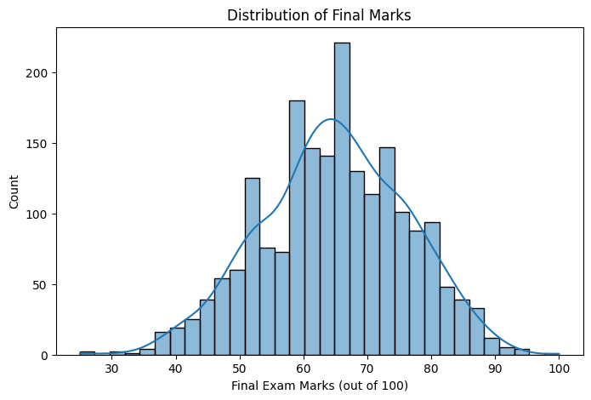
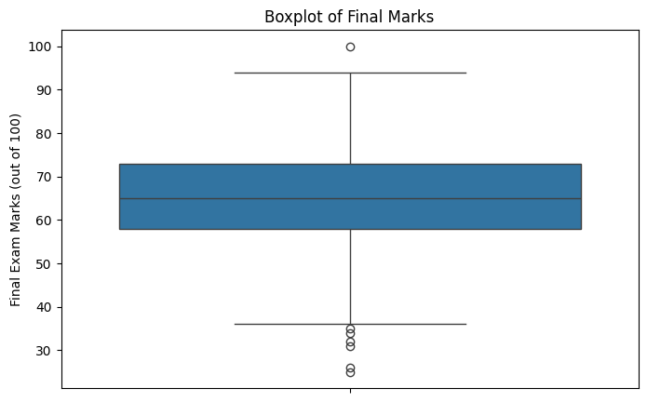
Exploratory Data Analysis
Final Marks Distribution
Score Variations (Boxplot)
The final marks follow an approximately normal distribution. The majority of students scored between 55 and 80 marks.
Boxplot analysis reveals the median scores and identifies potential outliers in the dataset, providing insights into the spread of academic performance.

Slide 8

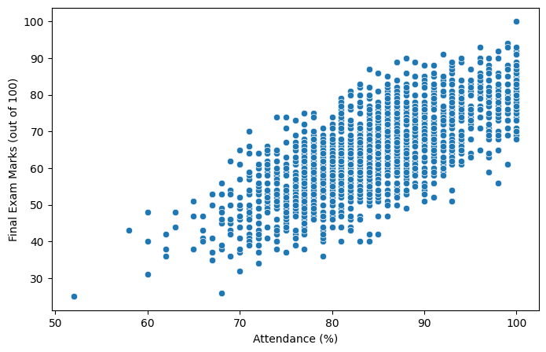
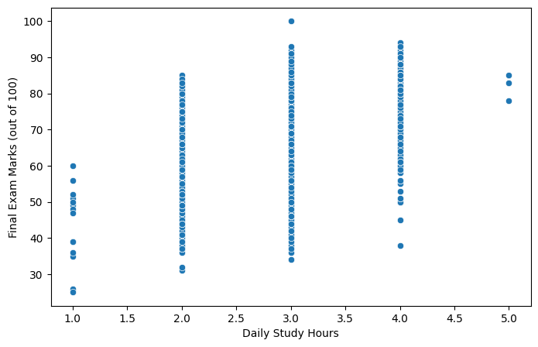
Relationship Analysis
Attendance vs Final Marks
Study Hours vs Final Marks
Strong positive correlation observed. Higher attendance consistently leads to better final marks.
Positive impact demonstrated. Increased daily study hours correlate with higher academic performance.

Slide 9


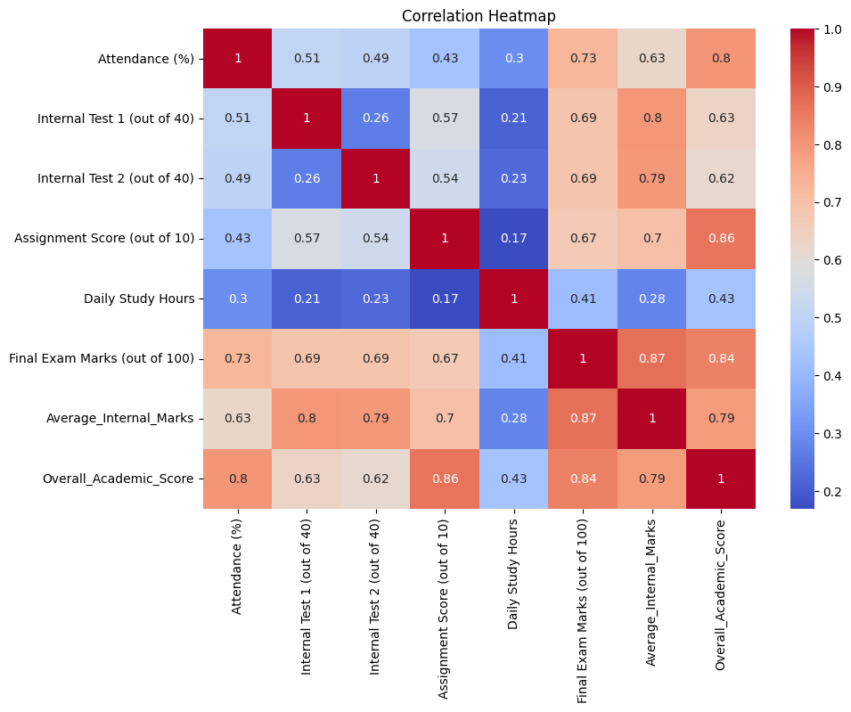
Strongest Predictors
0.87
Average Internal Marks
0.84
Overall Academic Score
0.73
Attendance

Slide 10
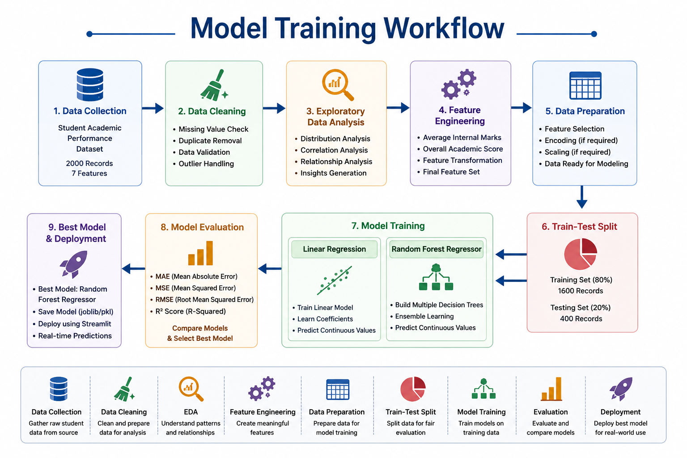


Model Development
Models Used
Linear Regression
Random Forest Regressor
Train-Test Split
80 : 20

Slide 11
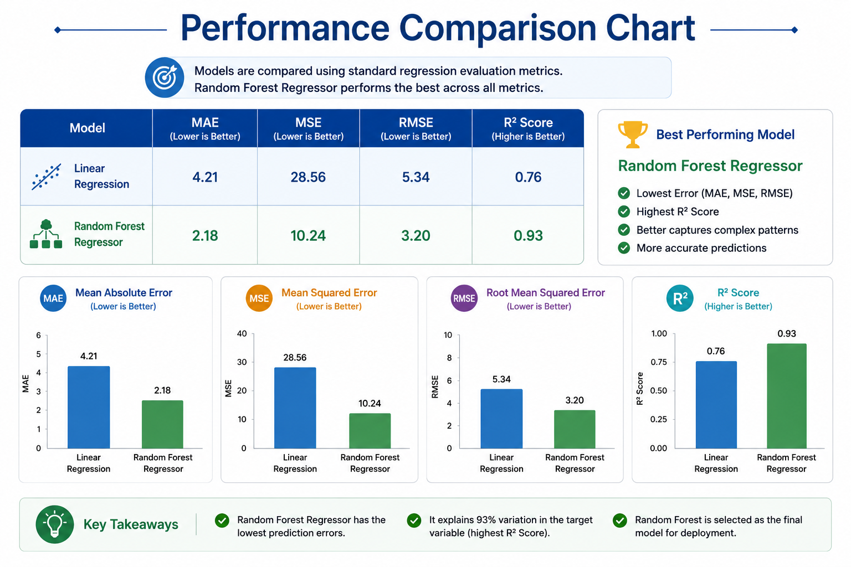
Results & Model Comparison

Slide 12


Deployment & Future Scope
Deployment
Future Enhancements
The Random Forest model was successfully deployed as a Streamlit Web Application, allowing for easy, interactive performance predictions based on user inputs.
Implement Deep Learning techniques
Develop a Mobile Application
Integrate Real-Time Monitoring
Full Cloud Deployment

Slide 13
Thank You

