Slide 1
VLSI Architecture for EMT Simulation
Presented by: Rajat Sharma
Under Professor : Weiping Shi

Slide 2
TABLE OF CONTENT (MODULES)
SERIAL NO | MODULE | SLIDES
1 | EMT Network and Problem description | 3-4
2 | Exciter (observation for filter) | 5- 8
3 | Filter (1 -2 -3) order | 9-34
4 | Limiter | 35-45

Slide 3
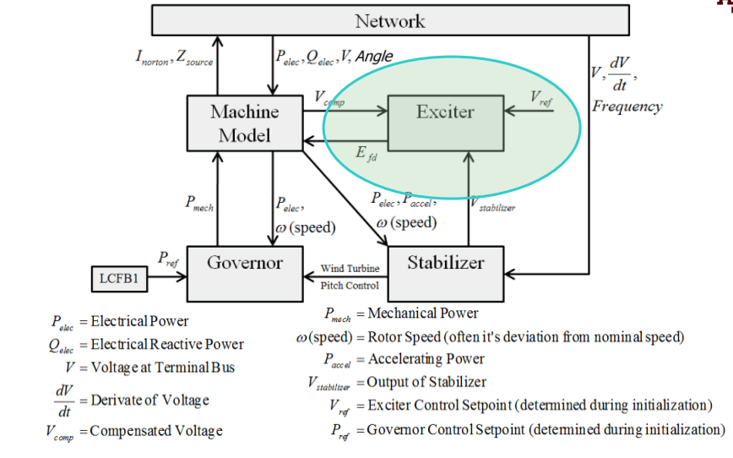
EMT Network
Figure : 1 (EMT Network)

Slide 4
Problem Description
Important part in hardware EMT simulation system is the control elements.
Control elements can be expressed in form of transfer function.
In the exciter or other control elements, multiple transfer functions are connected in series or in parallel to express the relationship between inputs and outputs.
Need to break down and categorize Transfer functions for effective system simulation.
Develop a programmable transfer function that can be configured to represent various transfer functions by adjusting the coefficients.

Slide 5
Control Elements:

Slide 6
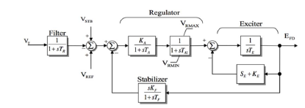
Exciter (Observation)
Most of the exciter modules are basically a control block comprising of various first order transfer function.
Take a example below:
Variables:
VT: Magnitude of the bus terminal voltage.
VREF: Voltage reference set point, used to control the desired output voltage.
VSTB: Power system stabilizer output signal (in this case, it is set to zero).
VMAX: Upper voltage limitation to prevent over-voltage in the system.
VMIN: Lower voltage limitation to prevent under-voltage in the system.
EFD: Generator field voltage, which controls the excitation of the generator.
Constants:
TR: Time constant of the voltage transducer, determining how quickly the system reacts to changes in VT.
TA: Time constant of the amplifier, affecting the speed of amplification of the control signal.
TA1: Additional time constant for amplifier dynamics.
TE: Time constant of the exciter, influencing how fast the excitation system responds.
TF: Time constant of the field, related to the field winding of the generator.
SE: Saturation function in terms of the generator field voltage (EFD), which helps to model the non-linear behavior of the exciter.
Figure 2: Exciter BPA EA - Continuously acting DC rotating excitation system model.

Slide 7
Input/Output
The input to the Exciter system is the generator terminal voltage from the transmission line.
The signal is passed through a Finite Impulse Response (FIR) filter to remove high-frequency noise.
Voltage magnitude extraction is performed.
The processed signal is fed into the exciter transfer function control block.
The transfer function control block consists of various filter blocks arranged in series and parallel to generate the desired output signal.
Output: The final output is the controlled excitation signal that regulates the generator’s field voltage, ensuring stable operation of the generator.

Slide 8
Observation: Exciter filter order
The transfer functions consist of:
Integrator
First-Order Lag
Derivative
Lead-Lag
These transfer functions are primarily first-order.
Implementation Approach:
Create a general first-order transfer function block.
Program the block’s coefficients to realize specific transfer functions.
The transfer functions represent digital filters like:
FIR (Finite Impulse Response)
IIR (Infinite Impulse Response)

Slide 9
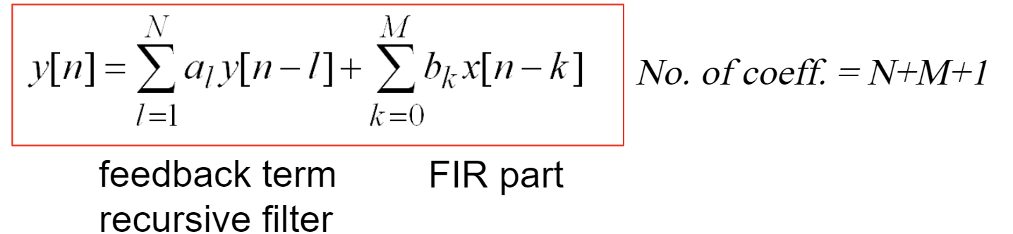

Type of Filters
Here, in Exciter there are two types of digital filter in discrete time domain:
1) IIR filter
$y\left[n\right]$ is discrete time output of the filter.
N, M is the order of the filter.
$a_{k}$ is the gain of the filter.
$x \left[n\right]$ is the discrete time input to the filter.
2) FIR filter : $y\left[n\right]=\sum_{k=0 }^{m}{a_{k}⋅x\left[n−k\right]}$
$y\left[n\right]$ is discrete time output of the filter.
m is the order of the filter.
$a_{k}$ is the gain of the filter.
$x \left[n\right]$ is the discrete time input to the filter.

Slide 10
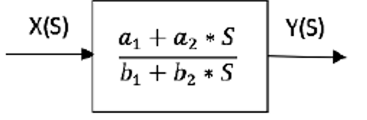
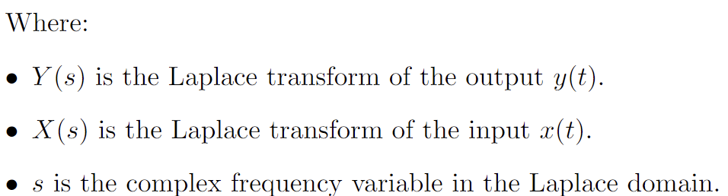

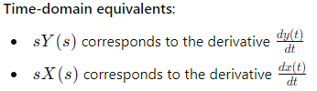
General:1st order transfer function
For the s, domain general 1st order transfer function.
Which is equivalent to,
Rearranging,

Slide 11

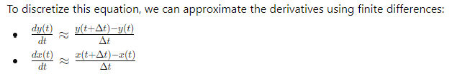
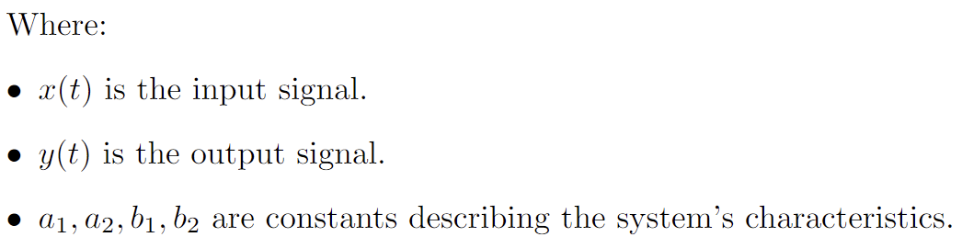
By applying the inverse Laplace transform to the above expression, we obtain the following differential equation:
Substituting the values for time domain,

Slide 12
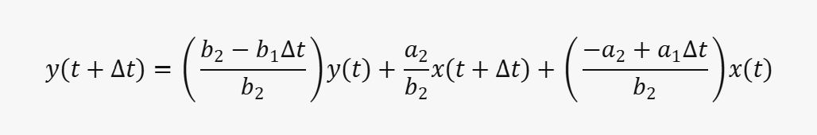
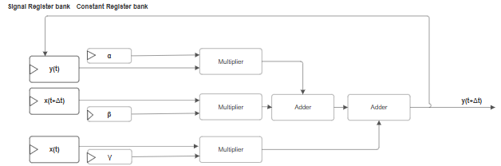
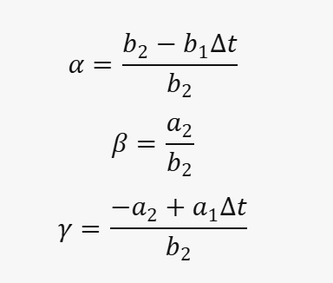
1st order transfer function (S domain: Euler's approximation)
Figure 3: Block diagram of 1st order filter

Slide 13
Multiplier block
a/ b / a *b
Multiplier
a
b
Figure : Multiplier Block

Slide 14
Connector Block
B
A / C
Here, the connector block is used to connect two adder together.
A is output from the current level adder.
B is the output from the previous adder.
C is the input from the next adder.
A
A
A / B
C
Figure 4: Connector Block

Slide 15
Arithmetic block
The arithmetic block accepts two input variables for multiplication. The multiplication result can then be added to a variable received from either:
The next connector block , if streaming data is available
A previous connector block, if streaming data is available
inp_streaming_result_from_above_to_below
inp_from_X(t+δt)
inp_prev_multiplier_result
β
Multiplier block
Adder
out_result_from_adder
inp_curr_Variable
X(t)
inp_streaming_result_from_below_to_above
out_X(t)
out_multiplier_result

Slide 16
FPFA - logical block
inp_streaming_result_from_above_to_below
out_streaming_result_from_below_to_above
inp_from_X(t+δt)
inp_prev_multiplier_result
β
Multiplier block
Adder
out_result_from_adder
inp_curr_Variable
X(t)
out_X(t)
out_multiplier_result
out_streaming_result_from_above_to_below
inp_streaming_result_from_below_to_above
in_X(t+δt)
in_p_m
in_s_a_b
out_s_b_a
in_curr
FPFA_logical_block
out_res
Short-hand representation
out_X(t)
out_m
out_s_a_b
in_s_b_a

Slide 17

1st order filter implementation
Maximum delay for 2nd order implementation is 1 multiplier, 3 adder and 3 mux.
Here,
A = 𝑦(𝑡) ⋅𝛼
B =𝑥(𝑡+Δ𝑡)⋅𝛽
C = 𝑥(𝑡)⋅𝛾
F = 𝑦(𝑡+Δ𝑡) “ Feedback”

Slide 18
Here, the Total delay for 1st order Filter from input to availability in feedback path :
MUX : 3
Adder: 2
Multiplier: 1
NOTE: BUS WIDTH IS SAME EVERY WHERE: IT IS VARIABLE FOR NOW.
β
Multiplier block
Adder
A
X(t+δt)
γ
Multiplier block
Adder
D = A + B
B
X(t)
Y(t+δt) = A + B + C
α
Multiplier block
Adder
C
E = C + D
Y(t)
Figure 5: 1st order Filter Implementation

Slide 19

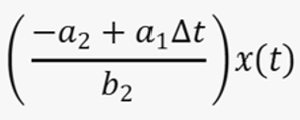
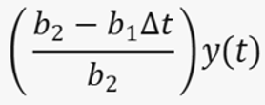
Symbol Multiplier output
A
1st order Filter implementation in FPFA fabric
FPFA_logical_block
B
FPFA_logical_block
A+B
Y(t+δt) = A+B+ C
C
FPFA_logical_block
FPFA_logical_block
Critical path delay = 1 multiplier + 3 Adder (approx.)
FPFA_logical_block
FPFA_logical_block
FPFA_logical_block
FPFA_logical_block

Slide 20
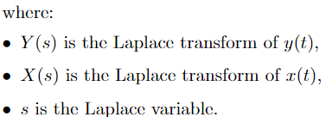

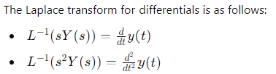
General:2nd order transfer function
For the s, domain general 2nd order transfer function.
This is a second-order system, where Y(s) is the output and X(s) is the input. This can also be written as:
Converting to time domain,

Slide 21

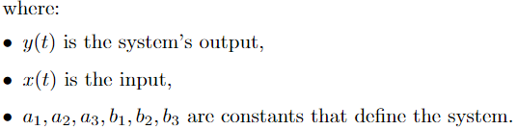


Using Euler's approximation,

Slide 22

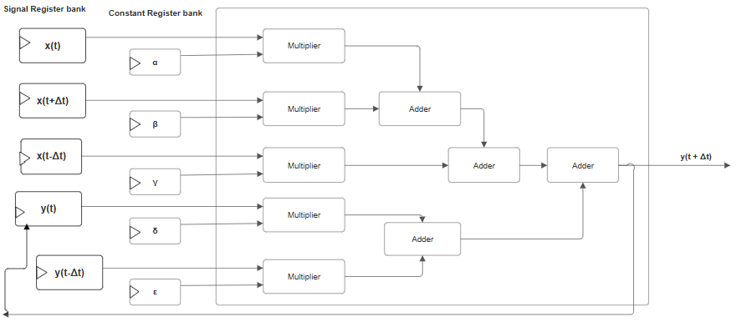
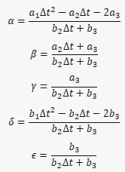
2nd order transfer function (S domain: Euler's approximation)
Figure 6 : Block diagram of 2nd order filter

Slide 23
2nd Order implementation of Configurable filter block
Maximum delay for 2nd order implementation is 1 multiplier, 3 adder and 3 mux.
Here,
B =𝑥(𝑡)⋅𝛼
A =𝑥(𝑡+Δ𝑡)⋅𝛽
C = 𝑥(𝑡−Δ𝑡)⋅𝛾
D = 𝑦(𝑡)⋅𝛿
E = 𝑦(𝑡−Δ𝑡)⋅𝜖
F = A + B
G = F + C
H = D + E
I = 𝑦(𝑡+Δ𝑡) = A + B + C +D + E = H + G

Slide 24
Here, the Total delay for 2nd order Filter from input to availability in feedback path :
MUX : 5
Adder: 3
Multiplier : 1
NOTE: BUS WIDTH IS SAME EVERY WHERE: IT IS VARIABLE FOR NOW.
β
Multiplier block
Adder
A
X(t+δt)
α
Multiplier block
Adder
F = A + B
B
X(t)
F = A + B
γ
Multiplier block
Adder
C
G = F + C
X(t-δt)
G = F + C
Y(t) = A + B + C + D+ E
δ
Multiplier block
Adder
I = H + G
D
Y(t)
H = D + E
ε
H = D + E
Figure 7: 2nd order Filter Implementation
Multiplier block
E
Adder
Y(t-δt)

Slide 25





2nd order Filter implementation in FPFA fabric
Symbol Multiplier output
A
FPFA_logical_block
FPFA_logical_block
A+B
B
FPFA_logical_block
i = A+B+ C
C
Y(t+δt) = i + j
FPFA_logical_block
D
FPFA_logical_block
j = D+E
E
FPFA_logical_block
FPFA_logical_block
Critical path delay = 3 Adder + 1 multiplier (approx.)
FPFA_logical_block

Slide 26

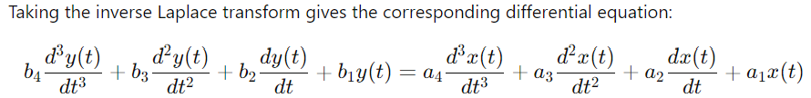
General:3rd order transfer function
For the s, domain general 3rd order transfer function.

Slide 27
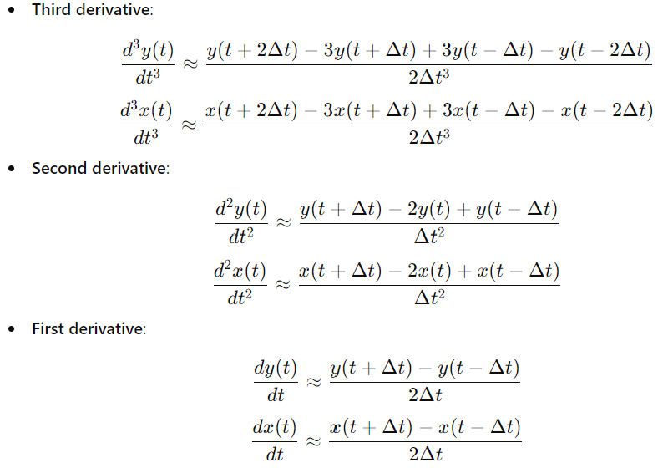
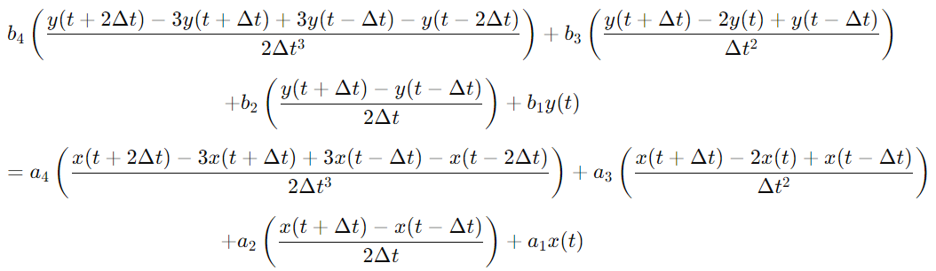
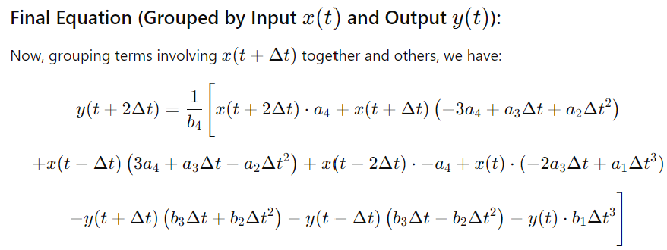
Substituting approximation:

Slide 28








3rd order Implementation
Symbol Multiplier results
Output
A
FPFA_logical_block
Critical path delay =
1 Multiplier + 3 Adder (approx.)
B
FPFA_logical_block
A + B
C
Y = A +B+ C + D
FPFA_logical_block
D
FPFA_logical_block
C + D
E
FPFA_logical_block
X + Y
F
FPFA_logical_block
E + F
X = E +F+ G + H
G
FPFA_logical_block
G + H
H
FPFA_logical_block

Slide 29

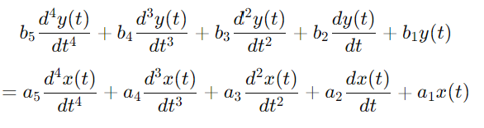
General:4th order transfer function
Taking inverse Laplace transform:

Slide 30
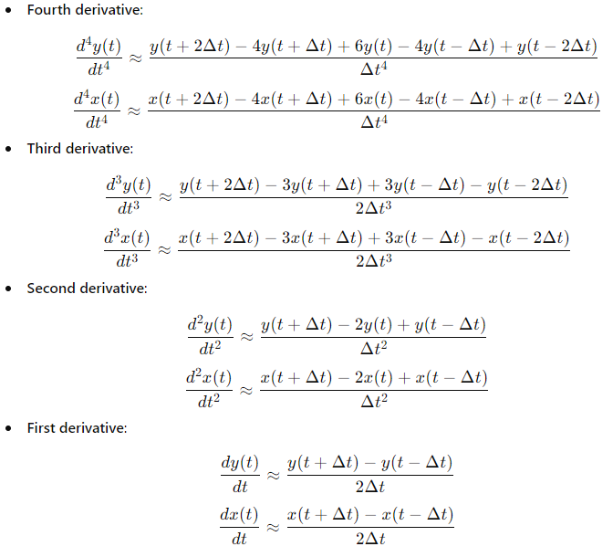
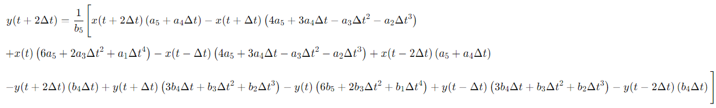
Substituting approximation

Slide 31

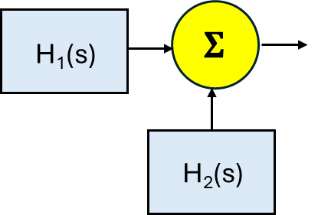



Technical Achievements
Merge Two 1st Order Filters
FPFA_logical_block
FPFA_logical_block
FPFA_logical_block
FPFA_logical_block
FPFA_logical_block
$H_{3}$(s)
FPFA_logical_block
FPFA_logical_block
FPFA_logical_block

Slide 32

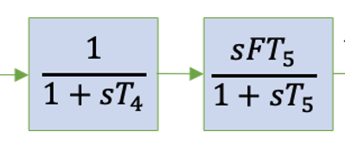

Technical Achievements
Connect Two 1st Order Filters
FPFA_logical_block
FPFA_logical_block
FPFA_logical_block
FPFA_logical_block
FPFA_logical_block
FPFA_logical_block

Slide 33
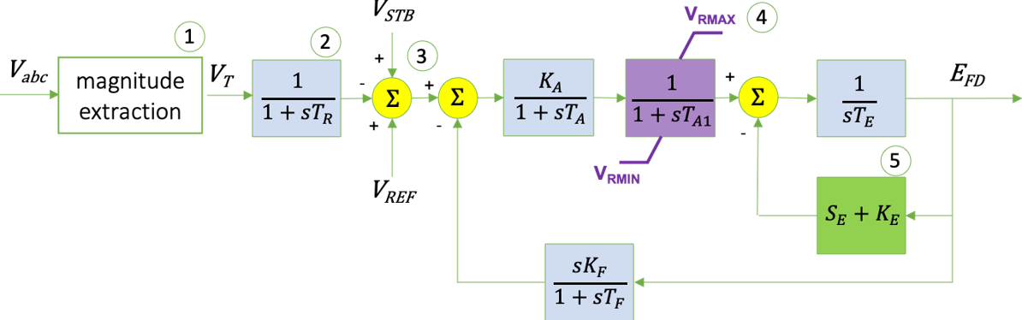
Technical Achievements
BPA EA - Continuously acting DC rotating exciter model

Slide 34









BPA EA model Implementation
FPFA_logical_block
FPFA_logical_block
FPFA_logical_block
Delay for respective logic,
1st order filter = 1 multiplier + 2 adder
Summation = 1 adder
Limiter logic delay = Limiter delay + 1 adder
Elements in the critical path,
Total no of 1st order filter = 5
Total no of summation = 4
Limiter logic = 1
Critical path delay = 5 multiplier + 14 adder + 1 limiter delay (approx.)
FPFA_logical_block
FPFA_logical_block
FPFA_logical_block
FPFA_logical_block
FPFA_logical_block
FPFA_logical_block
FPFA_logical_block
FPFA_logical_block
FPFA_logical_block
FPFA_logical_block
FPFA_logical_block
FPFA_logical_block
FPFA_logical_block
FPFA_logical_block
FPFA_logical_block
FPFA_logical_block
FPFA_logical_block
FPFA_logical_block
FPFA_logical_block
FPFA_logical_block
FPFA_logical_block
FPFA_logical_block
FPFA_logical_block
FPFA_logical_block
Limiter
Limiter
Limiter

Slide 35
Alternate architecture : 2nd order capable
S0
S1
S2
S3
S4
S5
S6
3
4
M
1
b
2
c
d
a
5
6
S7
S8

Slide 36
A3
A2
A1
Var<0>
Multiplier
const<0>
Var<1>
Multiplier
Adder
A3 A2 A1
Variable register bank
const<1>
var<5:0> 6 Channels
(each of 16 bit fixed point no)
Var<2>
Multiplier
A1
A3
Adder
const<2>
1st order filter
Adder
Var<3>
Multiplier
const<3>
Constant register bank
Var<4>
Multiplier
Adder
A2
Limiter
const<5:0> 6 Channels
(each of 16bit fixed point no)
const<4>
Var<5>
Multiplier
Adder
const<5>
1st order filter
Core

Slide 37




Magnitude extraction
Decoder (A3)
A3
Decoder (A2)
A2
$$V_{STB}$$
Decoder (A1)
A1
X(t+δt)
X(t+δt)
A3 - Pre
X(t+δt)
$$V_{REF}$$
X(t)
X(t)
5th Filter
X(t)
y(t)
y(t)
y(t)
C1
C1
C1
C1
$$V_{REF}$$
X(t+δt)
C2
C2
C2
C2
$$V_{STB}$$
X(t)
X(t)
X(t)
C3
C3
C3
C3
C4
C4
C4
C4
6th Filter
y(t)
y(t)
y(t)
C5
C5
C5
C5
S3.reg
C6
C6
C6
C6
S1.reg
S2.reg
S4.reg
Selector
6 Channels
6 Channels
Selector
(select 1 among different bank)
Variable registers banks (Parallel - in -> Parallel – out)
Constant registers banks
(Parallel - in -> parallel - out)
6 Channels

Slide 38

Variable register bank
Var<0>
Multiplier
Limi_out
A_feedback
var<2:0> 3 Channels
(each of 16 bit fixed point no)
const<0>
Limiter
Var<1>
Multiplier
Adder
const<1>
Var<2>
A_feedback
$$E_{FD}$$
Constant register bank
const<2:0> 3 Channels
(each of 16bit fixed point no)
Multiplier
Adder
const<2>
1st order filter
Core

Slide 39




Limiter output (S5.reg) step
Decoder (A2)
Magnitude extraction
A_feedback
$$V_{STB}$$
$$V_{REF}$$
X(t+δt)
$$V_{REF}$$
S1(out)
X(t+δt)
X(t+δt)
Lim_out
X(t+δt)
X(t+δt)
X(t+δt)
X(t)
$$V_{STB}$$
S8(out)
X(t)
X(t)
S7(out)
X(t)
X(t)
X(t)
y(t)
S0(out)
HOLD
y(t)
y(t)
HOLD
y(t)
y(t)
y(t)
S0.reg
S1.reg
S2.reg
S3.reg
S4.reg
S5.reg
S6.reg
S7.reg
S8.reg
Selector
(select 1 among different bank)
Variable registers banks (Parallel - in -> Parallel – out)
3 Channels

Slide 40
C1
C1
C1
C1
C1
C1
C1
C1
C1
C2
C2
C2
C2
C2
C2
C2
C2
C2
C3
C3
C3
C3
C3
C3
C3
C3
C3
Selector
Constant registers banks
(Parallel - in -> parallel - out)
3 Channels

Slide 41
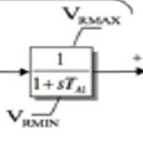

Limiter:
Requirement: In the EMT simulator model, the output of the Regulator must be constrained between $V_{\text{R} \text{M} \text{A} \text{X}}$​ and $V_{\text{R} \text{M} \text{I} \text{N}}$ ​ to suppress unwanted noise in the signal.
Hence, we need to design a Limiter, with minimum latency.
Figure 8: Limiter in EMT simulator

Slide 42
Limiter design 1: (RIPPLE – Limiter )
We will modify the basic ripple comparator, to compare both min and max together in same stage block.
a
b
Figure 9: The ripple carry adder provided can compare two bits.
The goal is to expand its functionality to compare a given number with specified maximum and minimum values and ensure that the number remains constrained within this range.
Figure 10 : The designed Limiter takes the maximum (max), minimum (min), and the given number as inputs. It outputs whether the given number is equal to the minimum, equal to the maximum, greater than the maximum, or less than the minimum.
a
b
Igt
in_gt
out_gt
Ieq
in_eq
out_eq
Ilt
in_lt
out_lt
Stage
Figure 9: Basic Comparator
min
a
max
min
a
max
Inp_gt_max
Inp_gt_max
out_gt_max
Inp_eq_max
Inp_eq_max
out_eq_max
Inp_lt_min
Inp_lt_min
out_lt_min
Inp_eq_min
Inp_eq_min
out_eq_min
Figure 10: Limiter stage block

Slide 43
RIPPLE – Limiter Equation
out_eq_min = output bit representing that a is equal to min
out_eq_max = output bit representing that a is equal to max
out_gt_max = output bit representing that a is greater than max
out_lt_min = output bit representing that a is smaller than min
Inp_gt_max = input bit representing that a is greater than max
Inp_eq_max = input bit representing that a is equal to max
Inp_lt_min = input bit representing that a is smaller than min
Inp_eq_min = input bit representing that a is equal to min
EQUATION:
out_eq_min = Inp_eq_min * ( a XNOR min)
out_eq_max = Inp_eq_max * (a XNOR max)
out_gt_max = Inp_gt_max + (Inp_eq_max * a* max’)
out_lt_min = Inp_lt_min + (Inp_eq_min * a’ * min)
min
a
max
min
a
max
Inp_gt_max
Inp_gt_max
out_gt_max
Inp_eq_max
Inp_eq_max
out_eq_max
Inp_lt_min
Inp_lt_min
out_lt_min
Inp_eq_min
Inp_eq_min
out_eq_min
Stage
Figure 11: Limiter stage block
If out = min or out < min : y = min ;
else if out = max or out > max : y = max;
else: y = a ;

Slide 44
Ripple Comparator: (Block Diagram)
Critical path delay (1 bit) = 1 Xnor + 1 and gate delay (approx.)
a
out_eq_min
min
Inp_eq_min
out_lt_min
Inp_lt_min
out_eq_max
max
Inp_eq_max
out_gt_max
Inp_gt_max

Slide 45
Selector : (block diagram)
Critical path delay (1bit) = 3 or + 2 and gate delay (approx.)
min
out_eq_min
out_lt_min
y
max
out_eq_max
out_gt_max
a

Slide 46
RIPPLE – Limiter Block diagram
This is 4 bit limiter, similarly it can be expanded to 8 bit, 16bit, 32bit etc.
min3
a3
max3
min2
a2
max2
min1
a1
max1
min0
a0
max0
min
a
max
min
a
max
min
a
max
min
a
max
Inp_gt_max
Inp_gt_max
out_gt_max
inr_gt_max
out_gt_max
inr_gt_max
out_gt_max
inr_gt_max
out_gt_max
Inp_eq_max
Inp_eq_max
out_eq_max
Inp_eq_max
out_eq_max
Inp_eq_max
out_eq_max
Inp_eq_max
out_eq_max
Inp_lt_min
Inp_lt_min
out_lt_min
Inp_lt_min
out_lt_min
Inp_lt_min
out_lt_min
Inp_lt_min
out_lt_min
Inp_eq_min
Inp_eq_min
out_eq_min
Inp_eq_min
out_eq_min
Inp_eq_min
out_eq_min
Inp_eq_min
out_eq_min
Stage3
Stage2
Stage1
Stage0
min3
a3
max3
min2
a2
max2
min1
a1
max1
min0
a0
max0
a1 | b1 | out
0 | 0 | a
0 | 1 | min
1 | 0 | max
out_gt_max
out_gt_max
out_gt_max
out_gt_max
out_eq_max
Selector
out_eq_max
Selector
out_eq_max
Selector
out_eq_max
Selector
out_lt_min
out_lt_min
out_lt_min
out_lt_min
out_eq_min
out_eq_min
out_eq_min
out_eq_min
out3
out2
out1
out0
Figure 12: 4bit (min/max) comparator

Slide 47
Delay – Ripple limiter
4 bit = 4 * (1 xnor + 1 and) + (3 or + 2 and gate delay) = (4 xnor + 3 or + 6 and) gate delay
16 bit = 16 * (1 xnor + 1 and) + (3 or + 2 and gate delay) = (16 xnor + 3 or + 18 and) gate delay
32 bit = 32 * (1 xnor + 1 and) + (3 or + 2 and gate delay) = (32 xnor + 3 or + 34 and) gate delay

Slide 48
Comparator based Limiter: X–OR–NOR cell based design (4 bit)
A_E_MIN
a3 min/max_3
This is a design for 4 bit comparator, for finding
If a is less or equal, similar design can be made
To find if a is greater or equal.
a2 min/max_2
a1 min/max_1
a0 min/max_0
Here,
a = input variable (4 bit)
min = min value a variable can have
max = max value a variable can have
A_E_MIN = a is equal to min/max
A_LT_MIN = a is less then min/max
Referenced : High-speed and area-efficient scalable N-bit
digital comparator : ISSN 1751-858X
A_LT_MIN
A_E_MIN
Figure 13 : XNOR based Comparator

Slide 49
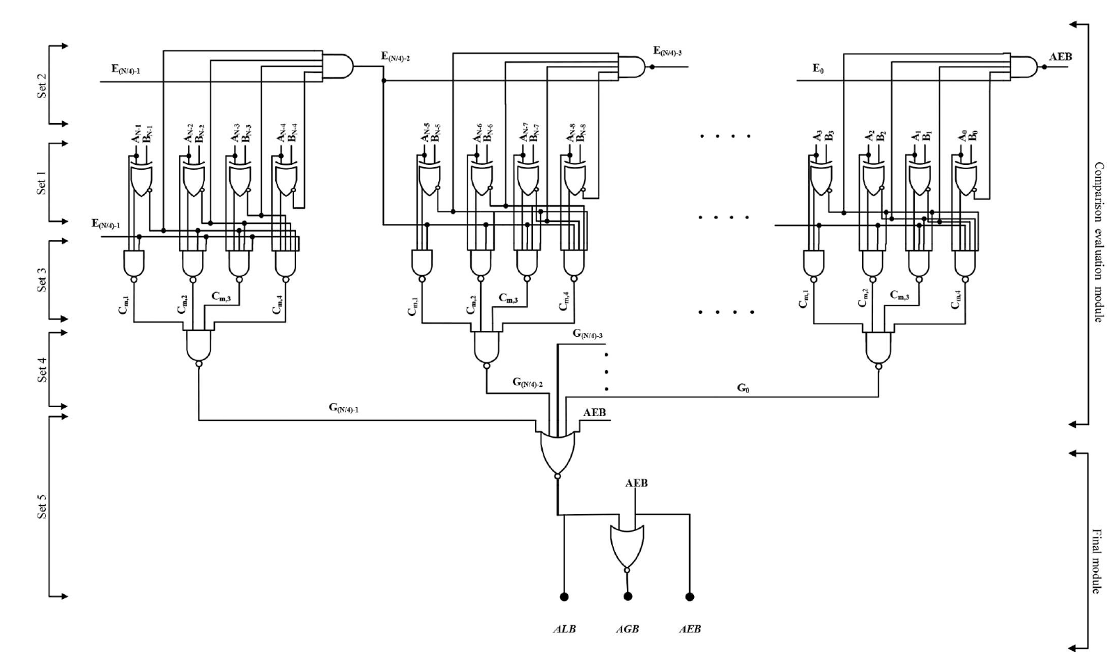
Referenced design

Slide 50
4 bit - State block : Block diagram
a3 min3
a3 max3
a2 min2
a1 min1
a0 min0
a2 max2
a1 max1
a0 max0
A_LT_MIN
A_E_MIN
A_GT_MAX
A_E_MAX

Slide 51
4 bit selector
A_LT_MIN
A_E_MIN
A_GT_MAX
A_E_MAX
A_LT_MIN
A_E_MIN
A_GT_MAX
A_E_MAX
max(0-3)
selector
min(0-3)
a (0-3)
min(0-3)
out(0-3)
a(0-3)
out(0-3)
max (0-3)

Slide 52
16 – bit _XNOR : Limiter
min3
a3
max3
min2
a2
max2
min1
a1
max1
min0
a0
max0
min
a
max
min
a
max
min
a
max
min
a
max
A_E_MIN
A_E_MIN
A_E_MIN
A_E_MIN
Stage3
Stage2
Stage1
Stage0
A_E_MAX
A_E_MAX
A_E_MAX
A_E_MAX
A_LT_MIN
A_GT_MAX
A_LT_MIN
A_GT_MAX
A_LT_MIN
A_GT_MAX
A_LT_MIN
A_GT_MAX
selector
selector
selector
selector
max(0-3)
max(4-7)
max(8-11)
max(12-15)
min(0-3)
min(4-7)
min(8-11)
min(12-15)
a (0-3)
a (4-7)
a (8-11)
a (12-15)
out(0-3)
out(4-7)
out(8-11)
out(12-15)
16 – bit (Limiter design)

Slide 53
Delay – XNOR limiter
4 bit = (2 xnor + 2 nand + 1 or + 1 nor + 1 tristate buffer ) gate delay
16 bit = (2 xnor + 2 nand + 2 and (5 input) + 1 and (4 input) + 1 or + 1 nor + 1 tristate buffer ) gate delay
32 bit = (2 xnor + 2 nand + 6 and (5 input) + 1 and (4 input) + 1 or + 1 nor + 1 tristate buffer ) gate delay

Slide 54
Miscellaneous
FPFA_logical_block
FPFA_logical_block
FPFA_logical_block
FPFA_logical_block
FPFA_logical_block
FPFA_logical_block
FPFA_logical_block
FPFA_logical_block
FPFA_logical_block
FPFA_logical_block
FPFA_logical_block
FPFA_logical_block
FPFA_logical_block
FPFA_logical_block
FPFA_logical_block
FPFA_logical_block
FPFA_logical_block
FPFA_logical_block
FPFA_logical_block
FPFA_logical_block
FPFA_logical_block
FPFA_logical_block
FPFA_logical_block
FPFA_logical_block
FPFA_logical_block
FPFA_logical_block
FPFA_logical_block
Limiter
Limiter
Limiter

Slide 55
FPFA_logical_block
FPFA_logical_block
FPFA_logical_block
FPFA_logical_block
FPFA_logical_block
FPFA_logical_block
FPFA_logical_block
FPFA_logical_block
FPFA_logical_block
FPFA_logical_block
FPFA_logical_block
FPFA_logical_block
FPFA_logical_block
FPFA_logical_block
FPFA_logical_block
FPFA_logical_block
FPFA_logical_block
FPFA_logical_block

Slide 56
min
a
max
min
a
max
inr_gt_max
out_gt_max
Inp_eq_max
out_eq_max
Inp_lt_min
out_lt_min
Inp_eq_min
out_eq_min
Stage

Slide 57
Alternate
β
Multiplier block
adder
X(t)
β
Multiplier block
adder
X(t)
β
Multiplier block
adder
X(t)
β
Multiplier block
adder
X(t)
β
Multiplier block
adder
X(t)
β
Multiplier block
adder
X(t)

