Slide 1
Digital PLL Modeling
Blake Chevalier
Prof. Weiping Shi

Slide 2
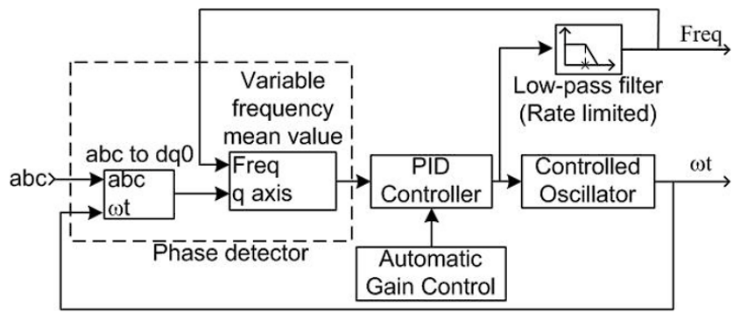
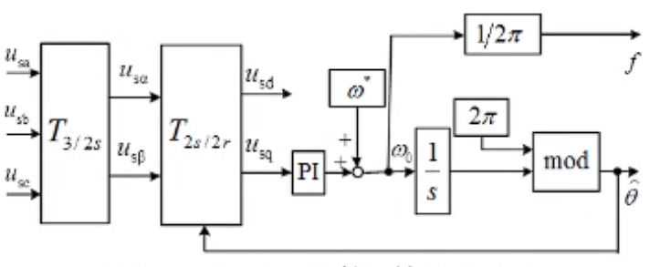
PLL Overview
The Phase Locked Loop (PLL) is a closed system that has a three-phase sinusoidal input and outputs the frequency and phase angle in real time
The park transformation is used to get a DC voltage corresponding to the three-phase sinusoidal input
The first diagram shows a general PLL and it’s block components, while the second diagram is specific to what is being modeled
Mod 2π is used as the controlled oscillator
The control component is a PID controller
All other differences are constants which depend on the use case

Slide 3
PID Controller Mean variable frequency block Controlled oscillator Low Pass Filter

Slide 4
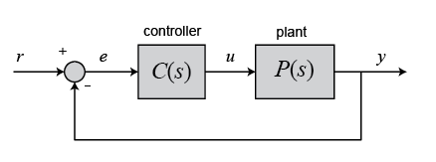
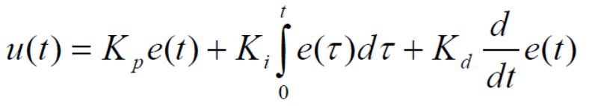
PID Overview
The PID controller is an electronics component that uses differentiation, integration, and proportionality to continuously adjust the controller output to achieve a final output equal to the set point value
The controller function is the model used to set y and the plant function is some transformation of the output u
r: set point value
e: error
u: output
y: actual value
For a PID controller, the output-error relationship can be modeled by the mathematical equation:

Slide 5
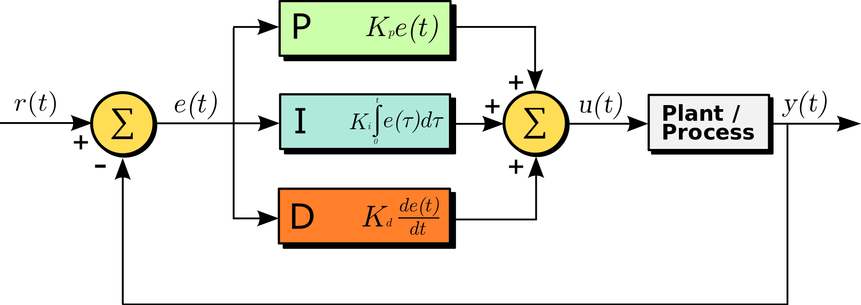
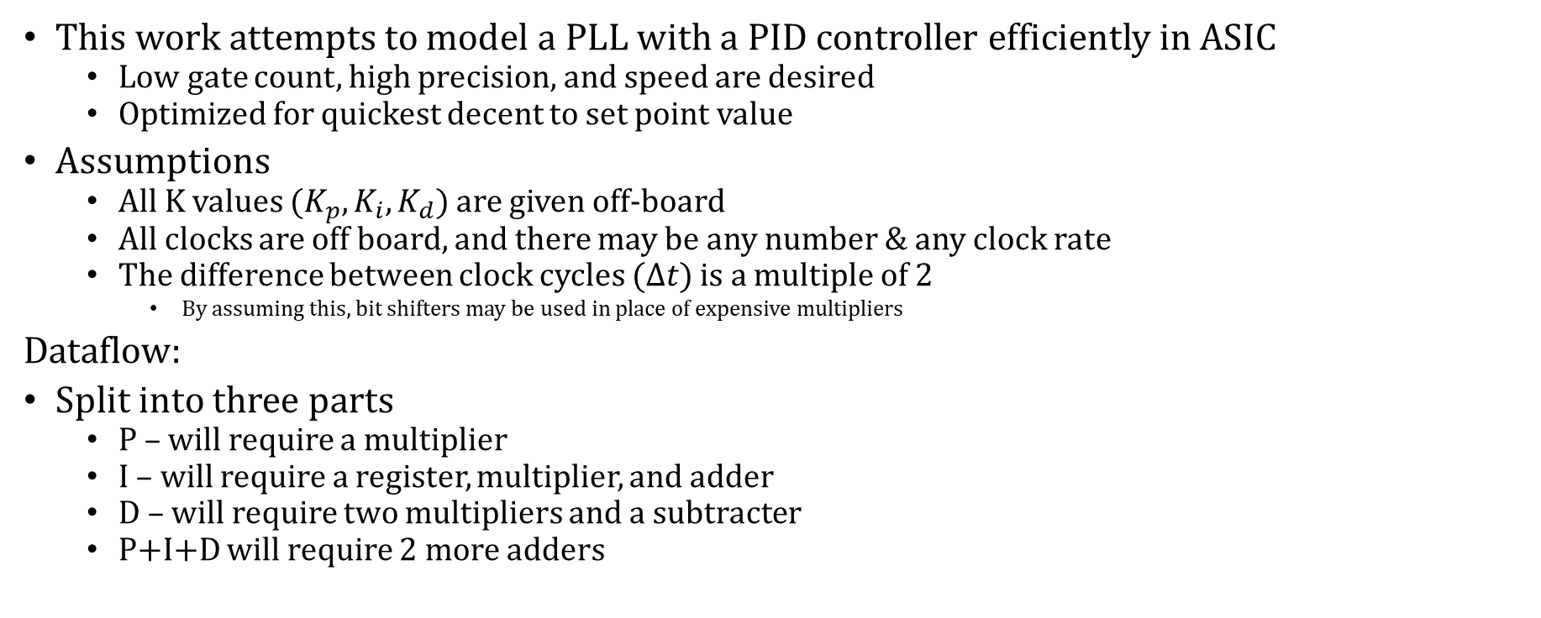
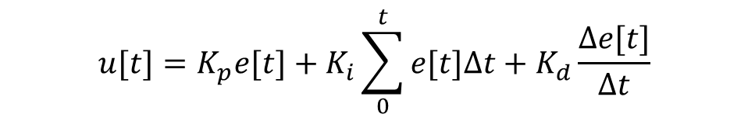
PID Problem Statement
This work attempts to model a PLL with a PID controller efficiently in ASIC
Low gate count, high precision, and speed are desired
Optimized for quickest decent to set point value
Assumptions
All K values ($K_{p},K_{i},K_{d}$) are given off-board
All clocks are off board, and there may be any number & any clock rate
The difference between clock cycles ($∆t$) is a multiple of 2
By assuming this, bit shifters may be used in place of expensive multipliers
Dataflow:
Split into three parts
P – will require a multiplier
I – will require a register, multiplier, and adder
D – will require two multipliers and a subtracter
P+I+D will require 2 more adders
The PID model can be translated to its discrete form to build a block diagram:
$$u[t]=K_{p}e[t]+K_{i}\sum_{0}^{t}{e[t]∆t}+K_{d}\frac{∆e[t]}{∆t}$$

Slide 6
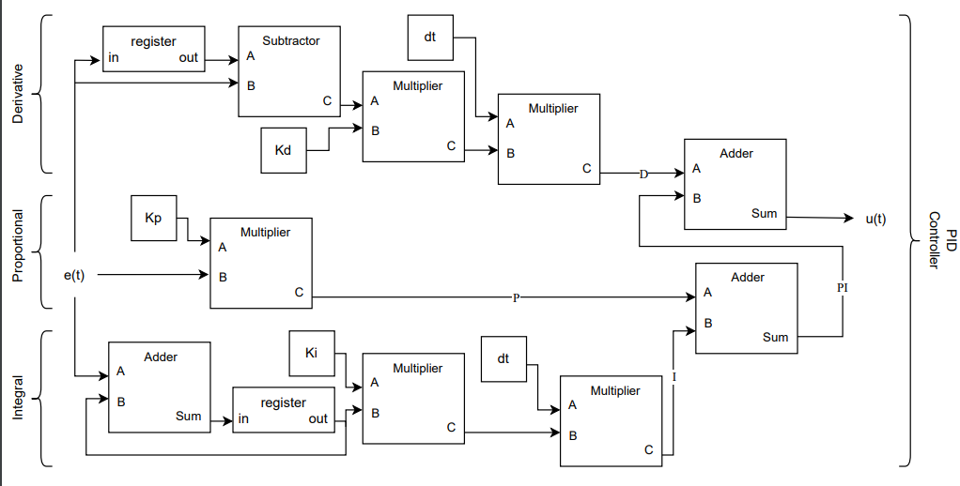
PID Dataflow (naïve approach)
By directly translating the PID model equation (from previous slide) into dataflow, the following diagram can be achieved
This diagram has a few issues, and will be used as the naïve/un-optimized model for future improvements
High gate count (many multipliers)
Large delay

Slide 7
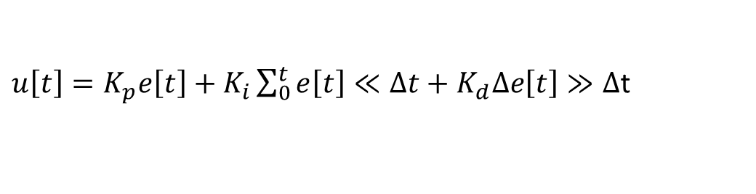


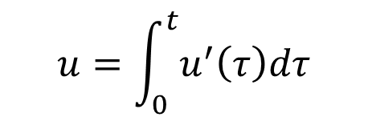
PID Optimizations
The logic blocks used to divide/multiply by $∆t$ may be replaced by shifters if we force the value to be a power of 2
The PID equation can also be transformed into its differential counterpart to look for spatial or time optimizations
$u\left[t\right]=K_{p}e\left[t\right]+K_{i}\sum_{0}^{t}{e\left[t\right]≪∆t}+K_{d}∆e\left[t\right]≫∆$t
$$u=\int_{0}^{t}{u^{′}\left(τ\right)dτ}$$
$$u^{′}(t)=K_{p}e^{′}\left(t\right)+K_{i}(e(t))+K_{d}e′′(t)$$
Into discrete form
$$u^{′}\left(t\right)=K_{p}\frac{Δe(t)}{Δt}+K_{i}\left(e(t)\right)+K_{d}\frac{Δ^{2}e(t)}{Δt^{2}}$$
$$u=\sum_{0}^{t}{u^{′}∗Δt}$$
Next, I’ll look at the both the integral and differential implementations and research scheduling options to optimize hardware utilization

Slide 8
PID Controller Mean variable frequency block Controlled oscillator Low Pass Filter

Slide 9
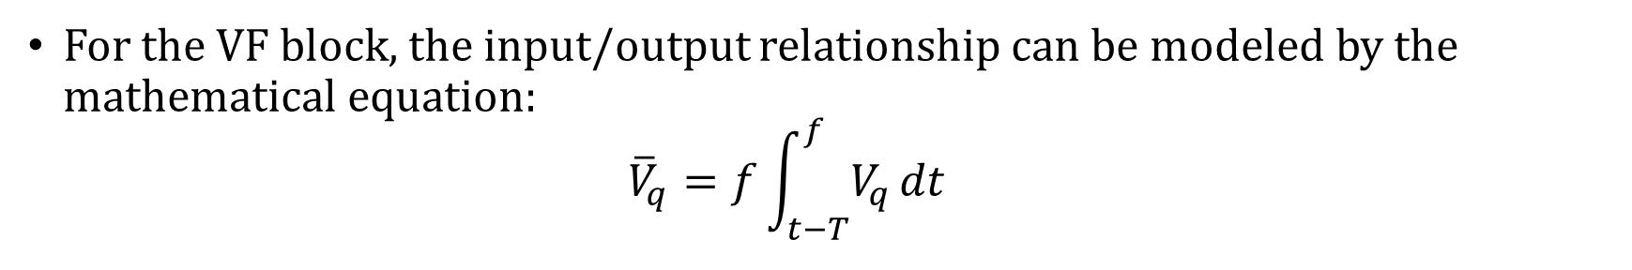
Mean VF Overview
To enhance robustness of the control system, the PID controller input will be filtered by a block calculating the mean variable frequency
This new system requires feedback from both outputs of the PLL
The ωt is passed back as the error term for the controller
The frequency is passed back to calculate VF mean
The VF block will calculate the running average over a single cycle of the signal
This attempts to reduce the overall noise of the signal so that the PID controller can reach its control variable more quickly
For the VF block, the input/output relationship can be modeled by the mathematical equation:
$${\overline{V}}_{q}=f\int_{t−T}^{f}{V_{q}}dt$$

Slide 10
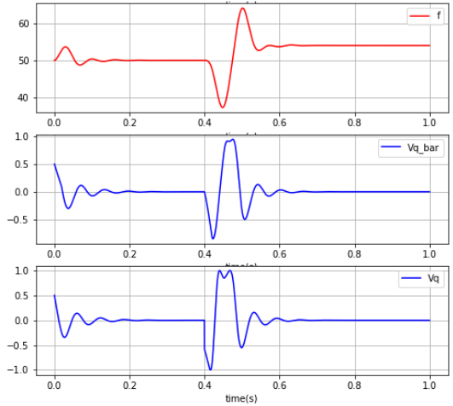
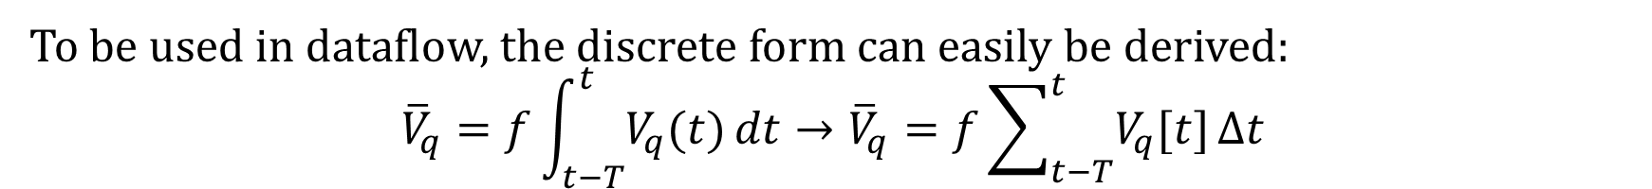
Mean VF Problem Statement
The goal is to develop a digital simulation for the variable frequency mean block with high efficiency
Low gate count, high speed, high accuracy (relative to model equation)
Improves PID accuracy, faster approach to control value,
To the left is an example of our simulated PLL with its control value of 0
It can be seen how the mean block is used to smooth the input to increase robustness of the control system
To be used in dataflow, the discrete form can easily be derived:
$${\overline{V}}_{q}=f\int_{t−T}^{t}{V_{q}(t)}dt→{\overline{V}}_{q}=f\sum_{t−T}^{t}{V_{q}[t]}∆t$$

Slide 11
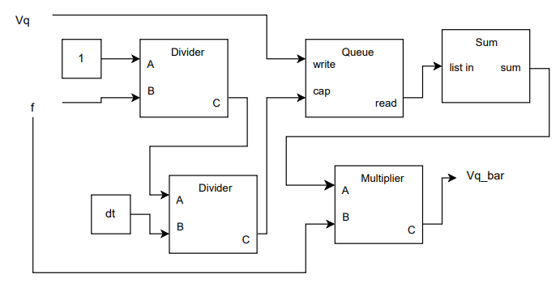

Mean VF Dataflow – naïve approach
By directly translating the mean model equation (from previous slide) into dataflow, the following diagram can be achieved
The queue block will hold data input to write, until the capacity is reached. After the capacity is reached, the item at the back of the queue will be forgotten
The sum component takes in N values and uses N adders to output the sum.
$${\overline{V}}_{q}=f\sum_{t−T}^{t}{V_{q}[t]}∆t$$
Note: the period is calculated as $T=\frac{1}{f∗Δt}$
Any frequency can be used in the circuit as long as the dt is adjusted accordingly

Slide 12
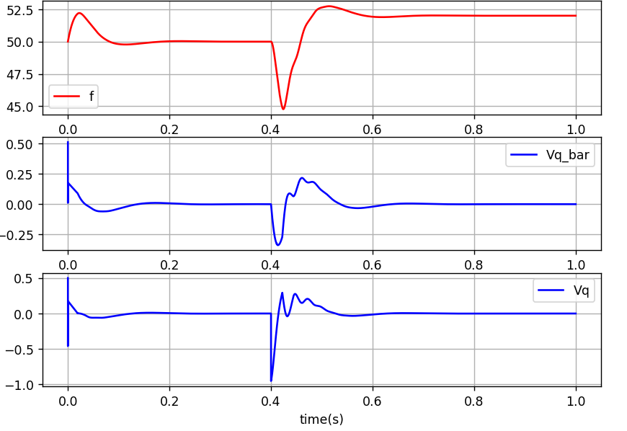
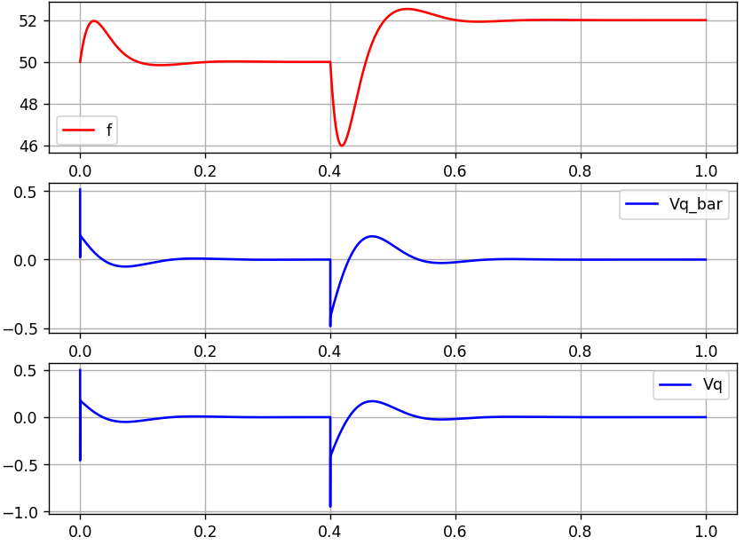
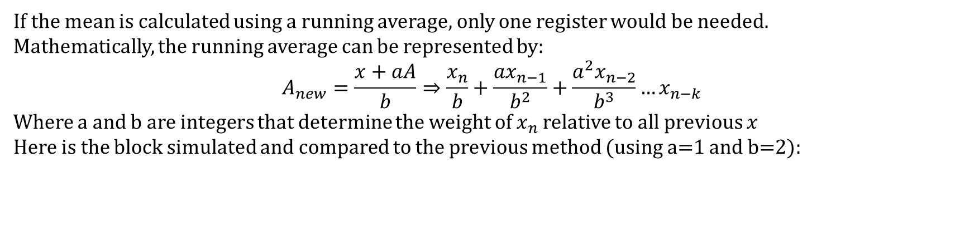
Mean VF Running Average Form (1/2)
If the mean is calculated using a running average, only one register would be needed.
Mathematically, the running average can be represented by:
$$A_{new}=\frac{x+aA}{b}⇒\frac{x_{n}}{b}+\frac{ax_{n−1}}{b^{2}}+\frac{a^{2}x_{n−2}}{b^{3}}…x_{n−k}$$
Where a and b are integers that determine the weight of $x_{n}$ relative to all previous $x$
Here is the block simulated and compared to the previous method (using a=1 and b=2):
Using Mean Equation: relative error = 2.86%
Using Running Avg: relative error = 2.53%
Using the running average formula, the system is much smoother, has less absolute error, and approaches the control value more quickly

Slide 13
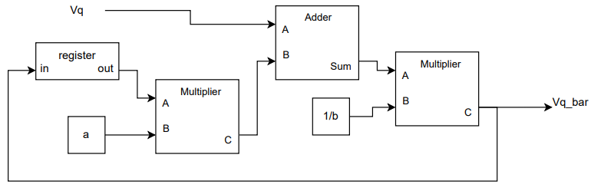

VF Mean Running Average Form (2/2)
Using the running average frequency the dataflow diagram would look like the following:
$$A_{new}=\frac{x+aA}{b}$$
The model has less hardware usage than the previous, but 2 multipliers are still used
If there are values for a and b that are ALWAYS the best choices for performance and accuracy, the size of the array multipliers can be reduced and the a and b registers could remain constant.
Lets analyze which choices for a and b give the lowest error, fastest transient, and best hardware usage

Slide 14
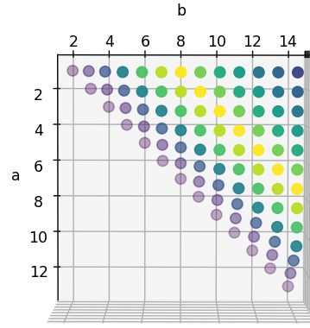
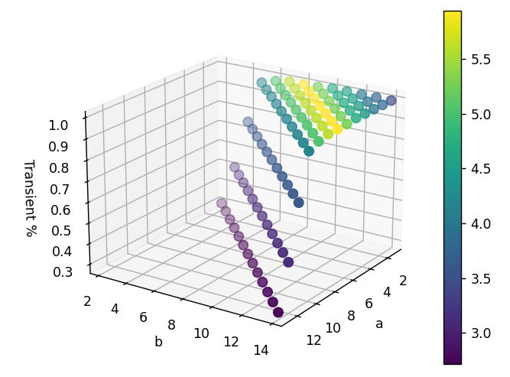
A and B Constant Analysis
By taking measurements of relative error and the time it takes for the controller to reach its control value for various a and b choices, the following is observed
Relative Error
By examining the 3D heatmap, we can see that the fastest transient response and least relative error occur when the a and b constants follow the pattern: $a+1=b$. This gives $A_{new}=\frac{x+aA}{a+1}$

Slide 15
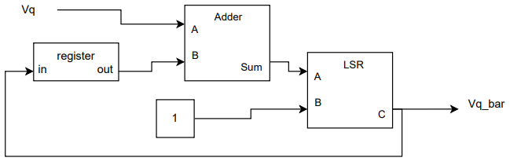
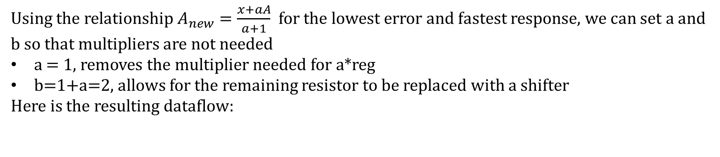

Fixed Constant Dataflow
Using the relationship $A_{new}=\frac{x+aA}{a+1}$ for the lowest error and fastest response, we can set a and b so that multipliers are not needed
a = 1, removes the multiplier needed for a*reg
b=1+a=2, allows for the remaining resistor to be replaced with a shifter
Here is the resulting dataflow:
Metrics (assuming 32-bit):
Relative error = 2.53%
Gate count =62+160=222 gates
Shifter: 1+(32-2)+2*31= 62 gates
Adder: 5*32=160 gates
Maximum Precision loss: 3 bits
Output every cc
Delay = 65+2=67 gate delays
Using this model greatly reduces the size (and cost) of the circuit while improving the error and speed the control variable is reached
$$A_{new}=\frac{x+A}{2}$$

Slide 16
Comparative Analysis
 | Running Average | Fixed Constant | Naïve Approach
Delay (ns) | 11.76 | 5.4 | > Running Average
LUT count | 159 | 31 | > Running Average
FF Count | 32 | 31 | > Running Average
Accuracy to Equation** | 0.962% | 0.962% | ~0%
Error to Control Value** | 2.53% | 2.53% | 2.86%
*a and b values are limited to 2 bits (4 values)
**Error were measured using data for an operational PLL

Slide 17
PID Controller Mean variable frequency block Controlled oscillator Low Pass Filter

Slide 18
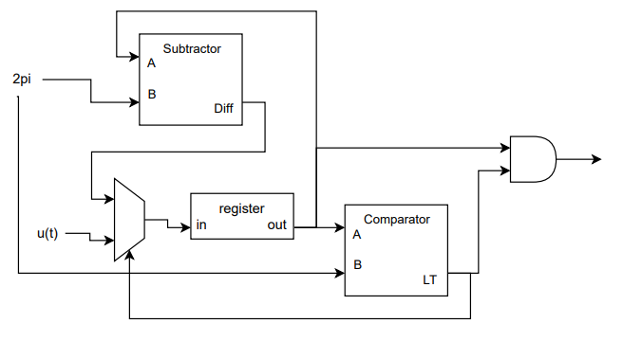
Controlled Oscillator
The controlled oscillator should perform $ωt=u\left(t\right) mod 2π$, where u(t) is the PID controller output
A dataflow implementation of this would look like:
For this implementation to work the register must begin holding the first value of u(t), or the MUX must have s=1 on startup

Slide 19
PID Controller Mean variable frequency block Controlled oscillator Low Pass Filter

Slide 20
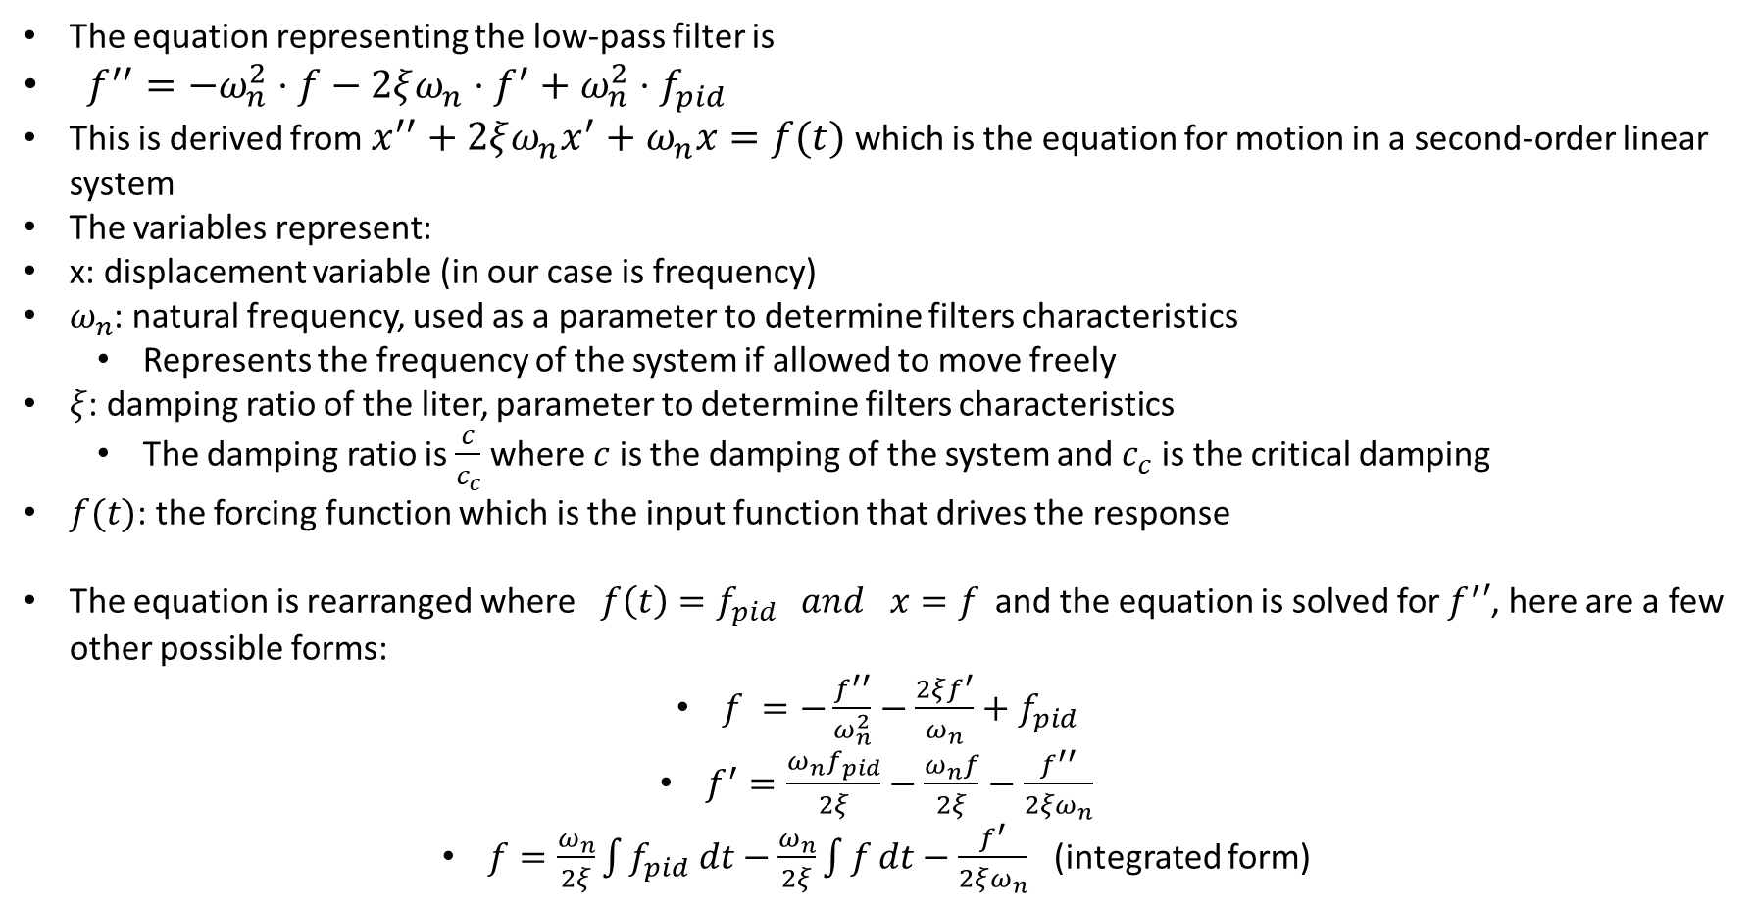
Understanding the LP Filter
The equation representing the low-pass filter is
$f^{′′}=−ω_{n}^{2}⋅f−2ξω_{n}⋅f^{′}+ω_{n}^{2}⋅f_{pid}$
This is derived from $x^{′′}+2ξω_{n}x^{′}+ω_{n}x=f(t)$ which is the equation for motion in a second-order linear system
The variables represent:
x: displacement variable (in our case is frequency)
$ω_{n}$: natural frequency, used as a parameter to determine filters characteristics
Represents the frequency of the system if allowed to move freely
$ξ$: damping ratio of the liter, parameter to determine filters characteristics
The damping ratio is $\frac{c}{c_{c}}$ where $c$ is the damping of the system and $c_{c}$ is the critical damping
$f(t)$: the forcing function which is the input function that drives the response
The equation is rearranged where $f\left(t\right)=f_{pid} and x=f$ and the equation is solved for $f^{′}′$, here are a few other possible forms:
$f =−\frac{f^{′′}}{ω_{n}^{2}}−\frac{2ξf^{′}}{ω_{n}}+f_{pid}$
$f^{′}=\frac{{ω_{n}f}_{pid}}{2ξ}−\frac{ω_{n}f}{2ξ}−\frac{f^{′′}}{2ξω_{n}}$
$f=\frac{ω_{n}}{2ξ}\int{f_{pid} dt}−\frac{ω_{n}}{2ξ}\int{f}dt−\frac{f^{′}}{2ξω_{n}}$ (integrated form)

Slide 21
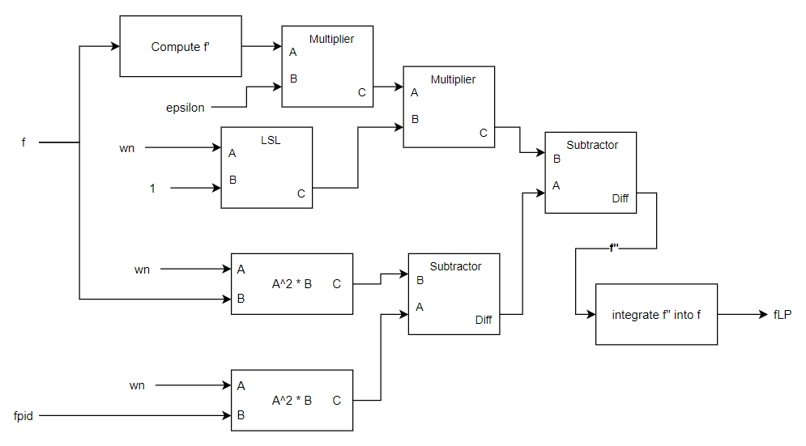
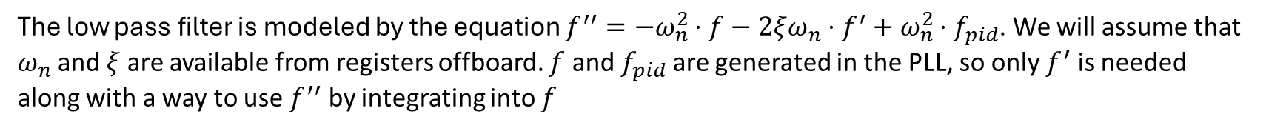
Low Pass Filter
The low pass filter is modeled by the equation $f^{′′}=−ω_{n}^{2}⋅f−2ξω_{n}⋅f^{′}+ω_{n}^{2}⋅f_{pid}$. We will assume that $ω_{n}$ and $ξ$ are available from registers offboard. $f$ and $f_{pid}$ are generated in the PLL, so only $f^{′}$ is needed along with a way to use $f^{′′}$ by integrating into $f$
Here is a top level dataflow for a brute-force approach

Slide 22
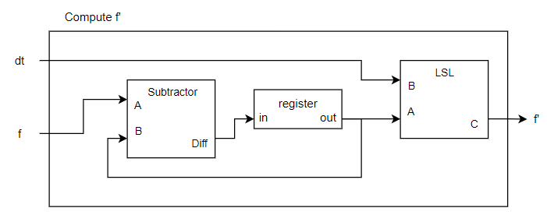
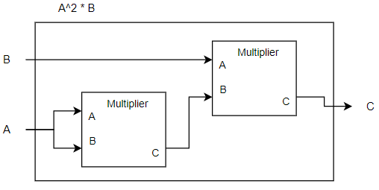
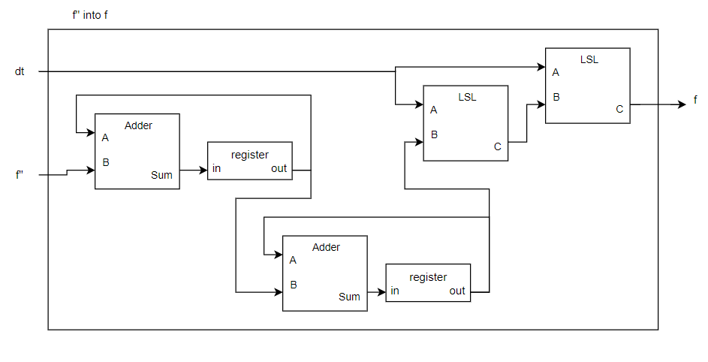
Low Pass Filter
The top level components that must be represented are compute f’, A^2 * B, and integrate f’’ into f

Slide 23
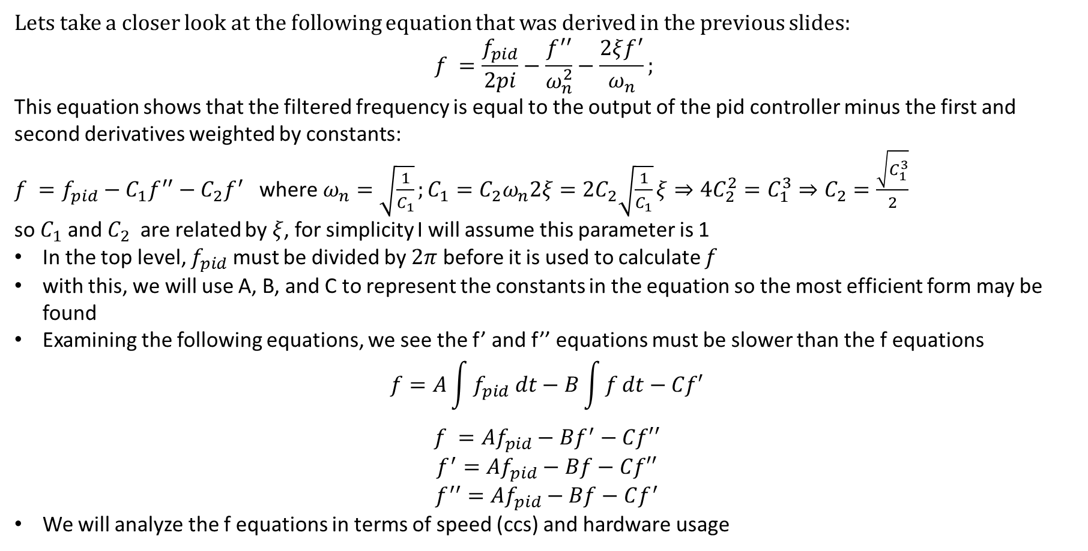
Low Pass Filter Optimization
Lets take a closer look at the following equation that was derived in the previous slides:
$$f =\frac{f_{pid}}{2pi}−\frac{f^{′′}}{ω_{n}^{2}}−\frac{2ξf^{′}}{ω_{n}};$$
This equation shows that the filtered frequency is equal to the output of the pid controller minus the first and second derivatives weighted by constants:
$f =f_{pid}−C_{1}f^{′′}−C_{2}f^{′}$ where$ω_{n}=\sqrt{\frac{1}{C_{1}}};C_{1}=C_{2}ω_{n}2ξ={2C}_{2}\sqrt{\frac{1}{C_{1}}}ξ⇒{4C}_{2}^{2}=C_{1}^{3}⇒C_{2}=\frac{\sqrt{C_{1}^{3}}}{2}$
so $C_{1}$ and $C_{2}$ are related by $ξ$, for simplicity I will assume this parameter is 1
In the top level, $f_{pid}$ must be divided by $2π$ before it is used to calculate $f$
with this, we will use A, B, and C to represent the constants in the equation so the most efficient form may be found
Examining the following equations, we see the f’ and f’’ equations must be slower than the f equations
$$f=A\int{f_{pid} dt}−B\int{f}dt−Cf′$$
$$f ={Af}_{pid}−Bf^{′}−Cf′′$$
$$f^{′}=Af_{pid}−Bf−Cf′′$$
$$f^{′′}=Af_{pid}−Bf−Cf^{′}$$
We will analyze the f equations in terms of speed (ccs) and hardware usage

Slide 24
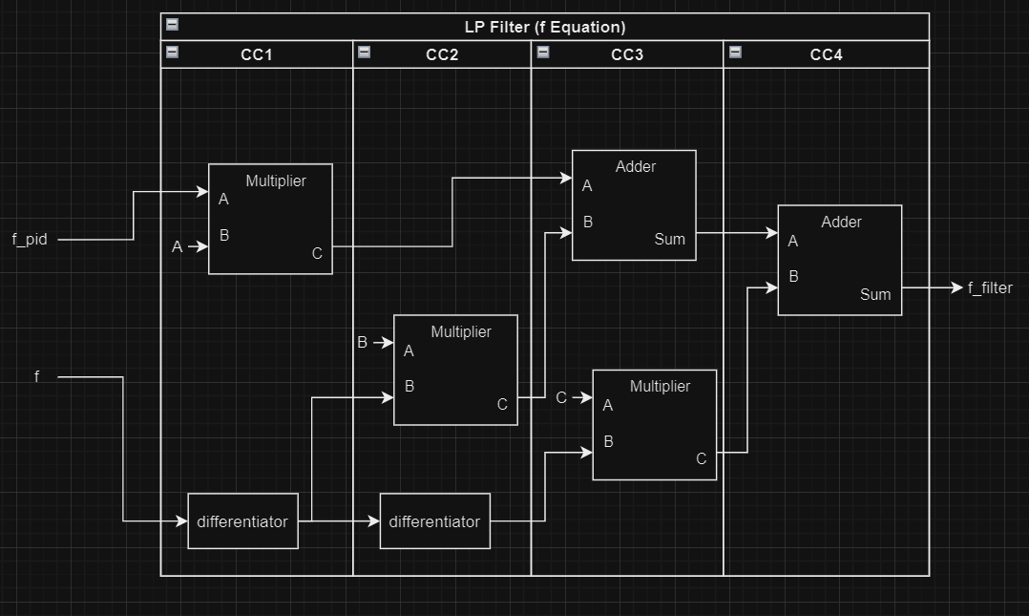
Low Pass Filter Scheduling
$$f ={Af}_{pid}−Bf^{′}−Cf′′$$
Hardware count
Multiplier: 1
Adder: 1
Differentiator: 1
Adder: 0 (will use available adders)
Shifter: 1
Register: 2
Timing
4 CCs
CC has delay of 1 multiplier
Another option of the same circuit performs CC3 and CC4 in one cycle.
Increases hardware usage
Increases delay
Decreases #CCs
Optimized for hardware

Slide 25
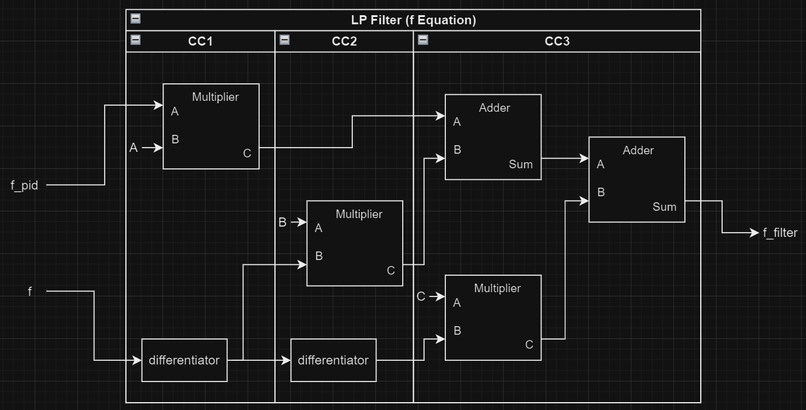
Low Pass Filter Scheduling
$$f ={Af}_{pid}−Bf^{′}−Cf′′$$
Hardware count
Multiplier: 1
Adder: 2
Differentiator: 1
Adder: 0 (will use available adders)
Shifter: 1
Register: 2
Timing
3 CCs
CC has delay of 1 multiplier + 1 adder
Next is a method using maximum parallelization
Speedup with slightly more hardware

Slide 26
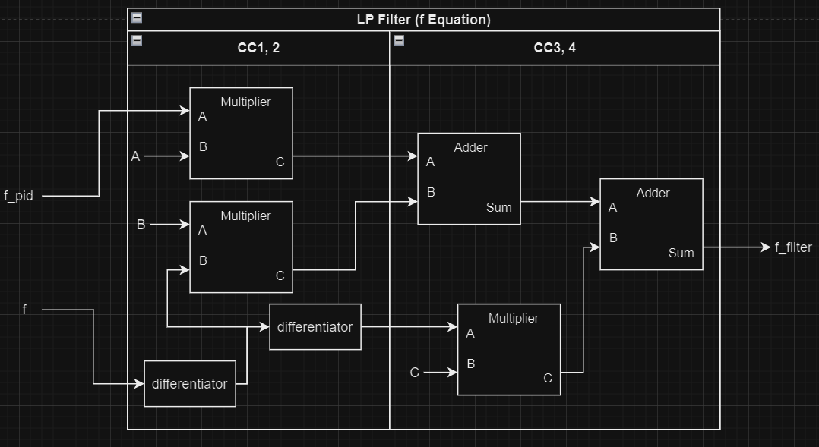
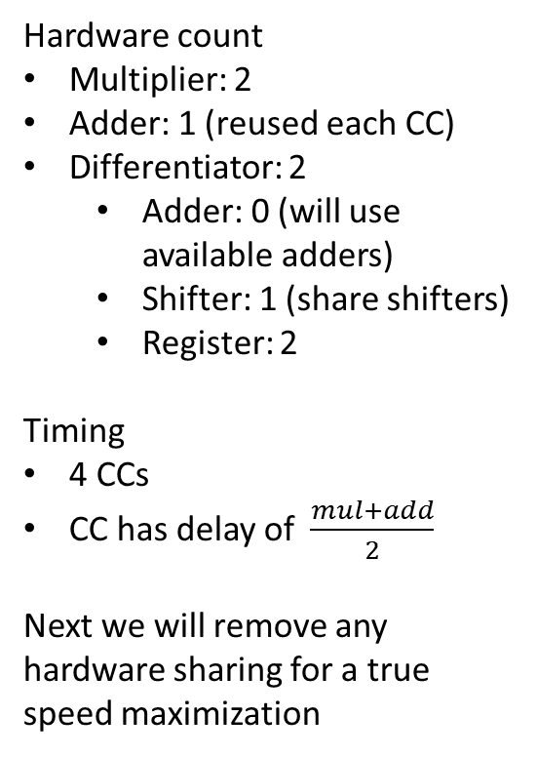
LPF Scheduling
$$f ={Af}_{pid}−Bf^{′}−Cf′′$$
Hardware count
Multiplier: 2
Adder: 1 (reused each CC)
Differentiator: 2
Adder: 0 (will use available adders)
Shifter: 1 (share shifters)
Register: 2
Timing
4 CCs
CC has delay of $\frac{mul+add}{2}$
Next we will remove any hardware sharing for a true speed maximization
Optimized for speed with some hardware sharing

Slide 27
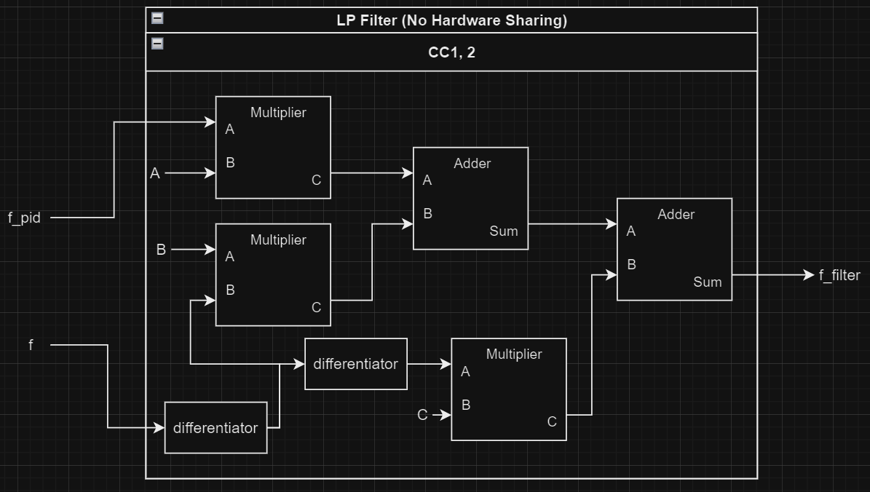
LPF Scheduling
$$f ={Af}_{pid}−Bf^{′}−Cf′′$$
Hardware count
Multiplier: 3
Adder: 2
Differentiator: 2
Adder: 2
Shifter: 2
Register: 2
Timing
1 CC
CC has delay of mul+2*add+shft
A faster clock will ensure that the regs in the differentiators are loaded
Next we will look at the integral form
Optimized for speed

Slide 28
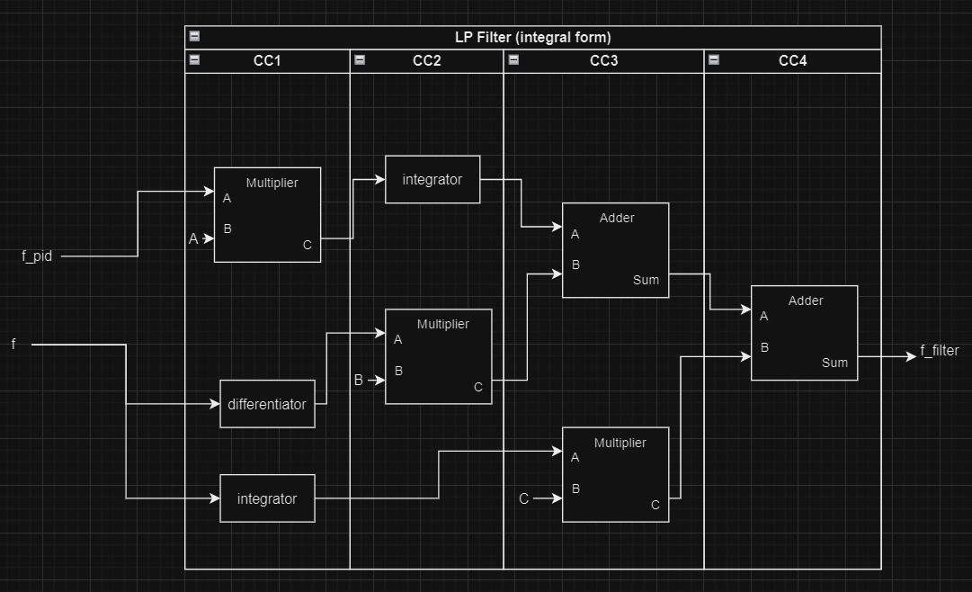
Low Pass Filter Scheduling
$$f=A\int{f_{pid} dt}−B\int{f}dt−Cf′$$
Hardware count
Multiplier: 1
Adder: 1
Differentiator/ Integrator : 2
Adder: 1 (will use 1 available adder)
Shifter: 2
Register: 3
Timing (same as f equation)
4 CCs
CC has delay of 1 multiplier
If we introduce 2 clocks to this circuit, we can find a faster circuit, with higher hardware count. NEXT SLIDE
Optimized for hardware

Slide 29
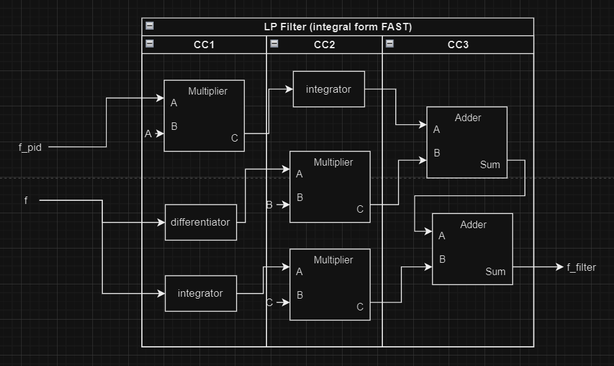
Low Pass Filter Scheduling
$$f=A\int{f_{pid} dt}−B\int{f}dt−Cf′$$
Hardware count
Multiplier: 2
Adder: 2
Differentiator/ Integrator : 1
Adder: 0 (will use available adders)
Shifter: 2
Register: 3
Timing
3CCs
Delay of 1 multiplier
Speedup with more hardware

Slide 30
LPF Scheduling Comparison
For this comparison we will assume the following delays and gate counts (only for comparison)
Multiplier: 10 delay units, 1k gates
Adder: 1.5 delay unit, 150 gates
Integrator/Differentiator: (1.5+5) 2 delay units, (150 + 50) 200 gates
 | Option 1 | Option 2 | Option 3 | Option 4 | Option 5 | Option 6
 | f equation | f equation MID | F equation FAST | F equation Large | Integral equation | Integral equation FAST
# CC | 4 | 3 | 4 | 1 | 4 | 3
CC Delay | 10 | 11.5 | 5.75 | 15 | 10 | 10
Throughput | 1/40 | 1/34.5 | 1/23 | 1/15 | 1/40 | 1/30
Latency | 40 | 34.5 | 23 | 15 | 40 | 30
Hardware cnt | 1200 | 1350 | 2350 | 3700 | 1400 | 2400
Speed vs 1 | = | +15.9% | +74% | +167% | = | +33%
Size vs 1 | = | +12.5% | +100% | +208% | +16.7% | +100%

Slide 31
LPF Scheduling Comparison
For this comparison synthesized values for LUT count will be used
Multiplier: 70.2 delay units, 702 LUTS
Adder: 3.1 delay unit, 31 LUS
Integrator/Differentiator: (3.1 + 7.3) 10.4 delay units, (31 + 73) 104 LUTS
 | Option 1 | Option 2 | Option 3 | Option 4
 | f equation | f equation MID | F equation FAST | F equation Large
# CC | 4 | 3 | 4 | 1
CC Delay | 70.2 | 70.2+3.1= 73.3 | (70.2+3.1)/2= 36.65 | 70.2+2*3.1+7.3= 83.7
Throughput | 1/280.8 | 1/219.9 | 1/146.6 | 1/83.7
Latency | 280.8 | 219.9 | 146.6 | 83.7
Hardware cnt | 702+31+73+mux= (965) | 702+2*31+73+mux= (1008) | 702*2+104+mux= (1599) | 3*702+2*31+2*104= 2376
Speed vs 1 | = | +27.7% | +92% | +235%
Size vs 1 | = | +4.46% | +65.7% | +146%

Slide 32
Further Exploration – HW/SW Collaboration

Slide 33


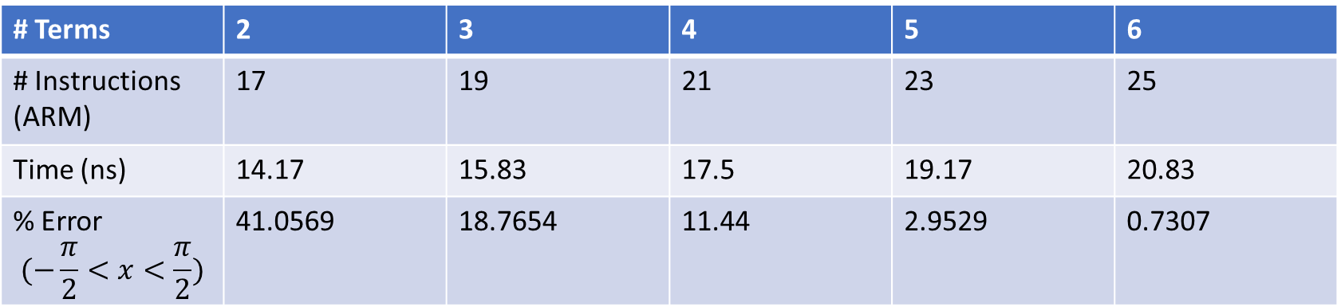
Processor – Trig Implementation
On the ARM processor, the sine and cosine trig functions can be implemented using the Taylor expansion
Since the Taylor series is infinite, we will choose a good stopping point. Here is an analysis of the processor implementation with regard to the number of instructions vs the accuracy.
$\sin\left(x\right)=x−\frac{x^{3}}{3!}+\frac{x^{5}}{5!}$ $−\frac{x^{7}}{7!}$ $+\frac{x^{9}}{9!} ⋯$
$\cos\left(x\right)=1−\frac{x^{2}}{2!}+\frac{x^{4}}{4!}$ $−\frac{x^{6}}{6!}+\frac{x^{8}}{8!} ⋯$
# Terms | 2 | 3 | 4 | 5 | 6
# Instructions (ARM) | 17 | 19 | 21 | 23 | 25
Time (ns) | 14.17 | 15.83 | 17.5 | 19.17 | 20.83
% Error $$(−\frac{π}{2}<x<\frac{π}{2})$$ | 41.0569 | 18.7654 | 11.44 | 2.9529 | 0.7307
To increase the accuracy while allowing for less terms (and instructions), we can narrow the range that we expect the input x to be
% Error $$(0<x<π/2)$$ | 12.74 | 1.396 | 0.05858 | 0.001607 | 3.002e-5

Slide 34
Embedded Core vs FPGA
The following is a time analysis of mathematical operations of an embedded core vs on FPGA
For calculations the Zynq-7000 SoC system will be used
The system includes an FPGA with embedded hard processor
Artix-7 FPGA
Dual ARM Cortex-A9 MP Core 0.8-2 GHz
Analysis Results:
Note: Sources show an expected 3-5x speedup from FPGA to ASIC
Operation | FPGA Time | Processor Time | FPGA w DSP
Addition/Subtraction | 5.667 ns | 9.167 ns | 5.667 ns
Multiplication | 12.395 ns | 9.167 ns | 10.06 ns
Shifter | 5.013 ns | 11.67 ns | 5.013 ns
Sine / Cos | ? | 17.5 ns (21 instructions) | ?

Slide 35

FPGA/Processor Implementation
To implement a design using both FPGA and a hard processor:
The processor runs at the top of the hierarchy
Verilog modules are individually established
The processor allocates values into registers that will be used by the Verilog modules
To get the delay of loading the registers (input delay): $Delay=T_{tot}−T_{FPGA}$
On the next slide I detail the SW / HW implementation in Vivado and the method to get the input delay
Processor
FPGA
Reg 1
Logical Operation
Load values into regs
Reg 0
Reg 2

Slide 36
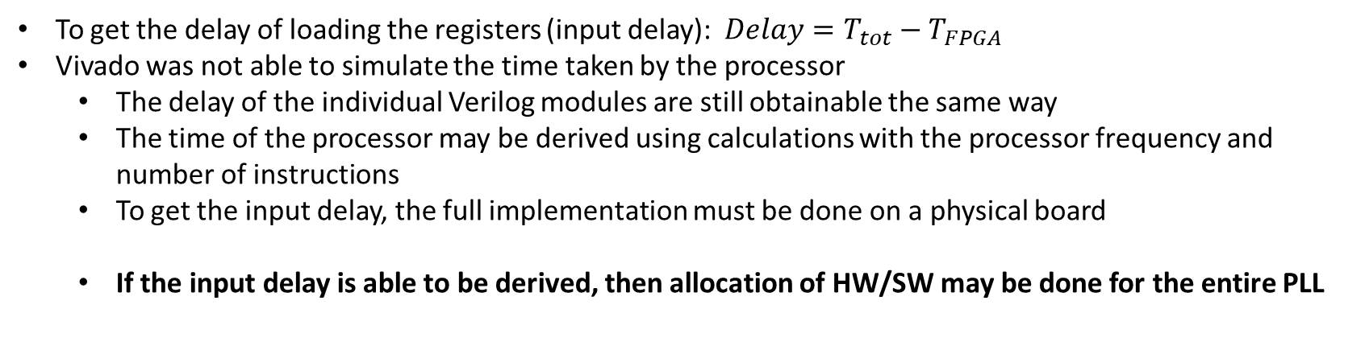
HW / SW Test
Below is a diagram of a test I have implemented in firmware and software using Vivado
Processor
FPGA
Reg 1
Multiply
Load values into regs
Adder
Reg 0
Reg 2
To get the delay of loading the registers (input delay): $Delay=T_{tot}−T_{FPGA}$
Vivado was not able to simulate the time taken by the processor
The delay of the individual Verilog modules are still obtainable the same way
The time of the processor may be derived using calculations with the processor frequency and number of instructions
To get the input delay, the full implementation must be done on a physical board
If the input delay is able to be derived, then allocation of HW/SW may be done for the entire PLL

Slide 37
Final Summary
Below is a total summary of the metrics gotten from the current components
 | PID Controller | LP Filter | Controlled Oscillator | Mean Variable Frequency
LUT Count | 1481 | 211 | 126 | 31
Delay (ns) | 12.65 | 3.549 | - | 5.4
Max f (MHz) | 79.051383 | 281.7695125 | - | 185.1851852

Slide 39
Archived Slides

Slide 40
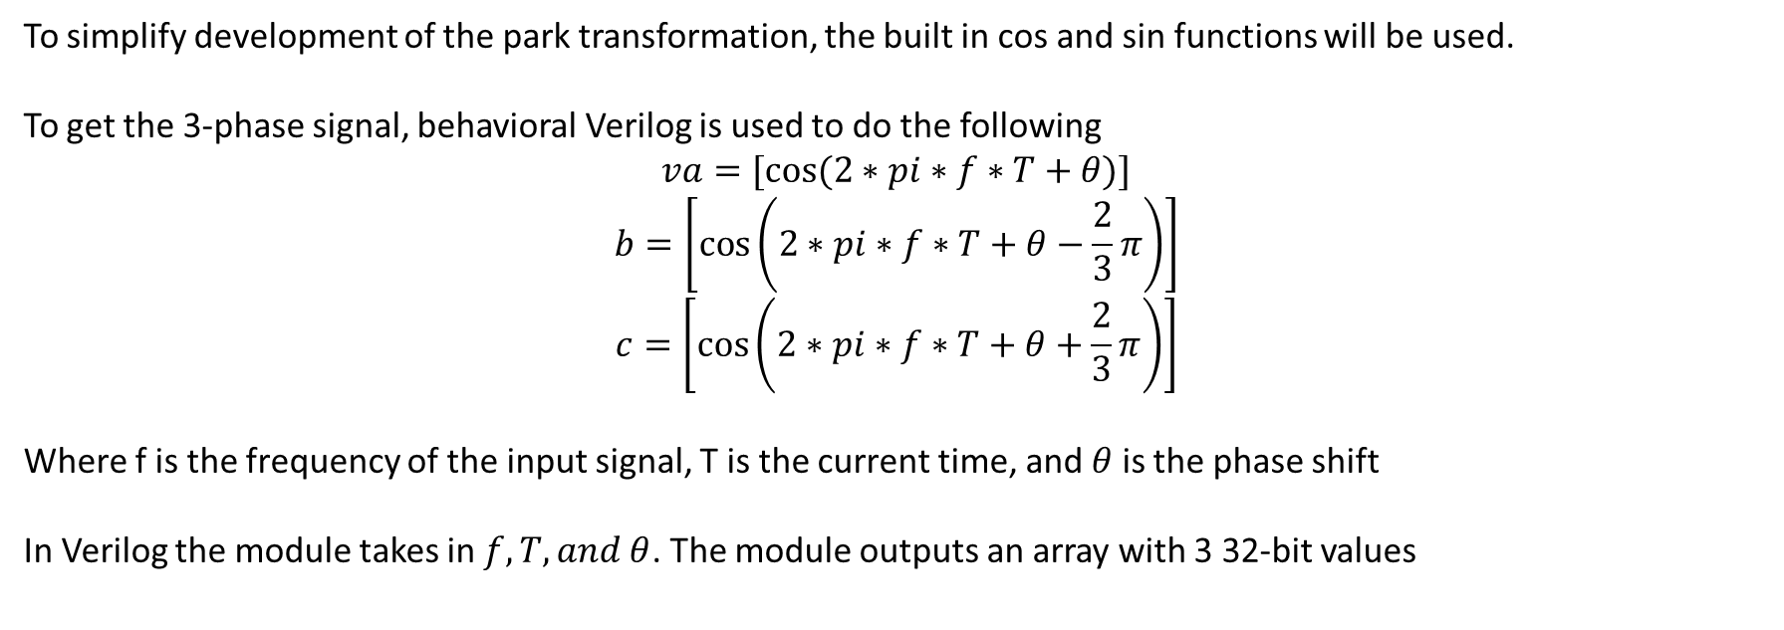
Generating vabc
To simplify development of the park transformation, the built in cos and sin functions will be used.
To get the 3-phase signal, behavioral Verilog is used to do the following
$$va=[cos⁡(2∗pi∗f∗T+θ)]$$
$$b=\left[\cos\left(2∗pi∗f∗T+θ−\frac{2}{3}π\right)\right]$$
$$c=\left[\cos\left(2∗pi∗f∗T+θ+\frac{2}{3}π\right)\right]$$
Where f is the frequency of the input signal, T is the current time, and $θ$ is the phase shift
In Verilog the module takes in $f, T, and θ$. The module outputs an array with 3 32-bit values

Slide 41


Park transformation
The park transformation module must be able to transform both to and from vabc and dq, here is the process
Determine the direction
If abc to dq
Compute K
$vabc∗K$
If dq to abc
Compute $K^{−1}$
$vabc∗K^{−1}$
This module takes in the vabc array, theta, and a bit deciding the transformation direction
Here are the calculations for K and K inverse. They are both 3x3 2D arrays
$K=\frac{2}{3}\left[\begin{matrix}\cos\left(θ\right) & \cos\left(θ−\frac{2}{3}π\right) & \cos\left(θ+\frac{2}{3}π\right) \\ −\sin\left(θ\right) & −sin\left(θ−\frac{2}{3}π\right) & −sin\left(θ+\frac{2}{3}π\right) \\ 0.5 & 0.5 & 0.5\end{matrix}\right]$
$$K^{−1}=\left[\begin{matrix}\cos\left(θ\right) & −\sin\left(θ\right) & 1 \\ \cos\left(θ−\frac{2}{3}π\right) & −sin\left(θ−\frac{2}{3}π\right) & 1 \\ \cos\left(θ+\frac{2}{3}π\right) & −sin\left(θ+\frac{2}{3}π\right) & 1\end{matrix}\right]$$

