Slide 1

Digi Store
TO THE DEPARTMENT OF CSE
SR GROUP OF INSTITUTIONS, JHANSI
SESSION: 2022-2023
Presented By: Project Guide
Er. Neeraj Yadav
Numan Adil Siddiqui (1901450100026)
Rishabh Gupta (1901450100033) HOD - CSE
Shubham Agarwal (1901450100040)
Raj Aryaman (1901450100032) Er. Chandra Prakash Singh

Slide 2
Contents
Introduction
Problem Statement
Technologies Used
Project Screenshots
Future Scope
Conclusion

Slide 3
Introduction
Welcome to our e-commerce website, your go-to platform for buying and selling a wide range of products.With a user-friendly interface and secure payment system, we offer a seamless online shopping experience.
Sellers benefit from our platform tools and support to showcase their products and reach a larger customer base.
Explore our diverse catalog, featuring electronics, fashion, home decor, and more, all from reputable sellers. Detailed product listings, customer reviews, and a secure checkout process ensure confident purchasing

Slide 4
Problem Statement
The goal of this project is to develop an e-commerce website using ReactJS and Strapi as primary technology. The website aims to address the following problems:
Lack of an efficient and scalable e-commerce solution.
There is a growing demand for online shopping, and businesses require an efficient and scalable eCommerce platform to meet the needs of their customers. However, existing solutions may not provide the necessary flexibility, customization options, or seamless integration with the backend.

Slide 5
Key Challenges to Address:
User Experience: Many eCommerce platforms do not offer a user-friendly and visually appealing interface, resulting in a subpar shopping experience for customers.
Content Management: Managing and organizing product information, categories, and other content can be cumbersome in traditional eCommerce systems.
Scalability and Customization: Many existing eCommerce platforms may not provide the scalability and customization options required by businesses.

Slide 6
Technologies:
ReactJS
Strapi
HTML5
SCSS
Stripe

Slide 7
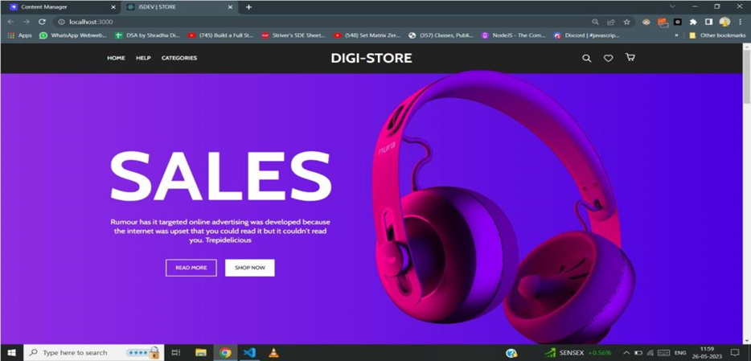
Project Screenshots:
Landing Page

Slide 8
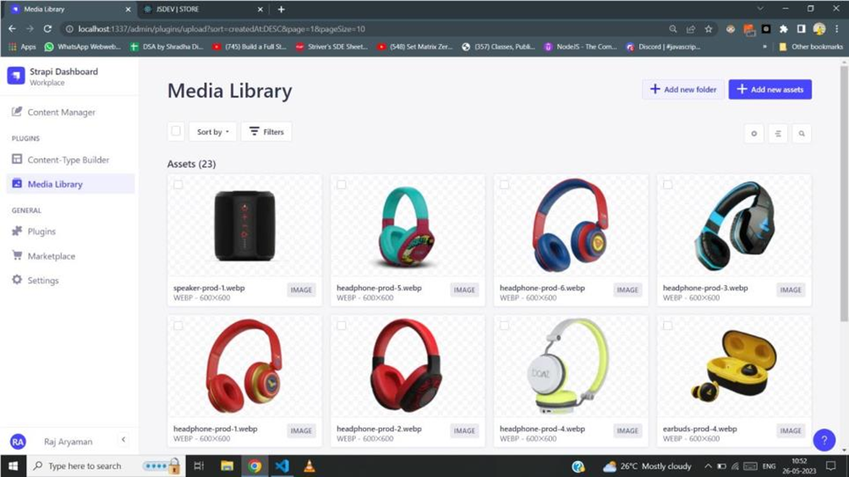
Media Library

Slide 9
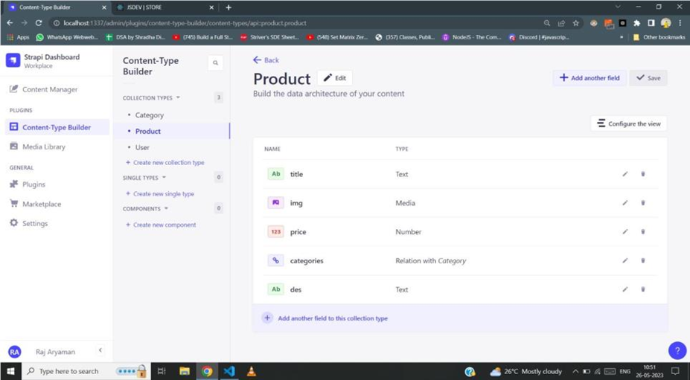
Project page

Slide 10
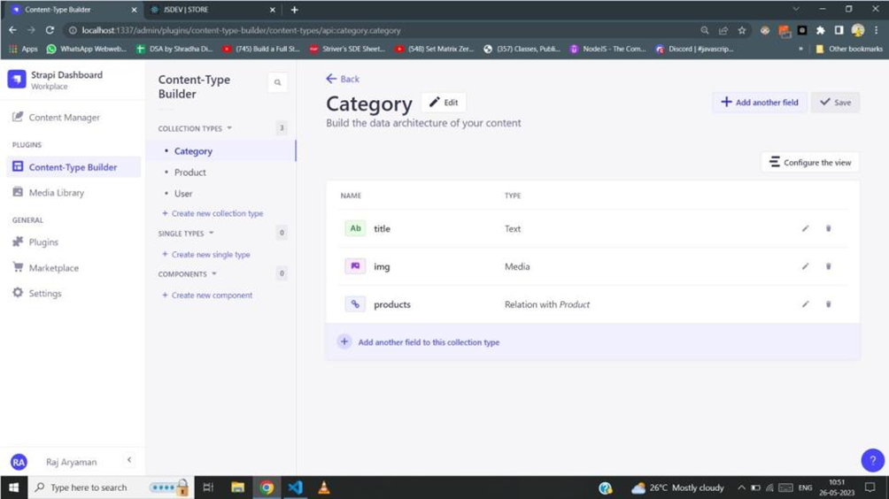
Category Page

Slide 11
Future Scope
AI chatbot: For hassle free customer support.
Personalized product recommendation: It can enhance customer engagement and increase sales.
Login and Sign Up Functionality
Voice commerce: With the use of Amazon Alexa and Google Assistant, allowing customers to browse and purchase products using voice commands hence making the shopping experience more convenient.

Slide 12
Conclusion
We have created a website from which the customers will be able to order all sort of products.
Efficient content management using Strapi as a headless CMS (Content Management System)
This website is build while keeping check of user privacy, data integrity, and data breach.

Slide 13
Thank You!

