Slide 1

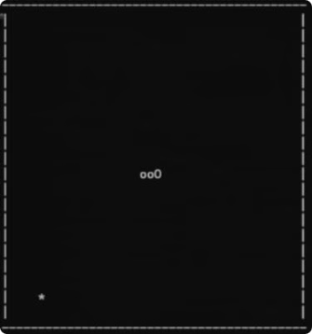
The Snake Game: A Tale of Survival and Growth
Embark on a thrilling journey with a digital serpent, navigating a world filled with challenges and rewards.
Rashad Rafid Alamgir
Rafi Saad
Riyad Ahammed Desh
Yasir Obayed

Slide 2
Embarking on the snakes epic voyage
The game's world is a 2D grid. The snake starts in the center, ready to explore. Its journey begins as it slithers through this digital landscape.

Slide 3
Functions and the header files that were used in this project:
Header Files:
1. conio.h
2. ctype.h
3. stdio.h
4. stdlib.h
5. windows.h
User defined functions:
Setup
Draw
Input
Logic

Slide 4
Making of the start
void setup() {
gameover = 0;
x = WIDTH / 2;
y = HEIGHT / 2;
frtx = rand() % WIDTH;
frty = rand() % HEIGHT;
while (frtx == 0)
frtx = rand() % WIDTH;
while (frty == 0)
frty = rand() % HEIGHT;
score = 0;
}

Slide 5
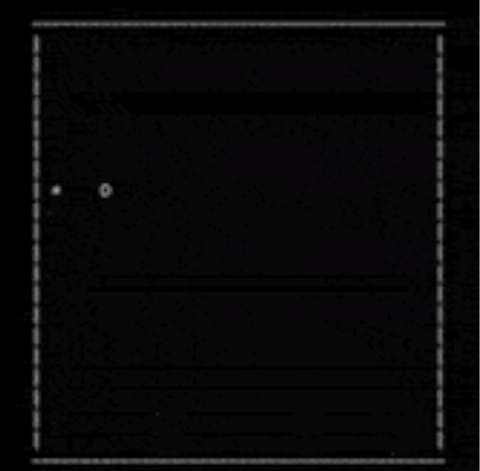
Navigating the 2D World
The game's landscape is a 40x20 grid, each cell representing a potential movement for the snake.
Horizontally
Vertically
Move left or right.
Move up or down.

Slide 6
Making of the snakes 2-D world
void draw() { system("cls"); for (int i = 0; i < WIDTH + 2; i++) printf("-"); printf("\n"); for (int i = 0; i < HEIGHT; i++) { for (int j = 0; j <= WIDTH; j++) { if (j == 0 || j == WIDTH) printf("|"); if (i == y && j == x) printf("O"); else if (i == frty && j == frtx) printf("*"); else { int prtail = 0; for (int k = 0; k < snktaillen; k++) { if (snktailX[k] == j
&& snktailY[k] == i) {
printf("o");
prtail = 1;
}
}
if (!prtail)
printf(" ");
}
}
printf("\n");
}
for (int i = 0; i < WIDTH + 2; i++)
printf("-");
printf("\n");
printf("score = %d", score);
printf("\n");
printf("Press W, A, S, D for movement.\n");
printf("Press X to quit the game.");
}

Slide 7




The Serpent's Movements: WASD Controls
Control the snake's direction on the 40x20 grid using the WASD keys. Each key press updates the snake's head coordinates (x, y), resulting in a movement of one cell.
W
A
S
D
Moves the snake's head one cell upward, decreasing the y-coordinate by 1.
Moves the snake's head one cell to the left, decreasing the x-coordinate by 1.
Moves the snake's head one cell downward, increasing the y-coordinate by 1.
Moves the snake's head one cell to the right, increasing the x-coordinate by 1.

Slide 8
How the movement works?
void input() {
if (kbhit()) {
switch (tolower(getch())) {
case 'a':
if(key!=2)
key = 1;
break;
case 'd':
if(key!=1)
key = 2;
break;
case 'w':
if(key!=4)
key = 3;
break;
case 's':
if(key!=3)
key = 4;
break;
case 'x':
gameover = 1;
break;
}
}
}

Slide 9
Boundary Constraints: Walls, Edges, and Self-Collision
The snake cannot pass through the walls or boundaries of the game world.
Walls
Impassable barriers.
Self-Collision
The snake cannot intersect itself.
Edges
Outer limits of the grid.

Slide 10
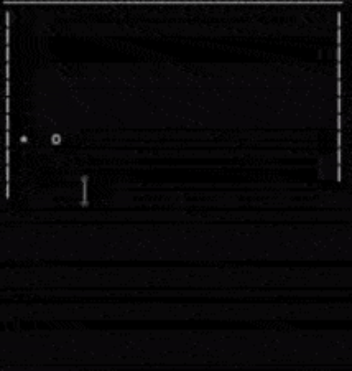
Feeding Frenzy: Collecting Asterisks for Points
The snake grows by consuming asterisks scattered throughout the game.
1
Asterisks
2
Growth
Food source for the snake.
Lengthens the snake with each consumption.

Slide 11



Random Asterisk Spawns: Keeping the Game Dynamic
Asterisks spawn randomly at different locations throughout the game.
Random
Timing
Unpredictable placement.
Spawns at varying intervals.

Slide 12

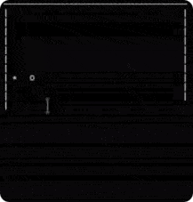
The snake's growth mechanics (adding 'o' segments)
Every time the snake consumes an asterisk, it gains an additional segment.
Consumption
Segment Growth
Asterisk
'o' segment

Slide 13
Game Pace: 40ms Updates for Smooth Animation
The game updates every 40 milliseconds to ensure smooth and fluid animation.
1
Update
Every 40ms.
2
Movement
One cell at a time.
3
Animation
Smooth and fluid.

Slide 14

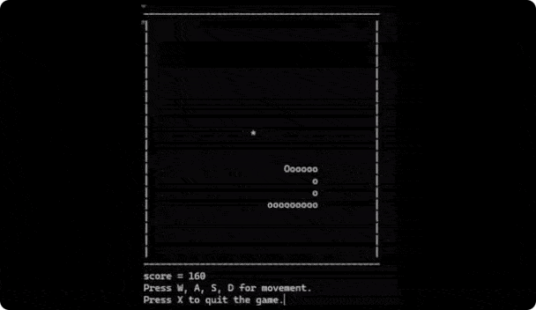
Scoring System: 10 Points per Asterisk
The player earns 10 points for each consumed asterisk.
The score board is updating each time the snake consumes an asterisk

Slide 15
Logic of the world
void logic() {
int prevX = snktailX[0];
int prevY = snktailY[0];
int prev2X, prev2Y;
snktailX[0] = x;
snktailY[0] = y;
for (int i = 1; i < snktaillen; i++) {
prev2X = snktailX[i];
prev2Y = snktailY[i];
snktailX[i] = prevX;
snktailY[i] = prevY;
prevX = prev2X;
prevY = prev2Y;
}
switch (key) {
case 1:
x--;
break;
case 2:
x++;
break;
case 3:
y--;
break;
case 4:
y++;
break;
default:
break;
}
if (x < 0 || x >= WIDTH || y < 0 || y >= HEIGHT)
gameover = 1;
for (int i = 0; i < snktaillen; i++) {
if (snktailX[i] == x && snktailY[i] == y)
gameover = 1;
}
if (x == frtx && y == frty) {
frtx = rand() % WIDTH;
frty = rand() % HEIGHT;
while (frtx == 0)
frtx = rand() % WIDTH;
while (frty == 0)
frty = rand() % HEIGHT;
score += 10;
snktaillen++;
}
}

Slide 16

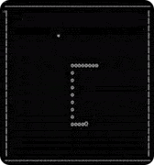
Dramatic Conclusion: Facing the Perils of the Snake's Journey
The snake's journey ends if it encounters any of the following obstacles.
1
Walls
2
Edges
Impassable barriers.
Outer limits of the grid.
3
Self-Collision
The snake cannot intersect itself.

