Slide 1


WE Connect

Slide 2


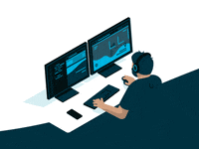
Major Project Review
Depart of Computer Science
Vaagdevi college of Engineering

Slide 3

Presented by
Banoth Srinivas
Rayaparthi Nikhil
Ainavolu Abhinav
Shabothu Saiteja

Slide 4
Professor Zareena Begum, for their valuable guidance and support throughout the project. We sincerely appreciate their expertise, patience, and dedication. Their insightful feedback and mentorship have been instrumental in shaping our project's success. We are grateful for the opportunity to work under their supervision and learn from their vast knowledge. Once again, thank you, Zareena Begum, for being an invaluable part of our project journey. Feel free to customize the slide by adding your project guide's name and any additional sentiments you'd like to express.
Thank you
our project guide

Slide 5
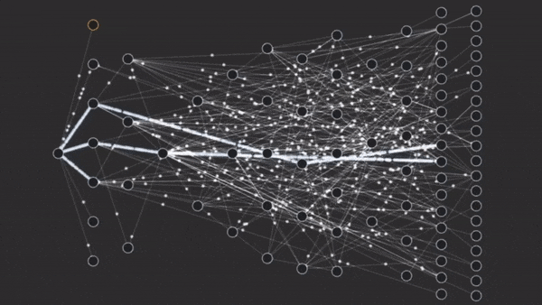

introduction
Group of minds ,connect into one stage, one space ,knowledge space.

Slide 6
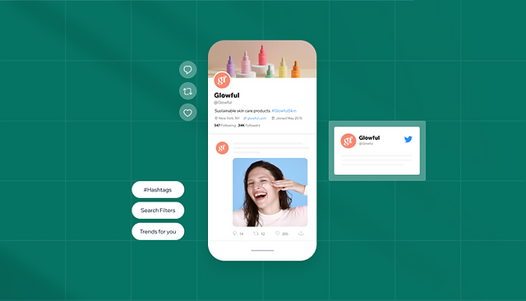
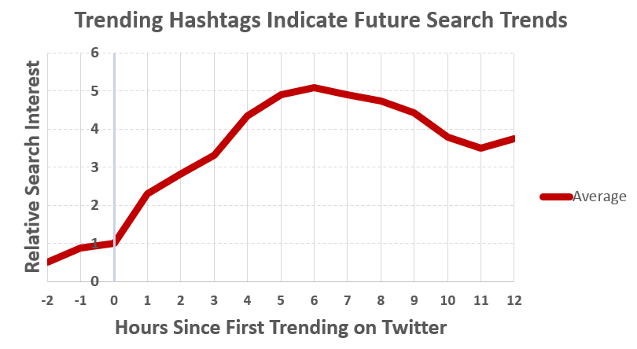
abstract
Our application which gives a space for knowledge share, ideas ,trends to the commodity.
We developed this application using react and spring boot to service for end user devices such as android, IOS, Desktop.

Slide 7
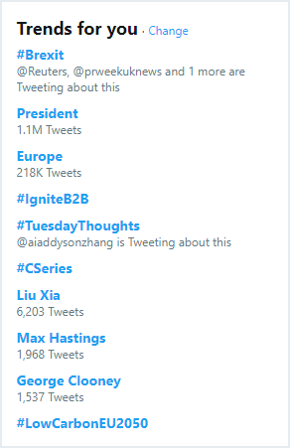
What is We connect?
We connect is an one platform where students create a commodity.
User can pin to the wall adding some tags.
These tags can be latest trending topics where commodity faces

Slide 8
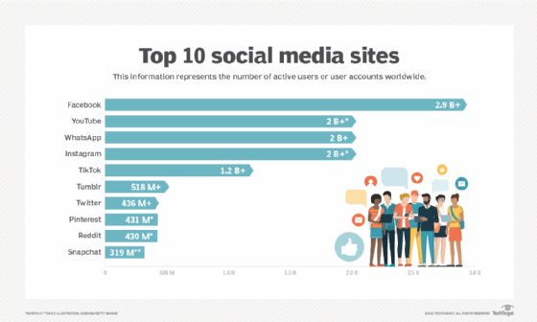
Existing Model
Small commodities such as institutions, colleges not every one use the global application.
Existing vs proposed
These model interact among the commodity.
Ideas, knowledges can be shared, new thoughts can be elevated.

Slide 9
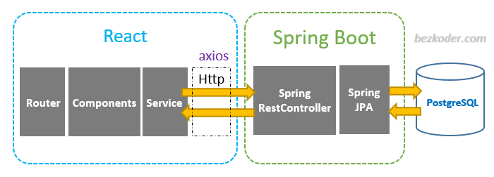
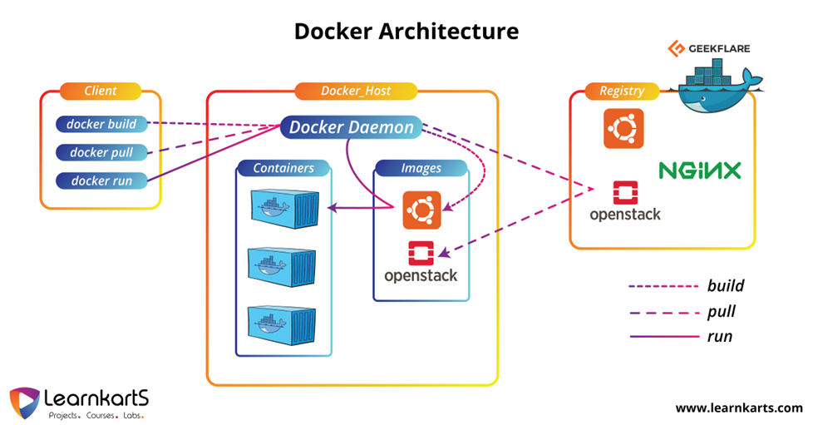
Technology
React Native
Spring boot
Postgres supabase
Docker
Kubernetes
Build -> Deployment

Slide 10


