Slide 1

Graph-to-Text Generation Using Language Models
AIL821
Guided by:
Prof. Tanmoy Chakraborty
Associate Professor, Dept. of Electrical Engineering
Associate Faculty Member, Yardi School of Artificial Intelligence
IIT Delhi
Presented by:
Rishu Raj Singh and Sonu Yadav
Yardi School of AI
IIT Delhi

Slide 2
Tasks and Presenters
Task 1: Enhancing GPT-2 (124M) for Graph-to-Text Generation
- Presented by Rishu Raj Singh
Task 2: Integrating GNNs with GPT-2 for Text Generation
- Presented by Sonu Yadav

Slide 3
Problem Statement
Investigating the effectiveness of task-specific adaptation techniques, originally designed to enhance graph-to-text generation in BART and T5 models, when applied to GPT-2 (124M).
The goal was to evaluate whether these techniques improve GPT-2's performance and to determine if it can outperform similar-sized encoder-decoder models like BART and T5.

Slide 4
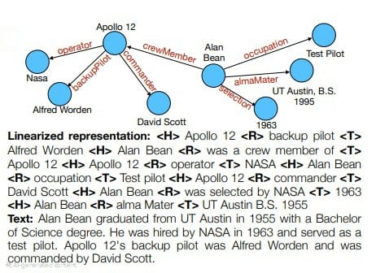
Dataset Description
WebNLG Dataset:
Contains RDF triples paired with human-written text.
Example:
<H>Eiffel Tower <R>Located <T>Paris
Output: 'The Eiffel Tower is located in Paris.'

Slide 5
Methodology
Prefix-Tuning: Encode graph structure into GPT-2.
{inp.strip()} -> {tgt.strip()} <|endoftext|>
Concatenation-Based Approach
<|startoftext|> {inp.strip()} <|endoftext|> {tgt.strip()}
Structured Inputs: Linearized RDF triples using special tokens (<H>, <R>, <T>).
inp.replace("<H>", ""), replace("<R>", ""), replace("<T>", "")
Data Augmentation: Generated more graph-text pairs.

Slide 6
Training Setup
Preprocessing:
- Tokenized RDF triples with special tokens.
- Standardized graph-text pairs.
Training Details:
- Learning Rate: 3 × 10^-5
- Epochs: 65 (early stopping at 15).
- Batch Size: 4
- Optimizer: AdamW
- Validation Metrics: BLEU, METEOR, CHRF.

Slide 7
Evaluation Metrics
BLEU: Measures fluency and correctness.
METEOR: Evaluates semantic similarity.
CHRF++: Scores fluency and grammatical accuracy.
Scores:
BLEU (All): 18.18
METEOR (All): 18.32
CHRF++ (All): 41.72

Slide 8
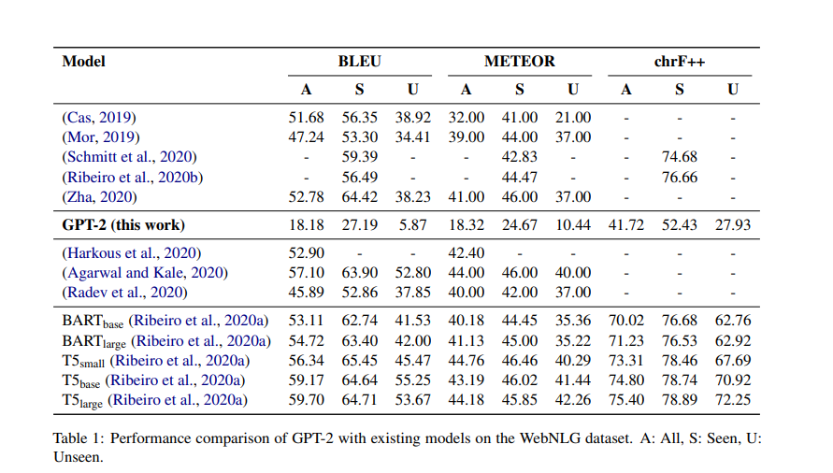
Results

Slide 9
Results and Observations
Qualitative Results:
Input: <H> Abilene Regional Airport <R> city Served <T> Abilene Texas
Output: “Thebreene Abilene,, Abilene Regional Texas is served by the Abilene regional airport. A Ab"

Slide 10
Strengths and Limitations
Strengths:
- Effective use of structured inputs and prefix-tuning.
- Improved fluency in text generation.
Limitations:
- Lower performance on unseen graph structures.
- Struggles with complex graphs.

Slide 11
Further Work
1. Enrich node representations with pre-trained embeddings.
2. Incorporate advanced GNN architectures like Graph Attention Networks.
3. Train on larger and diverse datasets to improve generalization.
4. Optimize training strategies for scalability.

Slide 12
Introduction
Purpose of the Model:
Integrating Graph Neural Networks (GNNs) with GPT-2 for text generation from graph data.

Slide 13
Model Architecture
Graph Embedding Model:
- Two-layer GCN for node embedding and graph-level feature extraction.
Text Generation Model:
- GPT-2 integrated with graph embeddings for generating descriptive text.

Slide 14
Data Processing and Training Setup
Data Parsing:
- Parsing graph data into edge_index, node features.
- Tokenizing text data using GPT-2's tokenizer.
Training Details:
- Learning Rates: lr_gnn=1e-3, lr_lm=1e-4.
- Epochs: 50, Batch Size: 16.
Evaluation Metrics:
- BLEU, ROUGE.

Slide 15
Challenges and Solutions
Graph Data Challenges:
- Handling variable graph sizes and adjusting feature dimensions.
Model Training Challenges:
- Balancing learning rates for GNN and GPT-2.
Regularization Techniques:
- Dropout and gradient clipping.

Slide 16
Results
Model Performance:
- BLEU score is 37.16
- ROUGE scores is 64.26.
Input: <H> Alan Bean <R> nationality <T> United States <H> Alan Bean <R> occupation <T> Test pilot <H> Alan Bean <R> birth Date <T> 1932-03-15 <H> Alan Bean <R> birth Place <T> Wheeler Texas <H> Alan Bean <R> time In Space <T> 100305.0minutes <H> Alan Bean <R> status <T> Retired
Prediction: Bean was a American born in March 15, 1932 in Wheeler, Texas. He was a test pilot and a a total of 100305 minutes in space. He is now retired.
Target: Alan Bean is an American born on March 15, 1932 in Wheeler, Texas. He was a test pilot and spent a total of 100305 minutes in space. He is now retired.

Slide 17
Conclusion
Integrating GNNs with GPT-2 for text generation from graph data.
got better result compare to task1, which not using GNN embedding for text generation.

Slide 18
Thank You QnA

