Slide 1
HEALTHCARE SYSTEM
Lorenzo Rocchi – 294418
Beatrice Tomassi – 295351

Slide 2
TABLE OF CONTENTS
01.
02.
03.
04.
05.
INTRODUCTION
ARCHITECTURE
HOW DOES IT WORK?
PROJECT DEMO
CONCLUSION

Slide 3
01.
INTRODUCTION

Slide 4
DOMAIN
The healthcare system operates within the medical services domain, focusing on optimizing administrative processes such as managing patient information, scheduling appointments, and maintaining medical histories.

Slide 5
INTENDED USERS
Administrative Staff of a hospital or a clinic.
In particular, the system is focused on the needs of receptionists and healthcare providers who are “behind the desk”.

Slide 6
02.
ARCHITECTURE

Slide 7
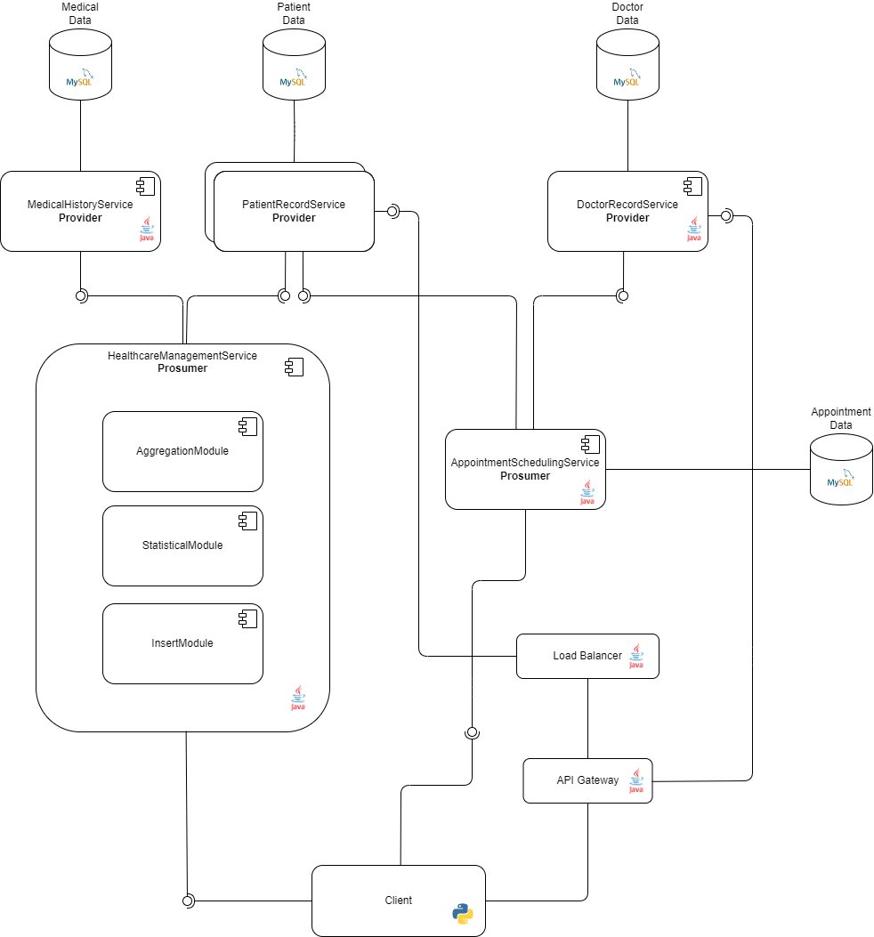
COMPONENT DIAGRAM

Slide 8
OUR SERVICES
Service Name | Type | Arch. Style | Implementation
Patient Record Service (PRS) | Provider | REST microservice | Spring Boot
Doctor Record Service (DRS) | Provider | REST microservice | Apache CXF
Medical History Service (MHS) | Provider | REST | Spring Boot
Appointment Scheduling Service (ASS) | Prosumer | SOAP | Apache CXF
Healthcare Management Service (MHS) | Prosumer | REST | Spring Boot

Slide 9
PATIENT RECORD SERVICE
The PRS provider is designed to manage all patient-related data (name, surname, CF, age, address…).
ENDPOINTS
[GET, POST] http://localhost:8080/prs/patientData
[GET, PUT, DELETE] http://localhost:8080/prs/patientData/{cf}

Slide 10
DOCTOR RECORD SERVICE
The DRS provider is designed to manage all doctor-related data (name, surname, specialization).
ENDPOINTS
[GET, POST] http://localhost:8082/drs/doctorData
[GET, PUT, DELETE] http://localhost:8082/drs/doctorData/{id}

Slide 11
MEDICAL HISTORY SERVICE
The MHS provider is responsible for storing detailed medical histories of patients, including past diseases or treatments.
ENDPOINTS
[GET, POST] http://localhost:8081/mhs/medicalRecord
[GET, PUT, DELETE] http://localhost:8081/mhs/medicalRecord/{cf}

Slide 12
APPOINTMENT SCHEDULING SERVICE
The ASS prosumer is responsible for scheduling appointments between a patient and a doctor. It’s possible to create, update, delete and retrieve appointments.
ENDPOINT
http://localhost:8083/appointmentSchedulingService

Slide 13
HEALTCARE MANAGEMENT SERVICE
The HMS prosumer contains three modules:
1. InsertModule to allow the client to communicate with the MHS provider.
ENDPOINTS
[POST] http://localhost:8084/hms/medicalRecord
[PUT] http://localhost:8084/hms/medicalRecord/{cf}

Slide 14
HEALTCARE MANAGEMENT SERVICE
The HMS prosumer contains three modules:
2. StatisticalModule to perform some analysis on the data of all patients, such as which is their average age or which is the percentage of patients without diseases.
ENDPOINTS
[GET] http://localhost:8084/hms/statistical/average-age
[GET] http://localhost:8084/hms/statistical/total-patient
[GET] http://localhost:8084/hms/statistical/gender-percentage
[GET] http://localhost:8084/hms/statistical/nodisease-percentage

Slide 15
HEALTCARE MANAGEMENT SERVICE
The HMS prosumer contains three modules:
3. AggregateModule to aggregate all the data regarding a patient, including the administrative informations provided by PRS and the medical informations contained in MHS.
ENDPOINTS
[GET] http://localhost:8084/hms/aggregateData

Slide 16
GATEWAY
Directs incoming requests to the appropriate service provider (PRS or DRS).
LOAD BALANCER
Ensures the efficient distribution of incoming requests across multiple instances of a microservice.
ENDPOINTS
[GET, POST] http://localhost:9000/prs
[GET, PUT, DELETE] http://localhost:9000/prs/{cf}
[GET, POST] http://localhost:9000/drs
[GET, PUT, DELETE] http://localhost:9000/drs/{id}

Slide 17
03.
HOW DOES IT WORK?

Slide 18
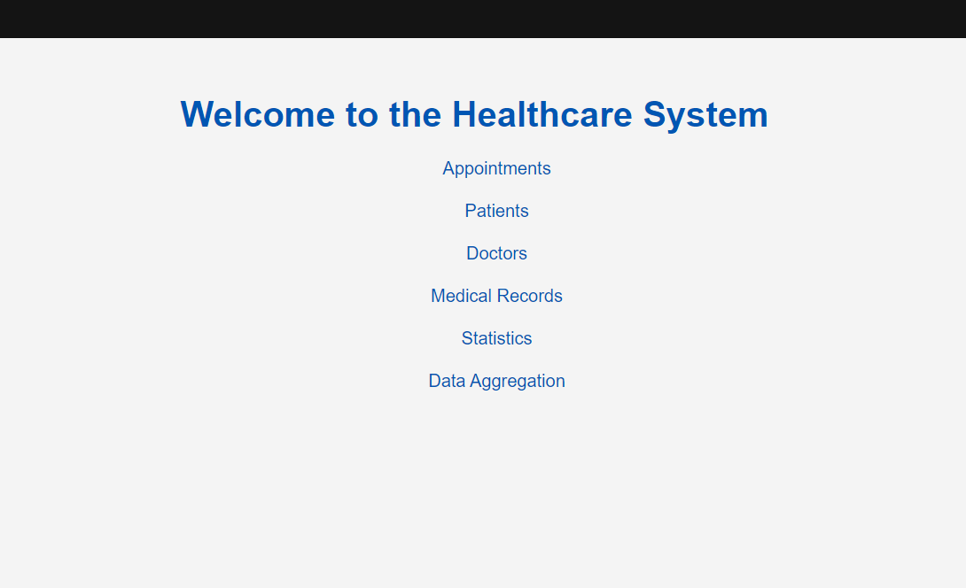
CLIENT
A client web application was built with python.

Slide 19
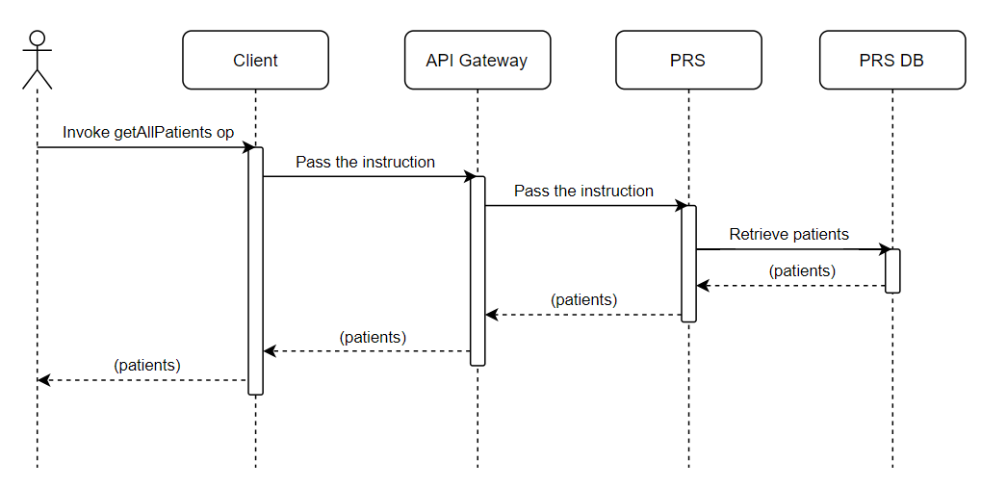
INTERACTION CLIENT - PRS
The receptionist wants to visualize all the patients registered in the system

Slide 20
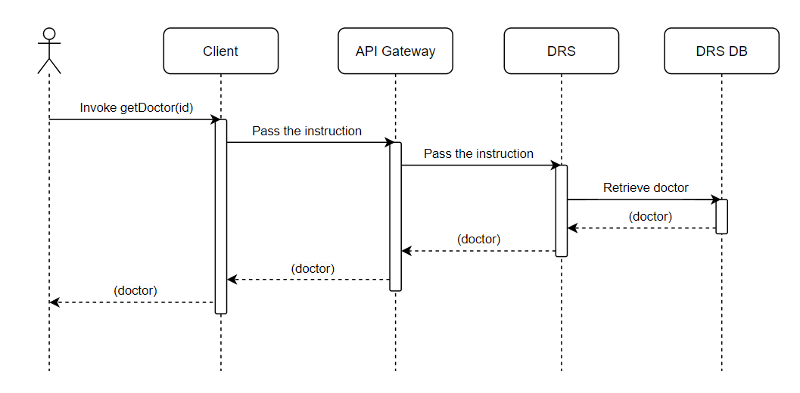
INTERACTION CLIENT - DRS
The receptionist wants to visualize the details of a single doctor

Slide 21
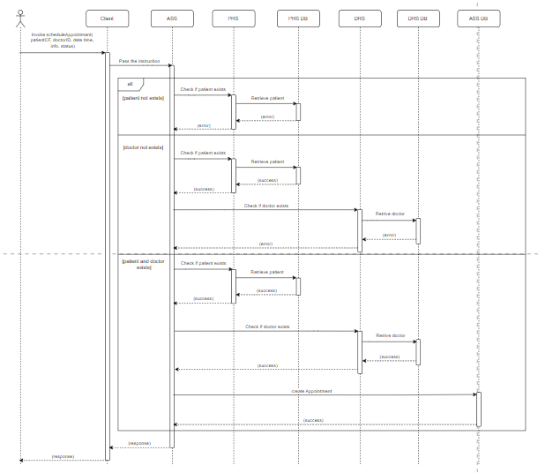
INTERACTION CLIENT - ASS
The receptionist wants to schedule a new appointment

Slide 22
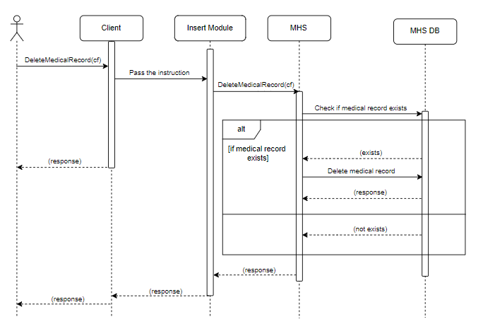
INTERACTION CLIENT – HMS (INSERT)
The receptionist wants to delete a medical record

Slide 23
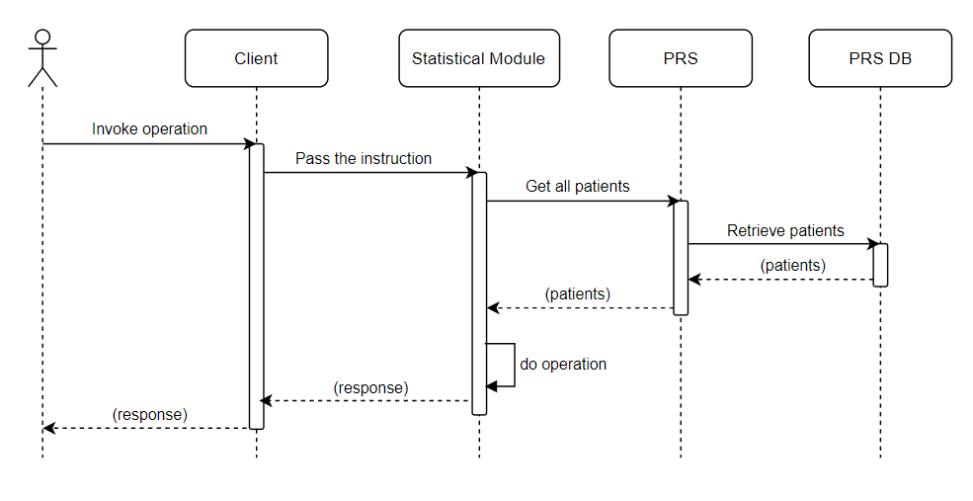
INTERACTION CLIENT – HMS (STATISTICAL)
The receptionist wants to visualize a statistic

Slide 24
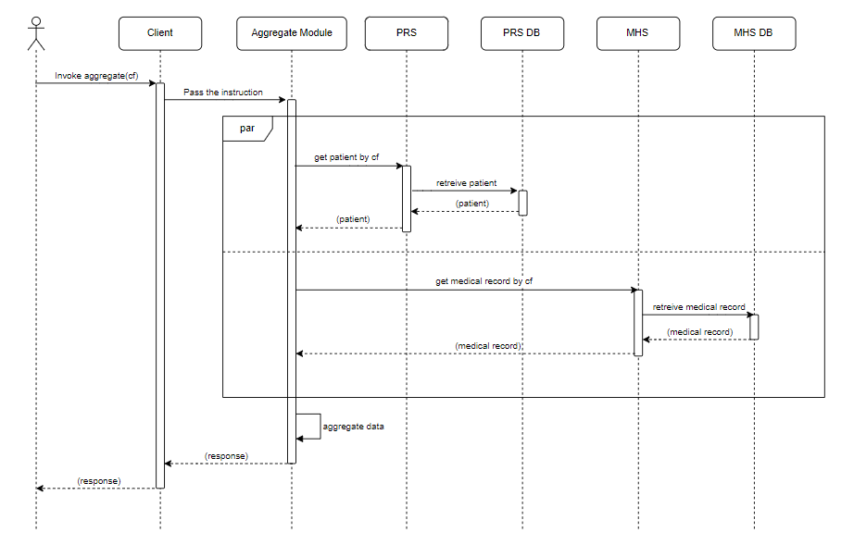
INTERACTION CLIENT – HMS (AGGREGATE)
The receptionist wants to aggregate all the informations regarding a patient

Slide 25
04.
PROJECT DEMO

Slide 26
https://github.com/itsrocchi/HealthCare-Sose

Slide 27
05.
CONCLUSION

Slide 28
MEETING THE SPECIFICATIONS
The system comprise REST and SOAP services and microservices developed with Apache CXF and Spring Boot.
It is composed of:
Providers
PRS
DRS
MHS
Prosumers
HMS
ASS
Client

Slide 29
MEETING THE SPECIFICATIONS
The interaction client-to-service pass through an API gateway.
The client interacts with two prosumers (ASS and HMS) and two providers (PRS and DRS).
One module (AggregateModule) is developed in an asynchronous way and allows two providers (MHS and PRS) to execute their job in parallel.
Microservice (PRS) can be deployed in multiple instances and their interaction is load-balanced.
The project is Mavenized and Dockerized.
The architecture and interaction scenario are shown as component and sequence diagrams.

Slide 30
THANK YOU!

