Slide 1
Supervised ML Regression BIKE SHARING DEMAND PREDICION
Capstone Project
INDIVIDUAL PROJECT :-
Name :
Rohit Bodkhe
E-mail :
rohitbodkhe6441@gmail.com

Slide 2
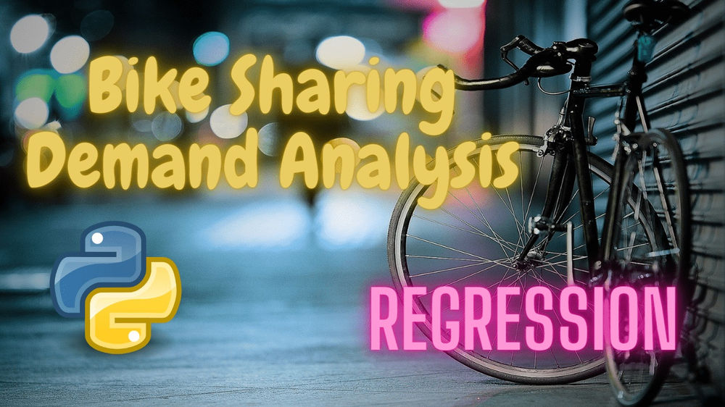
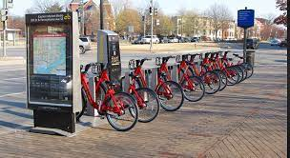

Slide 3
Description
Currently Rental bikes are introduced in many urban cities for the enhancement of mobility comfort.
It is important to make the rental bike available and accessible to the public at the right time as it lessens the waiting time.
Eventually, providing the city with a stable supply of rental bikes becomes a major concern.
The crucial part is the prediction of bike count required at each hour for the stable supply of rental bikes.

Slide 4
Data Description
Date : year-month-day
Rented Bike count - Count of bikes rented at each hour
Hour - Hour of the day
Temperature-Temperature in Celsius
Humidity - %
Windspeed - m/s
Visibility - 10m
Dew point temperature - Celsius
Solar radiation - MJ/m2
Rainfall - mm
Snowfall - cm
Seasons - Winter, Spring, Summer, Autumn
Holiday - Holiday/No holiday
Functional Day - NoFunc(Non Functional Hours), Fun(Functional hours)

Slide 5
About
Bike sharing systems are a means of renting bicycles where the process of obtaining membership, rental, and bike return is automated via a network of kiosk locations throughout a city.
Using these systems, people are able rent a bike from a one location and return it to a different place on an as-needed basis. Currently, there are over 500 bike-sharing programs around the world.
In this project, we train a model to predict the number of bike rentals at any hour of the year given the weather conditions.

Slide 6
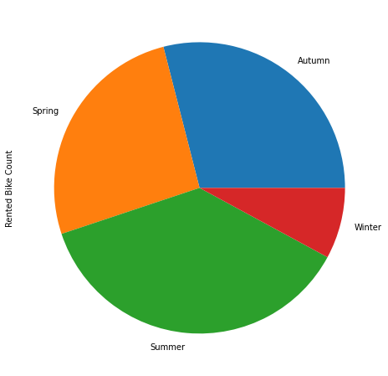
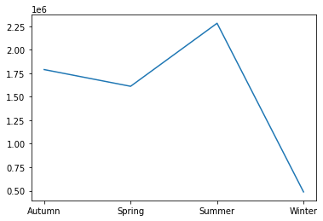
Rented Bike Count w.r.t. Seasons
Most bikes have been rented in the summer season.
Least bike rent count is in winter season.
Autumn and spring seasons have almost equal amounts of bike rent count.

Slide 7
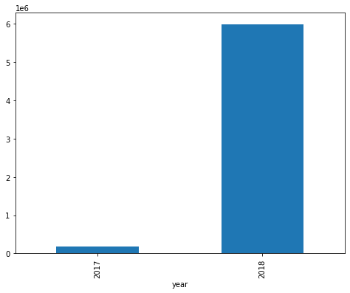
Rented Bike Count w.r.t. Year
Above plot shows that most of the bikes have been rented in the year 2018.

Slide 8
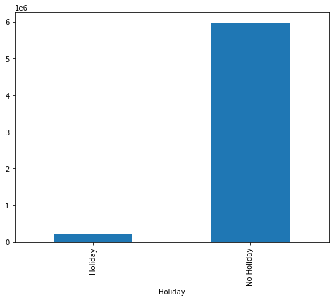
Rented Bike Count w.r.t Holiday
Above plot shows that most of the bikes have been rented on working days.
Max. people are renting the bikes on the working days as they have to come and go to the schools ,offices and other workplaces.

Slide 9
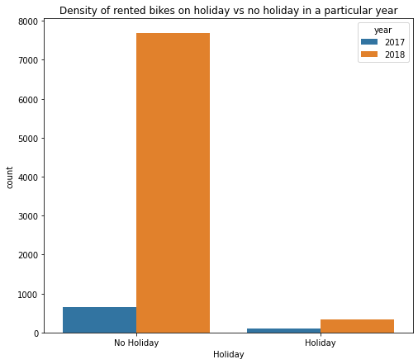
Density of Rented Bikes on Holiday in 2017 & 2018
It can be clearly seen that more bikes are rented in the year 2018 and in all the work data as compared to the data of year 2017

Slide 10
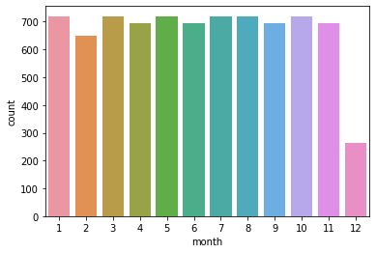
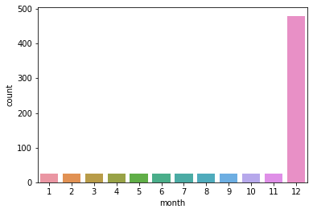
Rented Bike Count w.r.t. Months in 2017 and 2018
Above plot shows that very less bikes have been rented in december which is winter season.
Above plot shows that most bikes have been rented in december in the year 2017 as we dont have data before that.

Slide 11
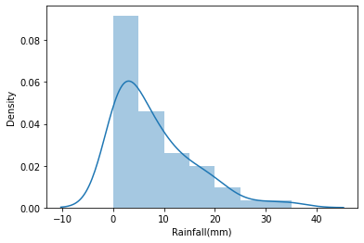
Rented Bike Count w.r.t. Rainfall
Above plot shows that people tend to rent bikes when there is no or less rainfall.

Slide 12
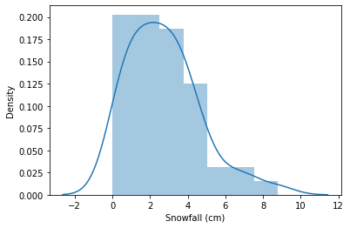
Rented Bike Count w.r.t. Snowfall
Above plot shows that people rent more bikes when there is no or less snowfall.

Slide 13
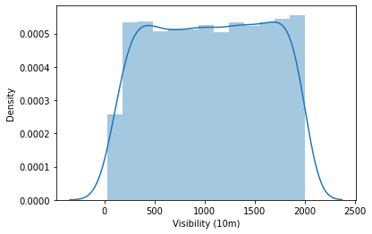
Rented Bike Count w.r.t. Visibility
Above plot shows that people rent more bikes when the visibility is between 300 to 1700.

Slide 14
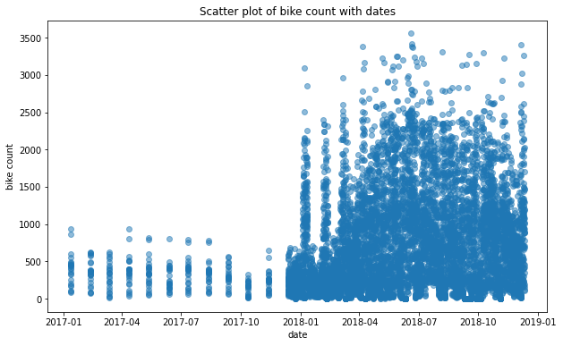
Rented Bike Count w.r.t. Dates
This is evident from the above plot that rentals increased in year 2018

Slide 15
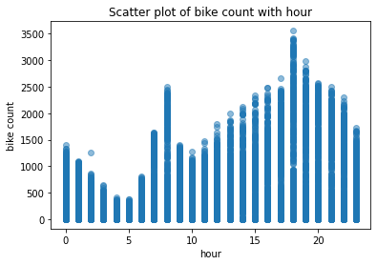
Rented Bike Count w.r.t. Hours of the Day
From above its clear that the rentals were more in the morning and evening.
This is because people who do not have personal vehicle, coming or going to offices and schools tends to rent bikes.

Slide 16
Means
MSE:- The Mean Squared Error measures how close a regression line is to a set of data points.
RMSE:- The Root Mean Square Error estimates the deviation of the actual y-values from the regression line.
R2-Score:- R² is a measure of the goodness of fit of a model. In regression, the R² coefficient of determination is a statistical measure of how well the regression predictions approximate the real data points.
Adjusted R2-Score:- Adjusted R² is a corrected goodness-of-fit (model accuracy) measure for linear models.

Slide 17
Linear Regression
Linear regression analysis is used to predict the value of a variable based on the value of another variable.
The variable you want to predict is called the dependent variable. The variable you are using to predict the other variable's value is called the independent variable.
MSE : 234427.9324728069
RMSE : 484.1775836124664
R2 : 0.4398679093079023
Adjusted R2 : 0.436650608384915

Slide 18
Lasso Regression
Lasso regression is a regularization technique. It is used over regression methods for a more accurate prediction.
This model uses shrinkage.
Shrinkage is where data values are shrunk towards a central point as the mean.
MSE : 234667.18894861892
RMSE : 484.4245957304593
R2 : 0.43929624010195667
Adjusted R2 : 0.4360756556108708

Slide 19
Ridge Regression
Ridge regression is a method of estimating the coefficients of multiple-regression models in scenarios where the independent variables are highly correlated.
It has been used in many fields including econometrics, chemistry, and engineering.
MSE : 234506.37981479266
RMSE : 484.2585877553362
R2 : 0.4396804705790264
Adjusted R2 : 0.4360756556108708

Slide 20
Conclusion
Coming from the beginning we did EDA on the dataset and also cleaned the data according to our needs.
After that we were able to draw relevant conclusions from the given data and then we trained our model on linear regression and other models .
Out of all models used , with Linear Regression model we were able to get the r2-score of 0.4398.
The model which performed poorly was Lasso Regression with r2-score of 0.4392.
Given the size of data and the amount of irrelevance in the data , the above score is good or normal we can say.

