Slide 1
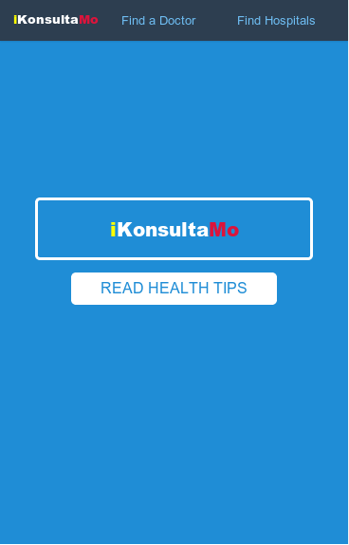

iKonsultaMo
Health and Wellness App

Slide 2
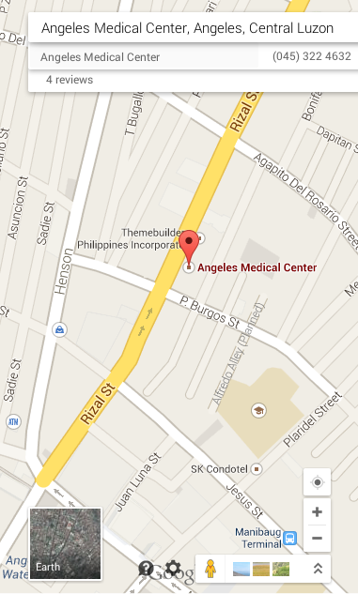
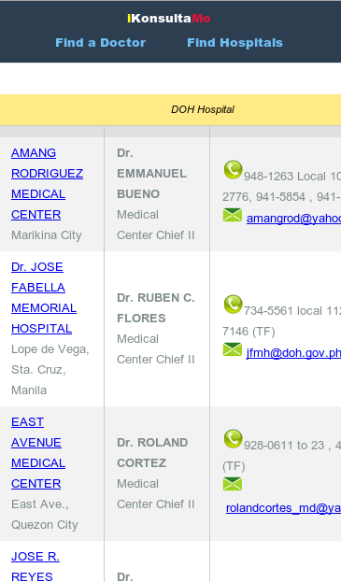
What is iKonsultaMo App ?
Inevitably, our body will deteriorate and as well as our organs. Eventually one will need professional medical services.

Slide 3


iKonsultaMo Features
Listings of Hospitals in the Philippines.
  Location Maps of Hospitals
  Nearest Hospital Routing

Slide 4


iKonsultaMo Features
Listings of Doctors in the Philippines.
  Find a Doctor feature
  Consult a Doctor via Email, SMS, Voice Call

Slide 5




iKonsultaMo Features
Watch Doctors TV Programs

Slide 6



iKonsultaMo Features
Health and Wellness Reading Materials.

