Slide 1
Overview
1- Preprocess
2- Model Specifications
Algorithm: Gradient Boosting Classifier
Preprocessing: Standard Scaler normalization
Optimization: Grid Search with 5-fold cross-validation
Target: Binary classification (Home Win vs. Away Win)
3- Create GUI

Slide 2
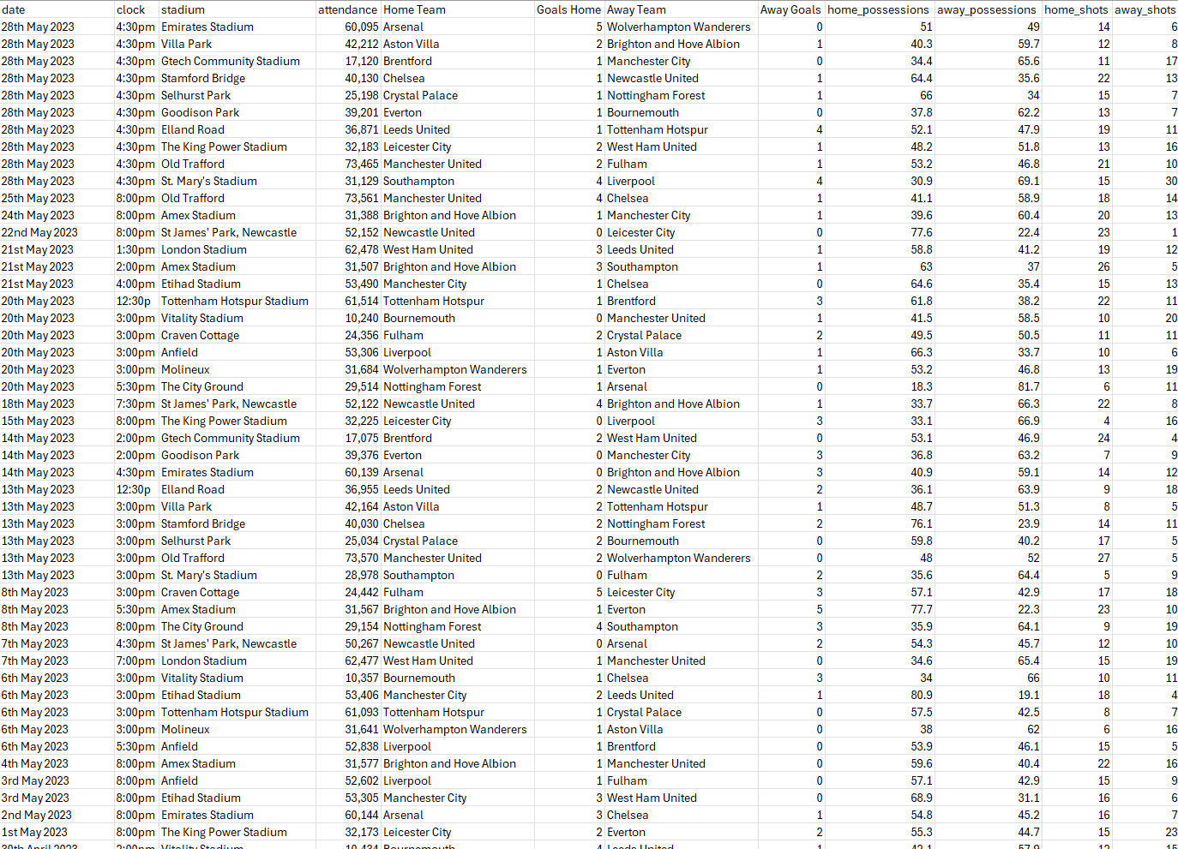
Dataset Preview

Slide 3
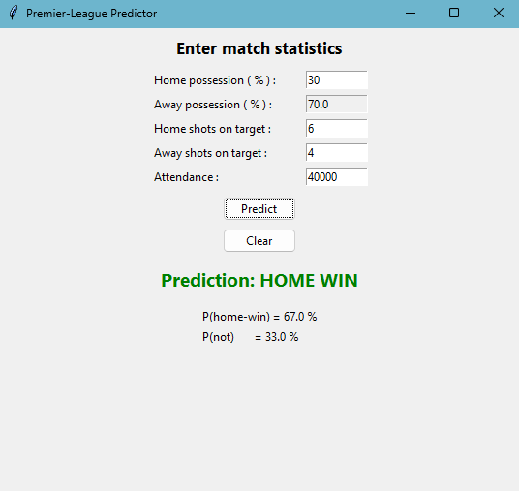
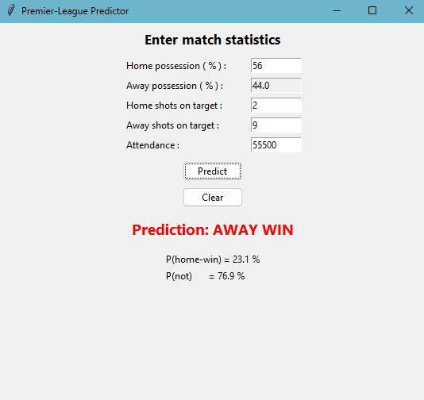
Results

