Slide 1
Project Presentation of Full Stack Engineering Project (FSE) (22CS037)
On
CODE-KARO
Supervised By : Mr. Vivek S. Parmar
Department of Computer Science and Engineering,
Chitkara University, Punjab
Team Member | Roll Number
Rudrakshi | 2210990747
Sakshi Rana | 2210990769
Samar Saini | 2210990772

Slide 2
Index
Sr. no. | Topic | Page No
1 | Introduction | 3
2 | Problem Statement | 4
3 | SW/HW Requirements | 5,6
4 | What Code-Karo Offers | 7
5 | Premium Features | 8
6 | Results | 9-16
7 | Conclusion | 17

Slide 3
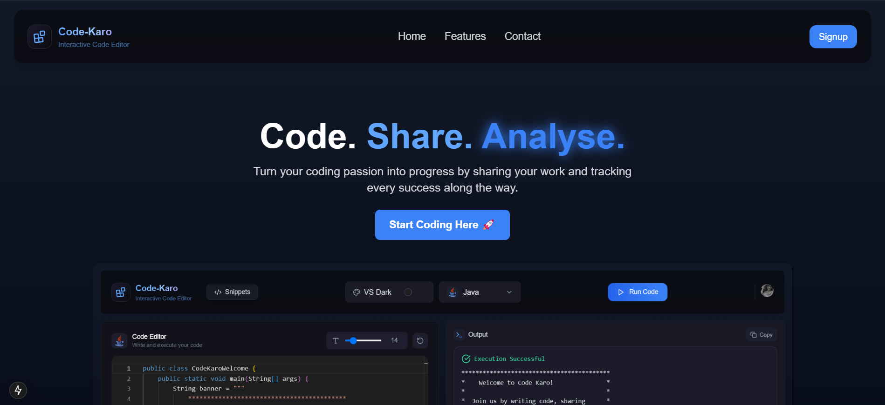
Introduction
Code-Karo is a versatile code editor meticulously designed to elevate coding experience with unparalleled flexibility and functionality. It offers robust support for 10 different programming languages, ranging from Python to Go, ensuring seamless switching between languages without ever leaving the comfort of a browser. This multi-language environment is not only versatile but also highly intuitive, making it the perfect tool for developers of all levels, from beginners taking their first steps into coding to seasoned professionals looking to streamline their workflow. Whether working on a small script or a large-scale project, Code-Karo is tailored to meet the diverse needs of developers worldwide, providing a powerful platform that enhances productivity and fosters creativity.
3

Slide 4

Problem Statement
Developers often face challenges with existing coding environments. Traditional code editors lack comprehensive multi-language support, forcing developers to switch between tools, which is inefficient. These editors also fail to provide a seamless browser-based experience, hindering on-the-go work and real-time collaboration. Personalization features like customizable themes and font sizes are often missing, reducing productivity and user satisfaction. Additionally, developers need better output handling to instantly see success or error states without complex debugging. The lack of community-driven sharing and advanced filtering/search capabilities limits the ability to discover and collaborate on code snippets, which is crucial for learning and innovation. Code-Karo addresses these issues by offering a versatile, multi-language code editor with a user-friendly interface, customizable themes, instant output feedback, and advanced sharing and search capabilities.
4

Slide 5
Software Requirements
Frontend: Utilizes NextJS for building a dynamic and responsive user interface.
Backend: Leverages NodeJS for server-side logic and API development.
Database: Uses MySQL for robust and reliable data management.
Authentication: Implements Clerk or custom JWT for secure user authentication and authorization.
Deployment: Deploys the application on platforms like AWS, Vercel, Render, and Netlify for reliable hosting.
Version Control: Employs Git and GitHub for version control and collaborative development.
IDE: Utilizes VS Code as the primary development environment for enhanced productivity.
5

Slide 6

Hardware Requirements
Processor: Any modern multi-core processor (Intel i5/i7 or AMD Ryzen 5/7)
RAM: Minimum 8 GB (recommended 16 GB for smooth development and multitasking)
Storage: Minimum 20 GB (recommended SSD for faster read/write speeds)
Graphics: Basic GPU (integrated or discrete) for handling graphical elements in UI design
Development Environment: Stable internet connection, IDEs like VS Code for coding, Git for version control, and Docker for containerized environments (if needed)
6

Slide 7
What Code-Karo Offers
💻 Online IDE with Multi-Language Support Code-Karo provides a powerful online Integrated Development Environment (IDE) that supports multiple programming languages. This browser-based environment enables seamless coding in Java, JavaScript, and C++, all within a single interface. Developers can switch between languages effortlessly, making it an ideal tool for versatile coding needs.
🎨 5 VSCode Themes Code-Karo offers five distinct VSCode themes to personalize your coding experience. These visually appealing themes allow you to customize the look and feel of your coding environment, enhancing both comfort and productivity. Choose from a variety of color schemes and styles to match your preferences and coding style.
✨ Smart Output Handling Code-Karo provides instant feedback with smart output handling. Every code run is immediately evaluated, and you can see success or error states without any guesswork. This feature ensures that developers can quickly identify and resolve issues, streamlining the coding process and improving efficiency.
⚙ Customizable Font Size Code-Karo allows you to adjust the font size in the editor to maintain comfort and readability while coding. This customizable feature ensures that you can work in an environment that suits your preferences, reducing eye strain and enhancing overall coding experience.
7

Slide 8
What Code-Karo Offers
5.🤝 Community-Driven Sharing Code-Karo fosters a collaborative environment through community-driven sharing. Developers can share, discover, and collaborate on code snippets with others worldwide, enhancing learning and innovation.
6. 🔍 Advanced Filtering & Search Code-Karo includes powerful search tools and advanced filtering options, allowing you to quickly find the exact code snippet you need. This feature saves time and increases productivity by making it easy to locate specific pieces of code.
7. 👤 Personal Profile & History Code-Karo provides a personal profile and history feature, allowing you to track every execution and monitor your growth and progress over time. This helps in maintaining a record of your coding journey and achievements.
8. 📊 Comprehensive Statistics Code-Karo offers detailed analytics and comprehensive statistics, providing insights into your performance and coding habits. This feature helps you understand your progress and areas for improvement, enhancing your overall coding experience.
8

Slide 9

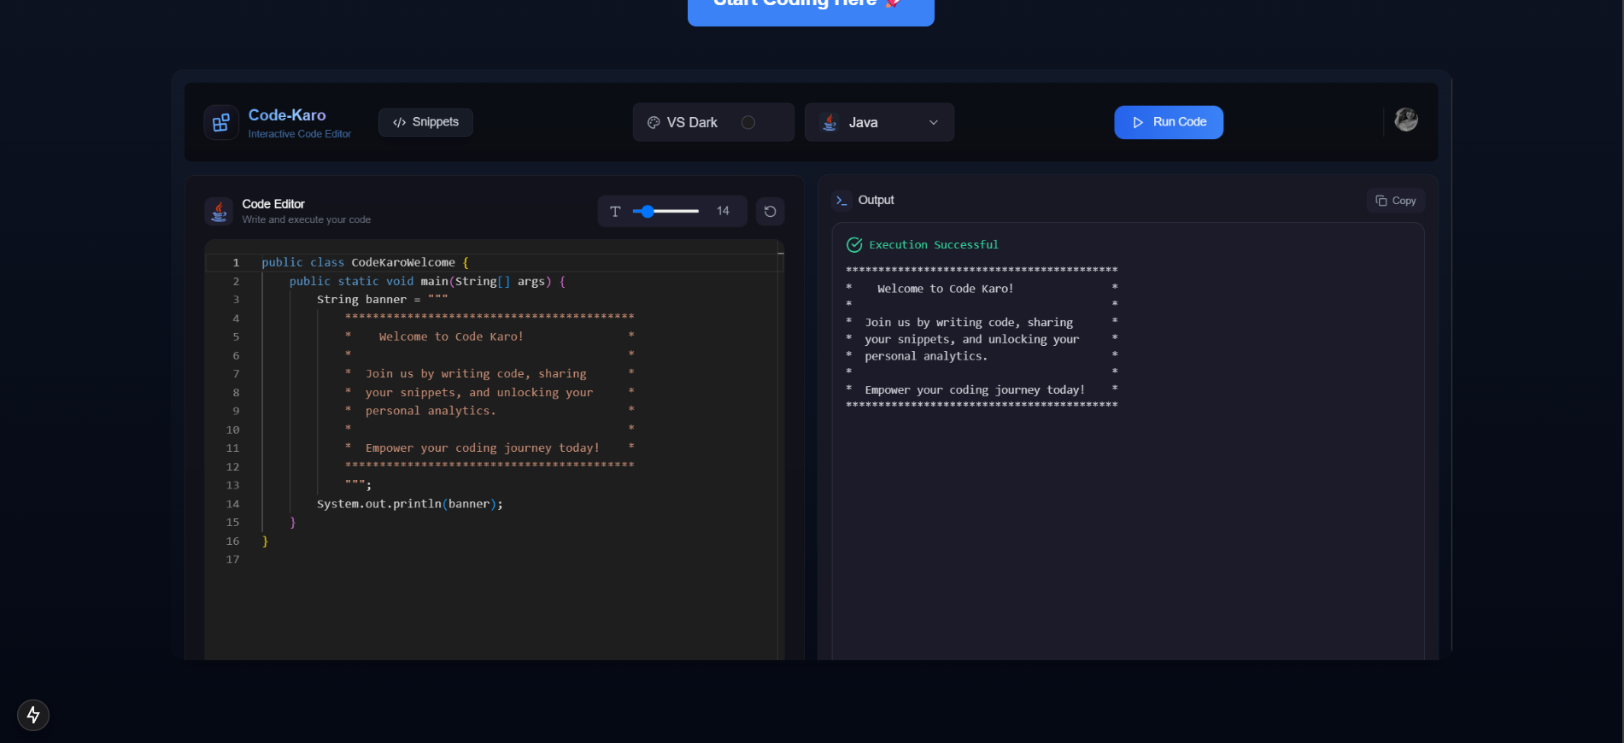
Result
Home Page:
The main entry point of Code-Karo, offering an overview of features and guiding users to get started.
9

Slide 10
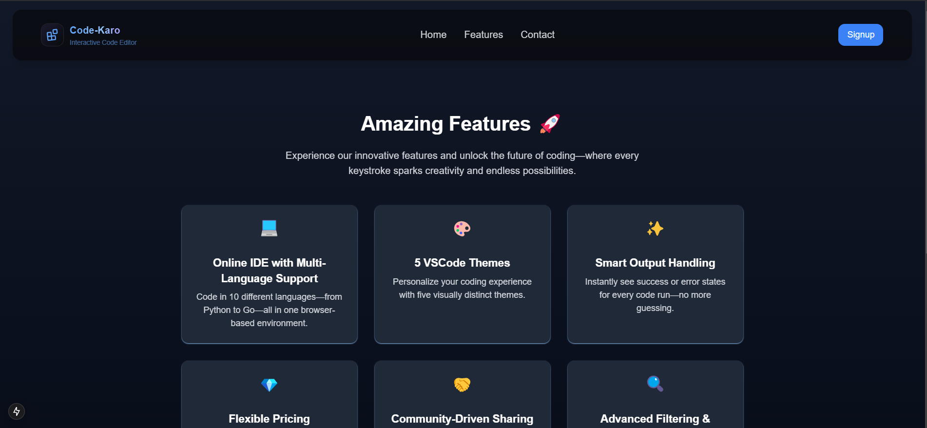
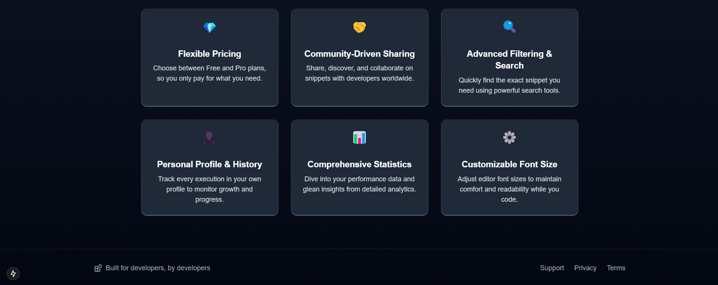
Result
Features:
Overview of Code-Karo's key functionalities and benefits.
10

Slide 11
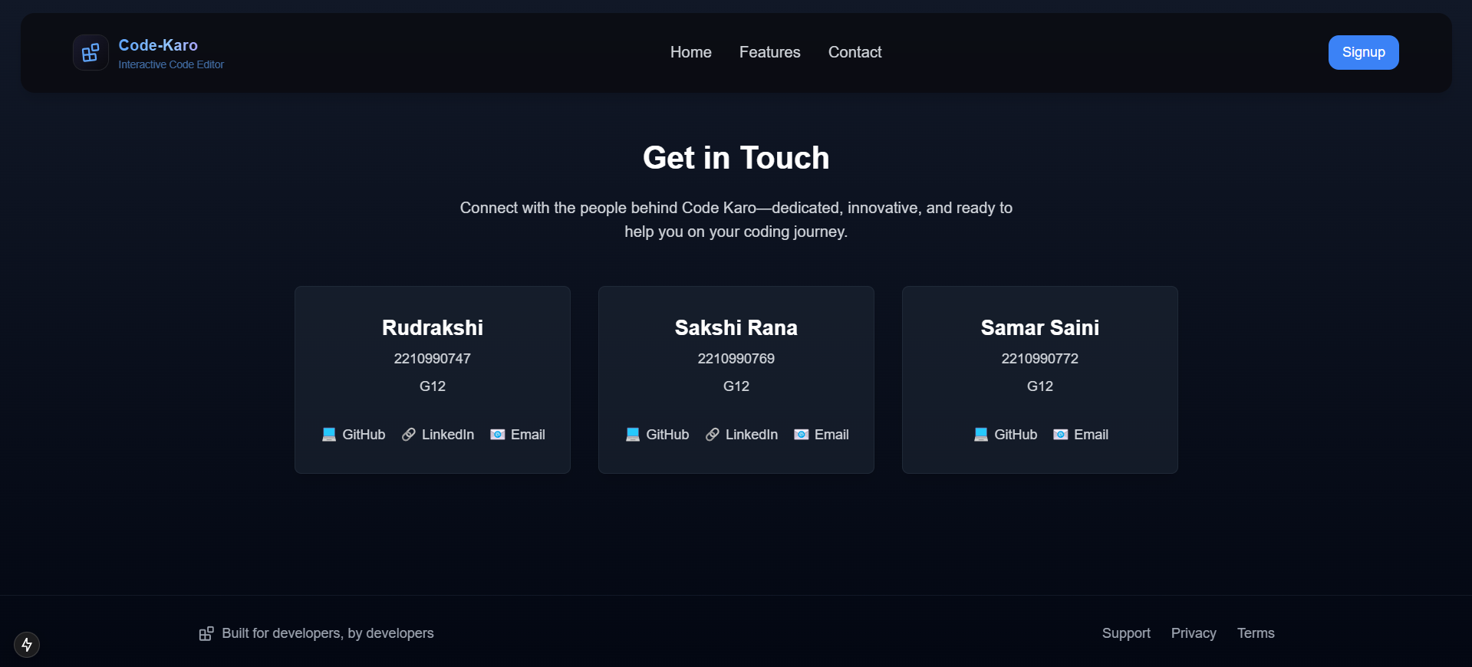
Result
Contact:
Information and support for getting in touch with Code-Karo.
11

Slide 12
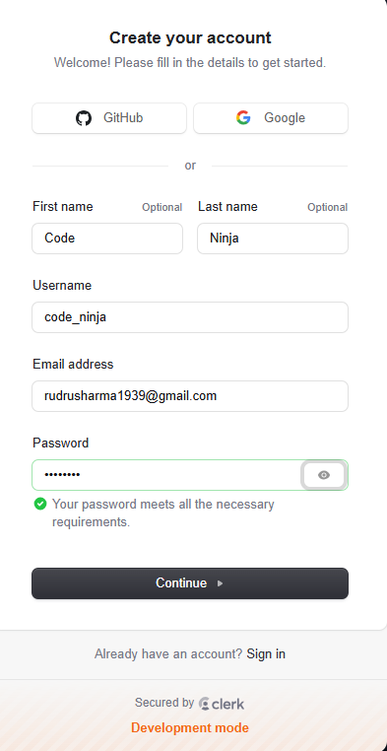
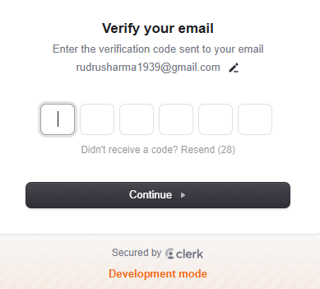
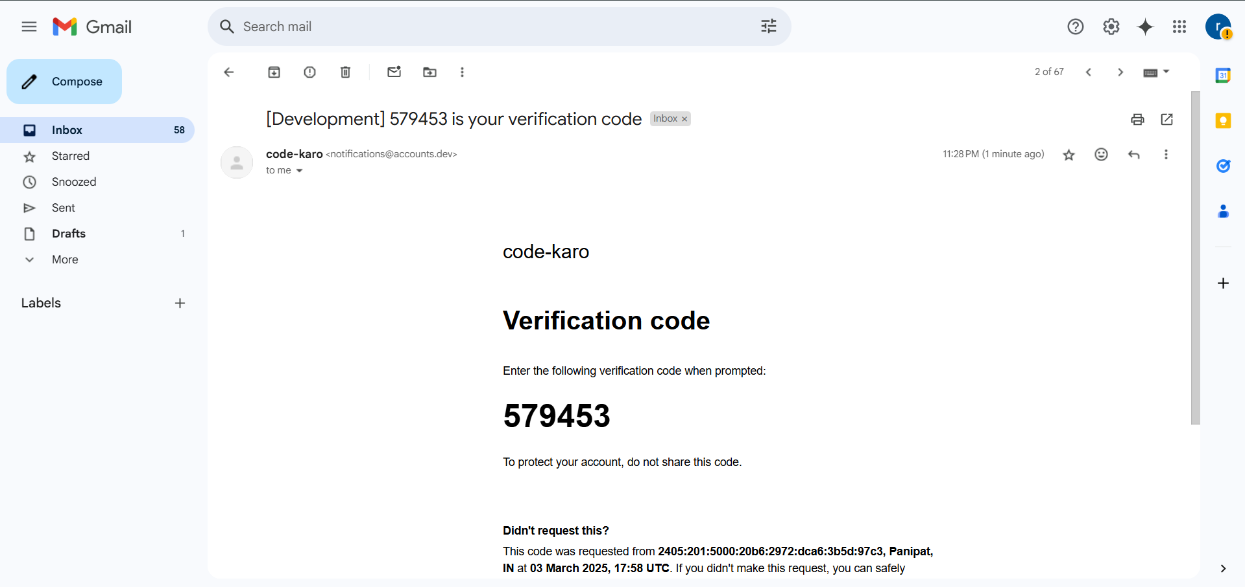
Result
Create Account with Two-Step Verification:
Securely create a new account using a two-step verification process for enhanced security.
12

Slide 13
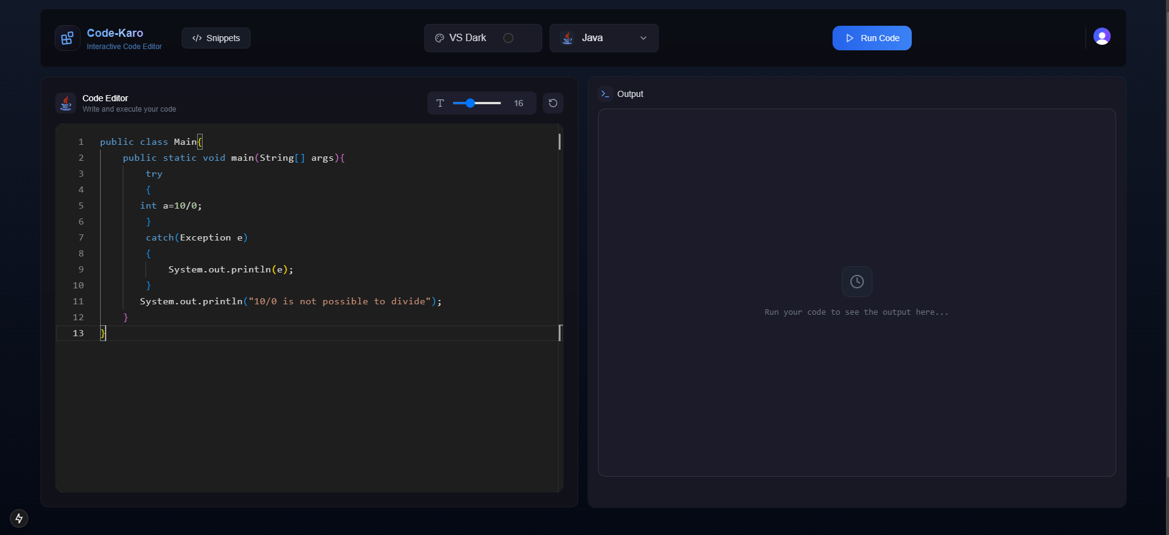
Result
Dashboard:
This is the dashboard of Code-Karo where code can be run and executed.
13

Slide 14
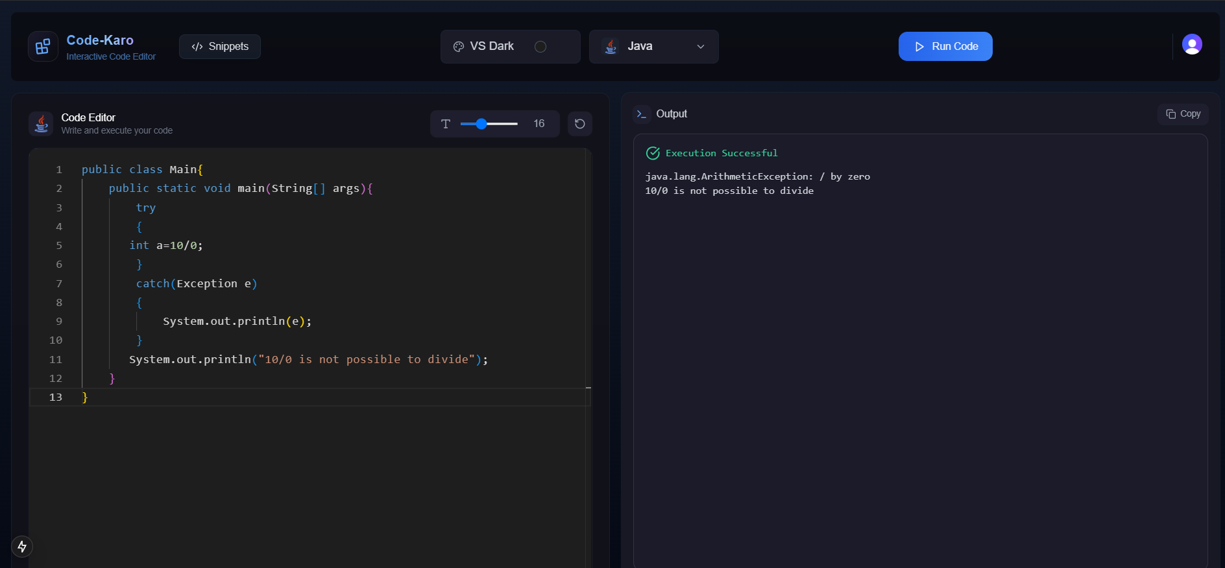
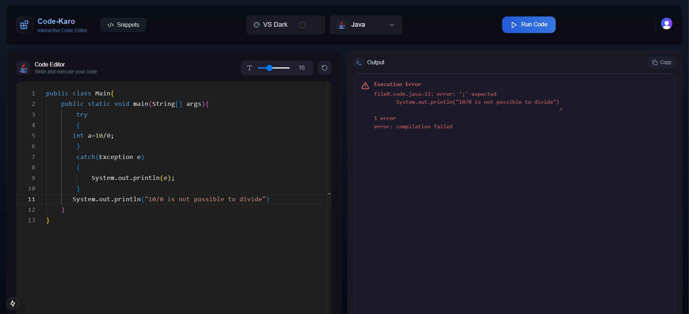
Result
Search Filter: Helps users quickly find posts and profiles for easier navigation.
Code Execution Successful:
The code ran without errors and produced the expected output.
Error in the Code:
There was an issue with the code, and it failed to execute correctly.
14

Slide 15
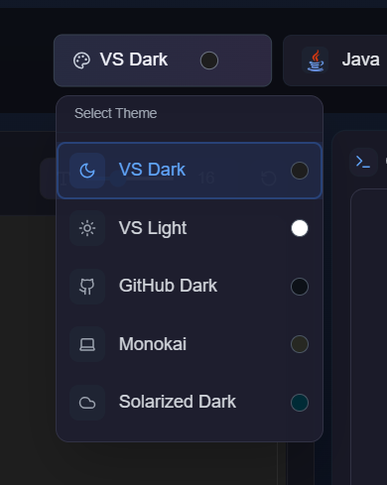
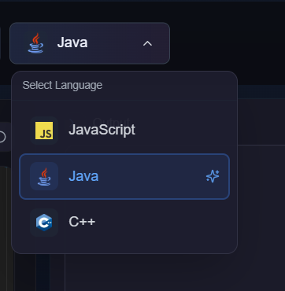
Result
Language Selector:
Choose your preferred programming language from the available options.
Theme Selector:
Customize your coding experience by selecting a theme.
15

Slide 16
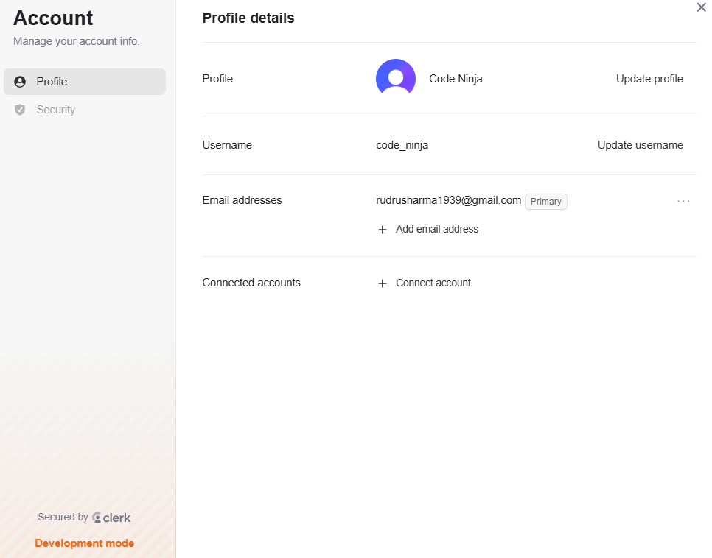
Result
Profile Update:
Manage profile information and preferences here.
16

Slide 17
Conclusion
Code-Karo has successfully delivered a versatile and user-friendly coding environment that enhances productivity and fosters collaboration. By offering multi-language support, customizable themes, and robust features like smart output handling and community-driven sharing, Code-Karo addresses key challenges faced by developers. The flexible pricing and comprehensive statistics further ensure that users can tailor their experience to meet their specific needs. As we look to the future, Code-Karo will continue to innovate and improve, driven by user feedback and the evolving needs of the developer community. We are committed to providing a platform that not only meets but exceeds the expectations of developers, making coding more accessible and enjoyable for everyone.
17

Slide 18
THANK YOU
18

