Slide 1




Team Details
SadhShre
Team Name:
SR. NO
ROLE
NAME
ACADEMIC YEAR
1
Team Leader
SHREY NAVNATH GALGALE
Third Year
2
Member 1
SADHANA BABASO KORAVI
Third Year
COLLEGE NAME
SHARAD INSTITUTE OF TECHNOLOGY COLLEGE OF ENGINEERING YADRAV , ICHALKARANJI
TEAM LEADER CONTACT NUMBER
TEAM LEADER EMAIL ADDRESS
+91 8329656344
galgaleshrey@gmail.com

Slide 2


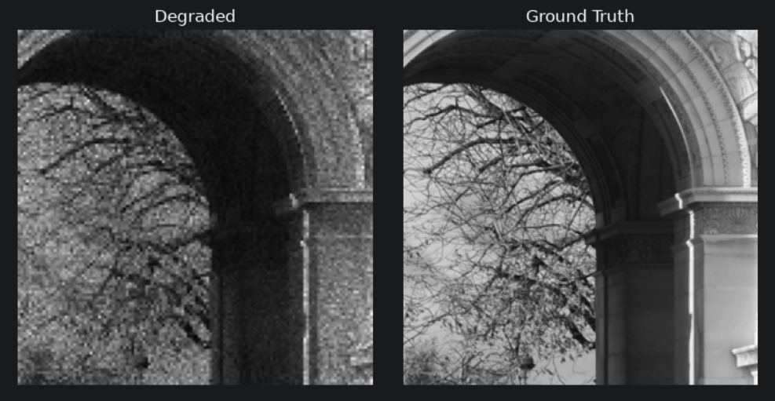
Problem Statement Addressed
AI-Based Restoration of Degraded Semiconductor Images
Semiconductor inspection relies on microscopic imaging to identify defects before production. Noise and reduced resolution can hide fine structures, making critical defects difficult to detect reliably.
Key Challenges
Noise Distortion Speckle / Gaussian noise
Resolution Loss Fine structures disappear
Structural Risk Important patterns may be distorted
False Detail Risk Restoration must not invent structures
⚠️ Core Challenge: Restore image quality without inventing false structures.

Slide 3



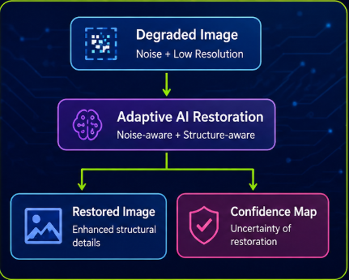
Idea Description
KEY CONCEPT & APPROACH
We propose an AI-powered image restoration system that enhances degraded semiconductor inspection images using deep learning. The system removes speckle noise, restores lost image details through super-resolution, and preserves defect integrity so that inspection systems can identify defects more accurately.
SOLUTION OVERVIEW
We propose an AI-powered image restoration system for degraded semiconductor inspection images. The system combines deep-learning-based denoising and super-resolution to suppress speckle noise, recover fine structural details, and preserve critical defect information for reliable inspection.

Slide 4

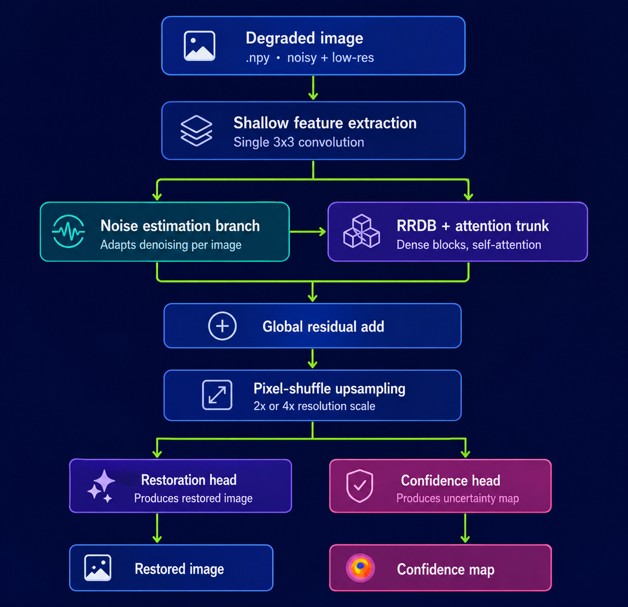
Proposed Solution
SOLUTION DETAILS
We design an adaptive restoration network that learns the degradation level and restores fine semiconductor structures while preserving important structures from the input. The model delivers two outputs: restored image and confidence map for trustworthy inspection.
Adaptive to noise level
Structure-aware restoration
Trustworthy output with uncertainty map

Slide 5
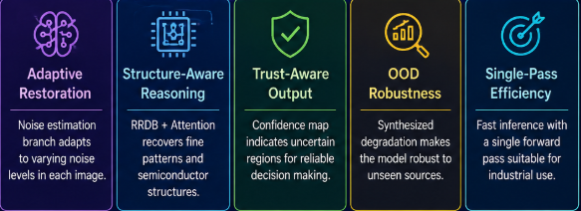
Innovation and Uniqueness
A structure-aware and uncertainty-aware restoration network designed specifically for reliable semiconductor image recovery.
KEY INNOVATION
COMPETITIVE ADVANTAGE

Slide 6



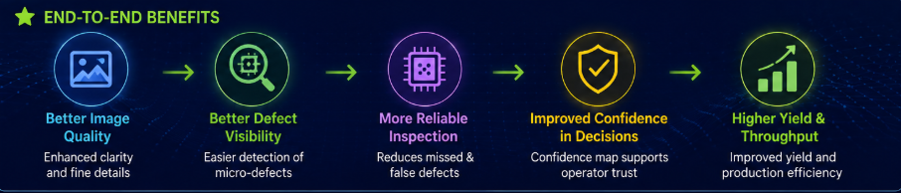
Impact and Benefits
Primary Impact
Provides cleaner, higher-resolution and structurally reliable images for semiconductor defect inspection, improving inspection confidence and potential yield.
Quantifiable Outcomes
PSNR
High image quality
SSIM
Better structural similarity
LIPPS
Improve perceptual quality
Latency
Fast , real-time capable inference

Slide 7





Technology & Feasibility/Methodology Used
✓ Custom PyTorch dataset for .npy files ✓ Per-image normalization (handles out-of-range pixel values) ✓ Synthetic degradation for OOD robustness ✓ Single-pass restoration network ✓ Evaluation using PSNR / SSIM / LPIPS
IMPLEMENTATION STRATEGY
Software Architecture
Python
PyTorch
Numpy/OpenCV
AI Restoration model
PSNR/SSIM/LIPPS
GPU-accelerated environment (Training / Benchmarking)
Development Tools
Hardware Components

Slide 8


GitHub & Video Link
GitHub Repository
https://github.com/itss-meS/LuciNoVera-Engine
Prototype / Simulation Video

Slide 9


Research and References
Research Background & Methodology
References & Citations
Our approach is inspired by recent advances in image restoration, super-resolution, and uncertainty estimation, with a focus on reliable semiconductor inspection.
Key Idea Used
✓ RRDB for deep feature learning.
✓ Windowed self attention for structural reasoning.
✓ Synthetic degradation for OOD robustness.
✓Confidence/ uncertainty estimation.
Wang et al. — Real-ESRGAN Training Real-World Blind Super-Resolution with Pure Synthetic Data ICCV, 2021.
2. Liang et al. — SwinIR Image Restoration Using Swin Transformer ICCV Workshops, 2021.
3. Zhang et al. — Beyond a Gaussian Denoiser Residual Learning of Deep CNN for Image Denoising IEEE TIP, 2017.

