Slide 1


Slide 2
SPARK CAPSTONE 301
Name: RHYTHM AHUJA
MID: M1074133

Slide 3
LEARNING JOURNEY
Course -1
Hands On Course - Python
Course - 2
Hands On Course - Spark
Course - 3
Python For Data Analysts
Course - 4
Course - 5
Hands On – PySpark
Querying Microsoft SQL Server
Course – 6
Course - 7
AWS Modern Data Platform
AWS Glue 201

Slide 4
DATASET DESCRIPTION
Brazilian E-Commerce Public Dataset by Olist
This is a Brazilian ecommerce public dataset of orders made at Olist Store. The dataset has information of 100k orders from 2016 to 2018 made at multiple marketplaces in Brazil. Its features allows viewing an order from multiple dimensions: from order status, price, payment and freight performance to customer location, product attributes and finally reviews written by customers. We also released a geolocation dataset that relates Brazilian zip codes to lat/lng coordinates.
SOURCE : Kaggle
DATASET LINK : https://www.kaggle.com/olistbr/brazilian-ecommerce/home

Slide 5
DATASET DESCRIPTION
DATASET NAME | FILE TYPE | SIZE(MB)
olist_customers_dataset | CSV | 9.03
olist_geolocation_dataset | CSV | 61.27
olist_order_items_dataset | CSV | 15.44
olist_order_payments_dataset | CSV | 5.78
olist_order_reviews_dataset | CSV | 14.45
olist_orders_dataset | CSV | 17.65
olist_products_dataset | CSV | 2.38
olist_sellers_dataset |  | 0.1747
product_category_name_ translation | CSV | 0.0026

Slide 6
TECHNOLOGIES USED
Technology | Tools
Cloud Services | Amazon Web Services
Data Storage | Amazon Simple Storage Service(S3)
Scripting Language | PySpark
Python Notebook | SageMaker
Cluster | Glue Endpoint
Serverless Interactive Query Service | Athena
Populate the AWS Glue Data Catalog with tables | AWS Glue Crawler
Serverless Data Integration Service | AWS Glue

Slide 7


SOLUTION ARCHITECTURE(Approach I)
AWS SageMaker
Notebook
(Performing ETL & Getting Solution)
Storing Datasets in
AWS S3
Saving results in
AWS S3

Slide 8





SOLUTION ARCHITECTURE(Approach II)
AWS Glue Data
Catalog
ETL Operation
S3 Storage
AWS Glue
AWS Athena
Crawler

Slide 9
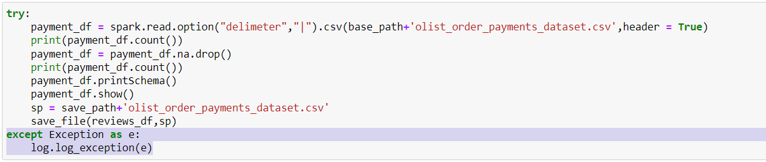
NFR : Logging Framework and Exception Handling
We log every exception which helps us better find where a certain code run failed and why exactly that problem occurred.
Whenever an exception arises it doesn’t stop the program execution whereas it is properly caught and logged for better use.

Slide 10
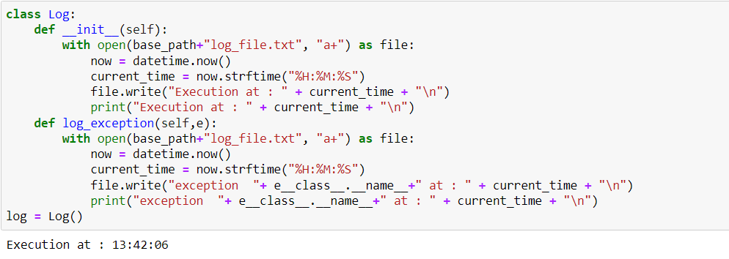
NFR: OOPs Implemnetation
We created a class for logs which handles all actions for the logging at one place.
An object of the same class can be used for calling of different type of functions related to it

Slide 11

NFR : Parameterised Implementation
Some variables are used everywhere and have to be changed frequently so instead of changing the code everywhere we can just change the value of the given varaiable and this will make the changes in your entire code.

Slide 12
KEY SPARK FEATURES
Simple to Write
Framework handles errors
Huge Number of Libraries
Extracting features from “raw” data
Scaling, converting, or modifying features
Selecting a subset from a larger set of features
Locality Sensitive Hashing (LSH)

Slide 13
VISUALISATIONS

Slide 14
CHALLENGES
Creating Right Structure through Crawlers
Apply Widgets on Databricks Community Edition
Py4JError while executing code on higher version of Python

Slide 15
THANK YOU

