Slide 1
Building an Operating System
Part 1 of 6
Integration
How the computer starts, and how programs ask it for things
[Presenter name]
[Course name] · [Date]
Notes:
Good morning. Our team built a working operating system. There are six of us, and each person explains one part. I’m the first speaker, so I’ll explain the project as a whole, and then my own part, Integration. Integration means two things: starting the computer in the right order, and giving programs one safe way to ask for things.

Slide 2

The project: a working OS
We built our own operating system: the software that runs a computer and shares it between programs.
Resource
Integration
110 of 110
tests passed
17,000
lines of code, roughly
1 virtual PC
File Handling
6 parts
Process
the same on every laptop
Made with C++, GRUB, QEMU and Ubuntu
Storage
Memory
OS Project · Integration
2
Notes:
An operating system is the software that runs a computer, like Windows or Linux. We built a small one of our own. It starts up, you log in, and you can run real programs. It has six parts, and each teammate explains one: Integration, Process, Memory, Storage, File Handling and Resource. All 110 of our automatic tests pass. It runs inside QEMU, a virtual PC, so it’s the same on every laptop and can’t harm Windows. We used C++ for the code, GRUB to start it, and Ubuntu to build it.

Slide 3
My job: the front desk
Like a college office: one counter takes every request, and sends it to the right department.
Process
Memory
Programs
make a request
Front desk
checks it and passes it on
File Handling
Storage
Resource
OS Project · Integration
3
Notes:
My part has two jobs, and the first is being the front desk. Think of a college office. You don’t walk into any department you like. You go to one counter, and they send your request to the right place. Programs work the same way. They aren’t allowed to touch the hardware themselves, so they send a request to the kernel, and the front desk checks it and passes it on. If a request is wrong or unsafe, it’s refused, and only that request fails. This keeps one bad program from damaging everything else.

Slide 4
Starting up, step by step
Programs
Login, then you can type
Files
Names and folders on the disk
Devices
Keyboard, mouse and disk
Sharing
Programs learn to take turns
Memory
Every part needs room to work
Power on
GRUB loads our kernel
OS Project · Integration
4
Notes:
My second job is starting everything in the right order. Think of a staircase: you can’t reach a step until the one below it exists. First GRUB, a ready-made tool, loads our kernel. Memory comes next, because every other part needs room to work. Then programs learn to take turns. Only then can the devices work, because waiting for the disk needs that turn-taking. Files need the disk. Programs come last, when everything they might ask for is ready. In the code this is 10 fixed steps, grouped here into 6, and that’s why the order can’t be changed.

Slide 5




What my part uses, and why
GRUB
Starts our kernel, so we needn’t write a loader
49 kinds of request, by who answers them
QEMU
Process
19
The same virtual PC on every laptop, and Windows stays safe
System call table
Files
15
One safe way into the kernel, in one place
Memory
8
Shell
The screen where people type commands
Resource
7
OS Project · Integration
5
Notes:
Here’s what my part uses, and why. GRUB is a tested tool that starts our kernel, so we didn’t have to write one. QEMU is a virtual PC: everyone gets the same machine, and a mistake can’t damage Windows. The system call table is the front desk’s list of 49 kinds of request. The chart shows who answers them: Process handles the most, then Files, then Memory and Resource. The next speakers explain each of these. Finally, the shell is the screen where people type commands.

Slide 6
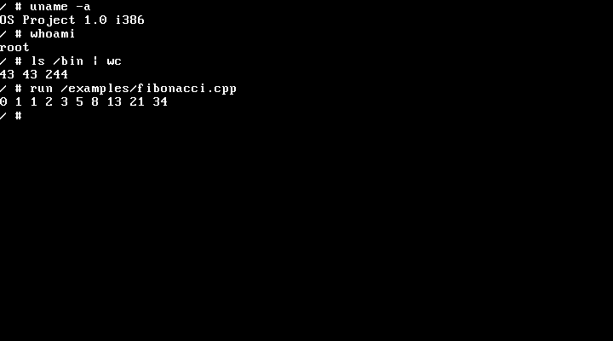
Does it work? Yes.
110 of 110 tests passed
A script boots the OS, types commands and checks the output
Compiles programs itself
The numbers on screen came from C++ compiled inside our OS
Not built yet
Network, multi-core and shutdown. Windows run: [tested or pending]
Real screen from our running OS
Next: Process Management, how one CPU runs many programs
OS Project · Integration
6
Notes:
Does it work? Yes. This is a real screen from our OS. uname gives its name, whoami shows I’m logged in as root, and ls with wc counts 43 commands. The last line is a Fibonacci program, compiled inside our own OS and then run. All 110 automatic tests pass: a script boots the OS, types commands like a person would, and checks the answers. You can type these same commands live. What isn’t built: there’s no network, it uses one CPU core, and there’s no shutdown command. Update the Windows line before presenting. Now over to Process Management, who will explain how one CPU runs many programs.

