Slide 1
Building an Operating System
Part 2 of 6
Process Management
How one computer runs many programs at the same time
[Presenter name]
[Course name] · [Date]
Notes:
Thank you. The first speaker showed how our operating system starts. I’ll explain what happens next: how one computer runs many programs at the same time. This part is called Process Management. A process simply means a program that’s running.

Slide 2

My part of the project
Our OS runs many programs, but the computer has one CPU. My part gives each program a fair turn.
Resource
Integration
4
queues, by importance
20 ms
turn for each program
64
File Handling
6 parts
Process
programs at once, at most
Storage
Memory
OS Project · Process Management
2
Notes:
Our project is a complete operating system with six parts, and mine is Process Management. Here’s the problem it solves. You may have many programs running, but the computer has only one CPU, and a CPU can do only one thing at a time. So my part gives each program a very short turn, 20 milliseconds, then moves to the next one. It’s so fast that all the programs seem to run together. There are four queues, sorted by importance, and at most 64 programs can run at once.

Slide 3
Four queues, by importance
Level 0, highest
Empty
Level 1
swapper
The CPU
One program at a time, for 20 ms each
Level 2, normal
init
sh
sleep
ps
top queue first
Level 3, lowest
Empty
Levels and programs from the ps command in our running OS.
Nobody waits forever: in our test, a level 3 thread beside a busy level 1 thread ran after 2.1 seconds.
OS Project · Process Management
3
Notes:
Our scheduler has four queues. These are the real programs in our OS, taken from the ps command. Normal programs like init, the shell, sleep and ps are at level 2. The swapper, a background worker for memory, is at level 1. The CPU always picks from the top queue that has someone in it, and each program gets 20 milliseconds. This method is called Round-Robin with priorities. To stop low-priority programs waiting forever, we use aging: after 1 second of waiting, a program moves up one level. Our aging test proved this: a level 3 thread beside a busy level 1 thread still ran after 210 ticks, which is 2.1 seconds.

Slide 4
The life of a program
Every running program moves through these five stages.
gets a turn
New
Ready
Running
finishes
Finished
Just created
In a queue
Using the CPU
Parent collects it
turn ends
the wait is over
needs the disk or a key
Waiting
Asleep, no CPU
OS Project · Process Management
4
Notes:
Every program goes through these stages. It’s created, which is New. It joins a queue, which is Ready. When its turn comes it’s Running. If its 20 milliseconds end, it goes back to Ready. If it needs something slow, like the disk or a key press, it moves to Waiting and sleeps, so it uses no CPU. When that’s done, it returns to Ready. At the end it’s Finished, and it stays as a zombie until its parent collects the result. Here’s a real example: the shell uses fork to make a copy of itself, the copy uses exec to become the new program, and the shell waits for it to finish.

Slide 5




What my part uses, and why
PCB
A file on each program, so it restarts exactly where it stopped
Two busy programs share the CPU
Scheduler
Program 1
300
Chooses who goes next, so every program gets a turn
fork and exec
Program 2
238
fork makes a copy, and exec turns it into a new program
Pipes and signals
CPU time after 4 seconds, measured in our OS, in 10 ms units. Program 2 started a little later.
Let programs pass data and alerts to each other
OS Project · Process Management
5
Notes:
Here’s what my part uses, and why. The PCB, or Process Control Block, is like a patient’s file: it records everything about a program, so it can restart exactly where it stopped. The scheduler chooses who runs next. fork and exec are how every new program starts. Doing it in two steps lets the shell set up pipes before the program begins. Pipes and signals let programs talk to each other. For example, pressing Ctrl+C sends a signal. The chart is a real measurement from our OS: two programs that never stop, both getting turns on one CPU.

Slide 6
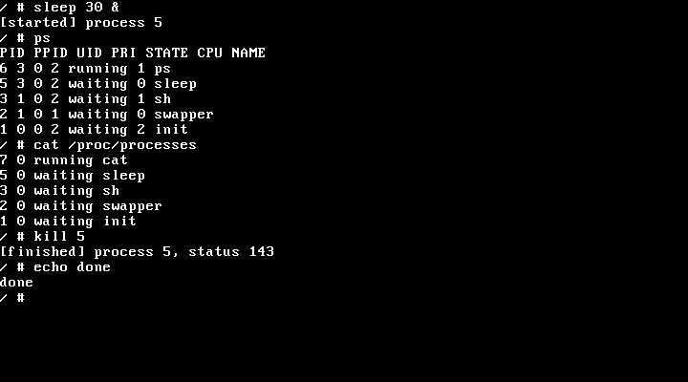
Does it work? Yes.
20 of 20 children collected
forktest left no zombie programs behind
Stopped cleanly
kill ended the sleep program with status 143
The 64-process limit holds
A program copying itself forever stops there, and Ctrl+C clears it
Not built yet
A nice command, and threads inside programs
Real screen from our running OS
Next: Memory Management, how each program gets private memory
OS Project · Process Management
6
Notes:
Does it work? Yes. This is a real screen from our OS. I started sleep in the background, and ps and /proc/processes both list it with its state. Then kill stopped it, and the shell reported status 143. Our forktest program started 20 child programs, and every one was collected with no zombies left. We also tested a program that copies itself forever. It stops at the limit of 64 processes, the kernel keeps running, and Ctrl+C clears it. If it’s started in the background, Ctrl+C can’t reach it, so we have to restart QEMU. Two things aren’t built: a nice command to change importance, and threads inside programs. Next, our Memory Management speaker will explain how each program gets its own private memory.

