Slide 1
Building an Operating System
Part 3 of 6
Memory Management
How every program gets its own private memory
[Presenter name]
[Course name] · [Date]
Notes:
Thank you. We’ve seen how programs take turns on the CPU. Each of those programs also needs memory to work in. I’ll explain how our OS gives every program its own private memory, and what happens when memory runs out.

Slide 2

My part of the project
Each program believes it has the memory to itself, and it can’t touch anyone else’s.
128 MB
Resource
Integration
of RAM
32 MB
of extra room on disk, called swap
4 KB
the size of one page of memory
File Handling
6 parts
Process
Storage
Memory
OS Project · Memory Management
2
Notes:
Our project has six parts, and mine is Memory Management. It has three goals. Each program should feel it has memory to itself. No program should be able to touch another’s memory. And programs should be able to use more memory than the RAM installed. Our virtual PC has 128 MB of RAM, plus 32 MB of extra room on the disk, called swap. Memory is handled in small pieces of 4 KB, called pages.

Slide 3
Each program’s private 4 GB map
Code and heap
Shared
Extra memory (mmap)
Stack
Kernel: top 1 GB
0x08048000
0x40000000
0xC0000000
1 MB
Program code starts here
Shared memory starts here
The kernel starts here
Largest stack, just below the kernel
Programs use the same addresses, but page tables send each one to different RAM. Only the kernel part is the same in all of them.
Tested: writing to kernel address 0xC0100000 ended that program with status 139, and the OS carried on.
OS Project · Memory Management
3
Notes:
This bar is the real memory map of every program in our OS. Code starts at 0x08048000, shared memory at 0x40000000, and the kernel takes the top 1 GB from 0xC0000000. The stack can reach 1 MB, so it’s drawn much wider than its real size to keep it readable. Every program uses these same addresses, and only the kernel part is the same in all of them. So how do they stay apart? Each program has its own page tables, which send its addresses to different places in RAM. You can think of it as a hotel where every key says Room 1, and the front desk sends each guest to a different room. Our forktest proves the protection works: a program that writes to kernel memory ends with status 139, and only that program stops.

Slide 4


When RAM gets full
The limits in our OS
The Clock method picks who leaves
Start moving pages to disk
Used recently: it gets a second chance
80%
Not used recently: it moves to swap on the disk
Stop moving pages
70%
18,356 KB
of swap in use at the peak of our 110 MB test
The gap stops the OS swapping back and forth around one number.
OS Project · Memory Management
4
Notes:
What if programs want more memory than the RAM has? Some pages move to swap, a part of the disk. A background worker called the swapper starts moving pages when RAM reaches 80 percent full, and it stops at 70 percent. That gap stops it moving pages back and forth around one number. To choose which page leaves, we use the Clock method. If a page was used recently, it gets a second chance. If not, it moves to swap. If that page is needed later, the OS quietly brings it back from the disk. In our 110 MB test, 18,356 KB of swap was in use at the peak.

Slide 5




What my part uses, and why
Page tables
Give each program its own private map of memory
A 110 MB test on our 128 MB PC
Demand paging
Brought in
56,346
Loads a page only when it’s needed, so programs start fast
Clock
Moved out
32,760
Chooses which page to move out when RAM is full
Slab allocator
Pages counted by swaptest in our OS. Every value read back correctly.
Reuses ready-made slots for the kernel’s own objects
OS Project · Memory Management
5
Notes:
Here’s what my part uses, and why. Page tables are the private map for each program. Demand paging means a page loads only when it’s first needed, so programs start quickly and unused pages take no RAM. The Clock method chooses what to move out. The slab allocator is for the kernel itself: it keeps making same-sized objects, so reusing ready-made slots is fast and wastes little. The chart is a real test. A program used 110 MB on our 128 MB PC. In this run, 56,346 pages were brought in, and 32,760 were moved out to disk. Afterwards, every value read back correctly.

Slide 6
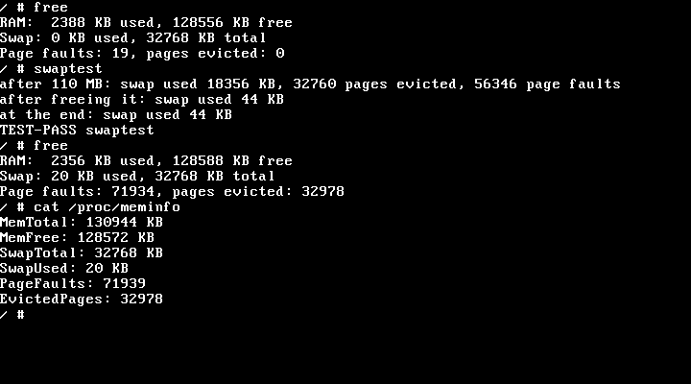
Does it work? Yes.
110 MB test passed
Pages went to disk and came back with every value correct
Memory was given back
Swap fell from 18,356 KB to 44 KB after the test freed it
Mistakes stay contained
A 240 MB program ran out of memory, and the OS carried on
Not built yet
Copy-on-write, so copying a big program is slower
Real screen from our running OS
Next: Storage Hierarchy, how data stays fast and safe
OS Project · Memory Management
6
Notes:
Does it work? Yes. This is a real screen from our OS. At the top, free shows the memory in use. swaptest then used 110 MB, and the pages went out to the disk and came back with every value correct. Afterwards, swap fell from 18,356 KB to 44 KB, so memory was really given back. /proc/meminfo shows the same numbers as a file. We also ran a 240 MB program, which is more than our RAM and swap together. It printed out of memory and stopped, and the OS kept running. One thing isn’t built: copy-on-write. Next, our Storage Hierarchy speaker will explain how data stays fast and safe.

