Slide 1
Building an Operating System
Part 4 of 6
Storage Hierarchy
Where our OS keeps data, so it stays fast and safe
[Presenter name]
[Course name] · [Date]
Notes:
Thank you. The last speaker explained memory, which is lost when the power goes off. My part is about where data is kept for the long term, and how the OS keeps it fast to reach and safe. Every number I show comes from our running OS.

Slide 2

My part of the project
My part divides the disk, speeds up reading, and gives memory extra room.
113 MB
Resource
Integration
disk, in 3 partitions
128
disk blocks kept in RAM (512 KB)
32 MB
of swap for memory
File Handling
6 parts
Process
Storage
Memory
OS Project · Storage Hierarchy
2
Notes:
Our project has six parts, and mine is Storage Hierarchy. RAM is fast but small, and it’s emptied when the power goes off. The disk is big and keeps data, but it’s slow. My part connects them. It divides our 113 MB disk into three partitions. It keeps 128 recently used disk blocks in RAM, so repeat reads are fast. And it gives memory 32 MB of swap, which is extra room on the disk.

Slide 3
Our disk, drawn to scale
Kernel: 16 MB
Swap: 32 MB
User files: 64 MB
The thin dark strip on the left is the 1 MB boot area.
How full the user files partition is, from the df command
Used: 16%
65,536 KB
10,468 KB
55,068 KB
total size
used
free
OS Project · Storage Hierarchy
3
Notes:
This is our real disk, drawn to scale. It starts with a small boot area, then 16 MB for the kernel, 32 MB of swap, and 64 MB for user files. Keeping them apart means a full user disk can’t damage the kernel or swap. The second bar shows how much of the user files partition is in use. These numbers come straight from the df command in our OS: 65,536 KB in total, 10,468 KB used and 55,068 KB free, which is about 16 percent used.

Slide 4
Reading the same data twice
First read
0
Program asks
Not in cache
Read the disk
Keep a copy
disk reads on the second read, measured in our boot test
Second read
Program asks
Found in cache
Done, without touching the disk
Saving is write-through: every save goes to the disk at once, so a crash loses less.
OS Project · Storage Hierarchy
4
Notes:
The disk is much slower than RAM, so we avoid reading it twice. The buffer cache keeps the last 128 disk blocks in RAM. The first time a program asks for data, it isn’t in the cache, so we read the disk and keep a copy. The second time, it’s found in the cache, and the disk isn’t touched. This is measured: our disk test printed “disk reads on the second read: 0”. For saving we use write-through, so each save reaches the disk at once. It’s slower than waiting, but a crash loses less.

Slide 5




What my part uses, and why
Partition table
Keeps the kernel, swap and user files apart
Swap during our 110 MB memory test
Buffer cache
Swap size
32,768 KB
Repeat reads don’t have to wait for the disk
Write-through
At the peak
18,356 KB
Saves reach the disk at once, so a crash loses less
After freeing
44 KB
Swap
Holds pages of memory when RAM gets full
Measured with swaptest in our OS. Swap slots are given back after use.
OS Project · Storage Hierarchy
5
Notes:
Here’s what my part uses, and why. The partition table keeps the three areas apart. The buffer cache saves repeat disk reads. Write-through means saves reach the disk at once. Swap holds pages of memory when RAM fills up. The chart is a real run of our swaptest program. Swap holds 32,768 KB. At the peak, 18,356 KB of it was in use. After the test freed its memory, only 44 KB was left, which shows swap slots are given back and not lost.

Slide 6
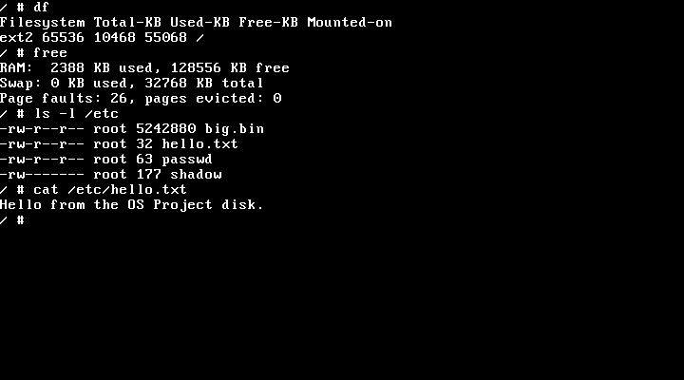
Does it work? Yes.
110 of 110 tests passed
Including the disk, cache and swap checks
Linux agrees our disk is clean
The e2fsck tool found no errors after our OS wrote files
Saved files survive a restart
A file written in one run was read back in the next
Not built yet
A crash journal, or a disk scheduling method
Real screen from our running OS
Next: File Handling, how disk blocks become files and folders
OS Project · Storage Hierarchy
6
Notes:
Does it work? Yes. This is a real screen from our OS. df shows the disk, free shows memory and swap, and cat reads a file from the disk. All 110 automatic tests pass. After our OS writes files, the real Linux tool e2fsck checks the disk and finds no errors. And a file written in one run was read back after a restart. To show it live, type df, free and cat /etc/hello.txt. Two things aren’t built: a crash journal, so a crash in the middle of a save could leave errors, and a disk scheduling method. Next, our File Handling speaker will explain how these disk blocks become files and folders.

