Slide 1
Building an Operating System
Part 5 of 6
File Handling
How disk blocks become named files and folders
[Presenter name]
[Course name] · [Date]
Notes:
Thank you. We’ve just heard how data stays fast and safe on the disk. But the disk only knows numbered blocks, and people use names like /etc/passwd. I’ll explain how our OS turns those blocks into files and folders, and how it decides who may open them.

Slide 2

My part of the project
A disk only knows numbered blocks. My part gives them names, folders and owners.
4 KB
Resource
Integration
the size of one disk block
64 MB
of disk space for our files
256
files one program can have open at once
File Handling
6 parts
Process
Storage
Memory
OS Project · File Handling
2
Notes:
Our project has six parts, and mine is File Handling. A disk only stores numbered blocks. Nobody could use a computer by remembering block numbers, so my part adds names, folders, owners and permissions. Our disk is split into blocks of 4 KB. We have 64 MB of disk space for files, and each program can have up to 256 files open at once. Our main filesystem follows the real ext2 format used by Linux, so Linux tools can build and check our disk.

Slide 3
One way to reach four kinds of files
Every program uses the same open and read calls
The VFS layer sends each call to the right place
/
/dev
/tmp
/proc
Saved on the disk
Hardware as files
Kept in RAM
Made when you read it
bin, etc, home. Still there after a restart
console, input, null, mouse
Fast scratch space, gone after a restart
meminfo, uptime, processes, date, diskinfo
OS Project · File Handling
3
Notes:
Not every file in our OS lives on the disk. These are the four real kinds, with the real names from our OS. The main folders are saved on the disk. /dev makes hardware look like files. /tmp is kept in RAM, so it’s fast, but it’s gone after a restart. /proc doesn’t store anything: the kernel makes the text at the moment you read it. Programs don’t need to know any of this, because a layer called the VFS, the Virtual File System, sends each call to the right place. That’s why one cat command can read /etc/passwd from the disk and /proc/meminfo from the kernel.

Slide 4
How a name finds its data
Opening /etc/shadow on our real disk takes four steps:
Top folder
Folder etc
File shadow
The data
Inode 2
Inode 57
Inode 61
Block 2,586
Says etc is inode 57
Says shadow is inode 61
Owner root, 177 bytes, in block 2,586
The file’s text, one 4 KB block
An inode is a file’s record card. It holds everything about the file except its name, and the name lives in the folder.
Numbers read from our OS disk image with the Linux tool debugfs. Block numbers can change between builds.
OS Project · File Handling
4
Notes:
Here’s how a name becomes data, using a real file from our disk. We want /etc/shadow. The top folder is always inode 2, and it says etc is inode 57. Folder etc says shadow is inode 61. Inode 61 is the file’s record card: its owner is root, its size is 177 bytes, and its data is in block 2,586. These numbers aren’t an example. We read them from our OS disk with the Linux tool debugfs. The block number can change when the disk is rebuilt, so don’t try to remember it. The idea to remember is that a folder is just a list of names and inode numbers. The name lives in the folder, and everything else lives in the inode.

Slide 5




What my part uses, and why
The ext2 format
The real Linux layout, so Linux tools can check our disk
Data blocks in three real files
VFS
shadow
1
One way for programs to reach every kind of file
File descriptors
c++ compiler
47
Small numbers that stand for each program’s open files
Permissions
big.bin
1,280
Checked on every open, so users can’t reach private files
Read from our disk image. Extra blocks that list other blocks: 0, 1 and 3.
OS Project · File Handling
5
Notes:
Here’s what my part uses, and why. We use the real ext2 format, so we didn’t need our own disk tools, and Linux can check our work. The VFS gives programs one way to reach every kind of file. A file descriptor is a small number a program uses for an open file, and each program has its own numbering. Permissions are the rwx bits you see in ls -l, checked on every open. The chart shows three real files from our disk. shadow fits in 1 block. The C++ compiler uses 47 blocks. Our 5 MB test file big.bin uses 1,280 blocks. An inode only has room for 12 block numbers, so bigger files use extra blocks that just list other blocks: none for shadow, 1 for the compiler, and 3 for big.bin. That’s why small files stay fast and big files still work. The smallest bar is drawn slightly wider so it can be seen.

Slide 6
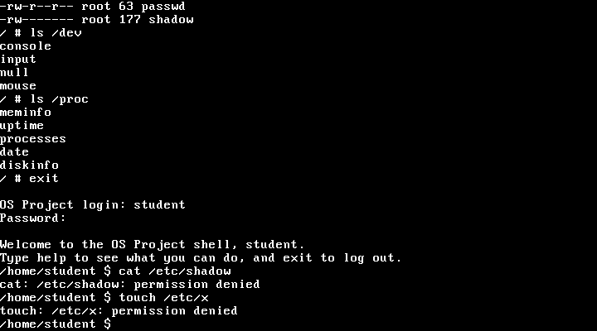
Does it work? Yes.
Private files stay private
student was refused /etc/shadow and couldn’t create /etc/x
Big files read back correctly
fstest wrote 300,000 bytes and checked every one
110 of 110 tests passed
Including fstest, permtest and tmptest
Not built yet
Links, chown, and moving folders with mv
Real screen from our running OS
Next: Resource Management, how programs share safely
OS Project · File Handling
6
Notes:
Does it work? Yes. This is a real screen from our OS. First it lists the device files in /dev and the live files in /proc. Then I logged in as student, a normal user. Reading /etc/shadow was refused, and creating a file in /etc was refused too. Our fstest program writes a file of 300,000 bytes, reads it back and compares every byte. All 110 automatic tests pass, including fstest, permtest and tmptest. The real Linux tool e2fsck also checks the disk after our OS writes to it, and it finds no errors. To show it live, log in as student and type cat /etc/shadow. Three things aren’t built: links, chown to change a file’s owner, and mv can’t move folders because we have no rename system call. Next, our Resource Management speaker will explain how programs share the computer safely.

