Slide 1
Building an Operating System
Part 6 of 6
Resource Management
How programs share the computer safely
[Presenter name]
[Course name] · [Date]
Notes:
Thank you. We’ve seen programs, memory, storage and files. All of them share one computer: one CPU, one disk and one keyboard. I’m the last speaker, and I’ll explain how our OS shares those things safely, so programs don’t clash.

Slide 2
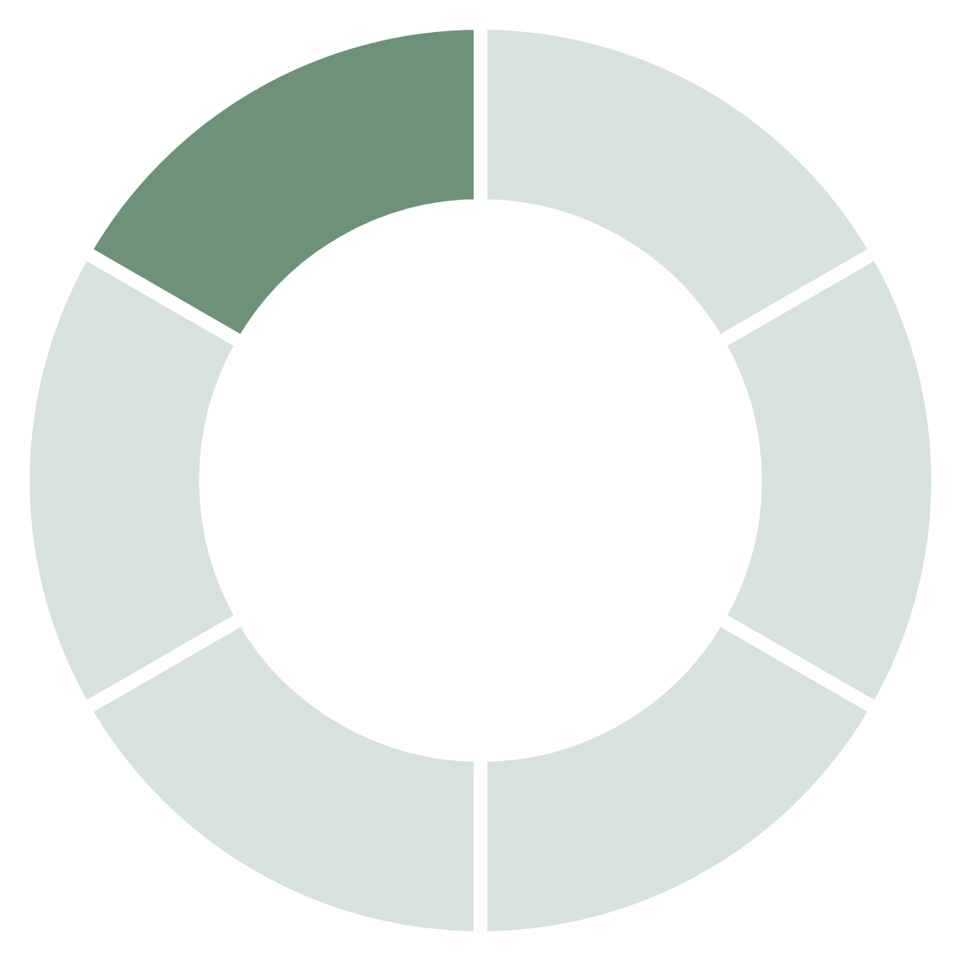
My part of the project
Programs share one CPU, one disk and one keyboard. My part keeps that sharing safe.
5
Resource
Integration
devices that can interrupt the CPU
100
timer beats every second
256
typed keys can wait in a queue
File Handling
6 parts
Process
Storage
Memory
OS Project · Resource Management
2
Notes:
Our project has six parts, and mine is Resource Management. Every program shares the same hardware, so my part decides who gets what, and how the OS responds when a device needs attention. Five devices can interrupt the CPU. The timer beats 100 times every second, and that beat is what drives the scheduler you heard about earlier. If you type while a program is busy, your keys wait in a queue that holds 256 of them, so nothing is lost.

Slide 3
How devices get the CPU’s attention
IRQ 0
IRQ 1
IRQ 4
IRQ 12
IRQ 14
Timer
Keyboard
Serial port
Mouse
Disk
100 times every second
Every key press
When text arrives
When it moves or clicks
When a read or write ends
Device sends a signal
CPU pauses the program
Driver does the work
Program carries on
“Disk: using DMA” is a real line from our boot screen. The disk copies data by itself, and the program waiting for it sleeps, so the CPU stays free.
OS Project · Resource Management
3
Notes:
The CPU can’t keep asking every device whether it needs something. That would waste its time. So devices tell the CPU instead, and that signal is called an interrupt. These are the five real interrupt lines in our OS, called IRQs. When one fires, the CPU pauses the running program, a small piece of code called a driver does the work, and the program carries on as if nothing happened. The disk goes one step further. It uses DMA, which means the disk controller copies the data into memory by itself. While that happens, the waiting program sleeps, and the CPU runs something else. Our boot screen confirms it with the line Disk: using DMA. If no DMA controller is found, the driver falls back to copying through the CPU.

Slide 4
Stopping a deadlock before it starts
Our banktest shares 8 pipes between programs A and B. Each may need up to 6.
Right now: A holds 4, and 4 are free
A
A
A
A
free
free
free
free
So B has to wait
A could still need 2, and B could still need 3. With 1 free, neither is sure to finish.
If B got the 3 it asks for: only 1 is free
Once A gave back its 4, B got its 3.
A
A
A
A
B
B
B
free
Banker’s Algorithm runs as its own demo: it counts pipes, but real pipes don’t go through it.
OS Project · Resource Management
4
Notes:
A deadlock is when programs wait for each other forever. We built the Banker’s Algorithm, the classic way of avoiding it, and this is exactly what our banktest program does. Our OS counts 8 pipes. Program A holds 4, and each program says up front that it may need up to 6. Now B asks for 3. There are 4 free, so a simple system would say yes. But that would leave only 1 free, while A could still need 2 and B could still need 3. Nobody could be sure to finish. That’s called an unsafe state, so B has to wait. When A gives back its 4, B gets its 3. Be clear about one thing if you’re asked. Banker’s runs as its own demo. It counts resources, but real pipes don’t go through it, and a real pipe deadlock between two programs is still possible. Linux and Windows don’t use Banker’s either, because programs rarely know their maximum needs. Our kernel avoids deadlock between its own locks by always taking them in a fixed order.

Slide 5




What my part uses, and why
Interrupts
Devices tell the CPU, so it never has to keep asking
CPU a busy program got in 2 seconds
DMA
No limit
200
The disk copies data itself, so the CPU can do other work
Mutexes and semaphores
With limit
60
Let one program at a time change shared data
CPU quotas
Timer ticks counted by quotatest in our OS. The limit was 20 ticks a second.
A hard limit, so one program can’t take over the CPU
OS Project · Resource Management
5
Notes:
Here’s what my part uses, and why. Interrupts mean the CPU doesn’t waste time checking on devices. DMA lets the disk copy data without the CPU. Mutexes and semaphores protect shared data: only one program at a time can change it, and the others sleep until it’s free. CPU quotas are a hard limit on how much CPU a program can use each second. The chart is a real measurement from quotatest. With no limit, a busy program got 200 ticks in 2 seconds, which is all of the CPU, since one tick is 10 milliseconds. With a limit of 20 ticks a second, it got 60. If you’re asked why it’s 60 and not 40: the limit resets at each clock second, and a 2-second run can touch three of them. So 60 is the most it can get, and the number can be a little lower in another run.

Slide 6
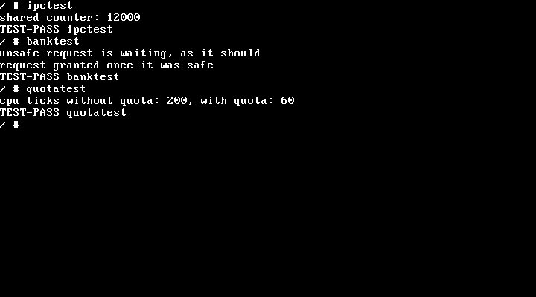
Does it work? Yes.
The shared counter stayed exact
4 programs added 3,000 each and reached 12,000
The unsafe request waited
banktest granted it only once it was safe
The CPU limit held
quotatest cut a busy program from 200 ticks to 60
Not built yet
Banker’s on real pipes, and a shell command for quotas
Real screen from our running OS
Thank you. Any questions?
OS Project · Resource Management
6
Notes:
Does it work? Yes. This is a real screen from our OS. In ipctest, 4 programs each add 3,000 to one shared counter, protected by a semaphore. The answer is exactly 12,000, so no update was lost. In banktest, the unsafe request waited, and it was granted once it was safe. In quotatest, the limit cut a busy program from 200 ticks to 60. To show it live, type ipctest, banktest and quotatest. All 110 automatic tests pass, across every part of the project. Two things aren’t built: Banker’s isn’t connected to real pipes, and there’s no shell command to set a quota, so only a program run by root can do it. That’s our whole OS: integration, processes, memory, storage, files and resources, all running together in QEMU. Thank you. We’d be happy to take your questions.

