Slide 1



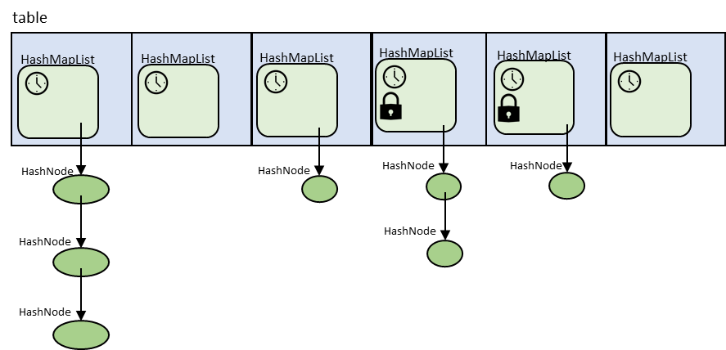
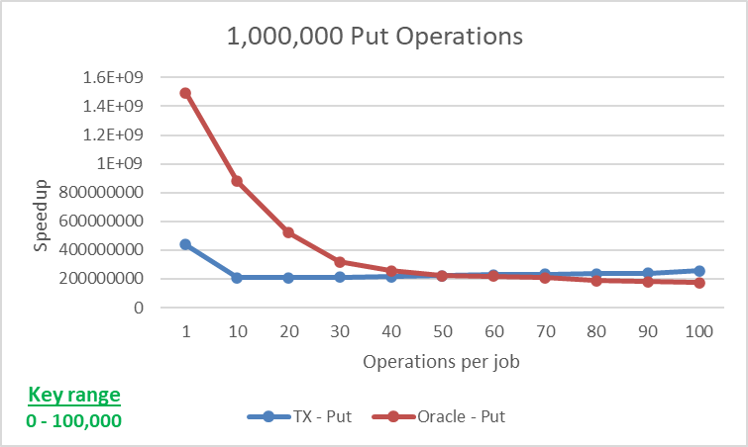
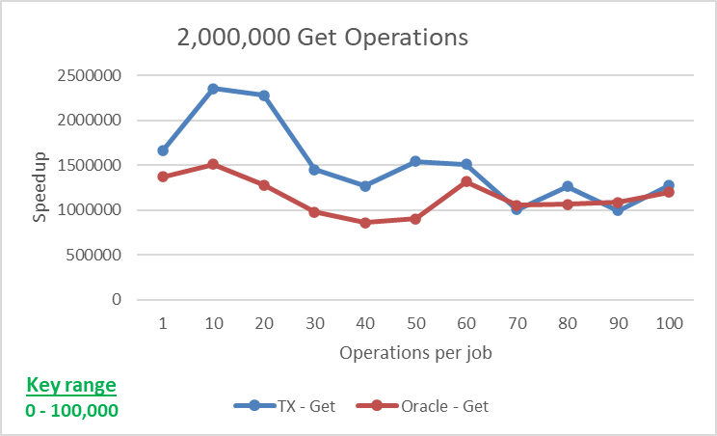
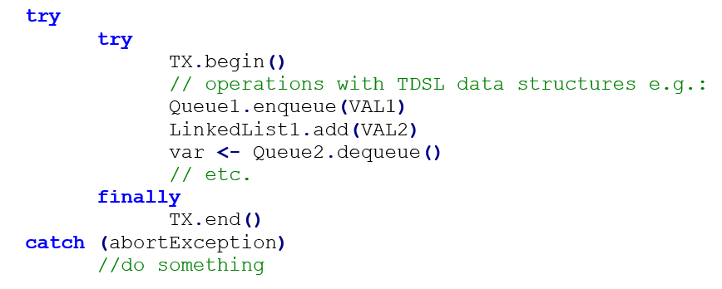
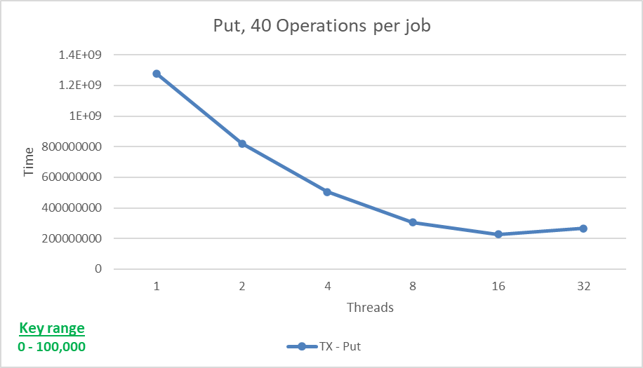

NSSL
Networked Software Systems Lab
Transactional Hash Table
Sapir Malka and Yael Shavit, supervised by Gal Assa
Introduction
Our Solution
Performance Analysis
Parallel programming is hard!
Especially when dealing with shared memory
Software transactional memory (STM) tries to solve this problem
Model critical sections as transactions
Transaction (TX):
block of operations where either all operations are executed (TX committed), or none (TX aborted)
In STM, transactions must maintain:
Atomicity
Isolation
Consistency
Opacity
STM has a big performance impact and as such is relatively rarely used in the industry
Transactional Data Structure Library (TDSL) tries to solve this issue:
Supplies STM semantics for specific data structures
Allows each data structure to be optimized for transactional semantics
Provides a big performance increase over STM
Usage scheme:
In order to interface with TDSL, we need to define the behavior during the commit phase.
Locks and node versions will be kept at the linked list granularity
Locking the entire structure will create too many conflicts.
Fully fine-grained locking (per node) is unnecessary since the linked lists will mostly be very short.
For each HashMap used in a transaction, we will save a read set and a write set.
The read set will keep track of every node list in the HashMap that had data read from it during the transaction.
The write set will keep track of all changes needed to be done in the HashMap by the transaction. (For Put/Remove operations)
General operations flow:
Get the needed node list (using hash function)
Add list to read set
Check if node exists in write set
Otherwise search the shared list
List traversal is done lock free
Correctness kept using a specific flow involving stages of lock/version verifications, and data reads.
For Put/Remove: required change is also logged in the write set.
Resize
Need to keep track of the number of nodes in the hash map
For better performance we use estimated size.
Need to replace table of node lists.
Done by the thread performing the resize.
Other threads wait for operation to complete.
Singleton support
Changed node list receives current GVC as it’s version.
To avoid correctness issues, singleton flag is added to node lists.
Transactions abort if node list version is the same as theirs with the singleton flag up.
Test scenario:
Single critical section which contains x number of put/get operations, to be performed until 1M operations are done in total.
Compare between our transactional HashMap and Oracle’s concurrent HashMap
Transactional HashMap models critical section as transaction. Concurrent HashMap protects critical section with lock.
Test configurations:
Put/Get with changing size of critical section.
Put with changing number of threads.
Time
Time
The Goal
Transactional Hash Map Design and implement a transactional hash map in Java, as part of the TDSL library.
Integrate into the TDSL library
Provide transactional semantics
Maintain the high level of performance associated with TDSL
Support large amounts of hash maps
Support singleton operations
Single operation performed outside of a transaction
Must maintain correctness while other singletons/transactions are performed
Provide an implementation of the structure
Perform a performance analysis
Conclusions
Implemented transactional hash map in TDSL
“Finer grained” concurrency control
Lock only used linked lists instead of everything
Added support for multiple hash maps
Added support for table resize
No unneeded aborts during resize
Added Singleton support
Performance scales well with threads and on smaller transactions.
More optimizations required for Get performance
January 2021

