Slide 1

JAVA WEB PROJECT
HABITFLOW
Personal Habit Tracker: plan routines, record daily check-ins and watch streaks grow.
Jakarta Servlets · JSP · JDBC · H2 / PostgreSQL · Maven · Java 17
OUR TEAM
TEAM LEADER
MEMBER
MEMBER
MEMBER
Saransh Mishra
Shaswat Gupta
Ayush Sharma
Shivansh Singh
Schema, JDBC, DAO
OOP models, schedules
Validation, exceptions, tests
Servlets and web UI
Notes:
Introduce HabitFlow and the team. Saransh Mishra is the team leader. Live demo: personal-habit-tracker-3vv1.onrender.com

Slide 2
WHY HABITFLOW?
01
02
03
Plans fade
Memory is unreliable
Visible progress
People forget which habits they completed or how regularly they followed a routine.
Dated check-ins stored in a database replace guesswork with a simple record.
Streaks, weekly counts and completion rate summarise recent activity at a glance.

Slide 3
OBJECTIVES & KEY FEATURES
OBJECTIVES
FEATURES
Add habits with a category and repeat schedule
Save one check-in per habit per date
Show current and best streak, weekly check-ins and completion rate
Practise OOP, collections, exceptions, JDBC, Servlets and JSP
Add habit
Category, schedule, description, accent colour
Check in / undo
Record or undo today's completion
Dashboard and Weekly Matrix
Today's habits, streaks and a 7-day routine log
Analytics and Focus Timer
Consistency score, heatmap and focus sessions
Blueprints
Ready-made starter habits to add in one click

Slide 4
USER FLOW
1
2
3
4
Create
Schedule
Check in
Review
Name, category and accent colour
Daily, weekdays or weekly
Save or undo today's entry
Streaks, weekly count and rate
CATEGORIES
Mind · Body · Career · Wellness · Learning

Slide 5
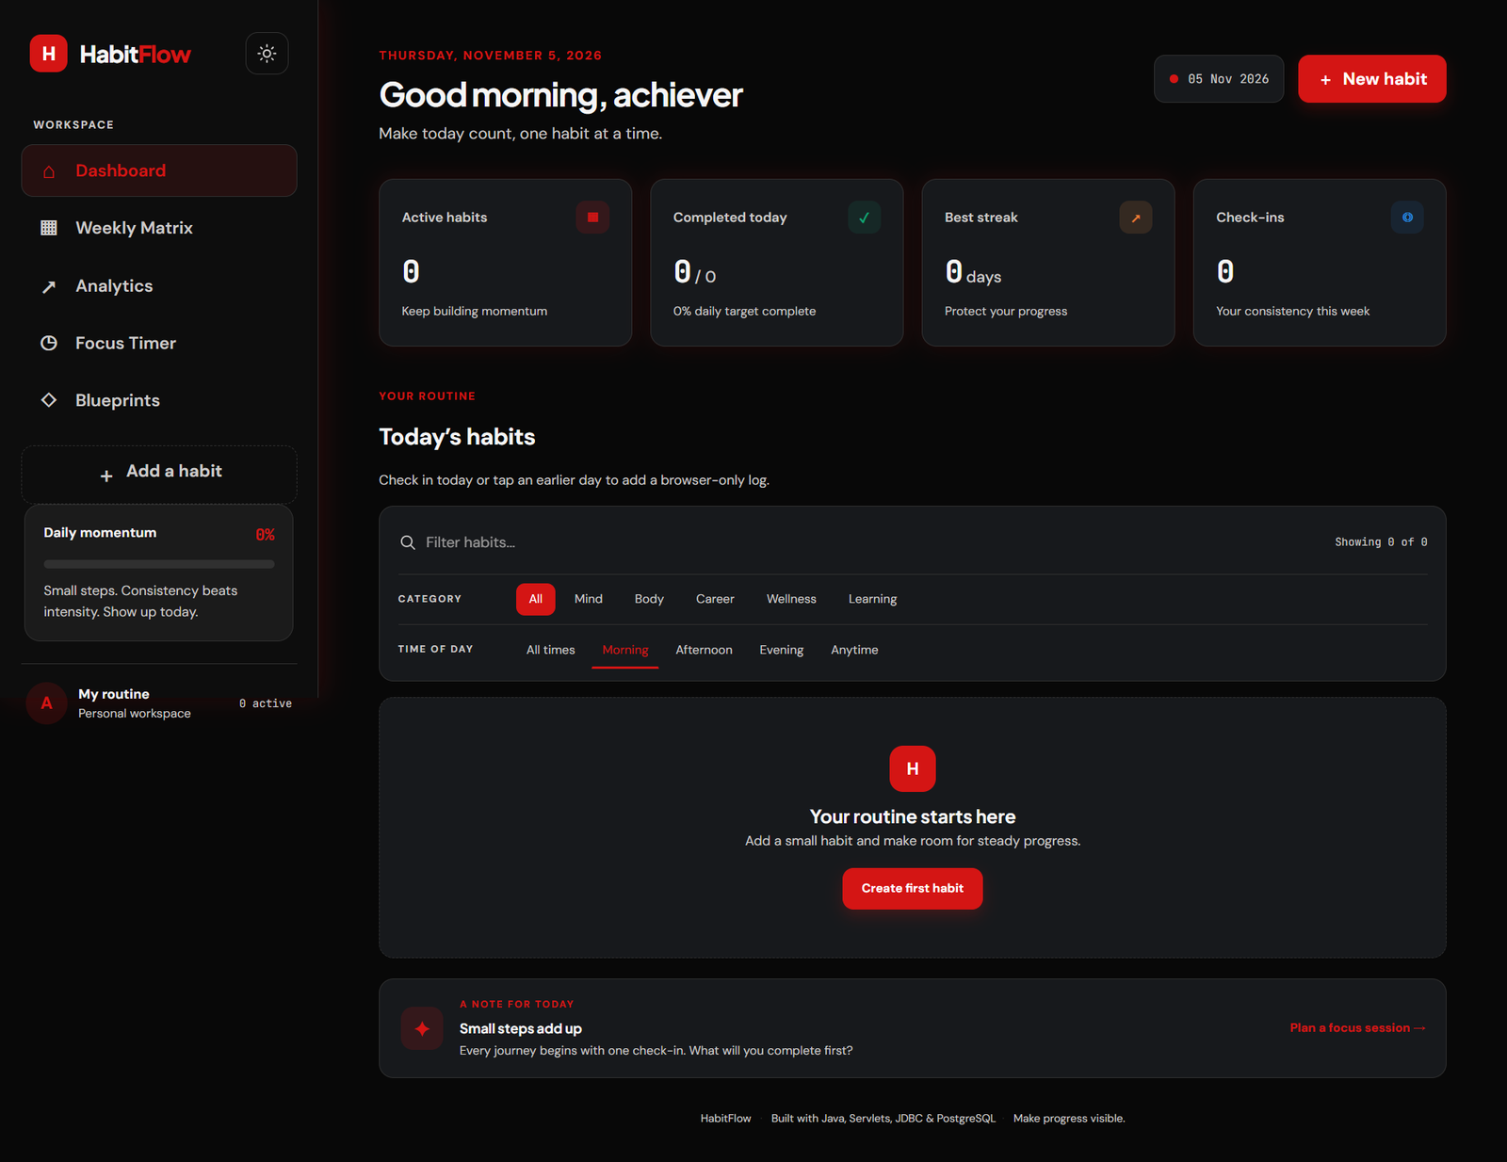
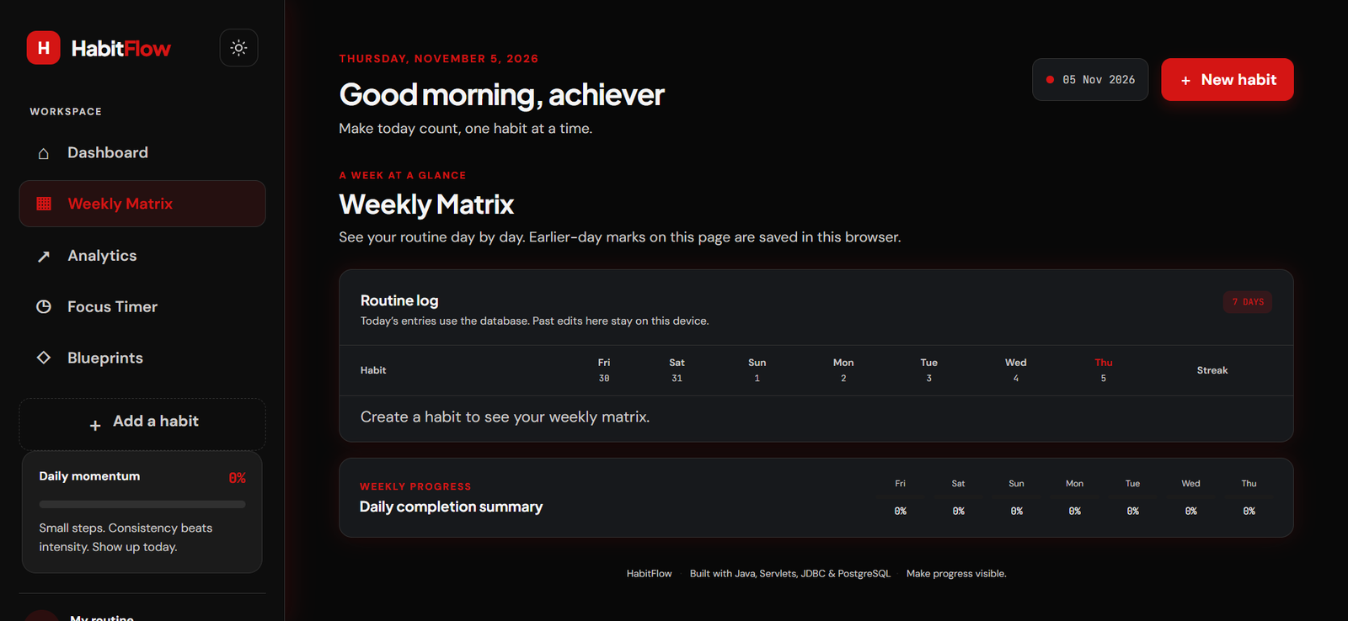
DASHBOARD & WEEKLY MATRIX
Weekly Matrix
A 7-day routine log with a streak column and a daily completion summary.
Good to know Today's entries use the database. Earlier-day marks are kept in this browser.
Dashboard
Stat cards, category and time-of-day filters, and today's habits to check in.

Slide 6
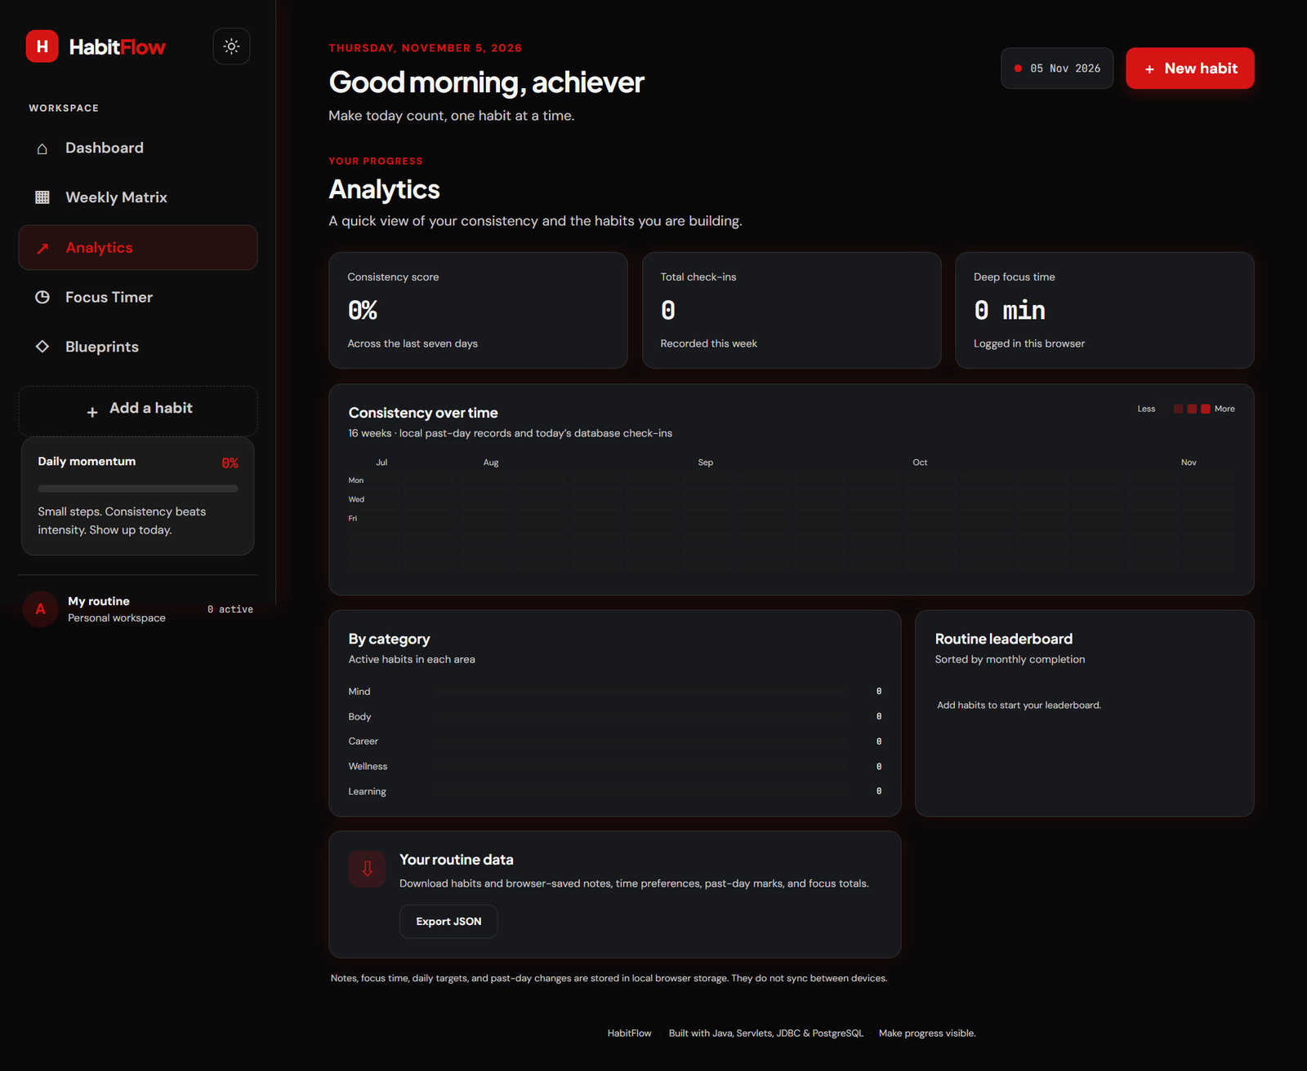
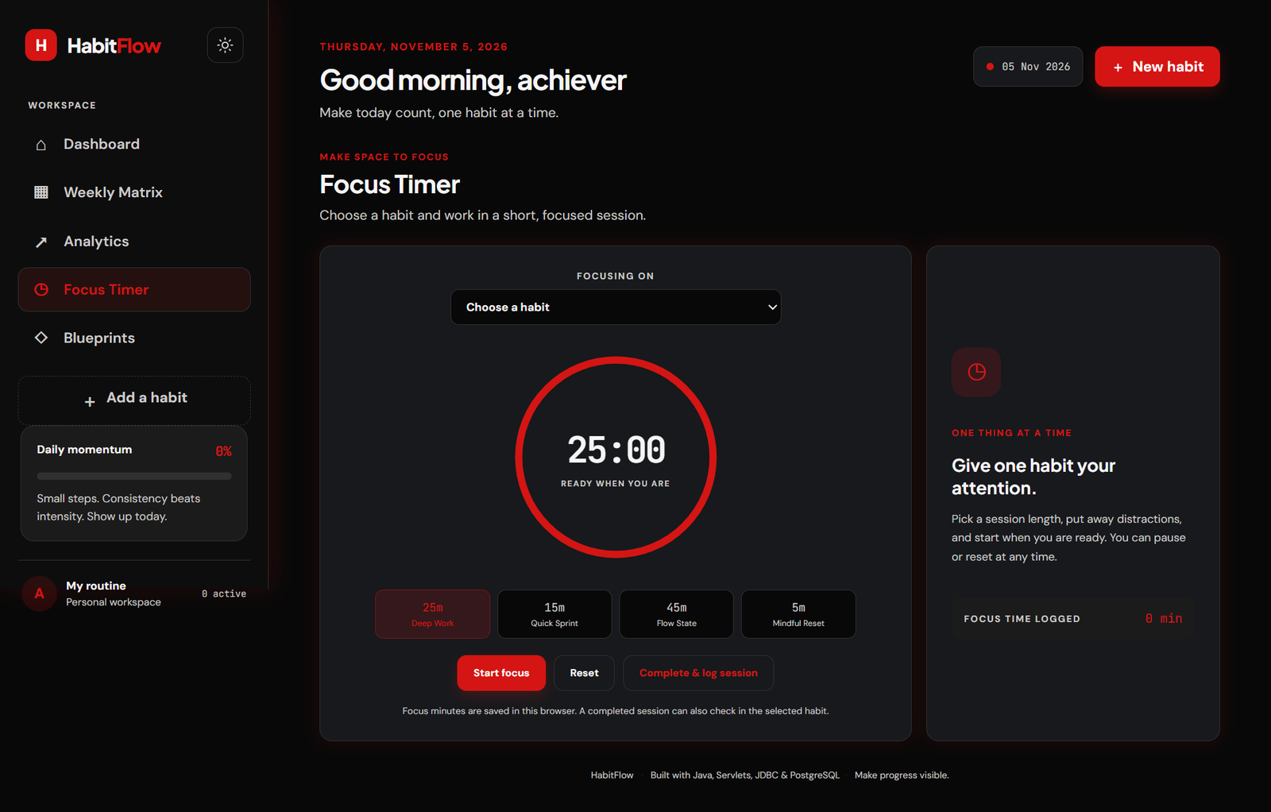
ANALYTICS & FOCUS TIMER
Focus Timer
Pick a habit, choose 25, 15, 45 or 5 minutes, then log the session as a check-in.
Analytics
Consistency score, 16-week heatmap, habits by category, leaderboard and Export JSON.

Slide 7
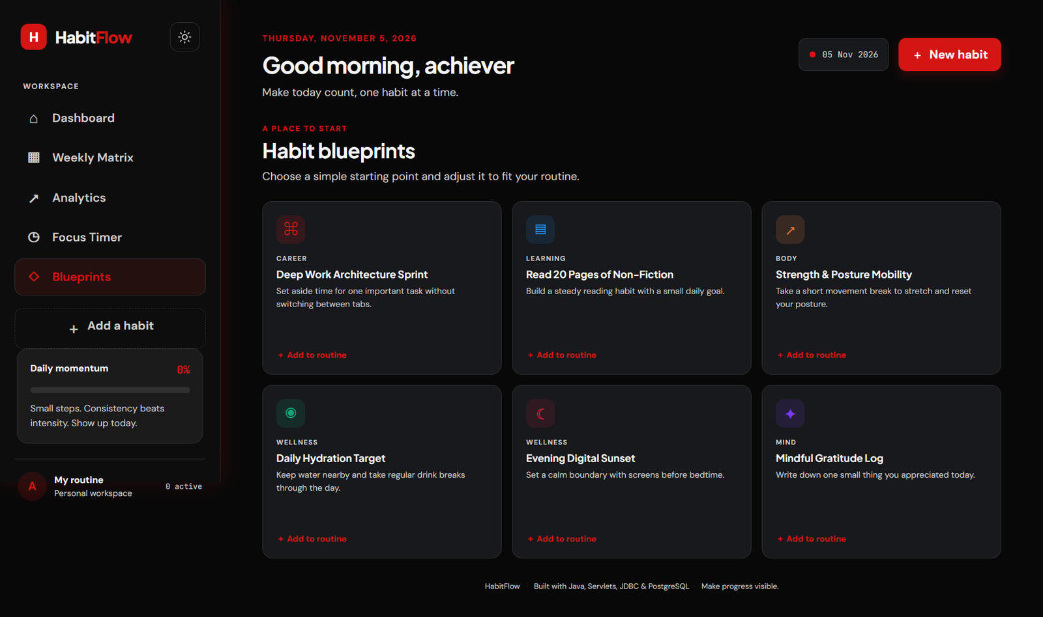
HABIT BLUEPRINTS
STARTER HABITS
Six ready-made habits across Career, Learning, Body, Wellness and Mind
Each has a short description and an Add to routine button
Adjust a blueprint to fit your own routine

Slide 8
TECHNOLOGY STACK
LANGUAGE
WEB
SERVER
Java 17, Maven
Jakarta Servlet 6.0, JSP 3.1, JSTL
Apache Tomcat 10.1
DATA
FRONT END
TESTING
JDBC with H2 (local) and PostgreSQL (hosted)
HTML, CSS, JavaScript
JUnit 5

Slide 9
LAYERED ARCHITECTURE
1
Browser
ROUTES
index.jsp, CSS, app.js
/ and /dashboard
/habits
/checkins
/health (Render check)
2
Servlets
Dashboard, Habit, CheckIn, Health
3
HabitService
Validation and habit operations
4
HabitDao / JdbcHabitDao
DashboardServlet loads the habits and totals, then forwards to index.jsp.
Prepared-statement SQL
5
Database
H2 (local) or PostgreSQL (hosted)

Slide 10
OOP: SCHEDULE POLYMORPHISM
abstract HabitSchedule
isScheduledOn(date, createdAt)
DailySchedule
WeekdaySchedule
WeeklySchedule
Due every day
Due Monday to Friday
Due on the weekday it was created
HabitScheduleFactory picks the subclass from the saved frequency (daily, weekdays or weekly) and rejects anything else.

Slide 11
PROGRESS METRICS
01
Current streak
02
Best streak
Consecutive due days completed; 0 if today is due and not yet done
Longest run of completed due days since the habit was created
03
Completion rate
04
Weekly check-ins
Completed days divided by due days over the last 30 days
Completed due days since Monday
Calculated by HabitMetrics from a Set of check-in dates, using each habit's schedule.

Slide 12
DATABASE DESIGN
habits
habit_checkins
id (PK, identity)
name VARCHAR(120)
description VARCHAR(500)
category, frequency, color
created_at DATE
id (PK, identity)
habit_id (FK to habits.id)
checkin_date DATE
note VARCHAR(250)
1 : many
UNIQUE (habit_id, checkin_date) prevents duplicate check-ins.
ON DELETE CASCADE removes check-ins when a habit is deleted.

Slide 13
DATA ACCESS & TESTING
JDBC / DAO
Service layer
Testing
Prepared statements
try-with-resources
H2 MERGE vs PostgreSQL ON CONFLICT
Dates grouped in a Map of Sets
Validates name, category, colour
HabitValidationException
Checks the habit is due today
2-thread pool for async stats
JUnit 5
JdbcHabitDaoTest: save, check in, delete
HabitServiceTest: dashboard totals
mvn clean verify

Slide 14
DEPLOYMENT
1
Build
GOOD TO KNOW
Multi-stage Dockerfile: Maven builds the WAR
Free tier sleeps after 15 minutes idle and takes about a minute to wake.
Records persist in Neon, outside the container.
Check-ins use the India time zone.
2
Run
Tomcat 10.1 on Java 17 serves ROOT.war
3
Host
Render free web service with a /health check
4
Store
Neon PostgreSQL via APP_ENV, JDBC_URL, JDBC_USER, JDBC_PASSWORD
Live demo
personal-habit-tracker-3vv1.onrender.com

Slide 15
HABITFLOW · PERSONAL HABIT TRACKER
THANK YOU
Questions and feedback are welcome.
LIVE DEMO
GITHUB
personal-habit-tracker-3vv1.onrender.com
github.com/itssaransh/habit-tracker

