Slide 1
Review on word2vec and item2vec
Rui Zhang
2020-10-07

Slide 2
Why word2vec?
Old methods of vectorization of natural language (e.g. one-hot-encoding) has problems:
Unmanageable high dimensions
No similarities among words (no context)
Advantages of word2vec
Vector representations of words in low dimension
Sematic or context involved
`king` + `man` - `women` = `queen`
`orange`, `apple` and `banana` are closer in the latent space

Slide 3
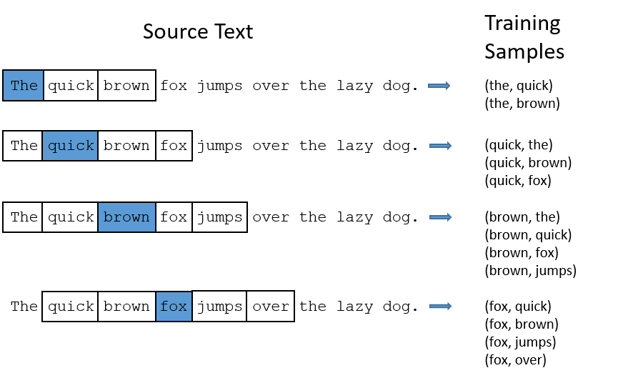
Skip-gram model
Given a specific word, predict the probability for every word in the dictionary of being the `nearby word`, when window size = 2:
Training data:

Slide 4
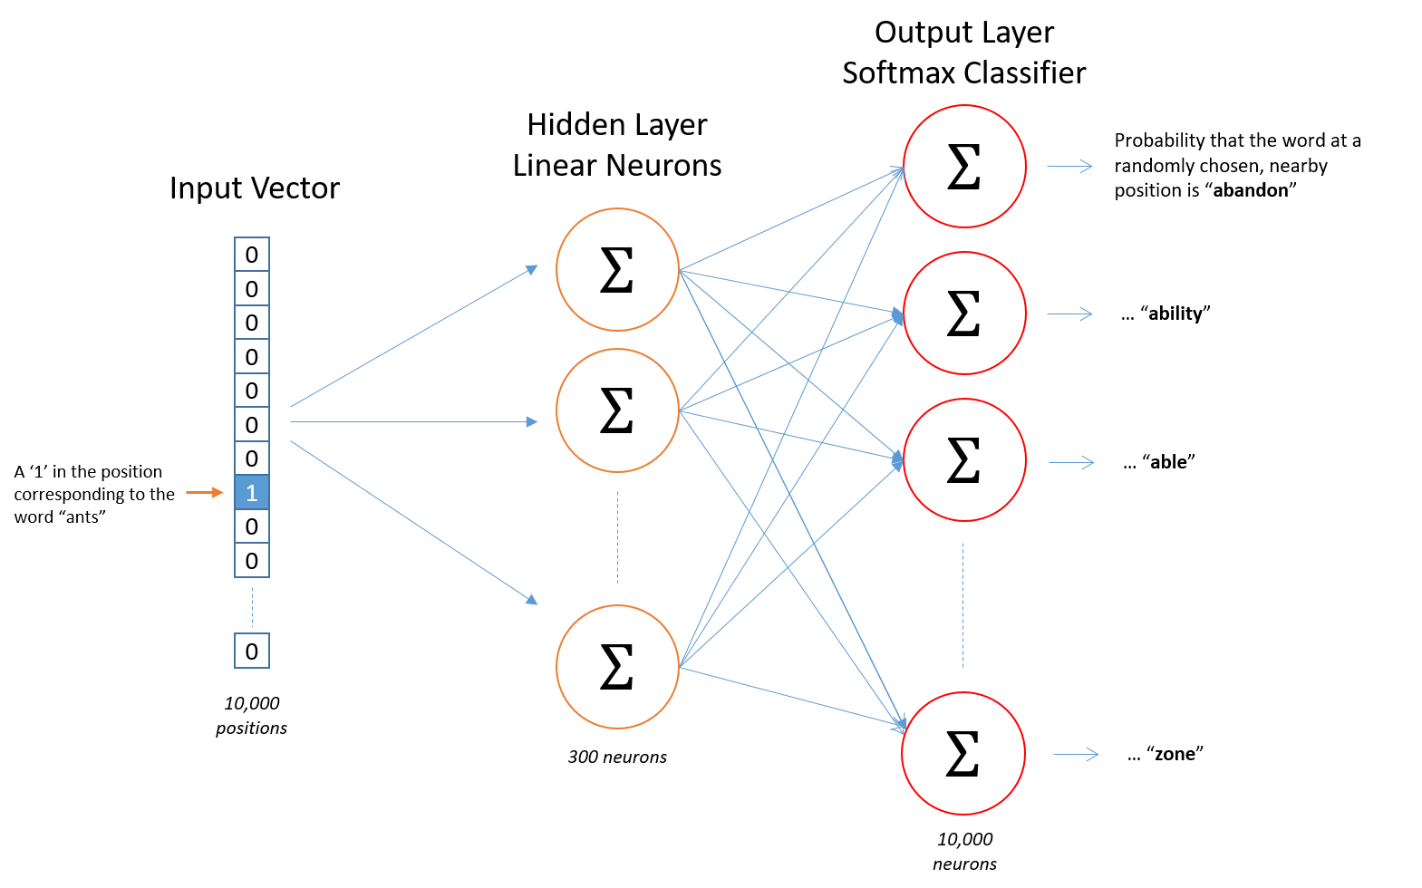
one single hidden layer neural network
weight matrix!

Slide 5
Variants and techniques of word2vec
Continuous bag of words and skip-gram models
Target word to context word or vice verse
Negative sampling to replace softmax function
Only update part of the weight for each training word pair
Improve computational efficiency
Sub-sampling procedures
Imbalance between rare and frequent words

Slide 6

Wide applicability of word2vec
“Researchers from the Web Search, E-commerce and Marketplace domains have realized that just like one can train word embeddings by treating a sequence of words in a sentence as context, the same can be done for training embeddings of user actions by treating sequence of user actions as context.” - Mihajlo Grbovic, Airbnb

Slide 7

Spotify music recommend based on playlist

Slide 8
From word2vec to item2vec
Word ---- Item
Sentence ---- a set of items that share some context (similarities)
Window size ---- set size

Slide 9
Retailor2vec
Retailors that share the same SIC code as a starting point?
The sets should be independent from the transaction data?
Other data sources on retailor context?

Slide 10
Implementation
Tensorflow code: https://github.com/cmcneil/board-yet/blob/master/model/item2vec.py confused by the OOP structure
Use word2vec from gensim https://github.com/bwange/Item2vec_Tutorial_with_Recommender_System_Application/blob/master/Making_Your_Own_Recommender_System_with_Item2Vec.ipynb set the random dynamic maximum window size to a huge number (9999999) to work around, which is not ideal, adding an option to the codes to make the window size constant could solve this.

