Slide 1


Slide 2
Concept of what we learn
INTRODUCTION OF INVERSION OF CONTROL
TYPES OF -
BeanFactory
ApplicationContext
INTRODUCTION OF DEPENDANCY INJECTION
TYPES OF -
CONSTRUCTOR
PROPERTY
METHOD

Slide 3
INVERSION OF CONTROL
Spring IoC (Inversion of Control) Container is the core of Spring Framework. It creates the objects, configures and assembles their dependencies, manages their entire life cycle. The Container uses Dependency Injection(DI) to manage the components that make up the application. It gets the information about the objects from a configuration file(XML) or Java Code or Java Annotations and Java POJO class. These objects are called Beans. Since the Controlling of Java objects and their lifecycle is not done by the developers, hence the name Inversion Of Control.file(XML) or Java Code or Java Annotations and Java POJO class. These objects are called Beans. Since the Controlling of Java objects and their lifecycle is not done by the developers, hence the name Inversion Of Control.

Slide 4
BeanFactory
The first foremost thing when we talk about spring is dependency injection which is possible because spring is actually a container and behaves as a factory of Beans. Just like the BeanFactory interface is the simplest container providing an advanced configuration mechanism to instantiate, configure and manage the life cycle of beans. Beans are java objects that are configured at run-time by Spring IoC Container. BeanFactory represents a basic IoC container which is a parent interface of ApplicationContext.
BeanFactory uses Beans and their dependencies metadata to create and configure them at run-time. BeanFactory loads the bean definitions and dependency amongst the beans based on a configuration file(XML) or the beans can be directly returned when required using Java Configuration. There are other types of configuration files like LDAP, RDMS, properties file, etc.

Slide 5
ApplicationContext
Spring IoC container is responsible for instantiating, wiring, configuring, and managing the entire life cycle of objects. BeanFactory and ApplicationContext represent the Spring IoC Containers. ApplicationContext is the sub-interface of BeanFactory. BeanFactory provides basic functionalities and is recommended to use for lightweight applications like mobile and applets. ApplicationContext provides basic features in addition to enterprise-specific functionalities which are as follows:
Publishing events to registered listeners by resolving property files.
Methods for accessing application components.
Supports Internationalization.
Loading File resources in a generic fashion.

Slide 6
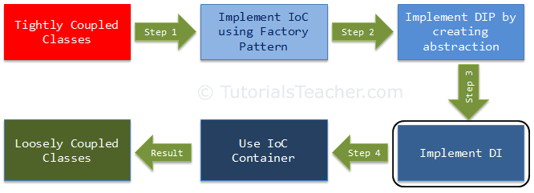
Dependency Injection
In the previous chapter, related to DIP, we created and used abstraction to make the classes loosely coupled. Here, we are going to implement Dependency Injection and strategy pattern together to move the dependency object creation completely out of the class. This is our third step in making the classes completely loose coupled.

Slide 7
Dependency Injection (DI) is a design pattern used to implement IoC. It allows the creation of dependent objects outside of a class and provides those objects to a class through different ways. Using DI, we move the creation and binding of the dependent objects outside of the class that depends on them.
The Dependency Injection pattern involves 3 types of classes.
Client Class: The client class (dependent class) is a class which depends on the service class
Service Class: The service class (dependency) is a class that provides service to the client class.
Injector Class: The injector class injects the service class object into the client class.

Slide 8
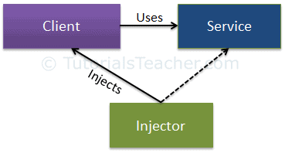
The following figure illustrates the relationship between these classes:
As you can see, the injector class creates an object of the service class, and injects that object to a client object. In this way, the DI pattern separates the responsibility of creating an object of the service class out of the client class.

Slide 9
CONSTRUCTOR -
Constructor Dependency Injection (CDI): In this, the DI will be injected with the help of constructors. Now to set the DI as CDI in bean, it is done through the bean-configuration file For this, the property to be set with the CDI is declared under the <constructor-arg> tag in the bean-config file.
Example: Let us take the same example :
Java –
Package com.geeksforgeeks.org;
Import com.geeksforgeeks.org.Igeek;
Public class GFG {
Igeek geek;
GFG(Igeek geek)
{
this.geek = geek;
}
}

Slide 10
Property
You should use property injection in case the dependency is truly optional
Property Injection however causes Temporal Coupling and when writing Line of Business applications, your dependencies should never be optional: you should instead apply the Null Object pattern.
property injection is considered bad in 98% of all scenarios because it hides dependencies and there is no guarantee that the object will be injected when the class is created.
The built-in IoC container does not support property injection. You will have to use a third-party IoC container.

Slide 11
Method
Thus method injection is useful in two scenarios: when the implementation of dependency will vary, and when the dependency needs to be renewed after each use. In both cases, it’s up to the caller to decide what implementation to pass to the method.
Example -
class CarPaintingRobotWithMethodInjection {
public PaintCar(aColor: string, aPaintGunTip: IPaintGunTip) {
CheckNeitherNullNorUndefined(aPaintGunTip);
aPaintGunTip.SprayCar(aColor);
}
}

Slide 12
Conclusion
Dependency injection is a powerful, useful, and critical technique to use in order to write clean, loosely coupled, easy to maintain code. There are three ways to do dependency injection, each having its own use case. Learn when to use these three techniques, and you will be well on your way to writing excellent, testable, and lovely code.

Slide 13


