Slide 1

studyforge
✦
Revision with a
clear next step
StudyForge connects learning, recall and practice in one student-first platform.
CONCISE PRODUCT PITCH
01
Notes:
Sources: user-supplied StudyForge illustration sheet at /Users/samle/Downloads/studyforge/assets.svg; current StudyForge project files in /Users/samle/Documents/Codex/web/studyforge/studyforge. The positioning sentence reflects the current About page and topic workflow.

Slide 2

studyforge
✦
Revision loses momentum between resources
The work is spread across separate places, so students must rebuild the route each time.
The core friction
Students move between notes, flashcards and questions without a clear handoff.
Practice also stalls when the useful question supply runs out.
02
Notes:
Sources: user-supplied StudyForge illustration sheet at /Users/samle/Downloads/studyforge/assets.svg; current StudyForge project files in /Users/samle/Documents/Codex/web/studyforge/studyforge. Problem framing comes from the previously supplied pitch scope and the current product structure.

Slide 3
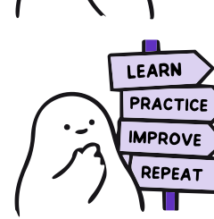
studyforge
✦
One connected revision loop
Each step prepares the student for the next one.
01
Learn
Focused notes explain the method
02
Recall
Flashcards bring key ideas back
03
Practice
Original questions build application
04
Test
Topic tests and papers check readiness
03
Notes:
Sources: user-supplied StudyForge illustration sheet at /Users/samle/Downloads/studyforge/assets.svg; current StudyForge project files in /Users/samle/Documents/Codex/web/studyforge/studyforge. The four-step route reflects the current topic hub: Learn, Remember, Practice and Test.

Slide 4

studyforge
✦
The product
A focused toolkit around the revision loop.
Revision notes
Methods and worked examples organised by topic
Flashcards
Recall practice from published or uploaded decks
Practice
Original questions with feedback
Testing
Topic tests with a route toward past papers
04
Notes:
Sources: user-supplied StudyForge illustration sheet at /Users/samle/Downloads/studyforge/assets.svg; current StudyForge project files in /Users/samle/Documents/Codex/web/studyforge/studyforge. Feature descriptions come from current StudyForge routes and interface copy.

Slide 5
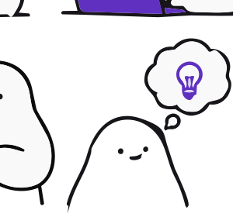
studyforge
✦
Students keep control of independent revision
Teacher visibility begins only when work is assigned.
PRIVATE
Independent study
Teachers do not see a student’s self-directed revision activity.
TRACEABLE
Assigned homework
Teachers can review completion and answers for compulsory work.
Student access remains free.
05
Notes:
Sources: user-supplied StudyForge illustration sheet at /Users/samle/Downloads/studyforge/assets.svg; current StudyForge project files in /Users/samle/Documents/Codex/web/studyforge/studyforge. Privacy and free-access boundaries come from previously supplied StudyForge requirements and current dashboard copy.

Slide 6

studyforge
✦
A focused school pilot
Proposed scope, subject to agreement with the participating school.
Initial scope
01
Set the scope
Maths
KS4 and below
Agree topics, classes and teacher contacts
02
Run the pilot
Use revision materials and assigned tasks
Start with one defined cohort and a manageable topic range.
03
Review evidence
Examine participation, answers and feedback
06
Notes:
Sources: user-supplied StudyForge illustration sheet at /Users/samle/Downloads/studyforge/assets.svg; current StudyForge project files in /Users/samle/Documents/Codex/web/studyforge/studyforge. Pilot scope is a proposal, not a claim of an existing school rollout or current traction.

Slide 7

studyforge
✦
The ask
Pilot StudyForge with
one defined maths cohort
01
Agree the topic range
02
Nominate a teacher contact
03
Choose the student cohort
Free student access. Private independent revision. Traceable assigned homework.
07
Notes:
Sources: user-supplied StudyForge illustration sheet at /Users/samle/Downloads/studyforge/assets.svg; current StudyForge project files in /Users/samle/Documents/Codex/web/studyforge/studyforge. The final ask is intentionally limited to a defined pilot. No numerical outcomes are asserted.

