Slide 1
Electricity Interruption Monitoring System

Slide 2
TABLE OF CONTENTS
Table of contents
1. Introduction
7. User Roles
2. Objectives
8. Project Overview
3. Problem Formulation
9. Limitations and Challenges
4. Methodology
10. Future Scope And Expansion
5. Project Structure
11. Conclusion
6. Tech Stack

Slide 3
Introduction
EIMS, the Electricity Interruption Monitoring System – a data-driven analytical website designed exclusively for electricity distribution and management companies.
It’s mission is to empower management teams with the tools they need to make informed decisions by analyzing interruption reports based on areas and their main causes.
By providing valuable reports and insights, EIMS will able to enhance the efficiency of electricity distribution and it will benefit the public consumers in the long run.

Slide 4
Our project is driven by a set of clear and impactful objectives :
Objectives
Improve Electricity Distribution: As in Bangladesh, the electricity consumption is considered higher than the production, Our foremost goal is to help the electricity sector to provide insightful reports so that the management can distribute the electricity properly.
Data-Driven Decision-Making: Enable the management team to make data-driven decisions by analyzing interruption reports. We aim to offer insights that allow for more efficient distribution and proactive measures to prevent interruptions.
In summary, our objectives revolve around creating a digital solution that not only reduce the problem of electricity interruptions but also improve decision-making, resource management, and ultimately, the well-being of the people of Bangladesh.

Slide 5
The current situation can be summarized with the following key issues:
Lack of Data:
Problem Formulation
Electricity offices lack a digital system to monitor electricity interruption reports, making it difficult to properly identify affected areas and main causes of the interruptions, and understand how bad the problem is.
Inefficient Resource Allocation:
Without accurate data on interruption patterns, it's challenging to distribute available electricity resources effectively, leading to unequal distribution of electricity.
Preventive Measures:
Without access to data-driven insights, it becomes challenging to tackle the underlying causes for electricity interruption, like maintenance issues or effective load management, in a proactive manner.
Our project aims to address these challenges by creating an analytical website that provides, insightful reports of electricity interruptions like interruption duration, affected people and areas which are affected most. Which will empower the management team to take necessary steps for efficient electricity distribution and preventive measures.

Slide 6
Methodology
Front-end development
UI design
Research
Back-end development
Maintenance
Launch

Slide 7



Frontend
React
Tech Stack
Backend
Database
Node JS
Mongo DB
React is a free and open-source front-end JavaScript library for building user interfaces based on components.
Node.js is a back-end JavaScript runtime environment, runs on the V8 JavaScript engine, and executes JavaScript code outside a web browser.
MongoDB is a source-available cross-platform document-oriented database program. Classified as a NoSQL database program.

Slide 8
Project Structure
Head Office
Sub/Zonal Office 1
Sub/Zonal Office 2
Head Office: Main Head office of an electricity distribution office. A head office can have single or multiple sub/zonal office. A head office has the highest privilege and can view and manage all it’s sub offices’ data and its users.
Sub/Zonal Office: Sub office has the least privilege. A sub office can have only one parent head office and it can be only used for adding interruption reports and only sub office wise reports can be seen from this account.

Slide 9
As our project has 2 types of accounts. It has 2 types of users roles:
User Roles
Head office User
Sub/Zonal Office User
Add and manage sub offices under head office.
Add daily reports for the assigned sub office.
Add and manage users under the head office.
View assigned sub office’s report.
Office wise reports view.
All office combined report view.

Slide 10
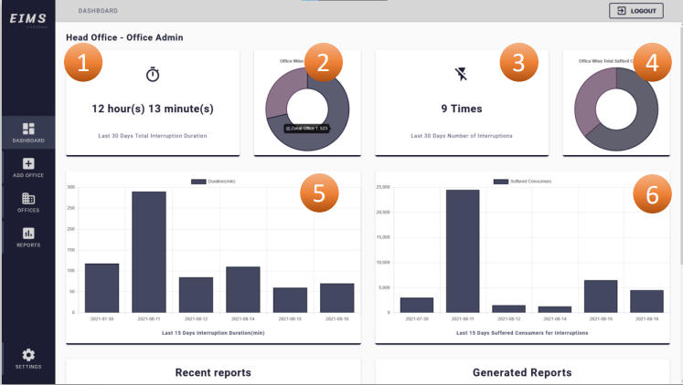
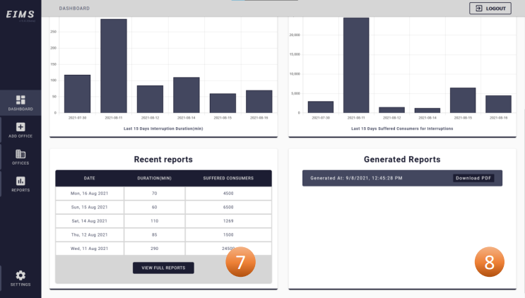
Project Overview
Head office dashboard

Slide 11
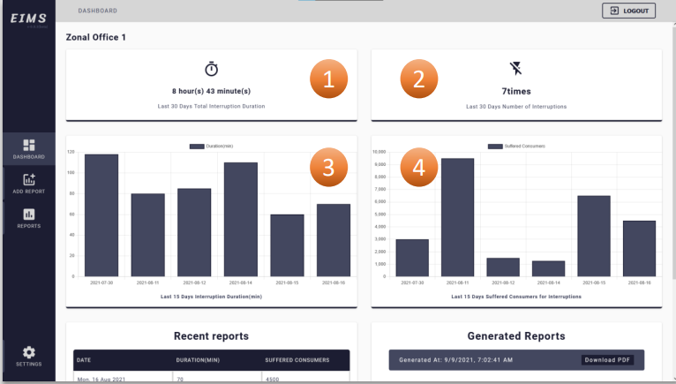
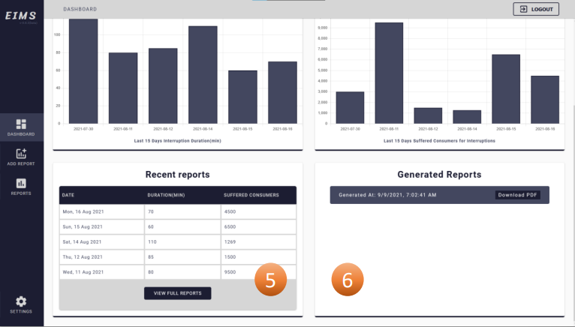
Project Overview
Sub/Zonal Office dashboard

Slide 12
Data Accuracy:
Limitations and Challenges
The website's data relies heavily on information provided by sub-offices. Incorrect data entry or omissions can significantly impact the accuracy of the analytical results.
Security & Data Privacy:
While the project maintains a robust user authentication process and respects data privacy, it currently lacks two-factor authentication (2FA). Enhancing security measures and data privacy is essential to ensure user trust and information protection.
User Training:
Training office management to fully understand how to utilize the system and recognize its benefits is critical for the project's success. It's important to bridge the gap between the system's potential and user proficiency.
Crisis Management:
The project lacks a dedicated crisis management section. In the event of a crisis or environmental disaster, data discrepancies may arise, causing significant outliers in the main analytics. Establishing a separate crisis management section can handle this challenge effectively.

Slide 13
New Features
Machine Learning
Mobile Application
Future Scope And Expansion
Real Time Data
Adding real time data system instead of adding it manually.
Adding new and improved features for more effectiveness.
Adding machine learning for prediction.
Creating mobile application for better accessibility.

Slide 14
Conclusion
In summary, our project aims to tackle electricity interruptions in Bangladesh.
We've created an analytical website that allows users to report and monitor interruptions, enabling data-driven decision-making.
We acknowledge challenges and are committed to improvements in data accuracy, security, user training, and crisis management.
The project's future scope includes expansion and advanced analytics.
We are determined to make a positive impact on electricity distribution and welcome collaboration for further growth.

Slide 15
THANK YOU!

