Slide 1
Electricity Interruption Monitoring System

Slide 2
TABLE OF CONTENTS
Table of contents
1. Introduction
7. User Roles
2. Objectives
8. Project Overview
3. Problem Formulation
9. Limitations and Challenges
4. Methodology
10. Future Scope And Expansion
5. Project Structure
11. Conclusion
6. Tech Stack

Slide 3
Introduction
EIMS, the Electricity Interruption Monitoring System – a data-driven analytical website designed exclusively for electricity distribution and management companies.
It’s mission is to empower management teams with the tools they need to make informed decisions by analyzing interruption reports based on areas and their main causes.
By providing valuable reports and insights, EIMS will able to enhance the efficiency of electricity distribution and it will benefit the public consumers in the long run.

Slide 4
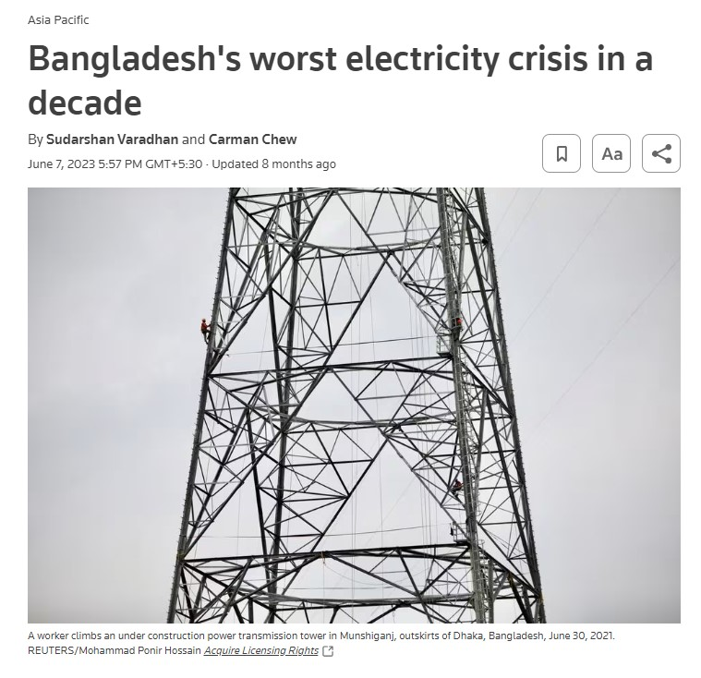
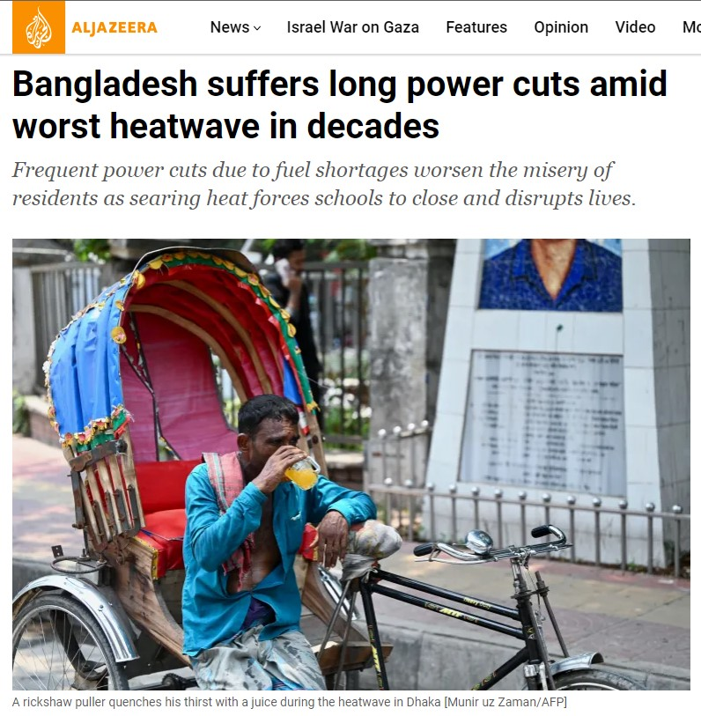
Power Crisis In Bangladesh
In June 2023, Bangladesh faced a severe electricity crisis when one of its major coal power plants shut down due to fuel shortage. The country typically struggles with electricity consumption exceeding production, and the closure of the power plant worsened the situation.
In addition to this problem, the country faced a more problems related to improper distribution and common electrical problems such as fuse malfunctions and transformer issues.
During this time, citizens experienced only 7-8 hours of electricity in a 24-hour period.
News Source: Reuters & Aljazeera

Slide 5
The current situation can be summarized with the following key issues:
Lack of Data:
Problem Formulation
Electricity offices lack a digital system to monitor electricity interruption reports, making it difficult to properly identify affected areas and main causes of the interruptions, and understand how bad the problem is.
Inefficient Resource Allocation:
Without accurate data on interruption patterns, it's challenging to distribute available electricity resources effectively, leading to unequal distribution of electricity.
This project aims to address these challenges by creating an analytical website that provides, insightful reports of electricity interruptions like interruption duration, affected people and areas which are affected most. Which will empower the management team to take necessary steps for efficient electricity distribution and preventive measures.

Slide 6
EIMS is driven by a set of clear and impactful objectives :
Objectives
Improve Electricity Distribution: As in Bangladesh, the electricity consumption is considered higher than the production, The foremost goal is to help the electricity sector to provide insightful reports so that the management can distribute the electricity properly.
Data-Driven Decision-Making: Enable the management team to make data-driven decisions by analyzing interruption reports. EIMS aim to offer insights that allow for more efficient distribution and proactive measures to prevent interruptions.
In summary, the main objectives revolve around creating a digital solution that not only reduce the problem of electricity interruptions but also improve decision-making, resource management, and ultimately, the well-being of the people of Bangladesh.

Slide 7
Project Structure
Head Office
Sub/Zonal Office 1
Sub/Zonal Office 2
Head office User
Sub/Zonal Office User
Add and manage sub offices under head office.
Add daily reports for the assigned sub office.
Add and manage users under the head office.
View assigned sub office’s report.
Office wise reports view.
All office combined report view.

Slide 8
New Features
Machine Learning
Mobile Application
Future Scope And Expansion
Real Time Data
Adding real time data system instead of adding it manually.
Adding new and improved features for more effectiveness.
Adding machine learning for prediction.
Creating mobile application for better accessibility.

Slide 9
Conclusion
In summary, our project aims to tackle electricity interruptions in Bangladesh.
We've created an analytical website that allows users to report and monitor interruptions, enabling data-driven decision-making.
We acknowledge challenges and are committed to improvements in data accuracy, security, user training, and crisis management.
The project's future scope includes expansion and advanced analytics.

Slide 10
THANK YOU!

