Slide 1




SMART INDIA HACKATHON 2026
  Problem Statement ID – SIH26070
  Problem Statement Title – To develop an Artificial Intelligence (AI) / Machine Learning (ML) based system for identification, classification, and prediction of different tropical cyclone patterns using multi-source satellite data
  Theme – Disaster Management
  Organization – Ministry of Earth Sciences (MoES)
  PS Category – Software
  Team ID – 136905
  Team Name – Tikka Techies

Slide 2





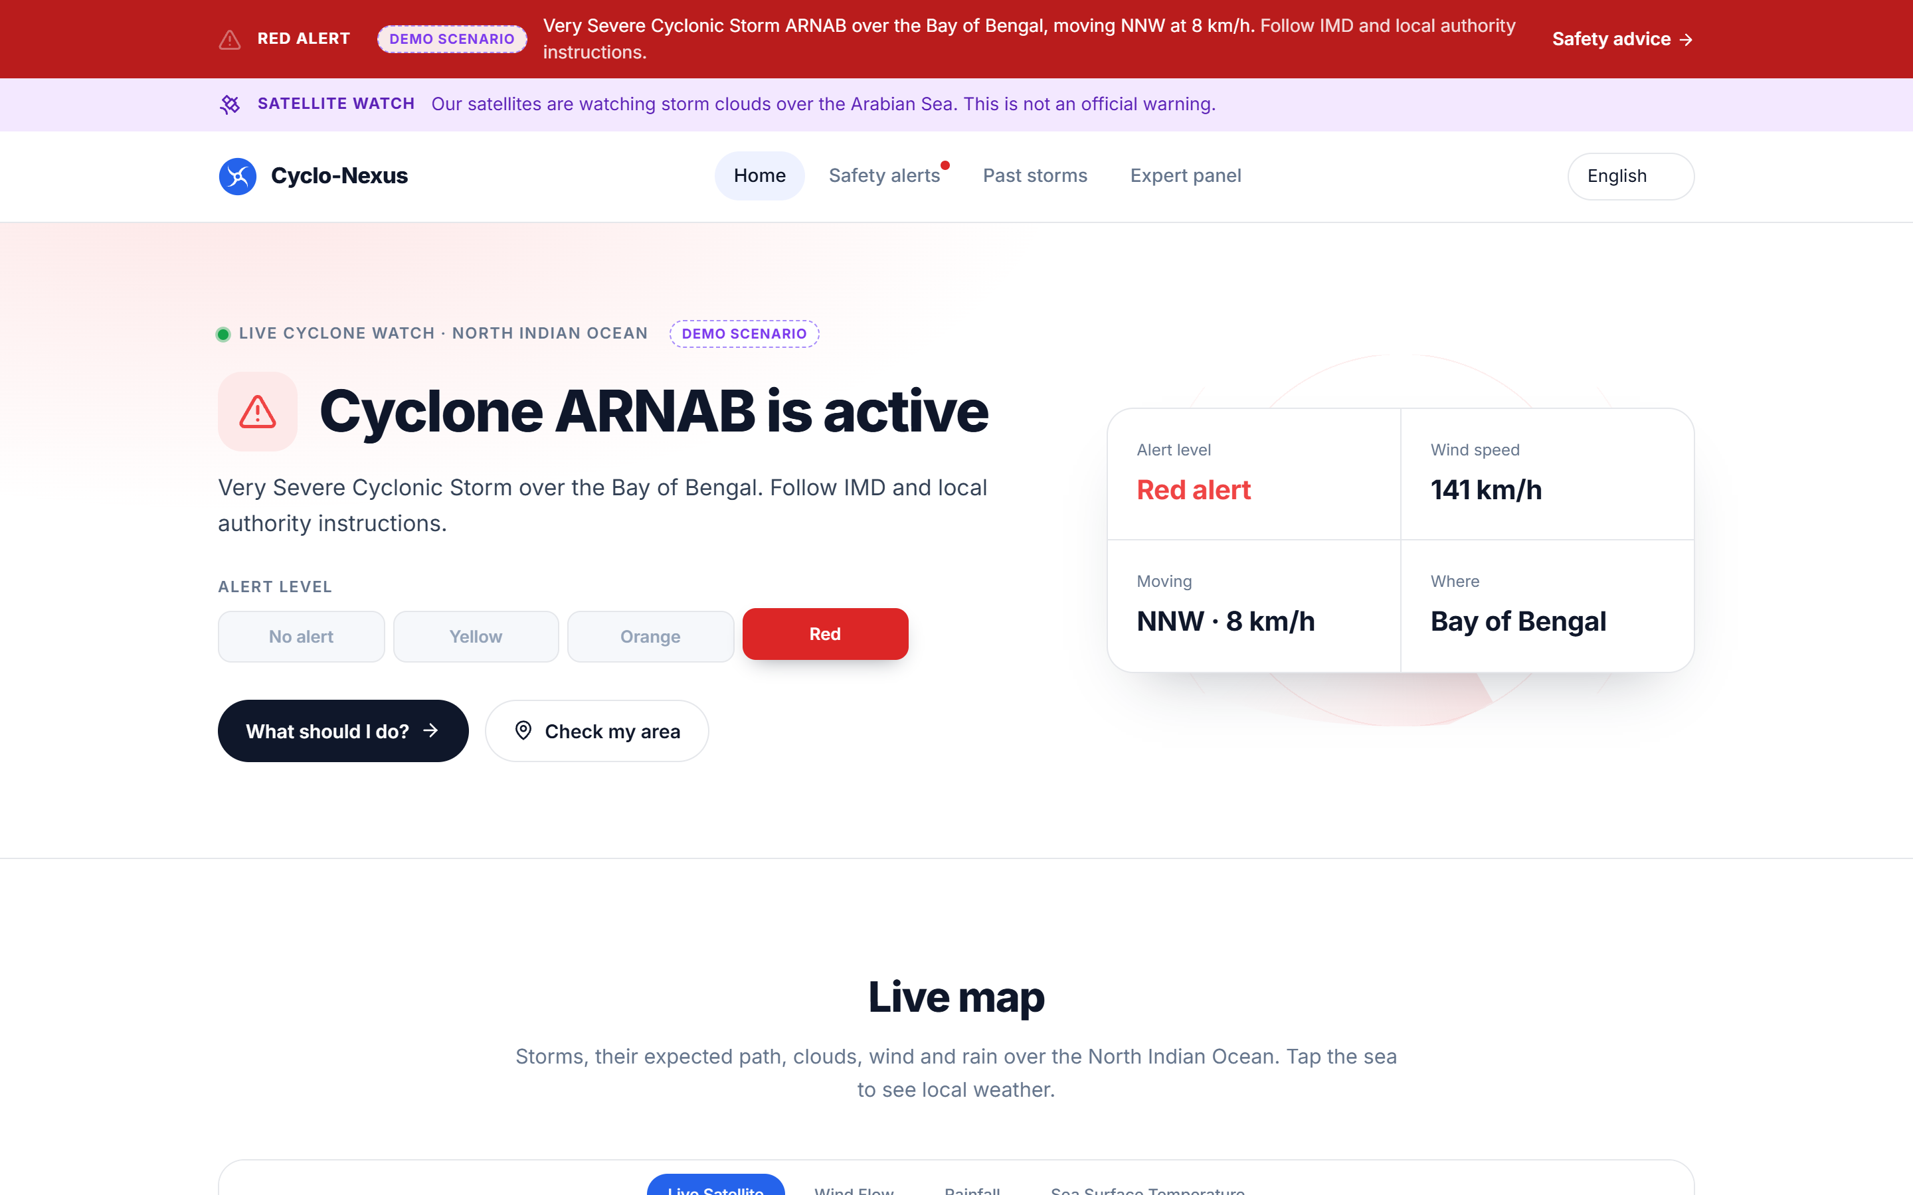













CYCLO-NEXUS: Multi-Satellite AI Cyclone Watch
Tikka Techies
Proposed Solution: detailed explanation of the proposed solution
cyclo-nexus · live dashboard
1
2
3
4
IDENTIFY
CLASSIFY
PREDICT
WARN
YOLO-OBB oriented boxes on the eye and cloud system
Physics (DAV) check flags developing systems early
IMD 7-tier scale, Depression to Super Cyclone
Yellow / Orange / Red alert levels
6 to 72 h track, wind and pressure
ConvLSTM + Bi-GRU deep learning
Auto-advisories for fishers, public, officials
English, Hindi and local languages
Every 30 min
D → SuCS
+6 h … +72 h
EN · हिंदी
Working prototype · demo scenario
How it addresses the problem
Innovation and uniqueness of the solution
Fragmented data
Many agencies, many formats
INSAT-3DS + GPM IMERG + JTWC/IBTrACS fused into one grid
Indian + NASA fusion
Hard-fail quality gates
Manual tracking
Slow and error-prone
Automated 30-minute pipeline, every satellite cycle
INSAT-3DS and GPM IMERG in one 4-channel AI tensor
Corrupt or blank tensors are blocked before inference
4 sources
0 bad inputs
Forecast uncertainty
Weak systems get missed
Physics check + validated watch threshold flag weak systems
Early weak-system flags
Clearly labelled, open
Coastal risk
High population exposure
People-in-path estimate, landfall ETA, EN/HI alerts
Satellite watch areas before a system is named
Official vs AI tags; low-cost open-source stack
Watch layer
Official first
CYCLO-NEXUS | Detect early. Warn clearly. Protect every coast.
Team Tikka Techies · SIH26070 · Ministry of Earth Sciences · Disaster Management
2

Slide 3



















TECHNICAL APPROACH
Tikka Techies
Technologies to be used: architecture, one signed and monitored path
TECH STACK
INSAT-3DS (ISRO)
IR + WV · every 30 min
GPM IMERG (NASA)
Rain rate · 30 min
JTWC + IBTrACS
Official warnings + tracks
Open-Meteo + GIBS
Wind, SST, map tiles
Frontend
React
Vite
MapLibre GL
ORACLE ALWAYS-FREE VM · MUMBAI
HOSTINGER BACKEND
Backend
Node.js
Express
MySQL
AI inference
FastAPI · PyTorch
YOLO-OBB · ConvLSTM + GRU
Pipeline runner
Calibrate + fuse · 6-frame tensor
Physics detector
Express API
Zod + HMAC checks
Advisories · REST
MySQL + workers
Official feed · wind grid
Health checks
AI / ML
PyTorch
YOLO-OBB
ConvLSTM
FastAPI
Data
HMAC-SHA256 signed + gzip hop
INSAT-3DS
GPM IMERG
JTWC
IBTrACS
4
data sources
2
servers
1
web app
React web app
Map · advisories · impact · expert panel
Citizens, fishers,
disaster officials
Deploy
Oracle Cloud
Hostinger
Vercel
Methodology and process for implementation: flow chart
1 Fetch
every 30 min
2 Merge
6 frames · 15 h window
3 AI inference
detect · classify · forecast
4 Match + alert
official tracks first
5 Publish
live map · advisories
INSAT-3DS + GPM IMERG
[4×1024×1024] tensor
YOLO-OBB → ConvLSTM
JTWC / IBTrACS check
REST API → React map
Every hop is signed (HMAC-SHA256), validated (Zod + tensor checks) and health-monitored — from satellite pixel to citizen.
CYCLO-NEXUS | One signed, monitored path from satellite pixel to citizen.
Team Tikka Techies · SIH26070 · Ministry of Earth Sciences · Disaster Management
3

Slide 4












FEASIBILITY AND VIABILITY
Tikka Techies
Analysis of the feasibility of the idea
Feasible
Low cost
Scalable
Validated on real satellite data
4 free public data sources
₹0 licence cost
Any phone or browser
20
0 / 6
83→15
ISRO, NASA, JTWC and NOAA — no paid feeds
Open-source stack on free cloud tiers
Cloud-hosted web app; 15 MB per AI cycle
real INSAT-3DS +
IMERG cases
false-alarm days
(threshold 0.95)
MB per 6-frame
AI window
Potential challenges and risks
Probability
Impact
Strategies for overcoming these challenges
Hard-fail data quality gate
Large satellite files (~24 MB each)
uint8 transport, compression and frame caching
Raw satellite tensor · 4×1024×1024
High
High
Cloud imagery hides the cyclone centre
Official tracks first; add rainfall (IMERG) data
Normalise 0–1 + variance check
Medium
High
False alarms from monsoon clouds
Persistence, sea-temperature and organisation checks
σ > 0.02 ?
Medium
Medium
NO
YES
Delayed data
Live health checks and a "data delayed" banner
Low
Medium
BLOCK
log + alert
PASS
to AI inference
Misinformation
Official vs AI labels; users directed to IMD
Low
High
The architecture anticipates data failure, model-input failure, mobile performance limits and API limits — and says so on screen.
CYCLO-NEXUS | Built on free public data, open source and free cloud tiers.
Team Tikka Techies · SIH26070 · Ministry of Earth Sciences · Disaster Management
4

Slide 5









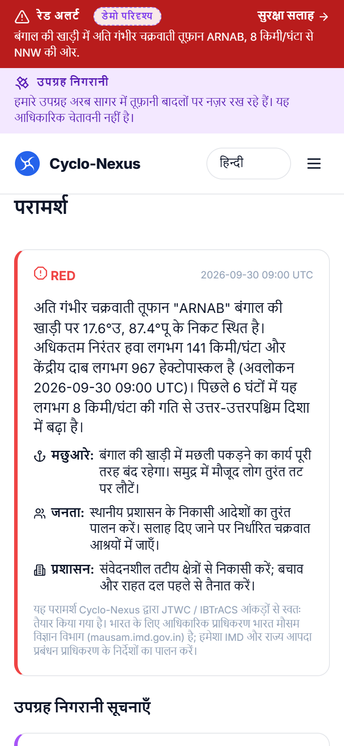



IMPACT AND BENEFITS
Tikka Techies
Potential impact on the target audience
11,098 km
3.77 million
~30%
~1 million
India's coastline
marine fisherfolk
less damage with a 24 h warning
evacuated for Cyclone Phailin
MoPSW revision, Apr 2025
CMFRI census 2016
Global Commission on Adaptation
Odisha, 2013 (World Bank)
Target users:
Coastal residents
Fisherfolk
Disaster officials
Researchers
Benefits of the solution (social, economic, environmental, etc.)
Social
Economic and livelihood
Environmental
RED / ORANGE / YELLOW
IMD-aligned alert levels
Earlier warnings in local language save lives
Phailin (2013): ~1 million evacuated; deaths far below the ~10,000 of 1999
Alerts reach any phone or browser
A 24 h warning can cut damage by ~30%
Amphan (2020): ~US$14 billion (≈ ₹1 lakh crore) losses in India
"Do not go to sea" alerts protect boats and nets
Rainfall hot-spot tracking supports flood preparedness
People-in-path estimates guide evacuation and relief
Open data supports climate research
हिंदी + English
advisories for every audience
People in path
towns and population exposed
~1 million
people evacuated before Cyclone Phailin (2013)
~US$14 billion
Amphan (2020) losses in India — WMO 2020
Every 30 min
rainfall hot-spots refreshed from NASA IMERG
Official + AI
always labelled
Real app screen · Hindi advisory
Turning satellite data into early action that protects lives.
CYCLO-NEXUS | Turning satellite data into early action that protects lives.
Team Tikka Techies · SIH26070 · Ministry of Earth Sciences · Disaster Management
5

Slide 6







RESEARCH AND REFERENCES
Tikka Techies
Details / Links of the reference and research work
Data sources
Research papers
Impact evidence
1
ISRO MOSDAC — INSAT-3DS Imager L1C
mosdac.gov.in
1
Shi et al. (2015) Convolutional LSTM Network — NeurIPS
arxiv.org/abs/1506.04214
1
MoPSW circular (29 Apr 2025): coastline 11,098.81 km
shipmin.gov.in
2
NASA GPM IMERG (via GES DISC)
gpm.nasa.gov/data/imerg
2
Piñeros, Ritchie & Tyo (2008) Deviation-Angle Variance — IEEE TGRS 46(10)
doi.org/10.1109/TGRS.2008.2000819
2
CMFRI Marine Fisheries Census 2016 — 3.77 million fisherfolk
eprints.cmfri.org.in/17490
3
JTWC — warnings and forecast tracks
metoc.navy.mil/jtwc
3
Dvorak (1975) TC intensity from satellite imagery — Mon. Wea. Rev.
doi.org/10.1175/1520-0493(1975)103…
3
WMO / Global Commission on Adaptation (2019) — 24 h warning cuts damage 30%
wmo.int — Early Warnings for All
4
NOAA NCEI IBTrACS v04 best tracks
ncei.noaa.gov/products/…best-track-archive
4
Atkinson & Holliday (1977) wind–pressure relationship — Mon. Wea. Rev.
doi.org/10.1175/1520-0493(1977)105…
4
World Bank — India averts devastation from Cyclone Phailin
worldbank.org/en/results/2014/04/10/…
5
IMD — RSMC New Delhi
mausam.imd.gov.in
5
Knapp et al. (2010) IBTrACS — Bull. Amer. Meteor. Soc.
doi.org/10.1175/2009BAMS2755.1
5
WMO State of Global Climate 2020 — Amphan ~US$14 bn loss (ThePrint)
theprint.in — UN report
6
Open-Meteo · NASA GIBS · GeoNames
open-meteo.com · geonames.org
6
Mohapatra & Sharma — Cyclone warning services in India, MAUSAM 70(4)
doi.org/10.54302/mausam.v70i4.204
6
Ultralytics YOLO — oriented bounding boxes (OBB)
docs.ultralytics.com/tasks/obb
Demo video
Scan to watch the working prototype
GitHub repository
Scan to view the source code
Project report
Scan for the full technical report
QR
QR
QR
CYCLO-NEXUS | Built on open science and public satellite data.
Team Tikka Techies · SIH26070 · Ministry of Earth Sciences · Disaster Management
6

