Slide 1

Vel Tech Rangarajan Dr. Sagunthala R&D Institute of Science and Technology
School of Computing
Department of Computer Science and Engineering
10211CS224 / FULL STACK APPLICATION DEVELOPMENT (JAVA)
PROJECT REVIEW : MILESTONE PROJECT – 1
Date: 17-04-2026
Design and develop a React JS based web application for Ticket Booking of an Internal Department Event.
SDG: SDG 9 – Industry, Innovation and Infrastructure
Presented By:
G.THANUSH – VTU24725 – 23UECS1071.
Courses Handling Faculty:
Dr. Hafizur Rahman

Slide 2
INTRODUCTION
- Event ticket booking is essential for managing registrations efficiently
- Manual booking systems are time-consuming and error-prone
- This project provides an online platform for booking event tickets
- It allows users to view event details and book tickets easily
- The system updates ticket availability in real-time
- It improves accuracy and reduces manual effort
- Useful for colleges and internal department events
- Built using React JS
- Simplifies event management and enhances user experience
1
2
3
4
5
6
7
8
9

Slide 3

PROBLEM STATEMENT
- Many institutions use manual methods for event registration
- Manual systems lead to errors and data inconsistency
- No real-time tracking of available tickets
- Difficult to manage large number of participants
- Time-consuming and inefficient process
- Lack of centralized system for booking management
- Risk of overbooking or duplicate entries
- Need for an automated and reliable booking system
1
2
3
4
5
6
7
8
9

Slide 4
OBJECTIVE(S)
- To design and develop a web-based ticket booking system
- To provide real-time event details and ticket availability
- To allow users to book tickets easily
- To prevent overbooking of tickets
- To implement proper input validation
- To improve efficiency and reduce manual errors
- To enhance user experience using React JS
1
2
3
4
5
6
7
8
9

Slide 5
PROPOSED SYSTEM
- A web-based application for booking event tickets
- Displays complete event information to users
- Allows users to enter details and book tickets online
- Automatically updates available ticket count
- Prevents booking more tickets than available
- Provides instant booking confirmation
- Implements validation for all input fields
- Improves efficiency, accuracy, and user experience
1
2
3
4
5
6
7
8
9

Slide 6
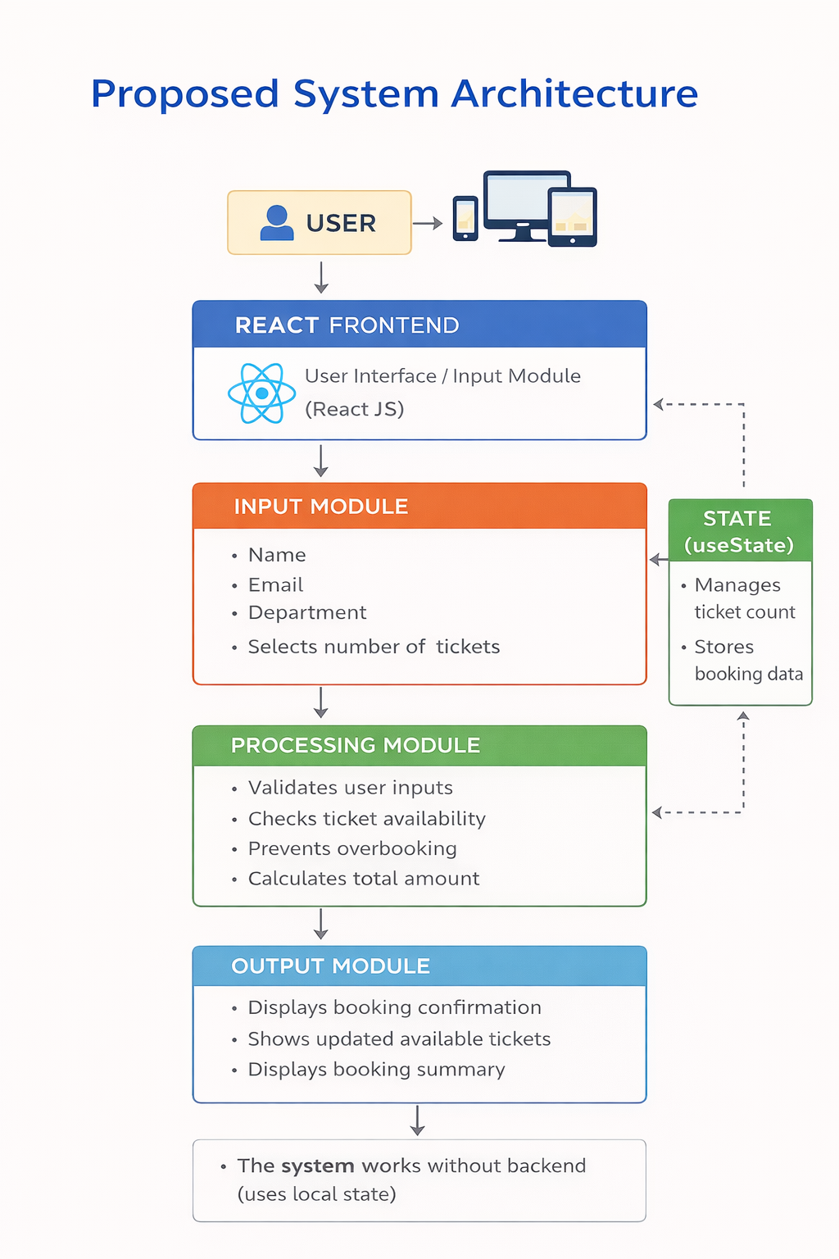
PROPOSED SYSTEM ARCHITECTURE
1
- The system is a web-based React application for ticket booking
- User interacts through the frontend interface
(React JS)
- Input Module:
- User enters name, email, department
- Selects number of tickets
- Processing Module:
- Validates user inputs
- Checks ticket availability
- Prevents overbooking
- Calculates total amount
2
3
4
5
6
7
8
9

Slide 7
PROPOSED SYSTEM ARCHITECTURE
1
- State Management:
- useState is used to manage ticket count and booking data
- Output Module:
- Displays booking confirmation
- Shows updated available tickets
- Displays booking summary
- The system works without backend (uses local state)
- Ensures fast performance and user-friendly experience
2
3
4
5
6
7
8
9

Slide 8
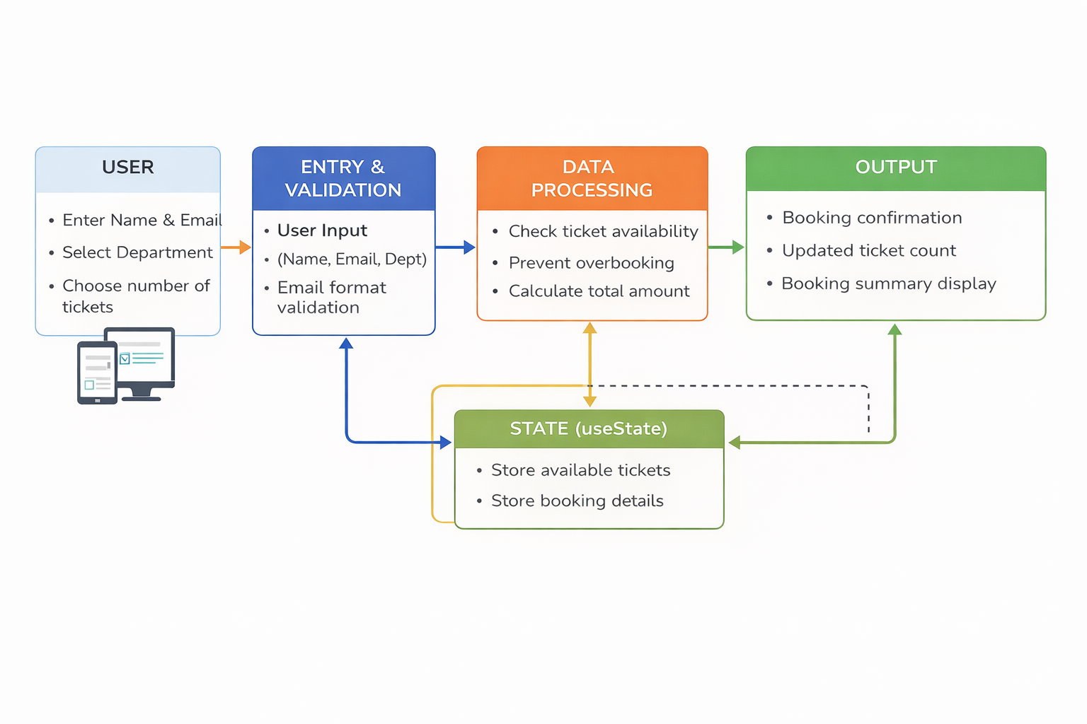
WORKFLOW
1
2
3
4
5
6
7
8
9

Slide 9
TECHNOLOGIES USED
TECHNOLOGIES USED
- Frontend: React JS
- Languages: JavaScript, HTML, CSS
- State Management: useState (React Hook)
- Build Tool: Vite
- Tools: VS Code, Web Browser (Chrome)
- Environment: Node.js & npm
- Operating System: Windows
1
2
3
4
5
6
7
8
9

Slide 10
MODULE DESCRIPTION
Module 1: Event Details Module
- Displays event name, department, date, time, venue
- Shows ticket price and available tickets
Module 2: Ticket Booking Module
- Allows user to enter name, email, department
- User selects number of tickets
Module 3: Validation Module
- Validates all input fields
- Checks email format
- Ensures ticket count is valid
Module 4: Booking Processing Module
- Checks ticket availability
- Prevents overbooking
- Calculates total amount
Module 5: Output Module
- Displays booking confirmation
- Shows updated ticket count
- Displays booking summary
1
2
3
4
5
6
7
8
9

Slide 11
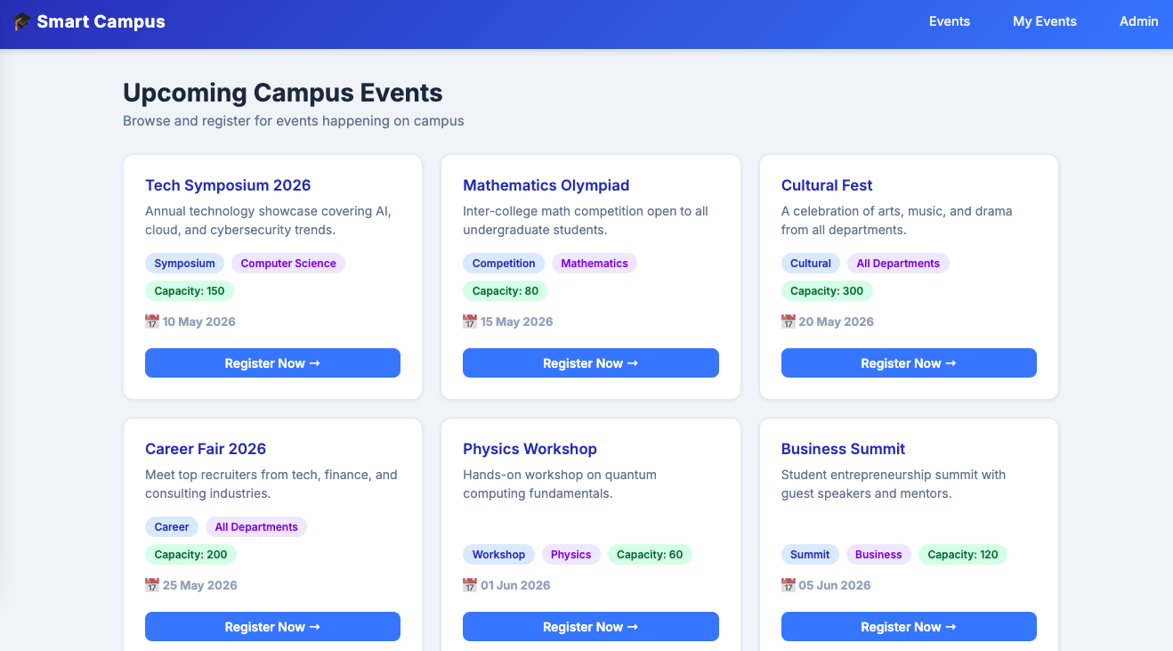
IMPLEMENTATION SCREENSHOTS
1
2
3
4
5
6
7
8
9

Slide 12
IMPLEMENTATION SCREENSHOTS
1
Event Booking Page:
- Displays event details such as event name, department, date, time, and venue
- Shows available number of tickets dynamically
- Displays ticket price information
- Provides a user-friendly booking form
- User can enter:
- Full Name
- Email ID
- Department
- Number of tickets
- Includes input validation for all fields
- Prevents invalid or empty submissions
- Allows users to confirm registration easily
2
3
4
5
6
7
8(A)
9

Slide 13
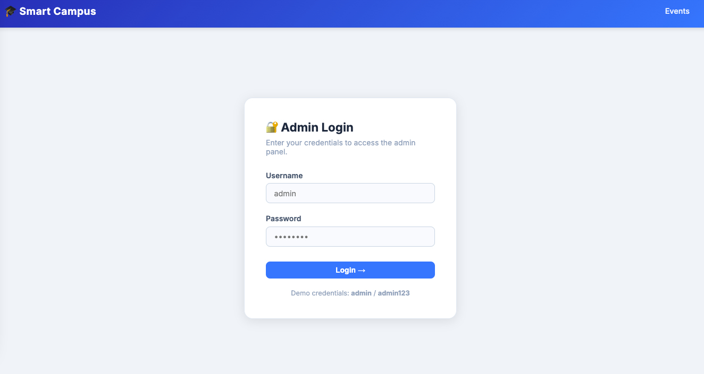
IMPLEMENTATION SCREENSHOTS
1
2
3
4
5
6
7
8(B)
9

Slide 14
IMPLEMENTATION SCREENSHOTS
1
Booking Confirmation Page:
- Displays confirmation message after successful booking
- Shows registration reference ID
- Displays user details:
- Name
- Department
- Shows booking details:
- Number of tickets booked
- Total amount paid
- Updates available ticket count in real-time
- Provides option to start a new booking session
2
3
4
5
6
7
8(C)
9

Slide 15
ADVANTAGES & LIMITATIONS
ADVANTAGES
- Easy and user-friendly interface
- Real-time ticket availability
- Prevents overbooking
- Reduces manual errors
- Fast and efficient booking system
LIMITATIONS
- No backend/database (data not stored permanently)
- No user authentication system
- Limited to small-scale usage
- Requires internet/browser
1
2
3
4
5
6
7
8
9

Slide 16
Thank you

