Slide 1
Hospital Readmission Analysis
IT3081 Statistical Modelling Consultancy
Team Members | 2026

Slide 2
The consultancy question
How can hospitals identify patients who need coordinated discharge support?
Goal: reduce preventable readmissions while protecting clinical judgement, privacy, and equity.
Evidence base: 101,766 encounter records plus statistical modelling and implementation design.

Slide 3
Why readmission matters
Readmission affects patient safety, continuity of care, staffing, and cost.
A discharge intervention must be clinically useful and operationally resourced.
Prediction alone is not a readmission-prevention programme.

Slide 4
Dataset and outcome
101,766 encounter records and 50 source variables.
Source outcome mapping: <30 = readmitted within 30 days; >30 and NO = not readmitted for binary modelling.
30-day readmission prevalence: approximately 11.2%.
Missingness is concentrated in selected administrative and clinical fields.

Slide 5
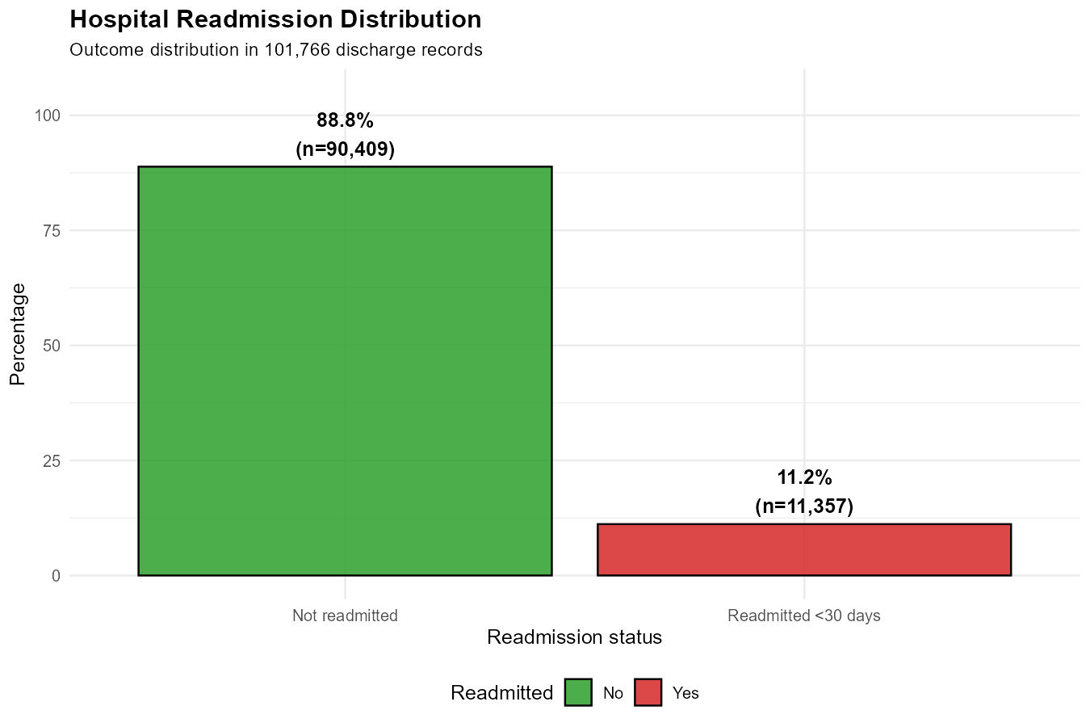
Descriptive analysis: outcome and age

Slide 6
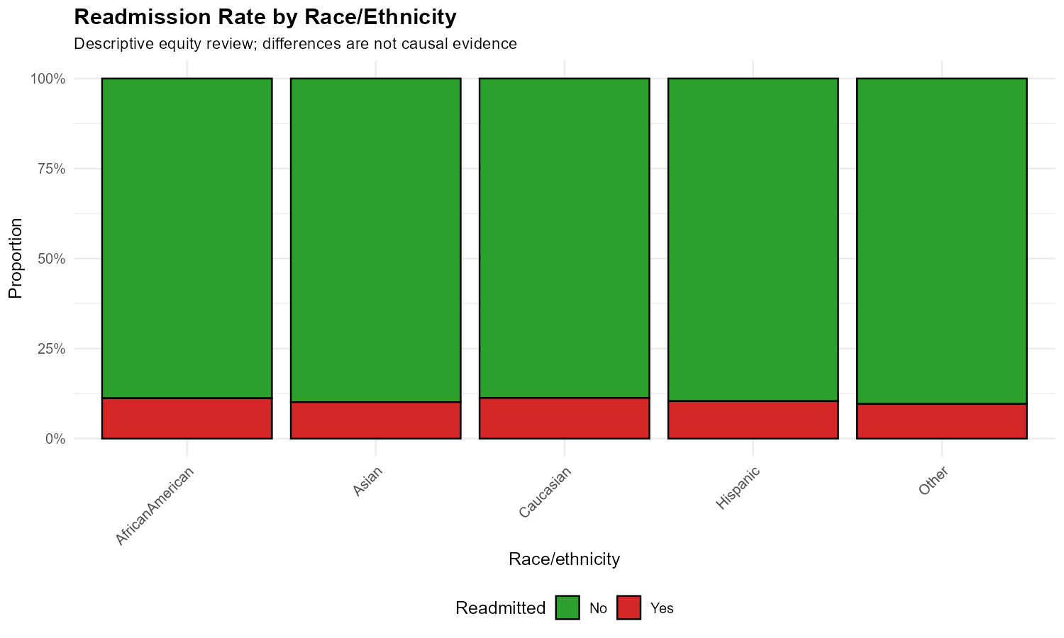
Descriptive analysis: utilisation and equity

Slide 7
Statistical inference
Associations were tested for age, gender, length of stay, medication count, discharge disposition, and diabetes medication status.
Age, length of stay, medication count, disposition, and diabetes medication status were significant in this large sample.
Gender was not significant. Effect sizes should be considered alongside p-values.
Observational associations do not prove causal effects.

Slide 8
Predictive modelling
Models: logistic regression, ridge regression, and LASSO.
Stratified split, training-only standardization, five-fold cross-validation, and ROC-derived thresholds.
Test AUC was approximately 0.66 across models.
The models support a monitored pilot, not autonomous decisions.

Slide 9
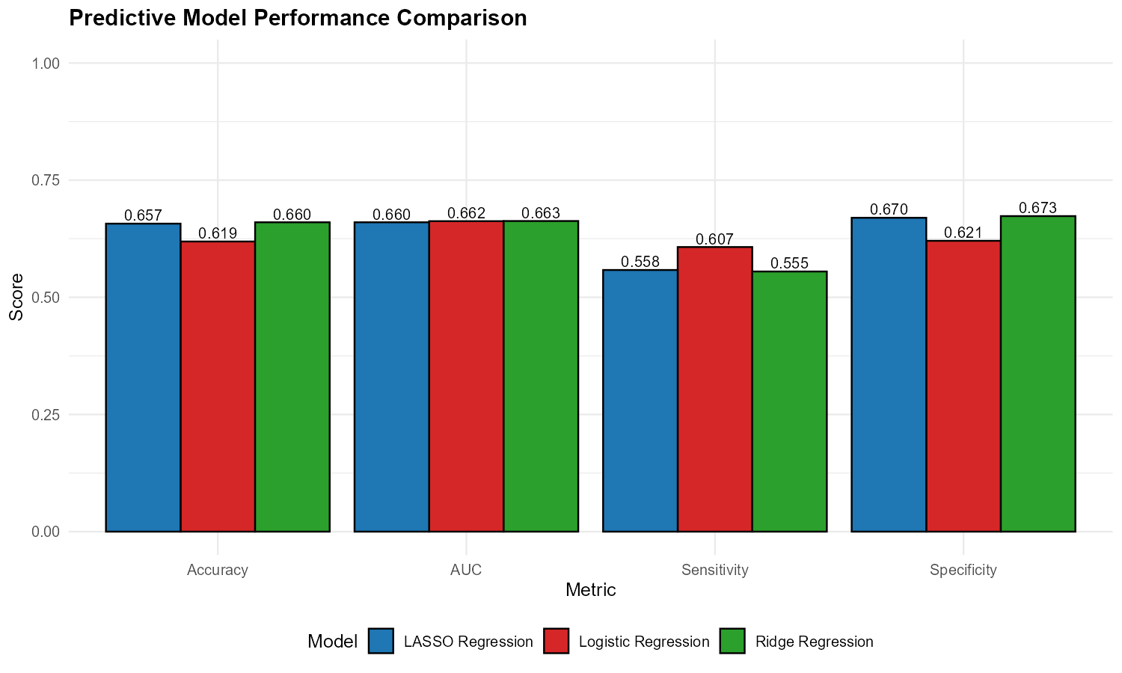
Model performance comparison

Slide 10
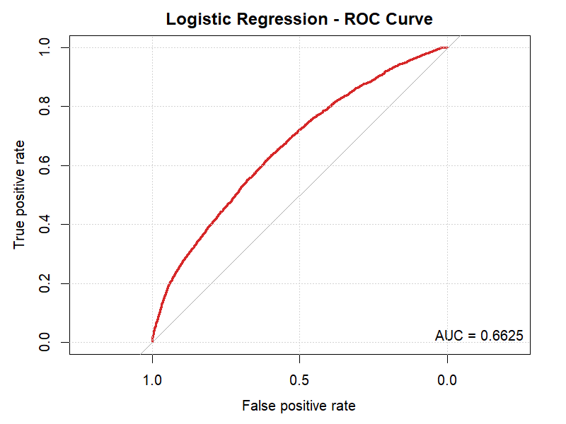
Model discrimination

Slide 11
Innovation: HREWS
An advisory Hospital Readmission Early Warning System.
Risk probability + key drivers + provisional tier + matched discharge checklist.
Clinical staff retain authority and can document overrides.
Local validation, calibration, equity auditing, and prospective evaluation come first.

Slide 12
Risk-matched support
Low: standard education and routine follow-up.
Moderate: medication reconciliation, structured checklist, and 48-72 hour call.
High: multidisciplinary planning, social-needs screening, and early nurse or telehealth contact.
The intervention must match available staffing and follow-up capacity.

Slide 13
Critical evaluation and validation
RCBD is preferred for testing interventions within validated risk strata.
PCA is not recommended as the primary method because interpretability matters.
Bayesian modelling is promising for uncertainty and cost-sensitive decisions.
The current encounter table is not a patient-level time series.
Expert validation must be completed with a genuine healthcare professional.

Slide 14
Implementation roadmap
Months 1-2: governance, local validation, privacy review, and pilot selection.
Months 3-5: dashboard, protocols, training, and monitoring plan.
Months 6-8: advisory pilot with safety, calibration, equity, and workload review.
Months 9-12: controlled expansion only if pilot criteria are met.

Slide 15
Final recommendation
Proceed with a governed, locally validated advisory HREWS pilot.
Measure readmission, calibration, follow-up completion, equity, workload, and cost.
Use a prospective controlled evaluation to test whether interventions cause improvement.
Next step: form the clinical and technical steering group.

