Slide 1
SINGLE SOURCE OF TRUTH
Beyond the Consensus
2026-10-30
Price cutoff
AI-Augmented Fundamental Valuation of Core Indian Blue Chips with Risk-Calibrated Portfolio Construction
6.85%
10Y G-Sec (DCF / DDM)
6.65%
91D T-Bill (portfolio Rf)
ICICI Bank
Reliance
TCS
91D T-Bill
6.00%
DDM
DCF + SOTP
DCF + Reverse DCF
Risk-free anchor
India ERP
25.17%
Sankarshana Mulugundam 246213080 • Aditi Routray 246213548 • Sasi 246213618
Corporate tax
Notes:
Good morning Professor and panel. We present Beyond the Consensus: multi-model valuation of ICICI Bank, Reliance and TCS, live FinBERT NLP, and utility-based portfolio construction anchored on the 91-day RBI T-Bill. I am Sasi; Aditi covers the AI pipeline; Sankarshana covers portfolio construction.

Slide 2
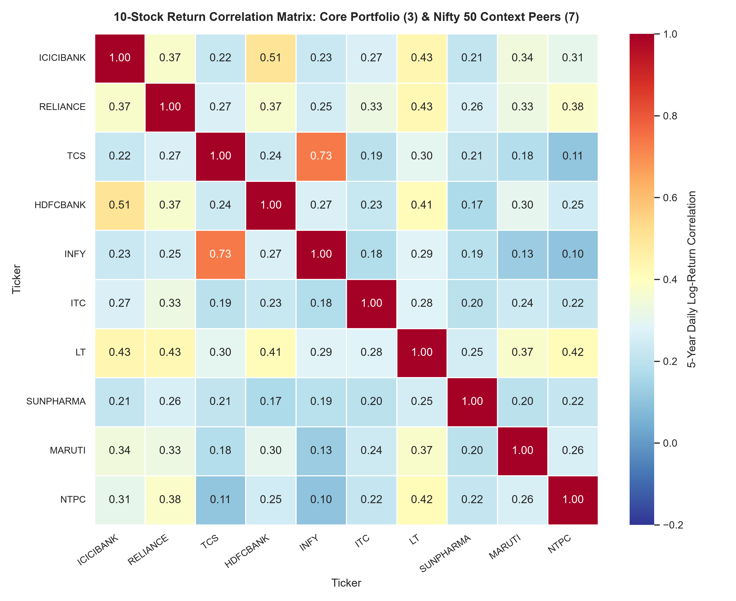
Universe: 3 Stocks + 1 Sovereign Anchor
02 / 15
Low correlation proves real diversification
Sasi
ICICI Bank
Reliance
Private credit
Energy • Jio • Retail
TCS
91D T-Bill 6.65%
Global IT • USD hedge
Core #4 • Risk-free anchor
0.34
0.73
Avg pairwise correlation
TCS vs Infosys (same sector)
REJECTED
ITC
HUL
Cummins
Coal India
Abbott
IHCL
BSE
Notes:
We picked three orthogonal engines of the Indian economy plus the 91-day T-Bill as risk-free anchor. Average pairwise correlation is 0.34 versus 0.73 for TCS-Infosys. We explicitly rejected ITC, HUL, Cummins, Coal India, Abbott India, IHCL and BSE Ltd.

Slide 3
5-Year Financial Health & Forensic Audit
03 / 15
FY22 – FY26 • cash conversion above 95% everywhere
Sasi
ICICI Bank
Reliance
TCS
17.5%
₹1.82 L Cr
51.0%
ROE
EBITDA
ROE
0.45%
95.9%
98.2%
Net NPA
CFO / EBITDA
CFO / PAT
₹92,400 Cr
₹10.15 L Cr
24.5%
NII (18% CAGR)
Revenue
EBIT margin
FORENSIC CHECKS
✓ Ind AS 116 leases deducted from EV
✓ Ind AS 24 RPTs arm's-length
✓ Ind AS 37 94% ICICI hedged FX
✓ Clean auditor opinions
Notes:
Before projecting cash flows we audited five years of financials. All three convert more than 95 percent of earnings to cash. Lease liabilities under Ind AS 116 are deducted in every EV bridge, related-party transactions are arm's length and 94 percent of ICICI's contingent liabilities are hedged FX contracts.

Slide 4
Intrinsic Value vs Market Price
04 / 15
Each model tailored to the business structure
Sasi
ICICI Bank
ACCUMULATE
+14.13%
2-Stage DDM • Ke 12.65%
Reliance
BUY
+21.91%
FCFF DCF + SOTP ₹1,441.95 • WACC 12.10%
TCS
ACCUMULATE
+16.10%
DCF + Reverse DCF • WACC 11.65%
Notes:
Banks cannot be valued with FCFF because deposits are operating inventory, so ICICI uses a 2-stage DDM: 1,595.50, plus 14.13 percent. Reliance uses a consolidated DCF of 1,420.14, plus 21.91 percent, cross-checked by SOTP at 1,441.95. TCS DCF gives 2,905.55, plus 16.10 percent, and the reverse DCF shows the market only prices 5.13 percent growth versus 8.5 percent.

Slide 5
Stress Test: Bear – Base – Bull
05 / 15
5x5 sensitivity grids (±100 bps discount rate and growth)
Sasi
₹1,165
Reliance CMP sits near its bear case (₹1,083)
+55.7%
TCS bull-case upside vs -6.3% worst-case
9.4x vs 42x
Reliance EV/EBITDA vs DMart peer
TCS 18.4x P/E vs Infosys 22.1x • ICICI 3.34x P/B
Notes:
Across the five by five grids every company keeps upside near the base case. Reliance trades near its bear-case value, TCS has an asymmetric payoff of plus 55.7 percent versus minus 6.3 percent. On relative multiples Reliance trades at 9.4 times EV/EBITDA versus 42 times for DMart. Now Aditi will take over.

Slide 6
AI Pipeline: Zero Hallucination
06 / 15
Live FinBERT + deterministic verification
Aditi Routray
1
2
3
4
5
24 concall
transcripts
Live FinBERT
inference
Verbatim quote
verifier
90-sentence
human benchmark
150-headline
bias framing
12 / 12
1.0000
0.00%
annual-report quotes verified
SequenceMatcher similarity
hallucination rate
Valuation math is deterministic Python. AI only extracts and scores text, and every extraction is checked against the source.
Notes:
To avoid LLM hallucination we paired live FinBERT with a deterministic verifier. All 12 extracted annual report quotes matched the source with similarity 1.0000, a 0.00 percent hallucination rate.

Slide 7
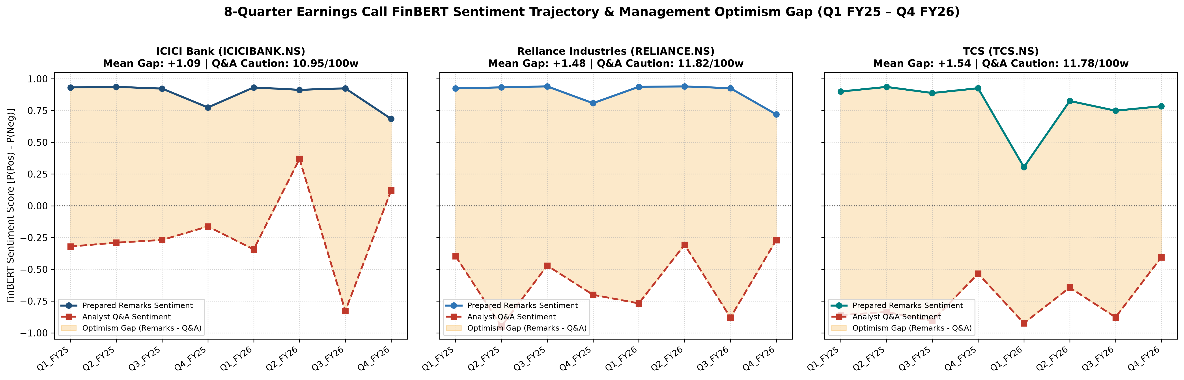
Management Optimism Gap
07 / 15
Scripted remarks vs unscripted analyst Q&A (24 concalls)
Aditi Routray
ICICI Bank gap
+1.09
Remarks +0.88 • Q&A -0.22
Reliance gap
+1.48
Remarks +0.89 • Q&A -0.59
TCS gap
+1.54
Remarks +0.79 • Q&A -0.75
Notes:
Opening remarks score between plus 0.79 and plus 0.89, but unscripted Q&A turns negative with 11 to 12 hedging words per 100. ICICI has the narrowest gap at 1.09; Reliance is 1.48 and TCS 1.54.

Slide 8
FinBERT vs Human Gold Standard
08 / 15
90 hand-labelled sentences (30 per company)
Aditi Routray
95.56%
0.9555
0.9333
Accuracy (86 / 90)
Macro-F1
Cohen's Kappa • almost perfect
Confusion matrix (rows = human, cols = FinBERT)
Accuracy by company
 | Positive | Neutral | Negative
Positive | 30 | 0 | 0
Neutral | 0 | 29 | 1
Negative | 3 | 0 | 27
Notes:
We benchmarked FinBERT against 90 human labelled sentences: accuracy 95.56 percent, macro F1 0.9555 and Cohen's kappa 0.9333. The four misses were double-barrelled sentences where a cautious qualifier sat next to a positive number.

Slide 9
Why the Market Misprices Them
09 / 15
150 headlines classified by behavioural bias
Aditi Routray
ICICI Bank
+14.13%
Hype / FOMO
ACCUMULATE
Reliance
+21.91%
Recency bias
BUY
TCS
+16.10%
ACCUMULATE
Loss aversion
Notes:
Headline framing explains the dislocation: ICICI suffers hype and FOMO, so we accumulate on dips; Reliance suffers recency bias over two weak refining quarters, creating our largest upside of 21.91 percent; TCS suffers loss aversion over AI fears, giving 16.10 percent upside.

Slide 10
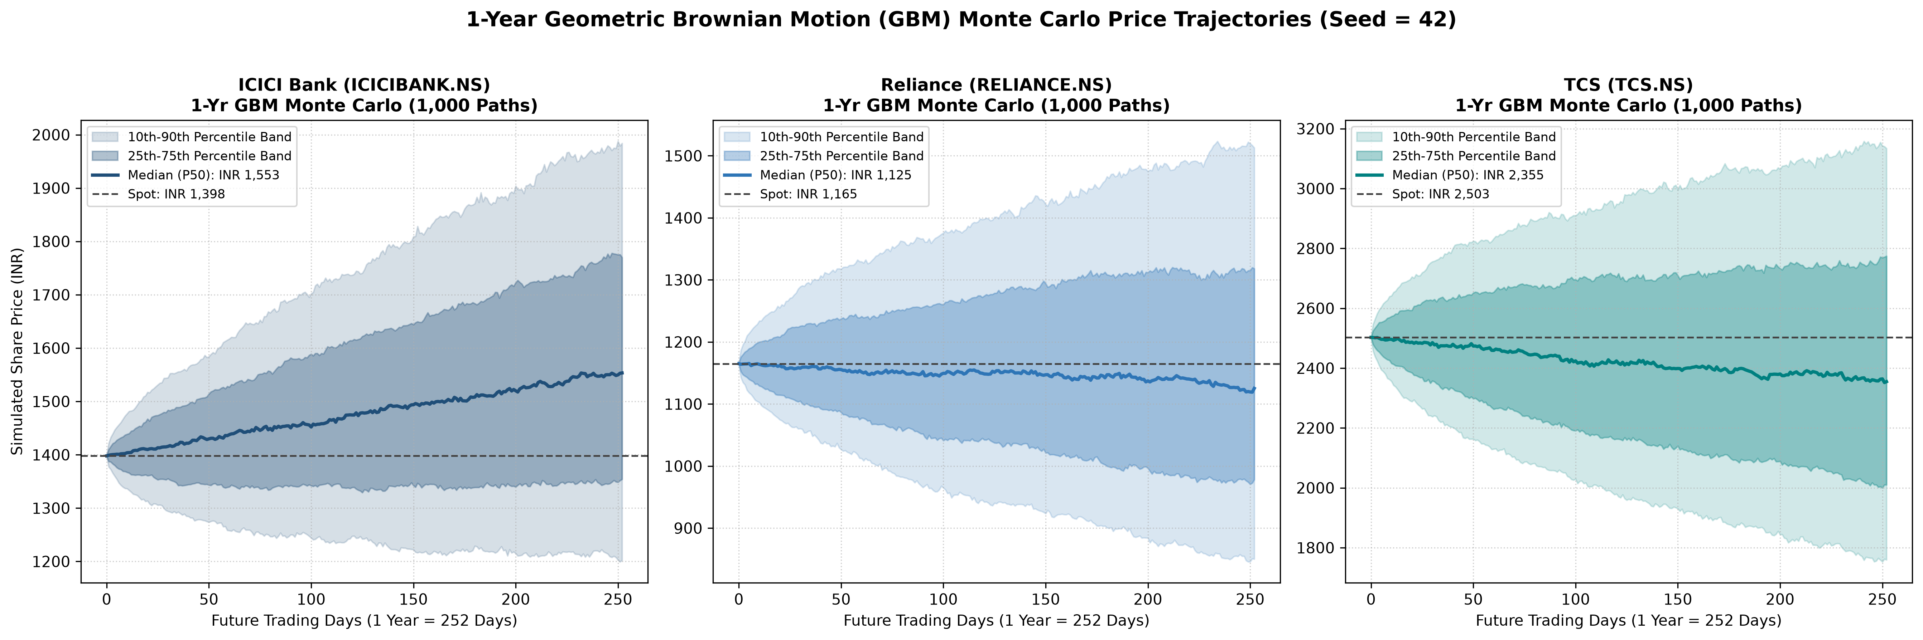
Momentum & Monte Carlo View
10 / 15
1,000-path GBM, 1-year horizon
Aditi Routray
ICICI Bank
RSI 56.97
MC median ₹1,553 ≈ DDM ₹1,596
Reliance
RSI 40.27 oversold
DCF ₹1,420 at 82nd percentile
TCS
RSI 67.56
DCF ₹2,906 between P75 and P90
Notes:
The Monte Carlo median for ICICI converges to our DDM. Reliance is oversold with a positive MACD crossover and our DCF sits at the 82nd percentile, a mean-reversion setup. TCS's target sits between P75 and P90. I now hand over to Sankarshana.

Slide 11
Expected Returns & Tangency Portfolio
11 / 15
Return = 50% CAPM Ke + 50% DCF/DDM implied IRR
Sankarshana M.
14.42%
15.74%
0.4935
Return
Volatility
Sharpe (Rf 6.65%)
Notes:
History punishes Reliance and TCS for cyclical derating, so we blend CAPM cost of equity with DCF implied IRR: 13.99, 15.55 and 13.28 percent, against 6.65 percent for the 91-day T-Bill. The max-Sharpe equity mix is 38.9, 37.9 and 23.2 percent, with 14.42 percent return, 15.74 percent volatility and Sharpe 0.4935.

Slide 12
Featured Investor: A = 4.00
12 / 15
Risk score 30 • Ability 15 • Willingness 15
Sankarshana M.
Where the money goes
Asset | Weight | ₹10 L lump sum | ₹25k SIP / mo
ICICI Bank | 30.50% | ₹3,05,000 | ₹7,625
Reliance | 29.72% | ₹2,97,200 | ₹7,430
TCS | 18.18% | ₹1,81,800 | ₹4,545
91D T-Bill | 21.59% | ₹2,15,900 | ₹5,398
Prudence rule: if |Sec A − Sec B| ≥ 6, use 2 × the lower score
0.4935
0.0786
+1.45%
0.0970
78.41%
21.59%
12.74%
12.34%
Equity y*
T-Bill
E(Rc)
Vol σ
Sharpe
Treynor
Jensen α
Utility
Notes:
At A equals 4 the optimal split is 78.41 percent equity and 21.59 percent in the T-Bill. That is 30.5 percent ICICI, 29.72 Reliance, 18.18 TCS. For ten lakh rupees: 3.05 lakh, 2.97 lakh, 1.82 lakh and 2.16 lakh in T-Bills; for a 25,000 monthly SIP: 7,625, 7,430, 4,545 and 5,398. Expected return 12.74 percent at 12.34 percent volatility. The prudence rule overrides when ability and willingness differ by six points or more.

Slide 13
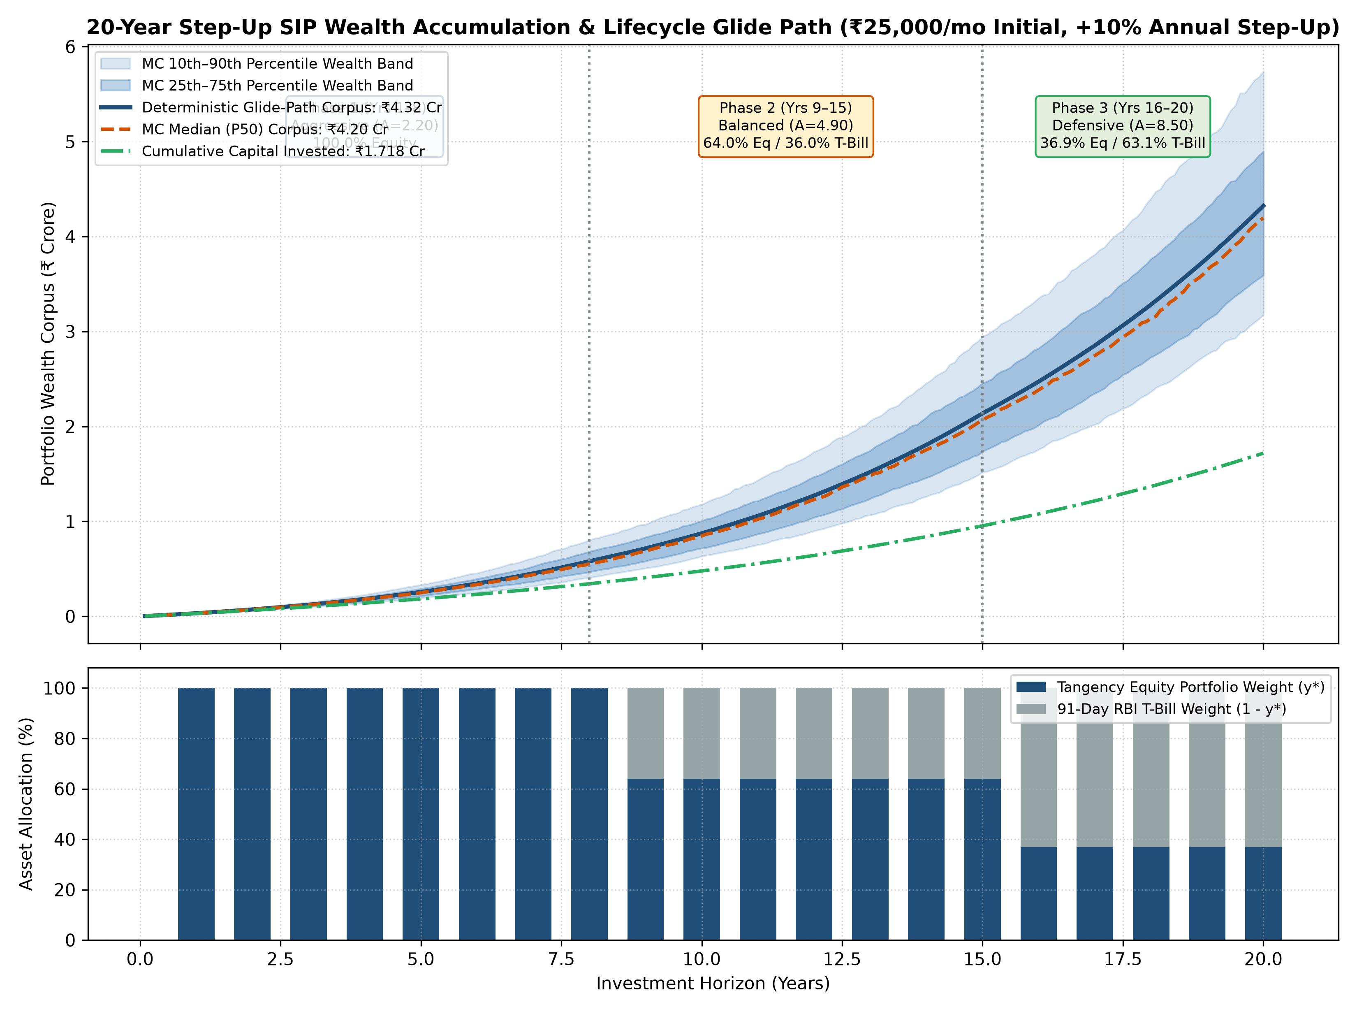
20-Year Step-Up SIP Glide Path
13 / 15
₹25,000 / month • +10% annual step-up
Sankarshana M.
₹1.72 Cr
Total invested
₹4.32 Cr
Expected corpus (2.52x)
₹4.20 Cr
Monte Carlo median
Accumulate
Consolidate
Preserve
₹3.18 – 5.74 Cr
Years 1–8
Years 9–15
Years 16–20
100% equity
64% equity • 36% T-Bill
37% equity • 63% T-Bill
P10 to P90 range
Notes:
A 25,000 rupee monthly SIP with a 10 percent annual step-up invests 1.72 crore over 20 years and compounds to 4.32 crore. The glide path moves from 100 percent equity to 63 percent in T-Bills in the last five years to lock in gains. The Monte Carlo median is 4.20 crore with a 3.18 to 5.74 crore range.

Slide 14
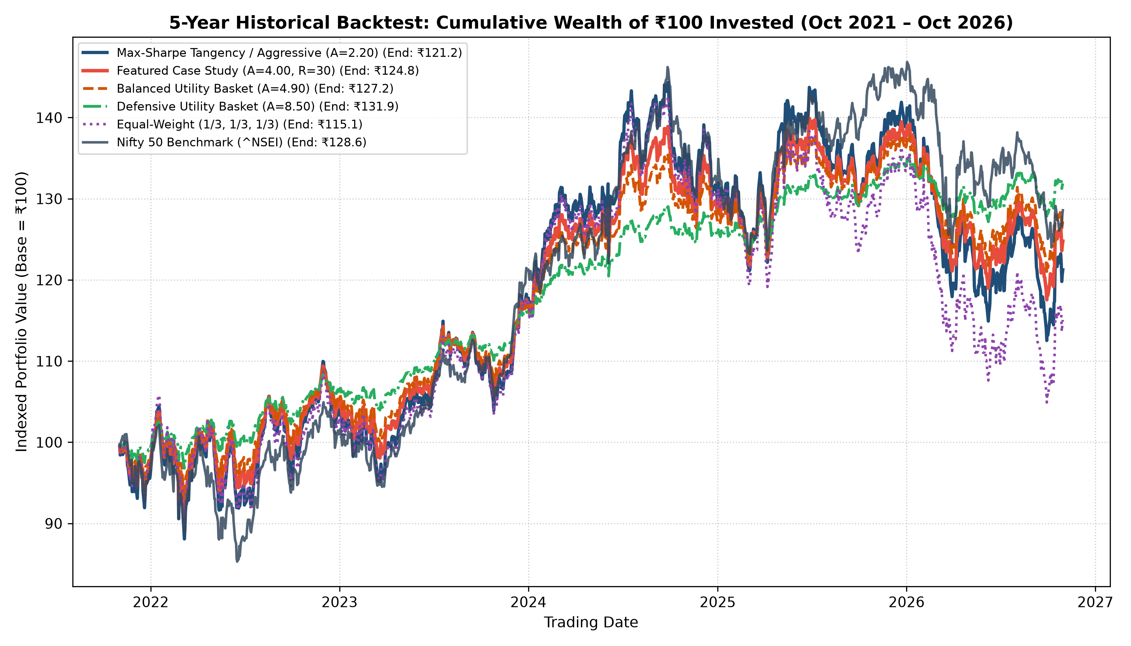
4-Metric Evaluation vs Nifty 50
14 / 15
Sharpe • Treynor • Jensen's alpha • Information ratio
Sankarshana M.
Portfolio | Sharpe | Treynor | Alpha | IR
Tangency | 0.4935 | 0.0786 | +1.84% | +0.227
A = 4.00 | 0.4935 | 0.0786 | +1.45% | +0.014
Balanced | 0.4935 | 0.0786 | +1.18% | +0.117
Defensive | 0.4940 | 0.0786 | +0.68% | +0.006
Nifty 50 | 0.4328 | 0.0600 | — | —
Same Sharpe
T-Bills cut risk
Every mix lies on the Capital Allocation Line (Tobin separation)
Defensive mix: ₹131.88 on ₹100 with a 63% T-Bill cushion
Notes:
All four mandatory ratios beat the Nifty 50. Sharpe and Treynor are the same along the capital allocation line because excess return and volatility both scale with y star, whereas the information ratio differs because it benchmarks against a fully invested index. T-Bill heavy baskets cushioned the Reliance and TCS derating in the five-year backtest.

Slide 15
Final Verdict
15 / 15
Triangulated: valuation + AI sentiment + portfolio
Sankarshana M.
Reliance
ICICI Bank
TCS
91D T-Bill
BUY
ACCUMULATE
ACCUMULATE
ANCHOR
+21.91%
+14.13%
+16.10%
6.65%
upside
upside
upside
risk-free yield
29.72% of A=4.00 portfolio
30.50% of A=4.00 portfolio
18.18% of A=4.00 portfolio
21.59% of A=4.00 portfolio
Live offline dashboard • 9 blocks
Limitations
py -m streamlit run 05_dashboard/app.py
Risk-aversion slider • ₹ lump sum & SIP
Double-barrelled sentences fool FinBERT (4 / 90)
GBM has constant volatility
5-year betas & covariance are static
Notes:
To conclude: Reliance is our contrarian BUY, ICICI and TCS are ACCUMULATE, and the 91-day T-Bill anchors the portfolio, 21.59 percent at A equals 4. Limitations are FinBERT on double-barrelled sentences, constant-volatility GBM and static betas. All nine modules run live in our offline dashboard. Thank you; we welcome your questions.

Slide 16
Appendix: Viva Quick Answers
16 / 15
Six likely questions • one line each
All
Why DDM for ICICI?
TCS return is negative, upside +16%?
Deposits are operating inventory, so FCFF/WACC is meaningless for a bank.
P/E fell ~32x → 18.4x while profit grew; reverse DCF prices only 5.13% growth.
How is AI hallucination ruled out?
Why 4 FinBERT misses?
Verbatim verifier: 12/12 quotes at similarity 1.0000.
Cautious qualifier next to a positive number (double-barrelled).
6.85% vs 6.65% risk-free?
Why identical Sharpe across baskets?
10Y G-Sec matches long DCF duration; 91D T-Bill is the zero-duration portfolio asset.
All lie on the CAL; return and volatility scale together with y*.
Notes:
Reference slide for viva questions.

