Slide 1
How Level I Stability Analysis (LISA) Program Works
By
Tasnia Shehrin
Graduate Student
WSU
Supervisor: Dr. Idil Deniz Akin

Slide 2
Introduction
LISA :
LISA is a probabilistic model
Used primarily for relative landslide hazard evaluation for resource allocation, forest planning, timber sale allocation, environmental assessment report.
Probabilistic Analysis:
A probabilistic analysis provides an estimate of the probability of slope failure, rather than the factor of safety.
Probabilistic analysis uses probabilistic models to quantify the uncertainty and variability associated with the prediction of slope stability.

Slide 3
Introduction (Cont.)
Probability of failure :
Probability of failure can be used qualitatively to make relative comparisons between landforms to identify areas that should be targeted for additional analysis.
It can also be used quantitatively in a risk analysis.
Monte Carlo simulation:
Monte Carlo simulation is the method used in LISA
Has capability to incorporate the variabilities of many input parameters.
Suitable for stable analysis of large, variable landforms using infinite slope model.

Slide 4
Introduction (Cont.)
Monte Carlo simulation (Cont.):
Final simulation output is a set of 1000 possible factor of safety values that can be displayed as a histogram.
Monte Carlo Simulation Steps:
For each component random variable being considered, select a random value that conforms to the assigned distribution.
Calculate the value of the FOS using the adopted performance function and the input values obtained from step-1.
Repeat step-1 and step-2 many times, storing the FOS result from each trial calculation.
Use the many calculated FOS values from the Monte Carlo simulation to estimate:
Probability, P (F<Fc)
Sample mean & variance
FOS PDF from histogram.

Slide 5
Introduction (Cont.)
Limitation of LISA:
Does not simulate the size or number of failure that might occur on a particular landforms.
Cannot predict
exact locations of any failure.
type of failure.

Slide 6
Steps of operation of LISA
Step-1: Select Distribution Type :
The user selects a distribution type for each input parameter in the infinite slope equation.
Enter values to describe the selected distribution.
The user may choose a constant value or a uniform, normal, lognormal, triangular, beta or relative-frequency histogram distribution.
The most popular parameter that is selected for random variable is cohesion, c and effective angle of friction, φ.
NB. Equations that will be used in our simulation is attached at the last portion of the presentation.

Slide 7
Steps of operation of LISA (Cont.)
Step-2: Generate values:
LISA generates a column of up to 1,000 values for each parameter. The number of values (how many values i.e. 700/900/1,000) is specified by the user.
A frequency histogram of the 1,000 values for each parameter will closely match the shape of the distribution specified by the user.
However, these 1,000 values are generated in a random order.
LISA displays the minimum, maximum, mean and standard deviation for each variable as the values are generated.

Slide 8
Steps of operation of LISA (Cont.)
Step-3: Calculate Factor of Safety (FS):
After step-2, LISA calculate the FS for each set of generated values.
The result is 1,000 possible realization of factor of safety, with relative frequencies being a result of the distribution used for each input variable.
The minimum, maximum, mean and standard deviation for the FS and probability of failure are displayed.

Slide 9
Steps of operation of LISA (Cont.)
Step-4: View Frequency Histogram of Factor of Safety (FS):
In this step, the user may view:
The frequency histogram of the factor of safety values.
The frequency histogram of the values simulated for each variable.
The scatter plots of any pair of variables or of a variable and the factor of safety.

Slide 10

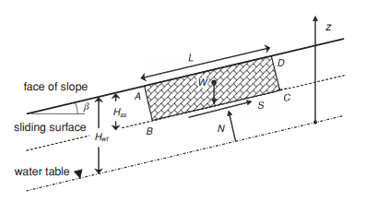

Equations that we will use in our simulation
Equations:
Equation developed by Lu and Godt (2008) for assessing the Factor of safety (FS) of infinite slope under variably saturated conditions:
Here,
φ’= effective angle of friction
β= Slope angle
c’= drained cohesion
$H_{ωt}$ = distance from ground
surface to water table (WT)
z= distance above the WT

Slide 11
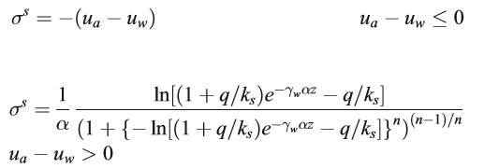
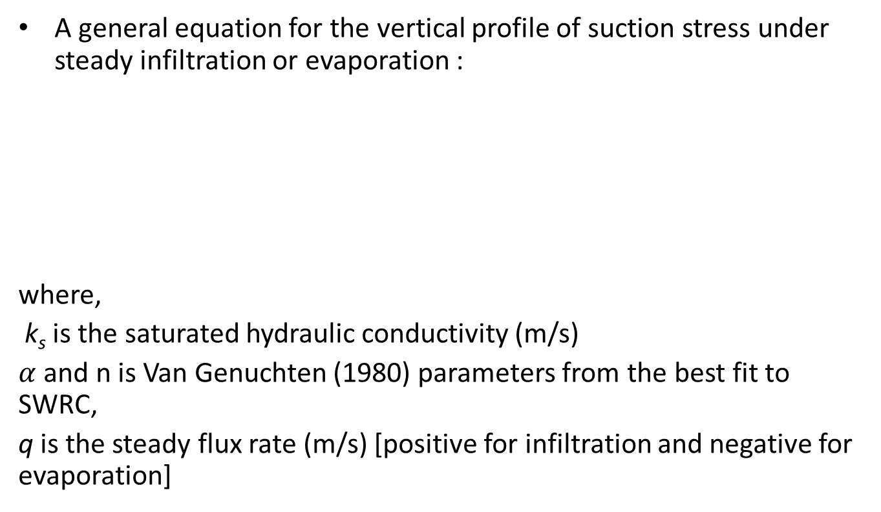
Equations that we will use in our simulation (Cont.)
A general equation for the vertical profile of suction stress under steady infiltration or evaporation :
where,
k_{s} is the saturated hydraulic conductivity (m/s)
$α$ and n is Van Genuchten (1980) parameters from the best fit to SWRC,
q is the steady flux rate (m/s) [positive for infiltration and negative for evaporation]

Slide 12
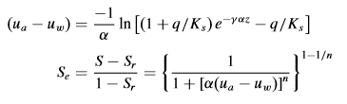

Equations that we will use in our simulation (Cont.)
Effective degree of saturation, $S_{e}$:
Here,
$α$ and n are fitting parameter
z= distance above the water table

Slide 13
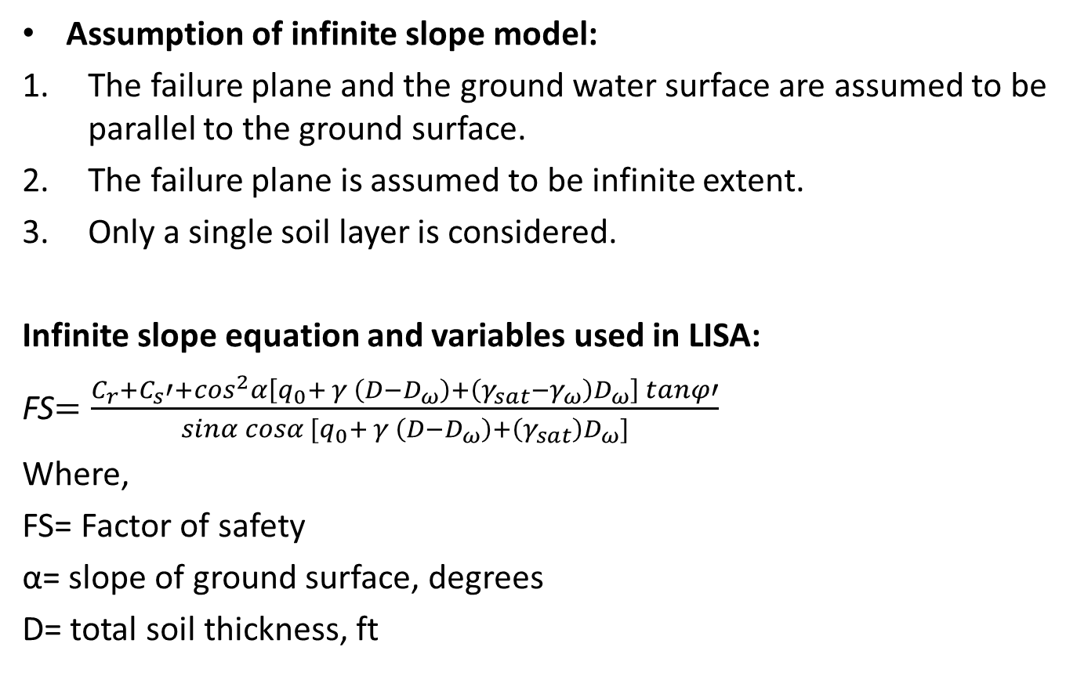
Equation used in LISA simulation
Assumption of infinite slope model:
The failure plane and the ground water surface are assumed to be parallel to the ground surface.
The failure plane is assumed to be infinite extent.
Only a single soil layer is considered.
Infinite slope equation and variables used in LISA:
FS$=\frac{C_{r}+C_{s}′+cos^{2}α\left[q_{0}+ γ \left(D−D_{ω}\right)+\left(γ_{sat}−γ_{ω}\right)D_{ω}\right] tanφ′}{sinα cosα [q_{0}+ γ \left(D−D_{ω}\right)+\left(γ_{sat}\right)D_{ω}]}$
Where,
FS= Factor of safety
α= slope of ground surface, degrees
D= total soil thickness, ft

Slide 14
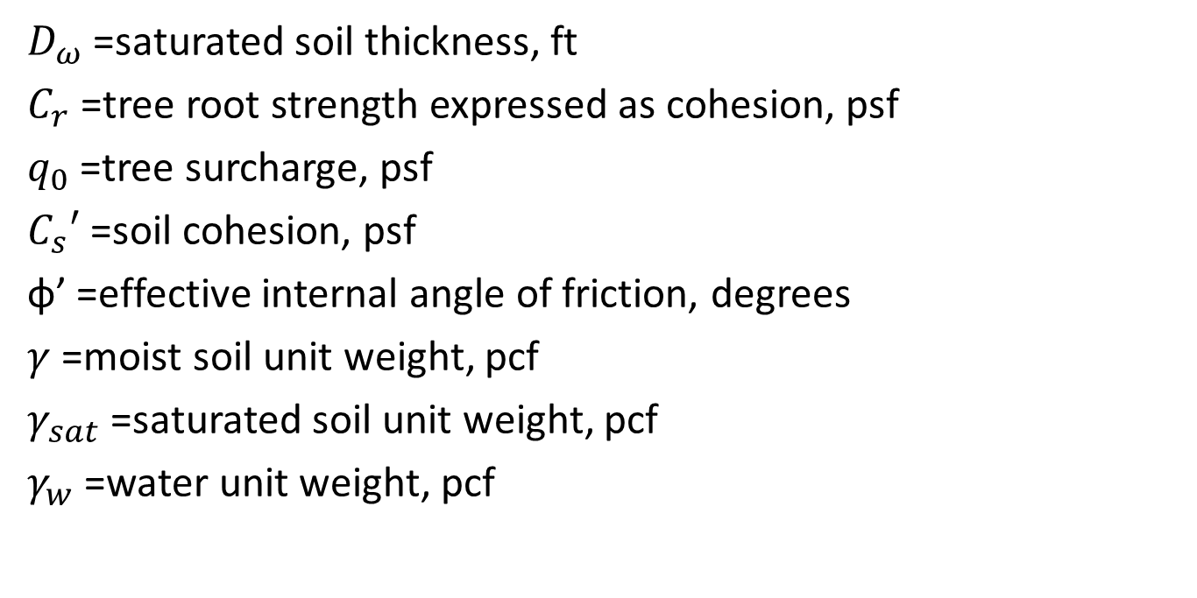
Infinite slope equation and variables used in LISA (Cont.)
$D_{ω}$ =saturated soil thickness, ft
$C_{r}$ =tree root strength expressed as cohesion, psf
$q_{0}$ =tree surcharge, psf
$C_{s}′$ =soil cohesion, psf
φ’ =effective internal angle of friction, degrees
$γ$ =moist soil unit weight, pcf
$γ_{sat}$ =saturated soil unit weight, pcf
$γ_{w}$ =water unit weight, pcf

Slide 15

Thank You..!!

