Slide 2
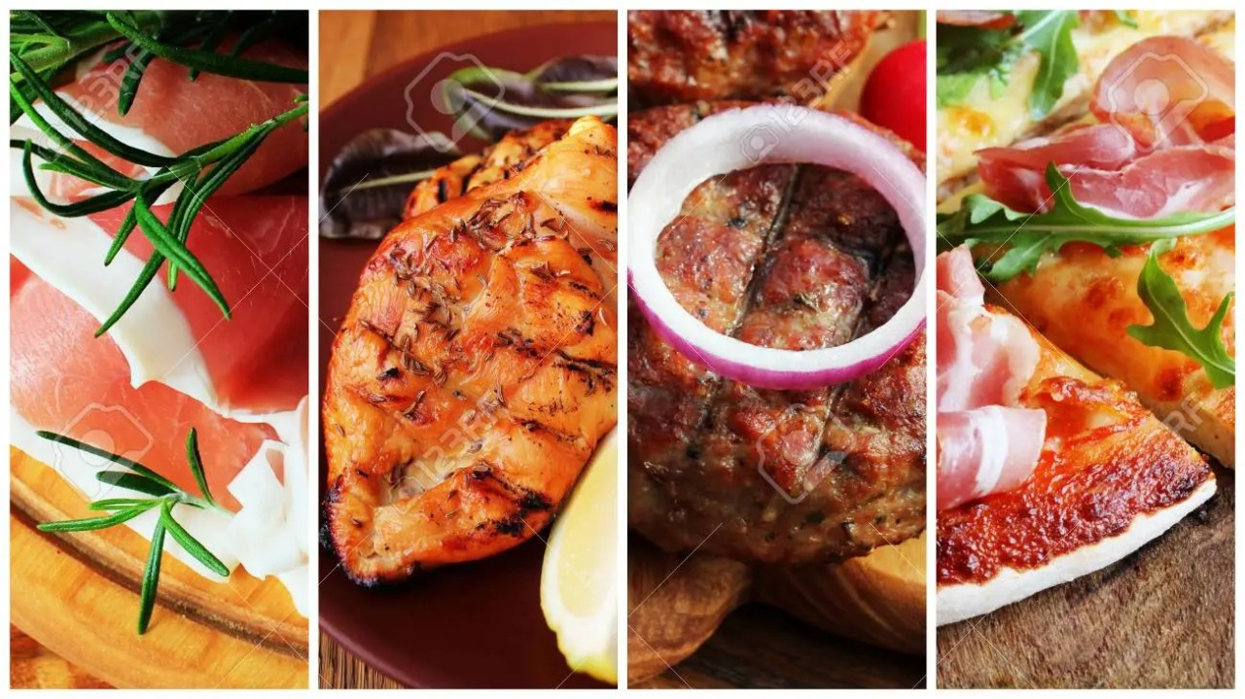
CAFETERIA ORDERING SYSYTEM
NAMES UID
KAUSTUBH NAITHANI 20BCS4000
DHRUVA MALIK 20BCS3976
PRASHANT KUMAR 20BCS4363
PALAK VERMA 20BCS4362
RITIK 20BCS4361

Slide 3
ABSTRACT
Order food from anywhere.
Multiple payment options.
User friendly.
Can edit the menu items.
Records the transaction history.

Slide 4


INTRODUCTION
Easy for customers to order food online and compare food items.
This website makes it easy for students to buy and review food and snacks and to automate the existing manual system.
Data and Information can be Stored for a longer period of time.

Slide 5
LITERATURE SURVEY
Wireless Food Ordering System
Point of Sale System
Online Ordering System
Comparison Between Similar Systems

Slide 6
METHODOLOGY
This undertaking started with conceptualizing thoughts with the supervisor, who gave the title.
In the next stage , information was gathered , we looked up about the present system , and its demerits and how they could be addressed.
In the planning stage, every information acquired during arranging and examination stage changed was laid out and a plan was formed.
In the Development stage is where the plan will carry out into the coding.
when the framework/website was done, we started the implementation and testing.
Finally the proposed system was finished

Slide 7
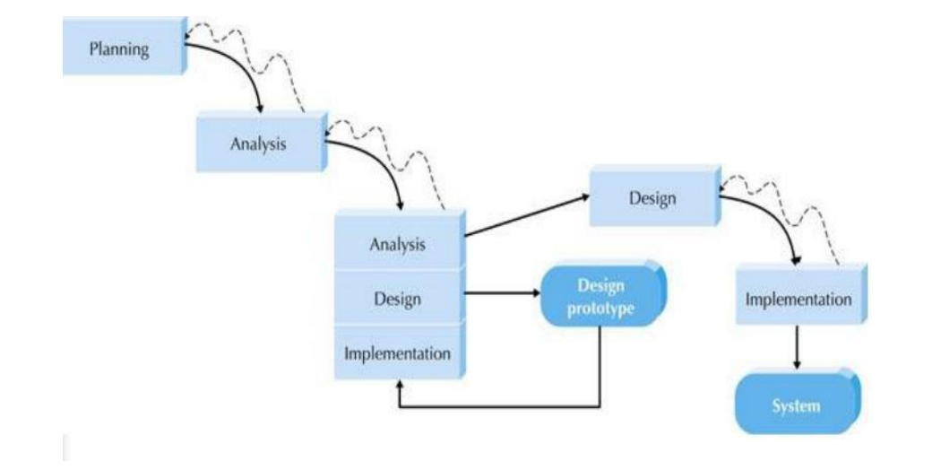

Slide 8
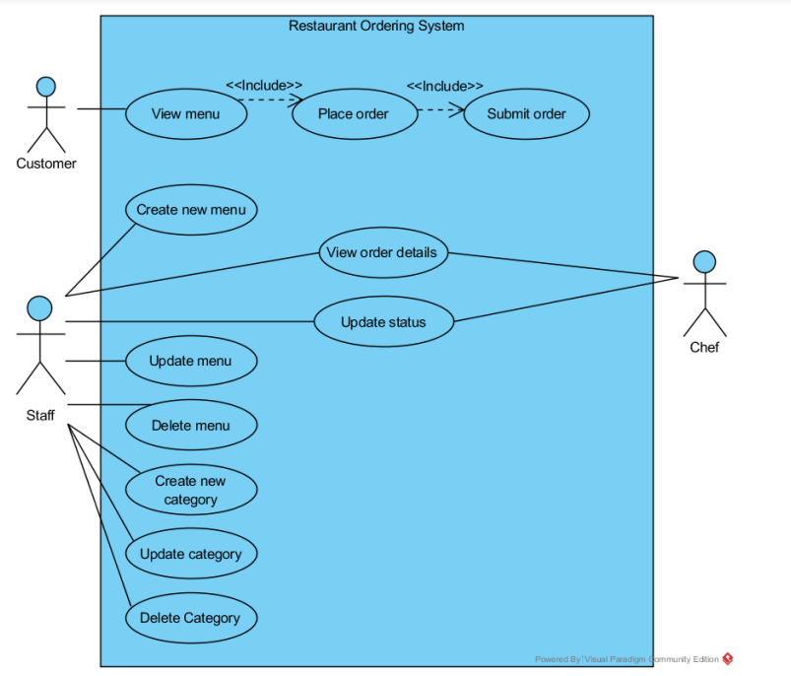
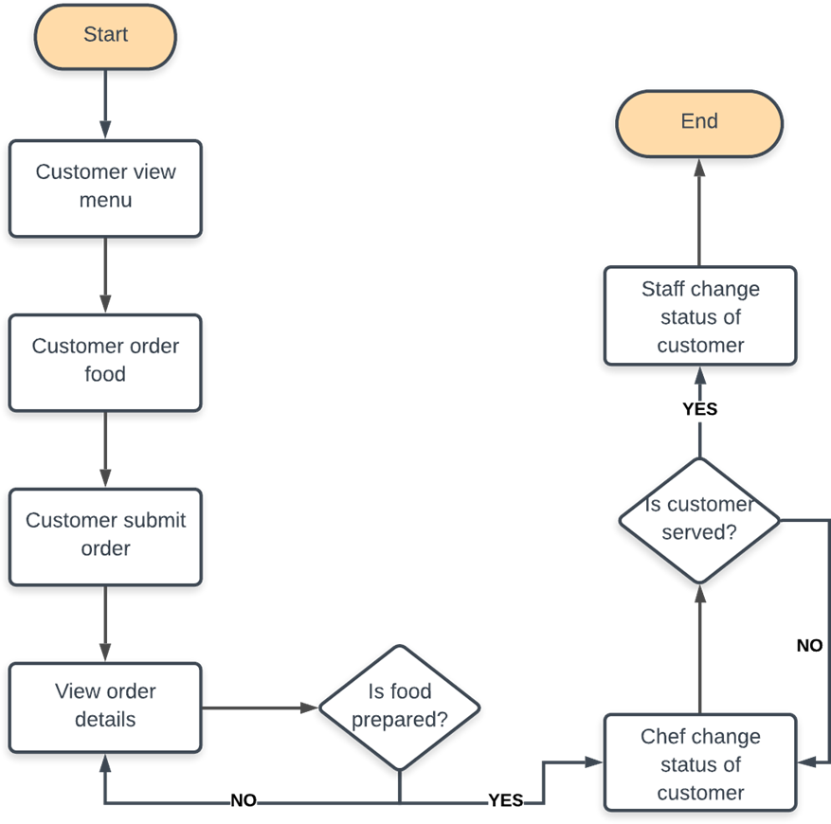
System Flowchart of Cafeteria Ordering System
Use Case Diagram of Restaurant Ordering System

Slide 9
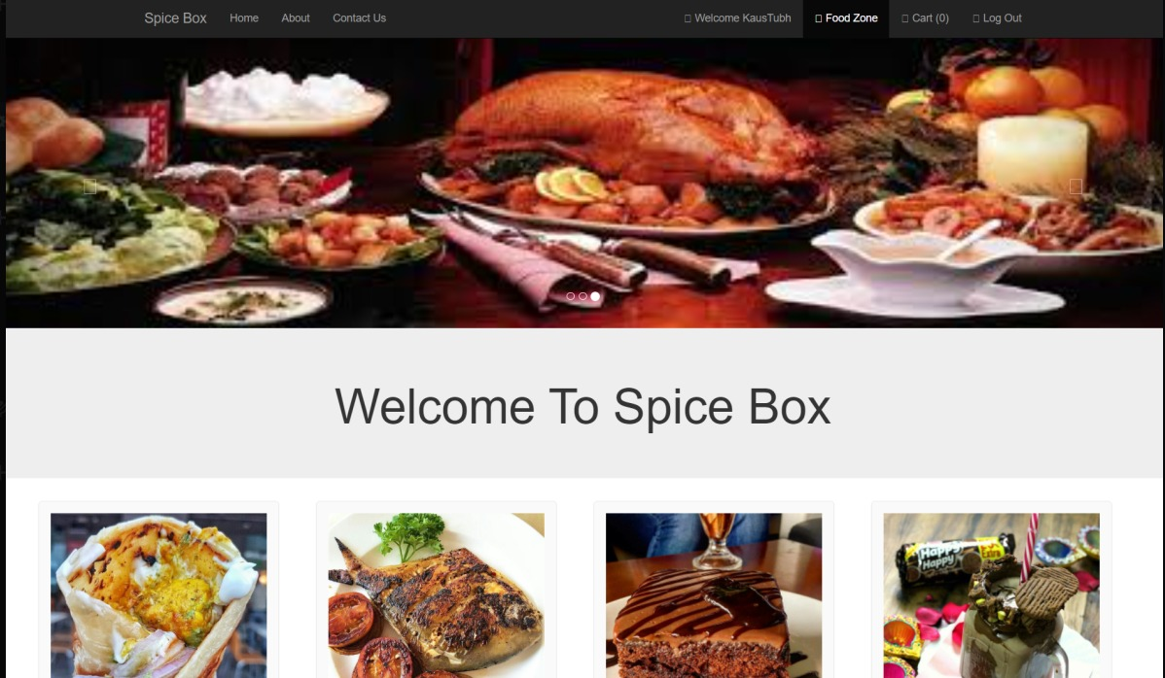
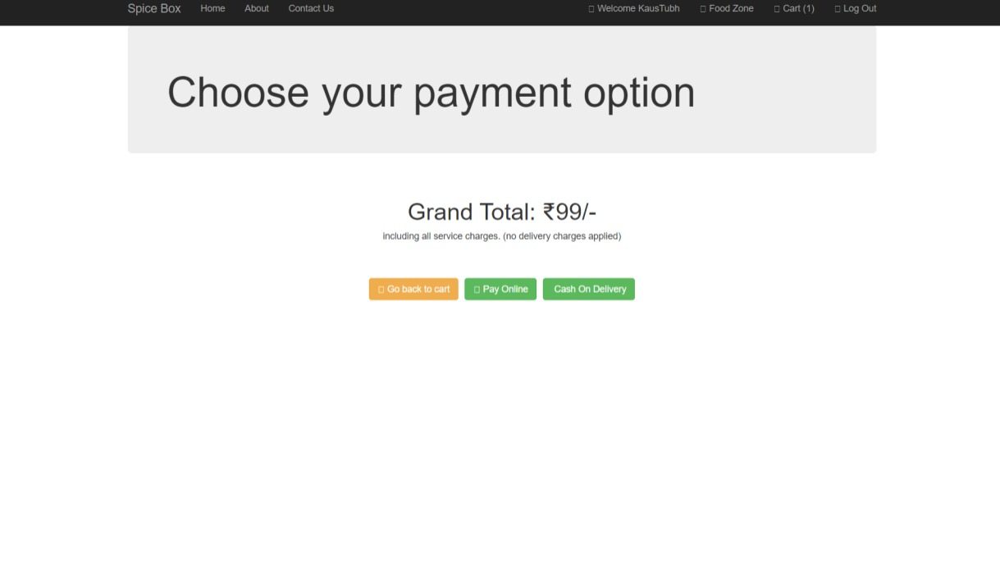
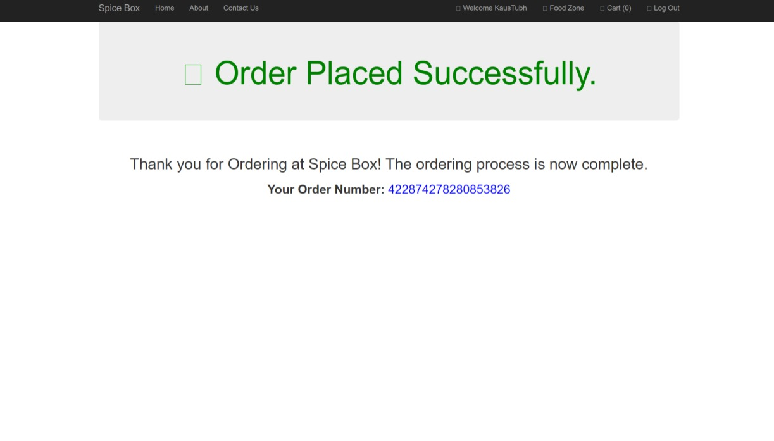
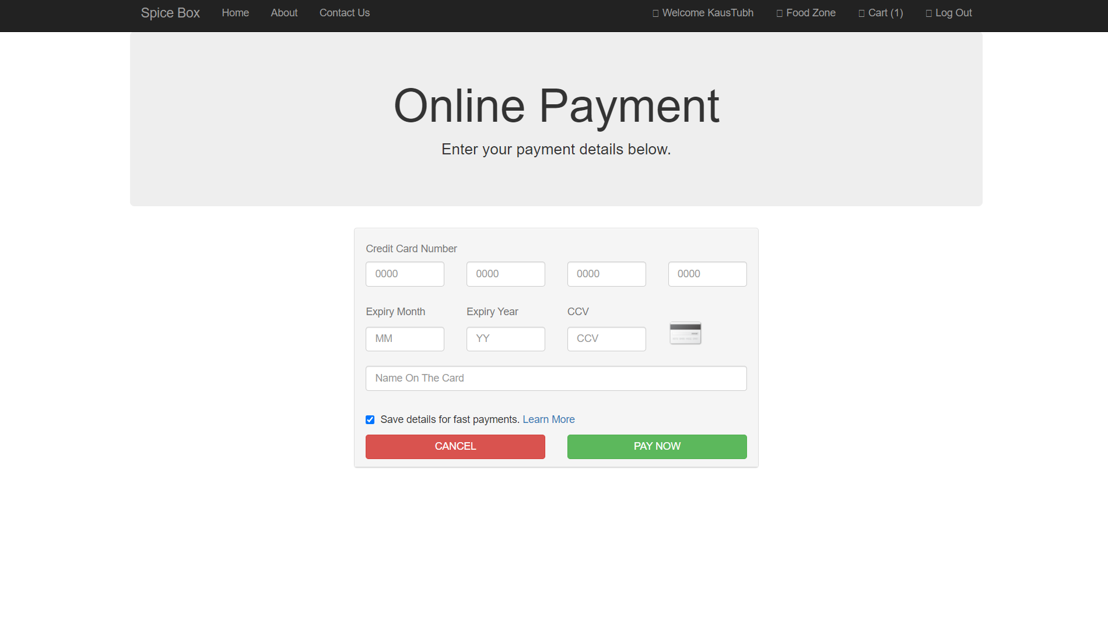
SCREENSHOTS

Slide 10
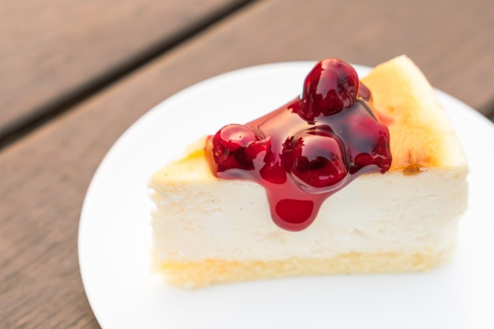

CONCLUSION
Current food ordering system faces many difficulties and issues.
Cafeteria Ordering System allows customers to order through the system.
Cafeteria Ordering System provides easy services to the customer and effortless process of the staff.

Slide 11
FUTURE SCOPE
Can provide QR code as an payment option.
Can add more Food Items.
Can provide a Tracker to track the delivery of their item.
Can dockerize and deploy the application as a container so that more and more cafeterias can use out project.
Can provide a section to give reviews and ratings of the food items.

Slide 12
REFERENCES
[1]. Kirti Bhandge, Tejas Shinde, Dheeraj Ingale, Neeraj Solanki, Reshma Totare,” A Proposed System for Touchpad Based Food Ordering System Using Android Application”, International Journal of Advanced Research in Computer Science Technology (IJARCST 2015).
[2].Varsha Chavan, Priya Jadhav, Nehal Korade, Priyanka Teli, ”Implementing Customizable Online Food Ordering System Using Web Based Application”, International Journal of Innovative Science, Engineering Technology(IJISET) 2015.
[3]. Resham Shinde, Priyanka Thakare, Neha Dhomne, Sushmita Sarkar, ”Design and Implementation of Digital dining in Restaurants using Android”, International Journal of Advance Research in Computer Science and Management Studies 2014.

Slide 13
THANK YOU
Submitted to:- Mr. Namit Chawla

