Slide 1
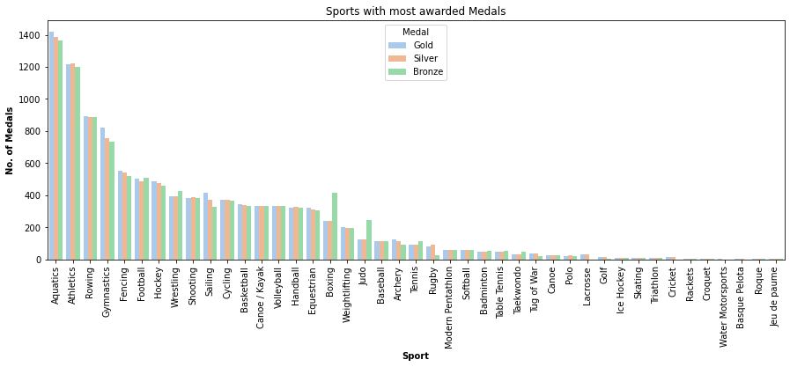

Exploratory data Analysis
The data allows us to explore:
Sports with the most awarded medals
Notes:
Next, I will introduce the Exploratory Data Analysis:
We generated a bar chart which could find the sport with most awarded medals, we can clearly see the most medals is Aquatics. If the government want to get more medals, they could focus on the Aquatics.
We found two interest sports which are boxing and judo.
At first, we think they are wrong data, but after we checked them in the internet, we found the real reason:
There are two bronze medals because of the special competition system for boxing and judo. It‘s interesting.

Slide 2
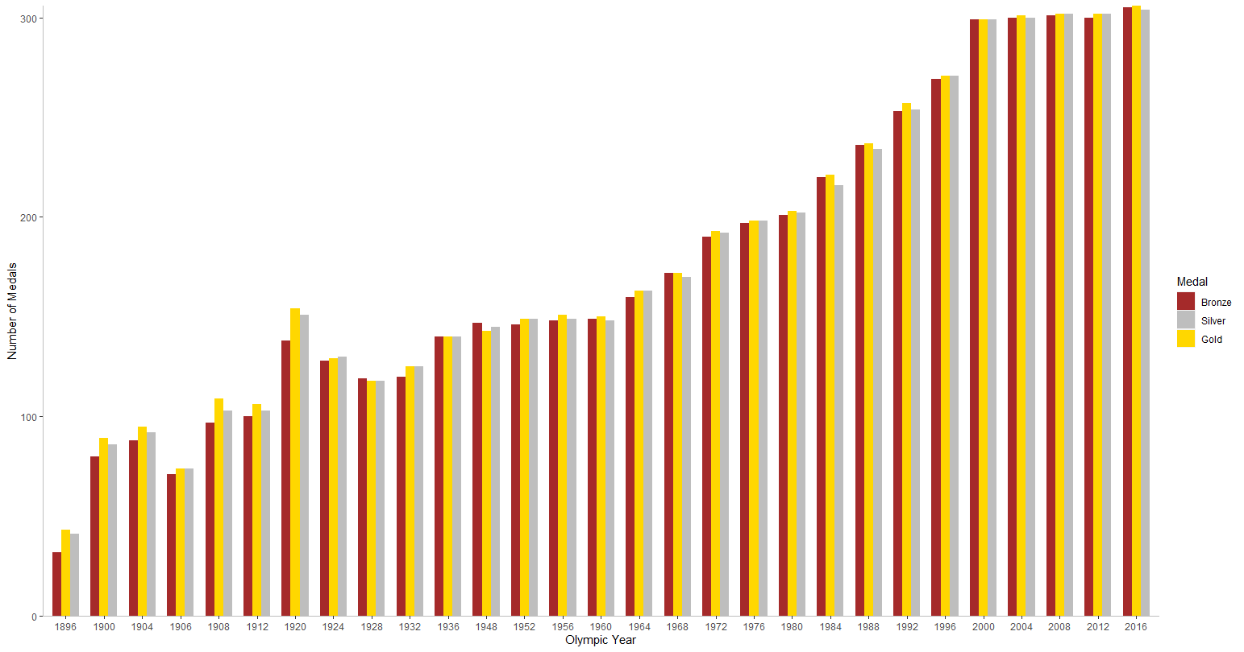
Exploratory data Analysis
The data allows us to explore:
Sports with the most awarded medals
Number of awarded medals each Olympic games (Summer shown)
Notes:
We have generated a bar chart based on the data of medals which showing the number of medals produced for each year.
We could clearly see that the overall trend in the total number of Olympic medals is increasing year by year.
Why are the three medals different in the same year ?
The reason is some sports will produce side-by-side first or side-by-side second and third. When two athletes are tied for first place, two gold medals and one bronze are produced.

Slide 3
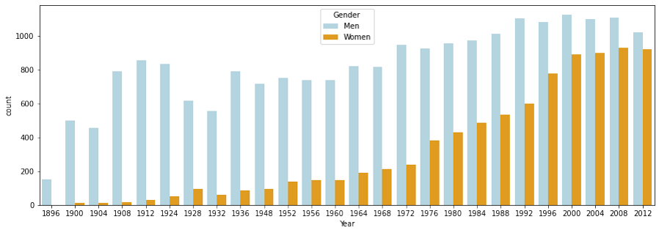
Exploratory data Analysis
The data allows us to explore:
Sports with the most awarded medals
Number of awarded medals each Olympic games (Summer shown)
Gender of participating athletes
Notes:
More and more female athletes in the Olympics.
As this bar chart, the relationship between gender and medal.
We can see that in eighteen ninety-six, almost no female athletes in the Olympic. But with the progress of the times, more and more female athletes participated in the Olympic. For governments, they should pay more attention on female in the future.

Slide 4
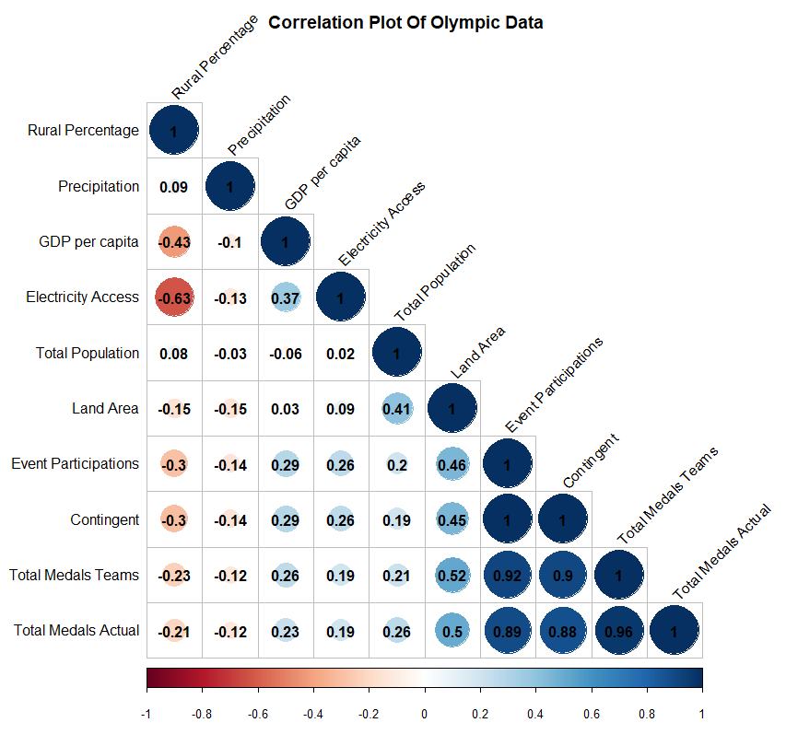
Exploratory data Analysis
The data allows us to explore:
Sports with the most awarded medals
Number of awarded medals each Olympic games (Summer and Winter)
Gender of participating athletes
Correlation between relevant data attributes
Notes:
This is a correlation chart showing the linear correlation coefficients between all attributes of our final data set.
The bottom row shows the number of actual medals awarded versus each of the factors.
We can see that event participations are heavily correlated with total medals.
Land area is also heavily correlated, but due to having unchanged values between Olympic years (country land area remains constant), the data is not very useful for prediction.
Electricity access also showed a correlation
Highlighted in yellow are the two factors (GDP per capita and Total Population) that we have chosen to build a model initially.
This is because they are extraneous factors to Olympic participation, unlike the number of event participations.

