Slide 1
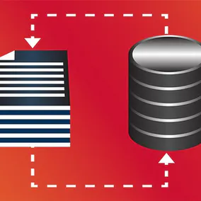

Use the Apache Spark Structured Streaming API with MongoDB.
Dave Dalsveen

Slide 2
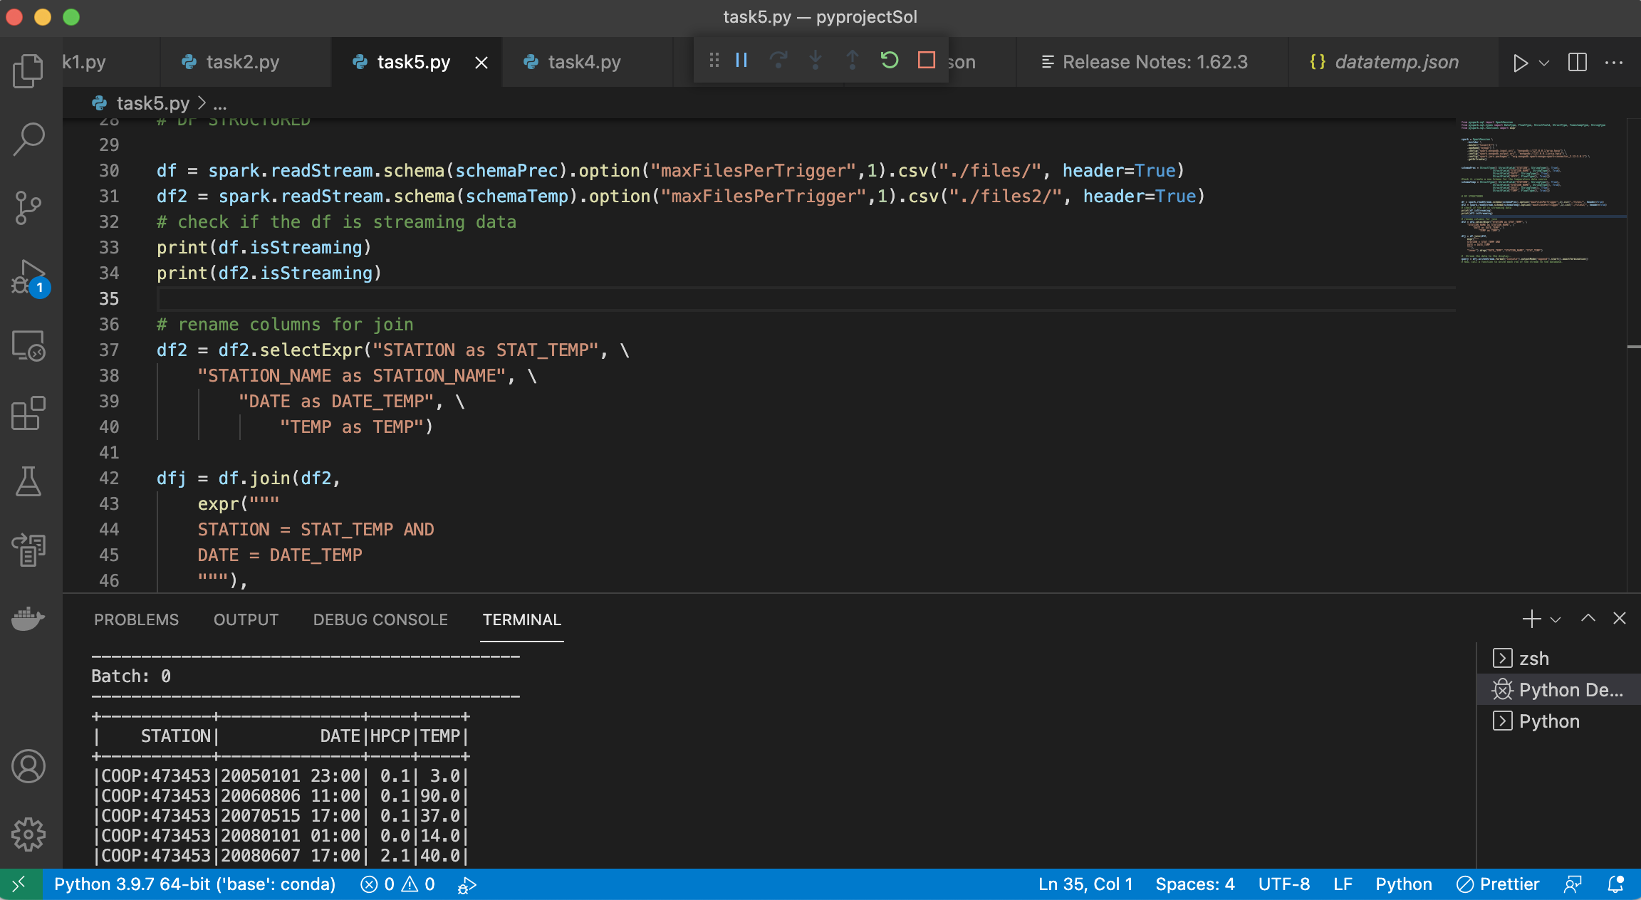
Completed Project

Slide 3
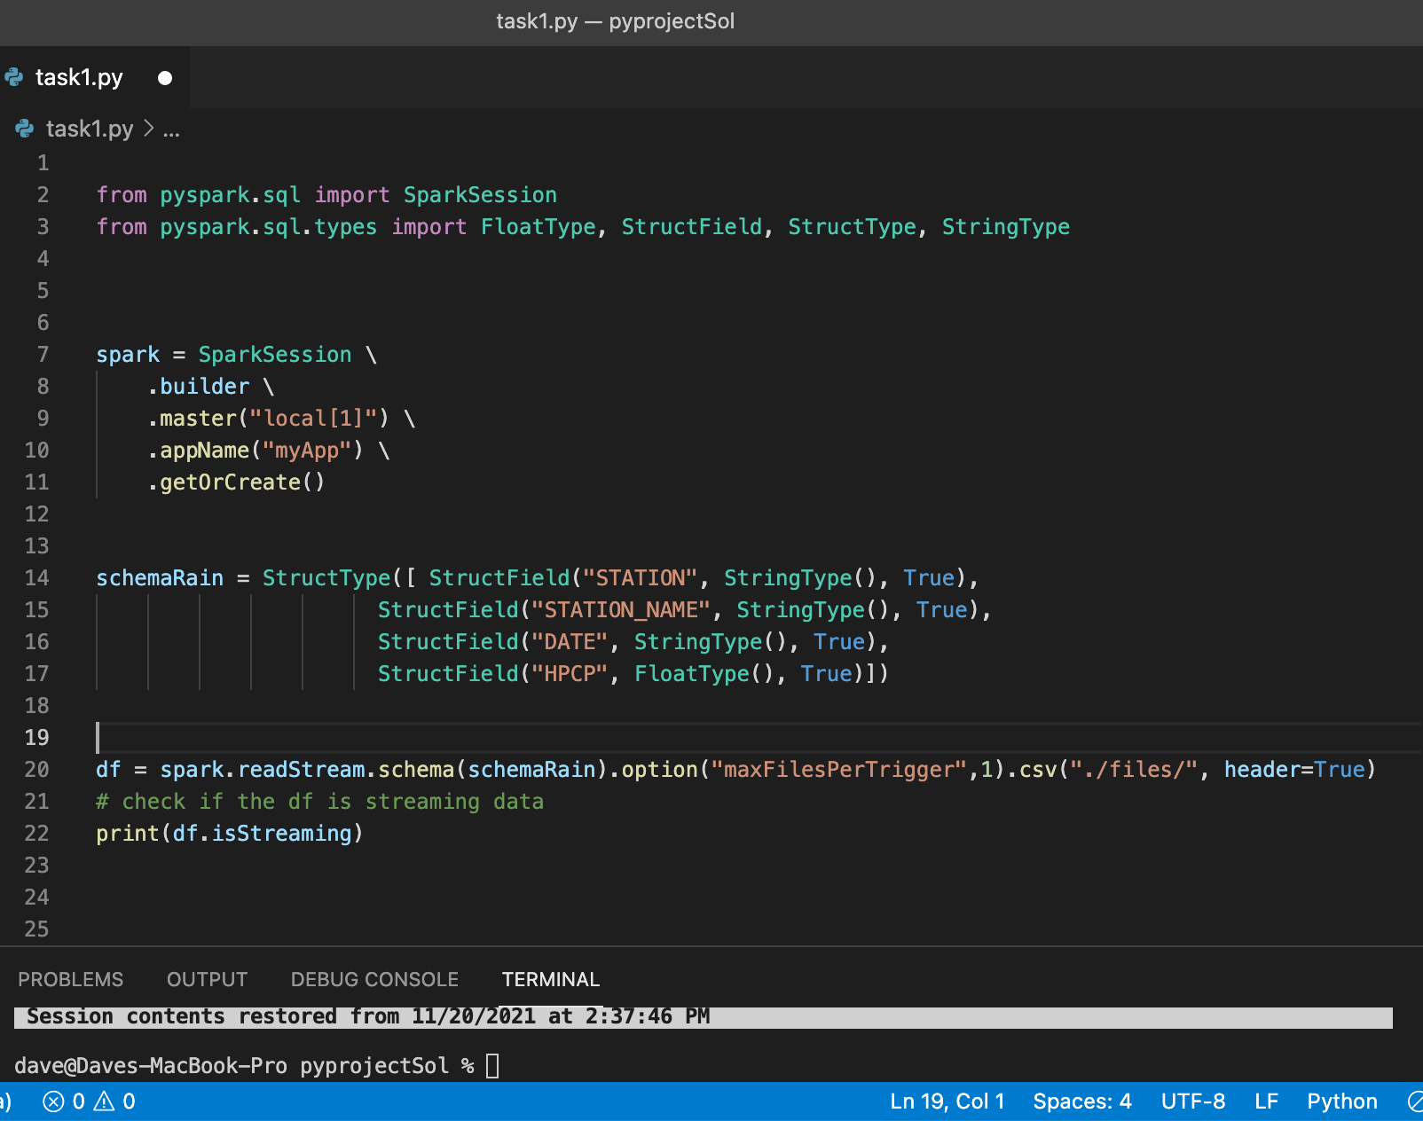
Task1: Create a Python PySpark program to read streaming structured data.
Build the SparkSession Object.
Create a Schema for the Streaming data.
Read from the data stream by providing the directory name containing the data.
Check that the dataframe is streaming.

Slide 4
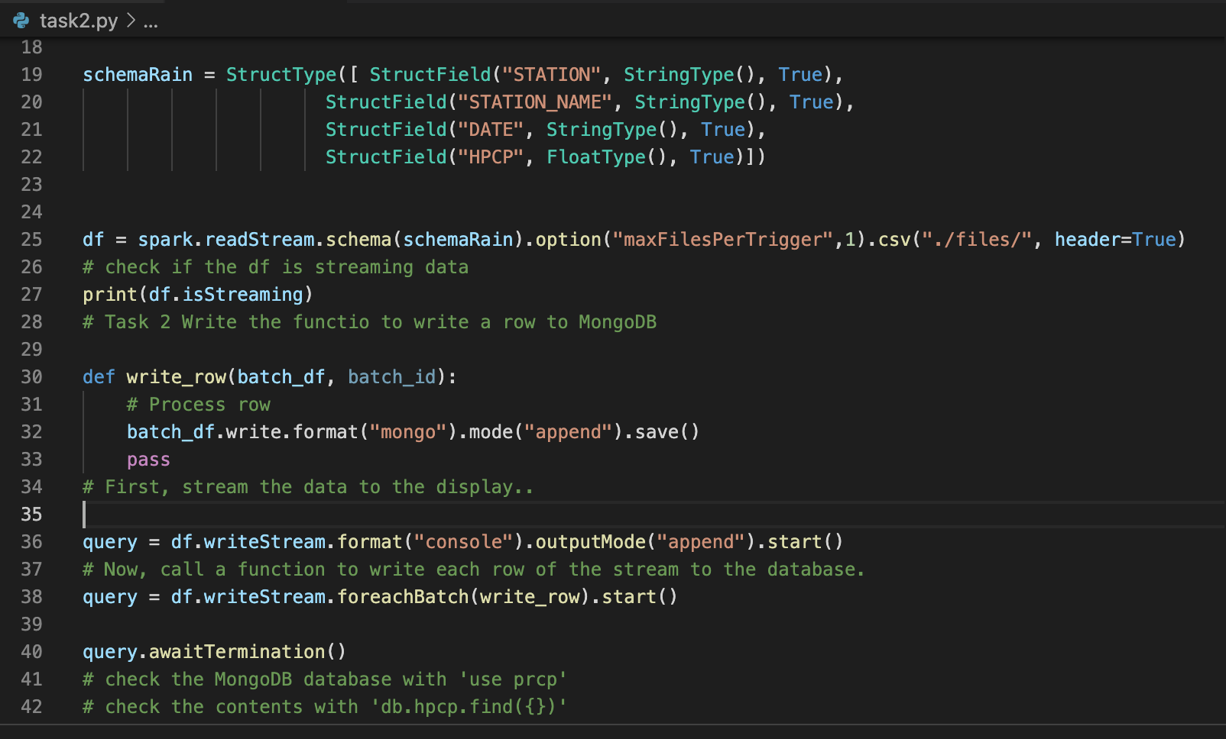
Task2: Persist Apache Spark data to MongoDB.
Create a function to write a row at a time to the database.
Use a streaming dataframe Writestream to output the data to a console.
Use a streaming dataframe Writestream to output the data to MongoDB.
Verify the MongoDB data.

Slide 5
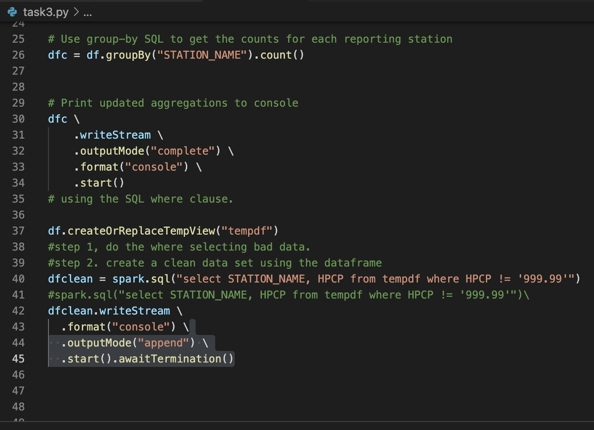
Task3: Use Spark Structured Query Language to query data.
Create an aggregation to count the number of reports for each Station.
Use the writeStream to output the result to the console.
Create a tempView dataframe to perform Spark SQL.
Use a Where clause to query for invalid data.
Create a clean streaming dataframe.

Slide 6
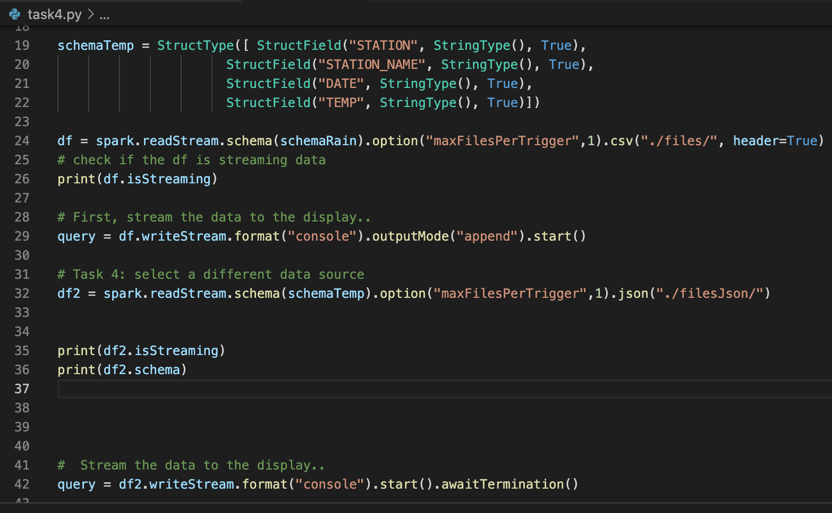
Task4: Use Spark to stream from two different structured data sources. .
Analyze the second source JSON file.
Create a schema for the JSON file format.
Use readStream to read from the source directory.
Use the writeStream to output the data stream to the console..
Modify the schema to use a more specific type.

Slide 7
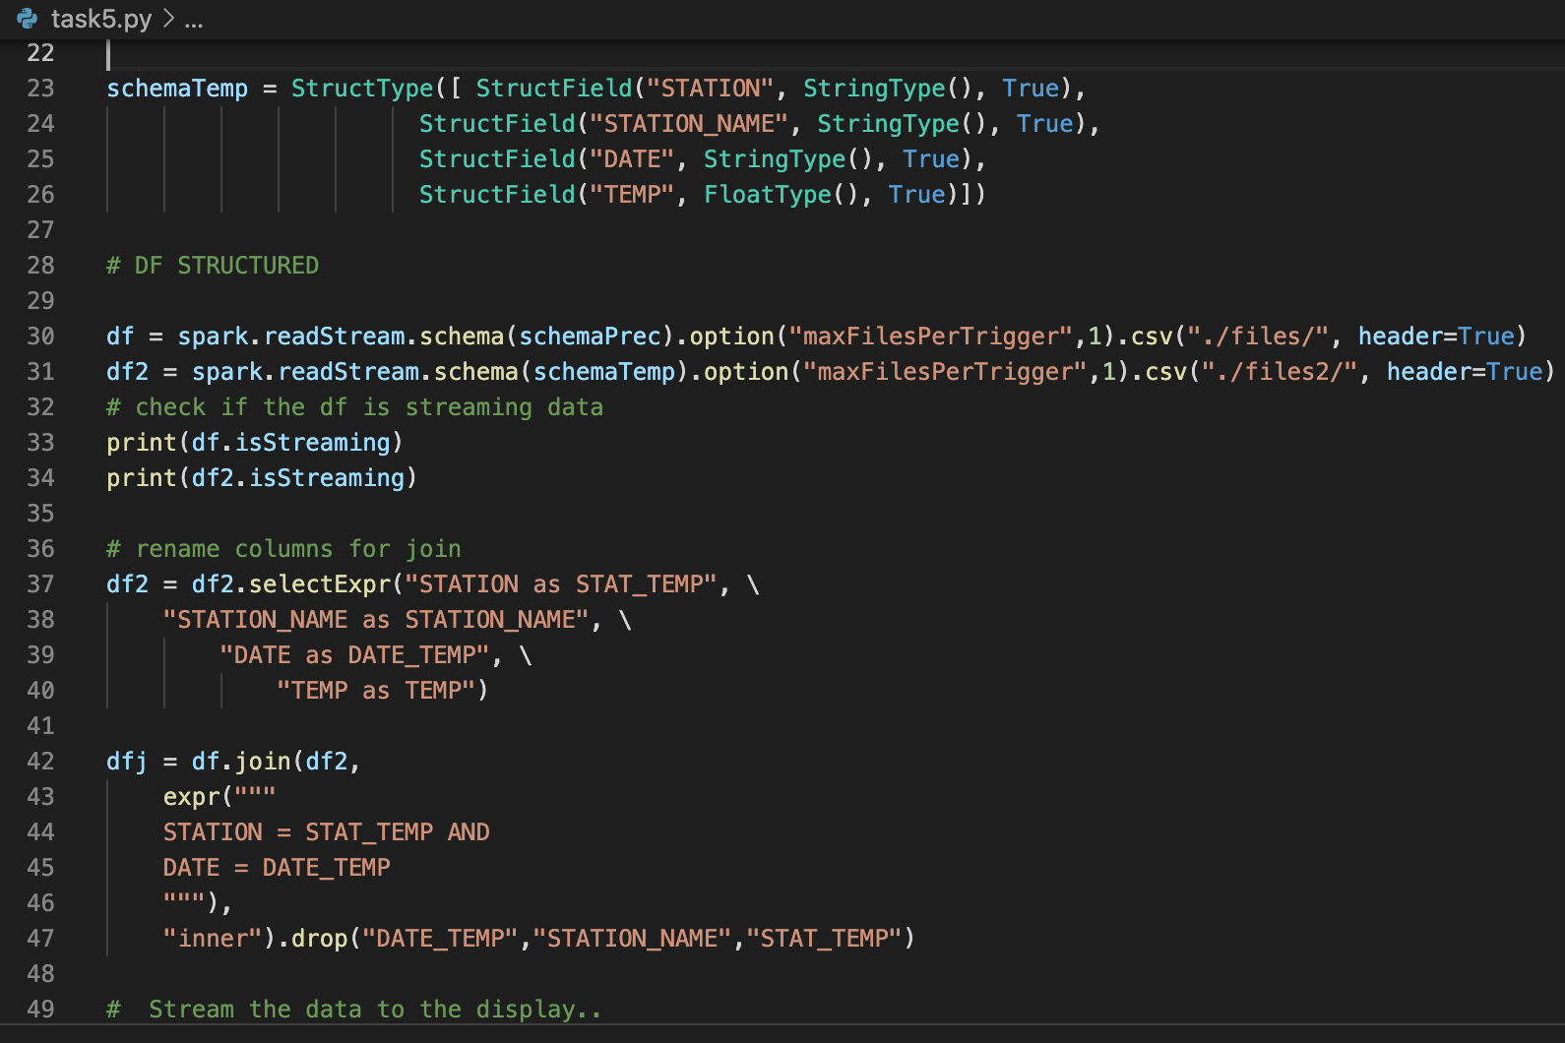
Task5: Use the Spark Structured Streaming API to join two streaming datasets.
Create a Schema for the second data CSV data source.
Use the Spark dataframe readStream to read from the source directory.
Create the stream-to-stream Join statement.
Execute the Inner Join.
Modify column names to avoid ambiguity issues.

