Slide 1


Deforestation - Classification Of Fire Types In India
UMESH
Student ID -STU684039b51dbfd1749039541
AICTE ID-INTERNSHIP_1748923002683e727a876ea

Slide 2

Learning Objectives
Classify fire incidents (forest, agriculture, thermal anomalies) in India
Use MODIS FIRMS dataset (2021–2023) for model development
Automate classification to assist authorities in quick decision-making
Identify fire-prone zones for preventive action
Integrate geospatial & thermal features in analysis
Improve accuracy of classification using ML models
GOAL
Source :
www.freepik.com/

Slide 3
Tools and Technology used
Python for end-to-end data analysis and ML model building.
Pandas, NumPy for dataset handling and preprocessing.
Matplotlib, Seaborn for visualization of distributions and correlations.
Folium for geospatial mapping of fire locations.
Scikit-learn for model building, evaluation, and feature selection.
XGBoost for advanced model testing and boosting.

Slide 4
Methodology
Data Collection: Downloaded MODIS FIRMS fire detection data for 2021–2023.
Data Cleaning: Removed duplicates, handled outliers, ensured correct formats.
EDA: Used plots (countplot, heatmap, scatter) to explore patterns Feature Analysis: Identified brightness, FRP, and confidence as key predictors Model.
Training: Tested Logistic Regression, Decision Tree, Random Forest, KNN, XGBoost.
Evaluation & Selection: Chose Random Forest based on performance metrics.

Slide 5
Problem Statement:
India experiences multiple types of fires every year due to agricultural residue burning, forest fires, and industrial activities
Manual classification of fires is slow and error-prone due to massive data size
MODIS dataset contains millions of observations, requiring automated analysis
Class imbalance exists with MODIS dominating over other fire types
Timely classification is critical for firefighting and policy decision-making
Need for AI-based solution to improve speed, accuracy, and scalability

Slide 6
Model Comparison & Selection:
Logistic Regression: Lower accuracy due to linearity
Decision Tree: Overfit risk
KNN: Distance-based, lower performance
Random Forest: Best accuracy & generalization
Final Model: Random Forest Classifier
Machine Learning Model Tested:
Logistic Regression: Simple, baseline model
Decision Tree: Captures non-linearities but risk of overfitting
Random Forest: Ensemble model, robust & accurate
KNN: Instance-based, less effective for complex data
XGBoost: Advanced boosting for classification

Slide 7
Solution:
Automate classification using Machine Learning models trained on MODIS FIRMS dataset
Perform detailed Exploratory Data Analysis (EDA) to identify important features
Address class imbalance using appropriate preprocessing techniques (e.g., SMOTE)
Evaluate multiple ML models to identify the most accurate one
Implement Random Forest as the final model for robust classification
Create visualizations to communicate results effectively for decision-makers
GitHub Repo Link - https://github.com/itsumesh03/Fire_Classification

Slide 8
Solution:
Insights from EDA:
Fire hotspots detected in certain regions
Brightness and FRP are key features
MODIS type imbalance needs handling
Nighttime and daytime detections differ
Exploratory Data Analysis:
Countplot: MODIS most frequent fire type
Histogram: Confidence shows bimodal distribution
Scatter: Lat-Long shows fire clusters
Heatmap: Brightness strongly correlated with FRP

Slide 9
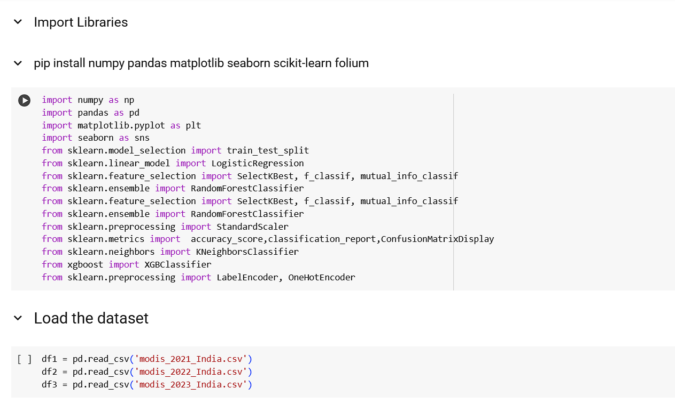
Screenshot of Output: Import Libraries & Load the Dataset

Slide 10
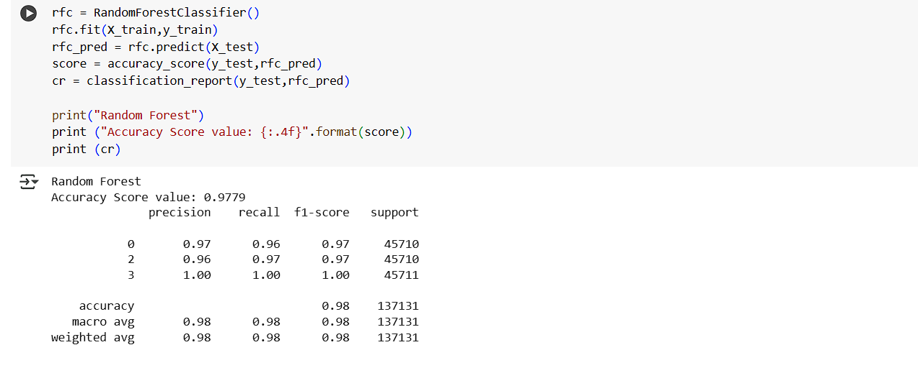
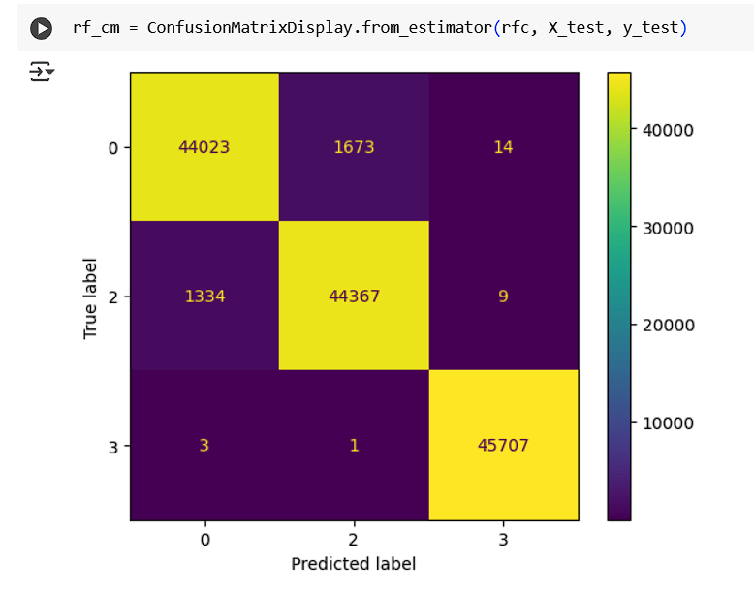
Screenshot of Output: Use Random Forest Classifier

Slide 11
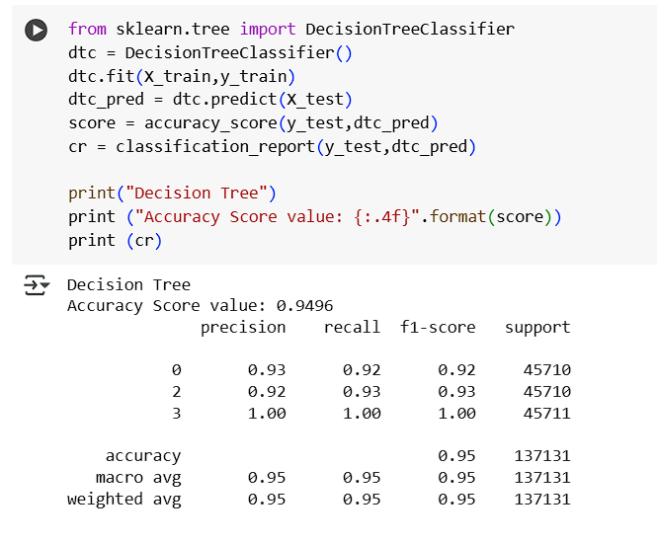
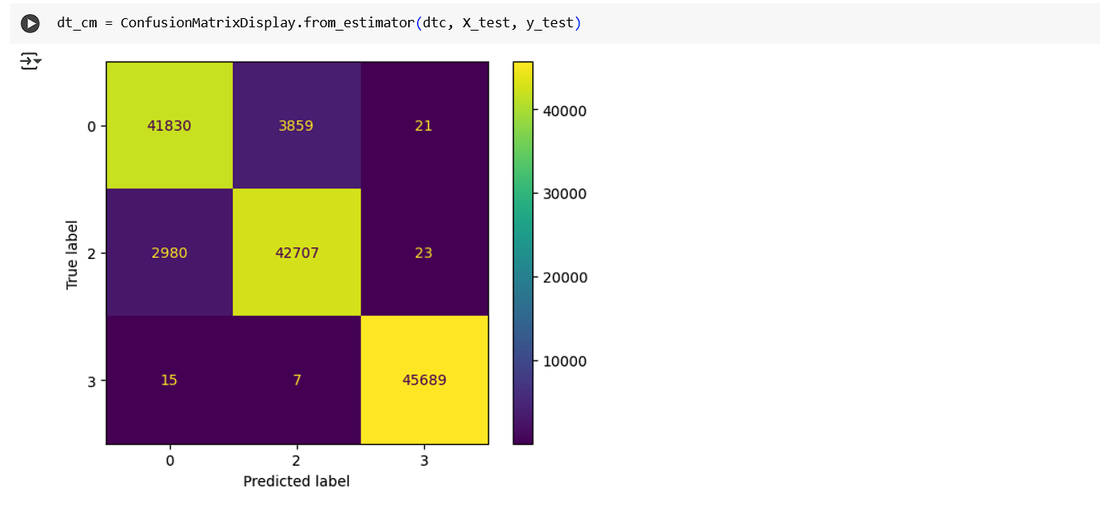
Screenshot of Output: Use Decision Tree Classifier

Slide 12
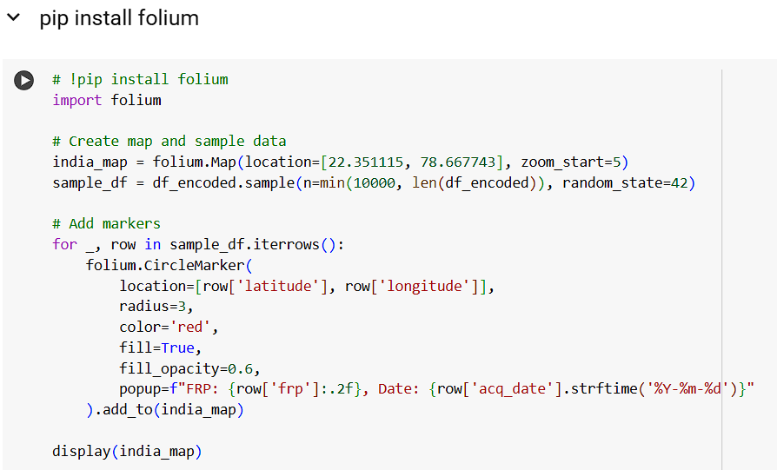
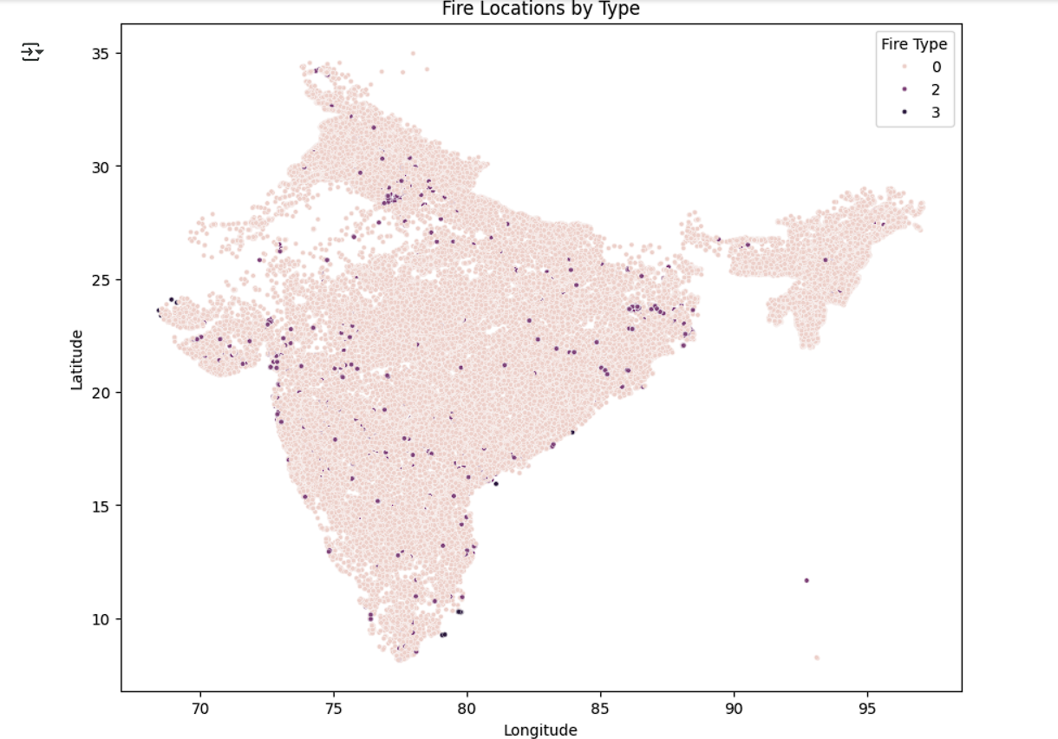
Screenshot of Output: Folium map of India to locate fire

Slide 13
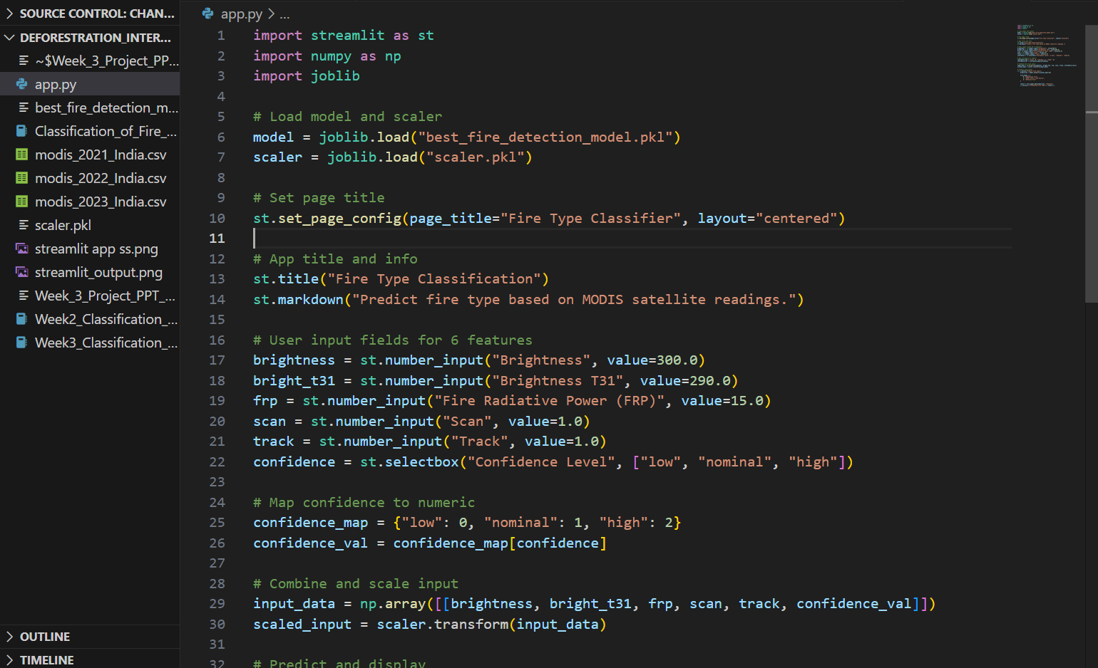
Screenshot of Output: App.py file

Slide 14
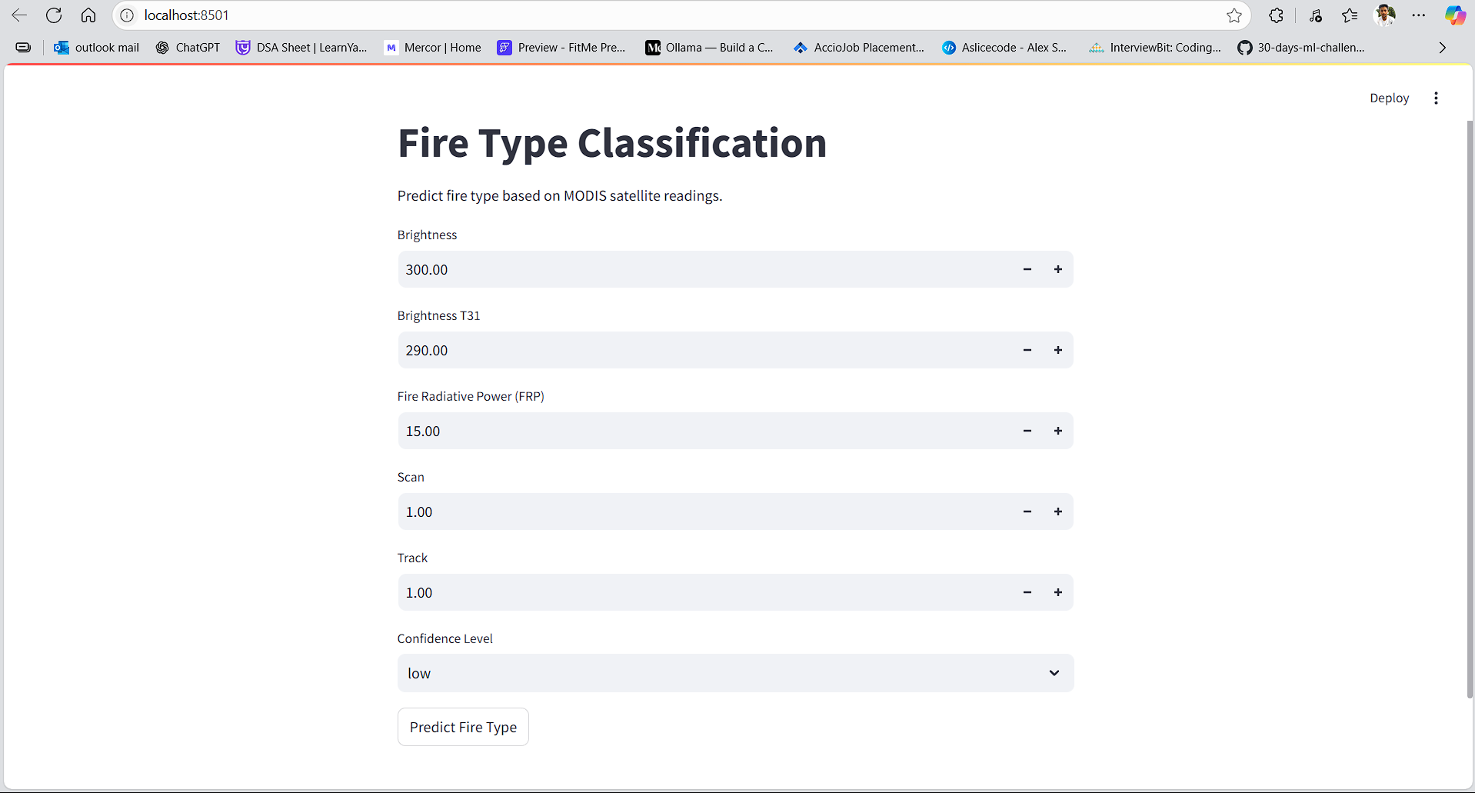
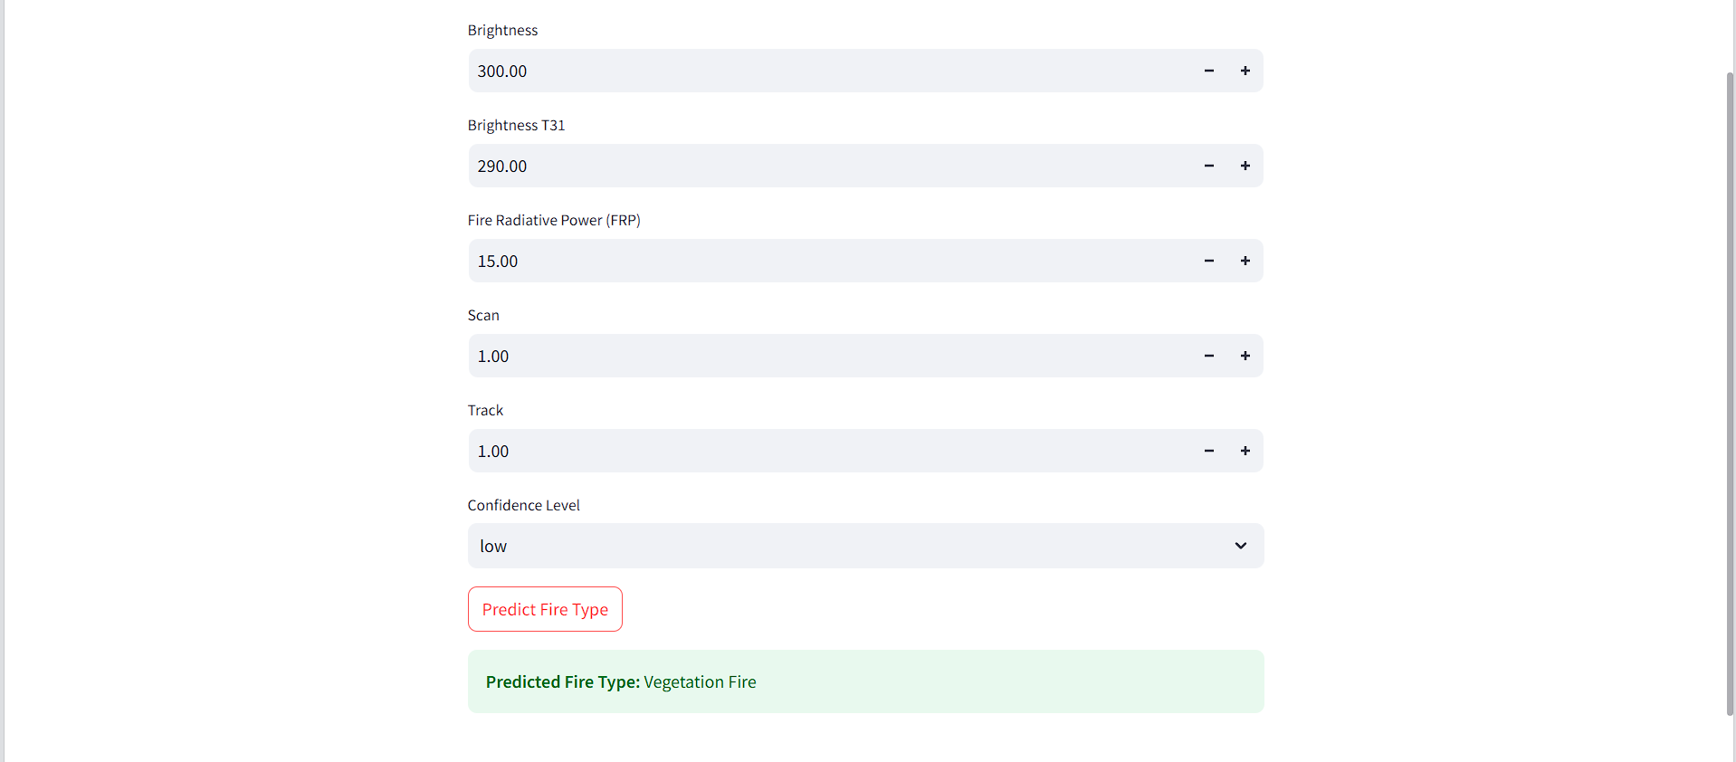
Screenshot of Output: Frontend using Streamlit

Slide 15
Conclusion:
Successfully built an ML model for fire type classification in India
Random Forest outperformed other tested models
EDA provided actionable insights about fire hotspots and patterns
Model can assist in disaster management and resource planning
Internship enhanced skills in ML, EDA, visualization, and model deployment
Scope for future work:
Real-Time API Integration – Connect model with NASA FIRMS live feed for instant fire type classification and alerts.
Interactive Web Dashboard – Deploy results on a dashboard (Flask/Django/Streamlit) for hotspot visualization and prediction trends.

