Slide 1
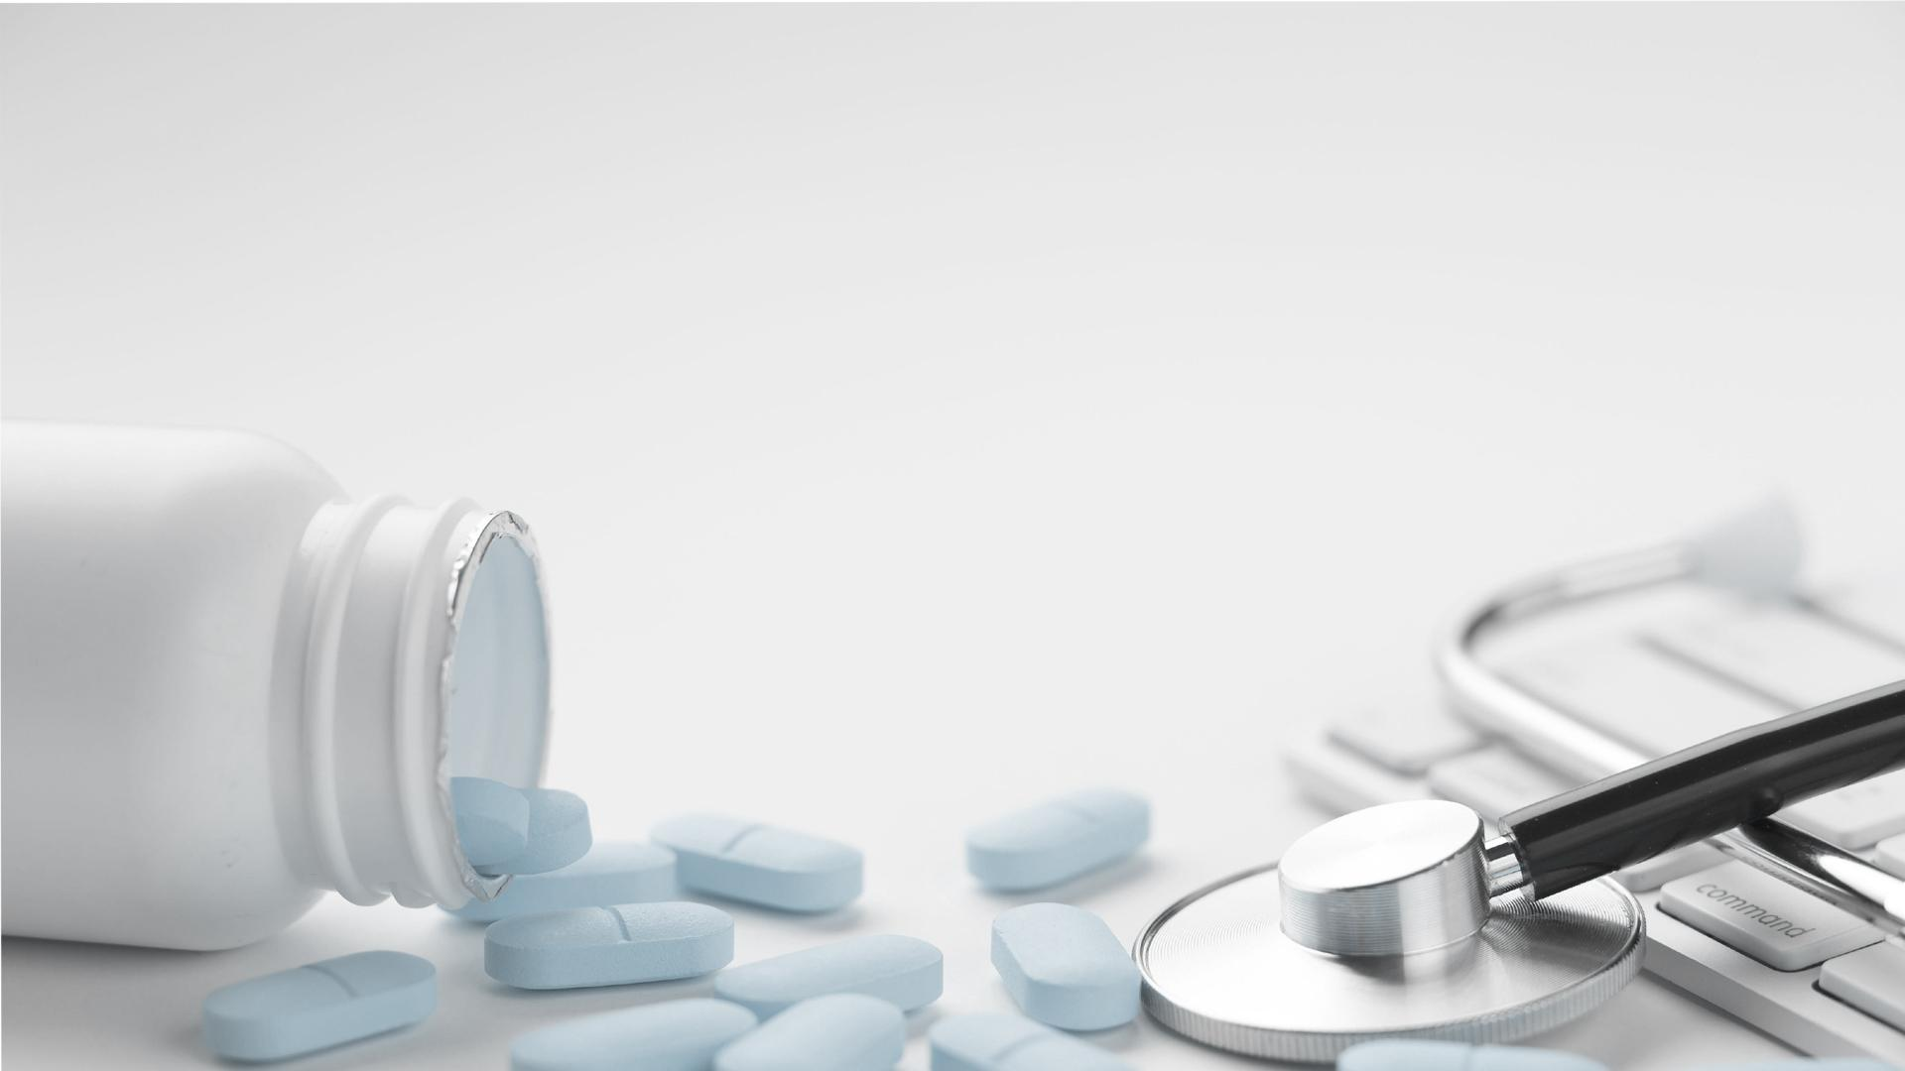
SKIN DISEASE CLASSIFICATION

Slide 2
01
05
INTRODUCTION
EXISTING SYSTEM
02
06
PROBLEM DEFINITION
PROPOSED SYSTEM
CONTENTS
03
07
SCOPE OF PROJECT
SYSTEM DESIGN
04
08
TOOLS AND TECHNOLOGY
CONCLUSION

Slide 3
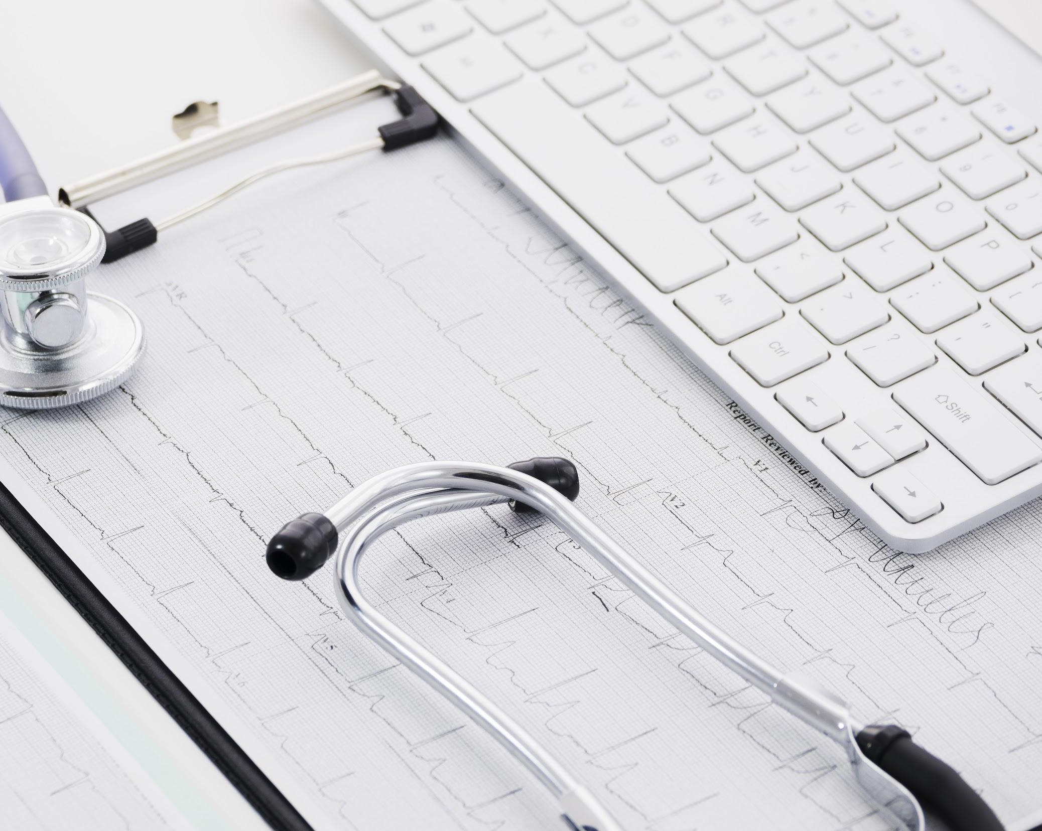
01
INTRODUCTION

Slide 4

INTRODUCTION
The skin covers the whole body. An important function of the skin is to protect the body from infection. We need automated computer application for skin disease classification to be installed at the medical facilities like rural health clinics for remote areas where skin specialists are unavailable. These application that is be made using Machine Learning Models. We can achieve upto 98% of accuracy using this algorithms and classify the correct disease. These can be very helpful to prevent chronic and severe skin disease if detected at early stages.

Slide 5
02
PROBLEM DEFINITION

Slide 6
PROBLEM DEFINITION
The skin is the main part of the body. But many times our skin degrades due to infection which leads to severe health problems. One of the most chronic disease is the skin cancer and the best ways to keep the skin healthy and cancer free is checking and examining skin once a month for suspicious moles or spots .This exam is a visual and clinical skin exam, it costs more than Rs.5000 and it needs hospital scan which is difficult for disabled people. In our paper, we propose a low cost Smartphone based intelligent scheme that allows people for regular skin examinations. We use a Smartphone camera and an intelligent learning algorithm to scan skin images.
By machine learning model it is easy and cost effective to detect any skin disease .

Slide 7
03
SCOPE OF PROJECT

Slide 8
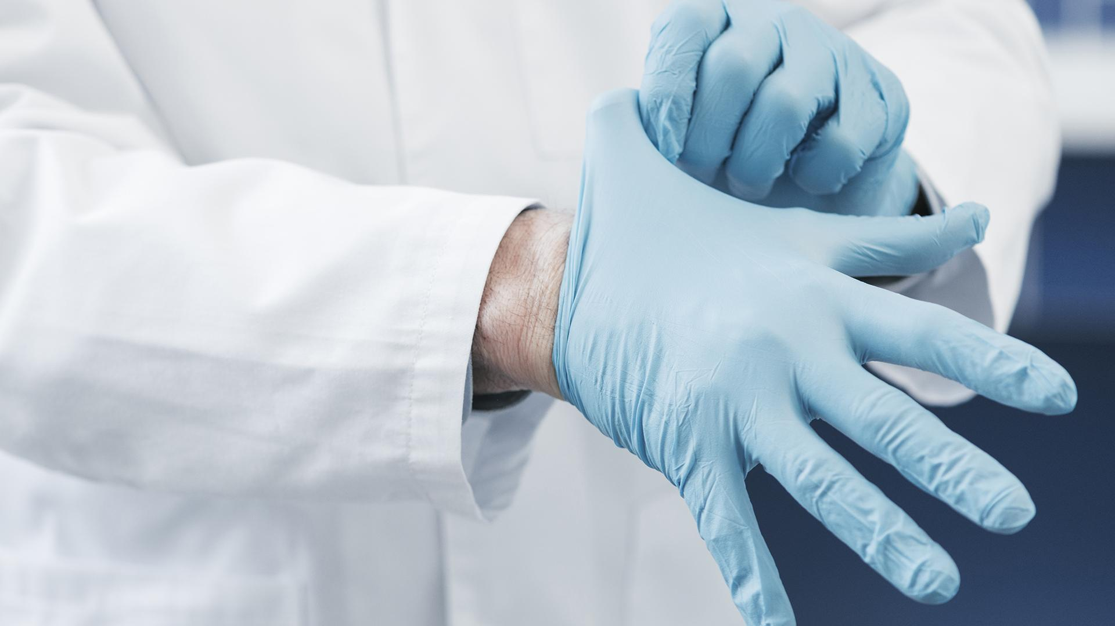
SCOPE OF PROJECT
Our purpose project will work in the following way:
Acquire Image.
Classify disease.
Upload Classified Image to web app for further opinion.

Slide 9
SCOPE OF PROJECT
The application will be able to classify the following disease:
Bacterial Infections- cellulitis
Bacterial Infections- impetigo
Fungal Infections - athlete –foot
Fungal Infections - nail-fungus
Fungal Infections – ringworm
Parasitic Infections - cutaneous-larva-migrans
Viral skin infections – chickenpox
Viral skin infections - shingles

Slide 10
04
TOOLS AND TECHNOLOGY

Slide 11
HARDWARE REQUIREMENTS
TOOLS AND TECHNOLOGY
SOFTWARE REQUIREMENTS
TOOLS/TECHNOLOGY USED
Processor: Pentium IV or above
RAM: 8GB
Hard disk: 1TB
Frontend: reactJS,CSS/HTML
Backend: Python, Machine Learning Model
Operating system: windows
Platform: Windows 10, 7
Tools: Pycharm, Jupyter Notebook

Slide 12
05
EXISTING SYSTEM

Slide 13

EXISTING SYSTEM
The traditional system requires a large number of features clinical as well as histopathological for analysis and to provide further treatment. The disease diagnosis and prediction becomes difficult as the complexity and number of features of the disease increases. Therefore a computer-aided diagnosis and recognition system is introduced.

Slide 14
06
PROPOSED SYSTEM

Slide 15

PROPOSED SYSTEM
.
Therefore a computer-aided diagnosis and recognition system is introduced.
Computer algorithm which contains few steps that involve image processing, image feature extraction, and classification of data has been implemented with the help of a classifier such as an artificial neural network (ANN). The algorithm uses feature extraction & soft-max classifier of Convolutional neural network (CNN) for the detection of skin disease. The system will give more accuracy & efficiency making it more reliable for dermatology.

Slide 16
ADVANTAGES AND GOALS
ADVANTAGES
DISADVANTAGES
GOALS
Low maintenance cost.
Reliability of system is high due to proper storage of information.
Data can be converted easily to information
Retrieval of information is quick and efficient.
Skilled manpower is required.
Internet connection is necessary.
The system should be easy to operate.
The working in the organization will be well planned and organized.
The level of accuracy in the proposed system will be higher.
The reliability of the proposed system will be high due to proper storage of information and scanning of images.
Provide quick and efficient retrieval of information.

Slide 17
07
SYSTEM DESIGN

Slide 18
RESEARCH PAPERS
Paper name | Algorithm/Model used | Citied | Accuracy
Intelligent System for Skin Disease Prediction using Machine Learning | Convolutional Neural Network with Support Vector Machine classifier | 22 | 70 -100%
A machine learning model for skin disease classification using convolution neural network | Convolutional Neural Network (CNN) | 70 | >90%
Machine Learning Algorithms based Skin Disease Detection | Convolutional Neural Network (CNN) | 38 | 99.05 % and 96 %
Skin Disease Classification System Based on Machine Learning Technique: A Survey | Convolutional Neural Network (CNN), Artificial Neural Network(ANN), Naive Bayes | 14 | >94%
Classification of Skin Disease using Ensemble Data Mining Techniques | CART, SVM, Decision Tree (DT) , Random Forest (RF) and GBDT |  | 95.90%
Skin Disease prediction | deep learning algorithm |  | 88%
A Web-Based Skin Disease Diagnosis Using Convolutional Neural Networks | Convolutional Neural Network (CNN) | 29 | 88%

Slide 19
SYSTEM DESIGN
Project main flow:
Acquire Image.
Image Acquisition
Image Pre-processing
Feature extraction of image
Classify disease using CNN
Upload Classified Image and its details

Slide 20

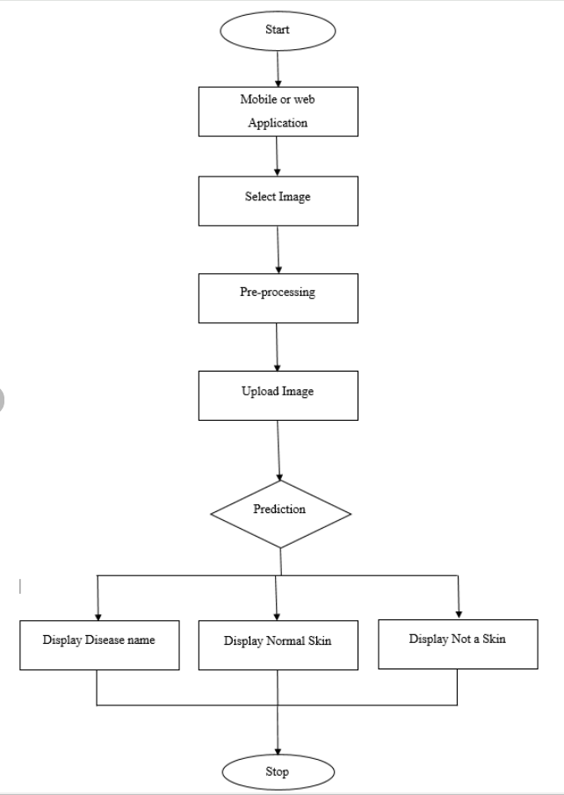
FLOW DIAGRAM

Slide 21
8
CONCLUSION

Slide 22

Skin is an extraordinary human structure. It frequently suffered from many known and unknown disease. Therefore, diagnosis of human skin diseases is the most uncertain and complicated branch of science. It has been observed that most of the cases remain unnoticed because of the lack of better medical infrastructure and facilities. To evaluate the performance of the proposed system several experiments are conducted on our dataset. This dataset consists around 1159 images which collected kaggle. A comparative study of applying different Feature extraction algorithms with different classifiers and image processing OpenCV along with machine learning algorithm was accomplished.
This will help in detection of skin disease upto 70 -100% in rural parts of India where there is already a huge lack of basic medical facilities.

Slide 23
THANK YOU

