Slide 1
Leaf Disease Detection
Patel Parth-IT105
Patel Jal-IT098

Slide 2
Introduction:-
India's significant agricultural market, particularly in tomato cultivation, faces challenges due to decreasing crop production and quality caused by various diseases.
implementing machine learning algorithms for early disease detection becomes crucial to minimize losses and ensure effective crop management

Slide 3
Problem Definition:-
During cultivation process, tomato leaves expose to many of problems and disease such as
Late Blight
Powder Mildew
Early Bright
Gray Mold
Etc.

Slide 4
Problem Definition:-
Traditional plant disease detection relies on human experts' visual observation, but this method is costly and challenging for continuous monitoring, especially on large farms.
By machine learning model it is easy and cost effective to detect disease in plants

Slide 5
Technology:-
Frontend:
React Js
CSS / HTML
Backend:
Python
Machine learning model
Pycharm / jupyter notebook

Slide 6
Research Papers:-
Paper Title | Dataset | Size of the data set | Algorithm/Model used | Accuracy
Tomato Leaf Disease Detection Using Machine Learning | Dataset used in the paper is taken from the directory available on kaggle. | In total there are 10 directories each containing 1000 images | CNN and Res Net 50 | CNN- 94 % -95 % Resnet50- 88 % -89%
ToLeD: Tomato Leaf Disease Detection using Convolution Neural Network | Plant Village dataset | The dataset includes over 50,000 images of 14 crops, such as tomatoes, potatoes, grapes, apples, corn, blueberry, raspberry, soybeans, squash and strawberry. | A Convolution Neural Network based approach is applied | Mobilenet: 63.75% VGG 16: 77.2% InceptionV3: 63.4% Proposed Model: 91.2%

Slide 7
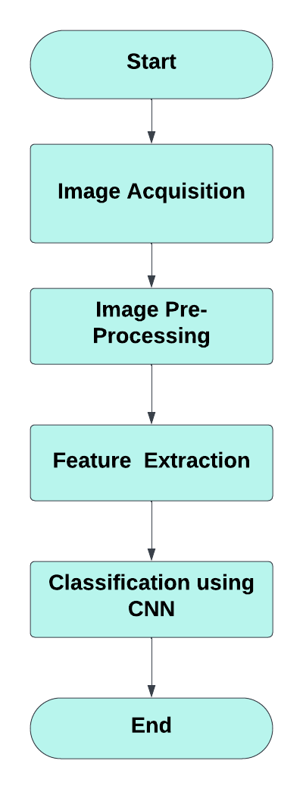

Slide 8
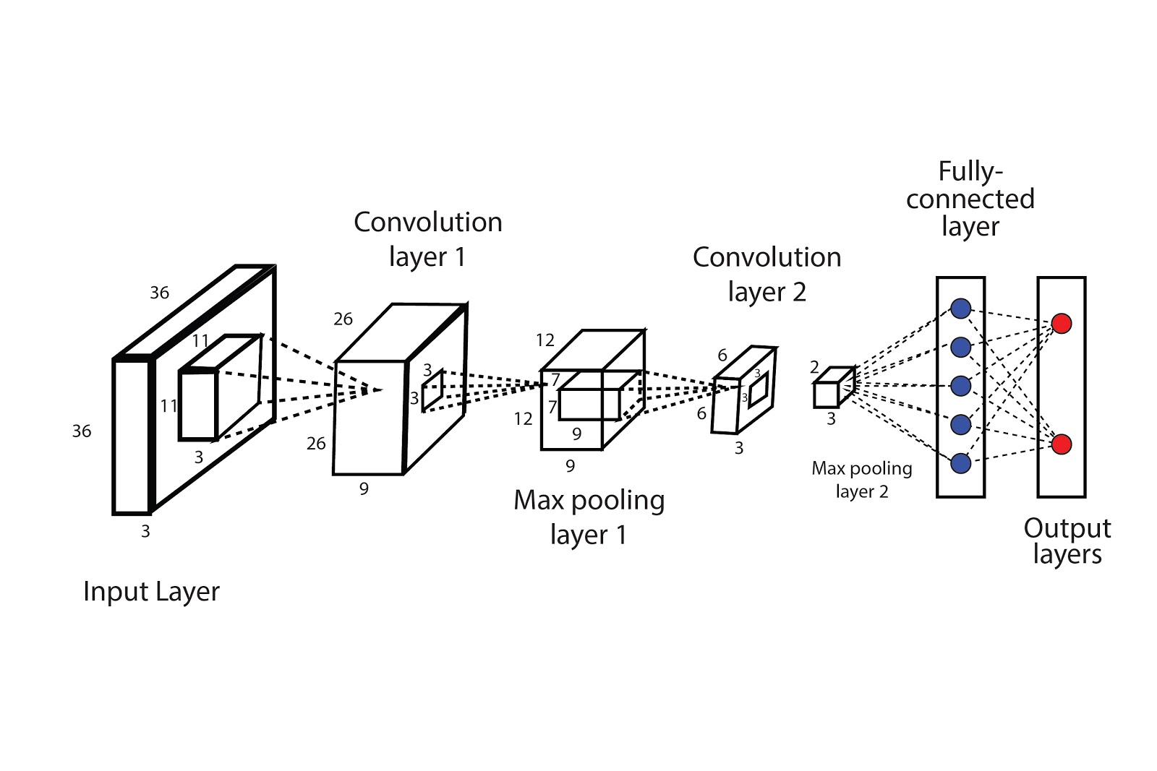
CNN
Layers:
Convolution Layer
Relu Layer
poolIng Layer

Slide 9
Convolution layer:-

Slide 10
ReLU Layer:-

Slide 11
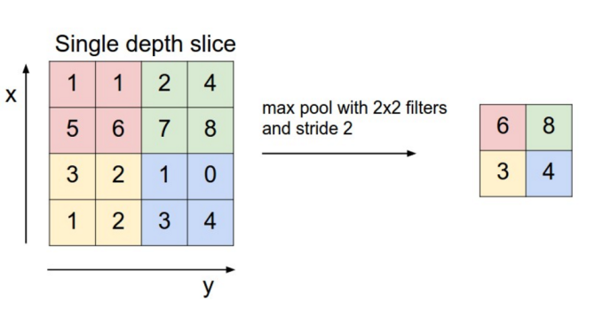
Pooling layer:-

Slide 12
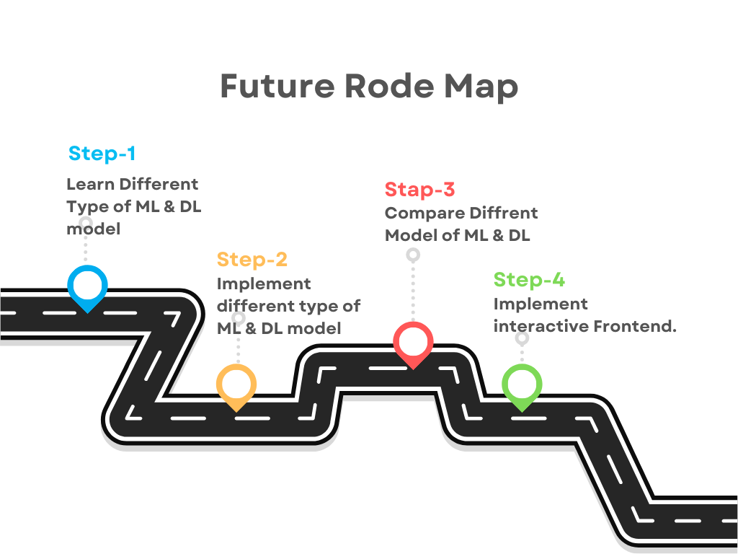

Slide 13
Resource:
DataSet: https://www.kaggle.com/datasets/kaustubhb999/tomatoleaf

Slide 14
Thank You!

