Slide 1


DingTalk Visiting Notes
A Step-by-Step Guide on the DingTalk Mobile App
Learn how to access, create, and manage Visiting Notes
from start to finish — right on your smartphone.
Mobile App Guide • DingTalk Workbench • Visiting Notes Module

Slide 2
What You'll Learn
Open DingTalk & Login
View Existing Notes
01
04
Launch the app and sign into your account
Browse and search previous visit records
Navigate to Workbench
Create a New Visiting Note
02
05
Find the Workbench module in the app
Fill in all required fields for a new visit
Access Visiting Notes
Save & Submit
03
06
Locate the Visiting Notes feature
Save your note and confirm submission

Slide 3

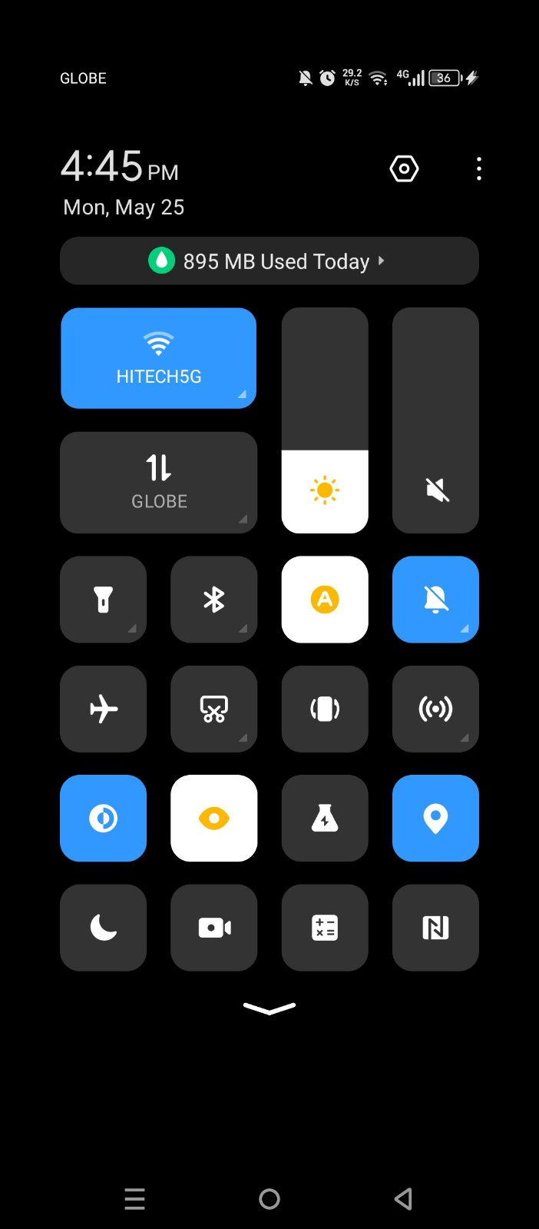
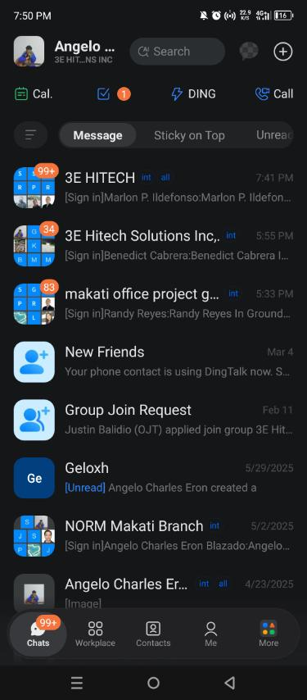
STEP 1
Open DingTalk & Log In
💡 Tip: Make sure DingTalk is installed from the App Store or Google Play. Use your company account credentials to log in.
Open DingTalk
→
→
Login Dashboard
→
Open Location Accessibility

Slide 4
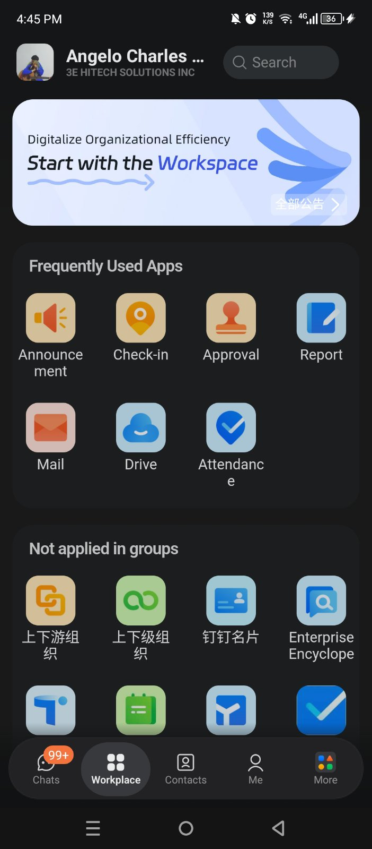
STEP 2
Navigate to Workplace
🏠
1
Tap "Workplace"
From DingTalk Home, tap the Workplace tab at the bottom navigation bar.
Tap Here!
🔍
2
Find Report Module
Scroll the Workplace apps. Tap the ”Report” module.
📂
3
Open the Module
Tap the Report icon to open the multi-purpose reports for organization.
Go to Workplace Tab

Slide 5
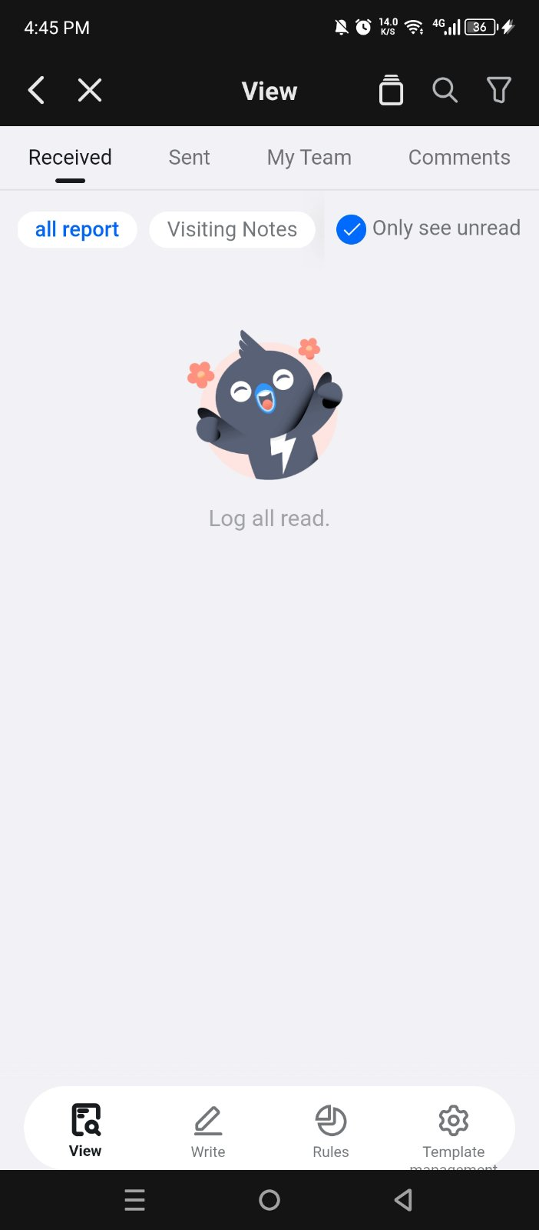
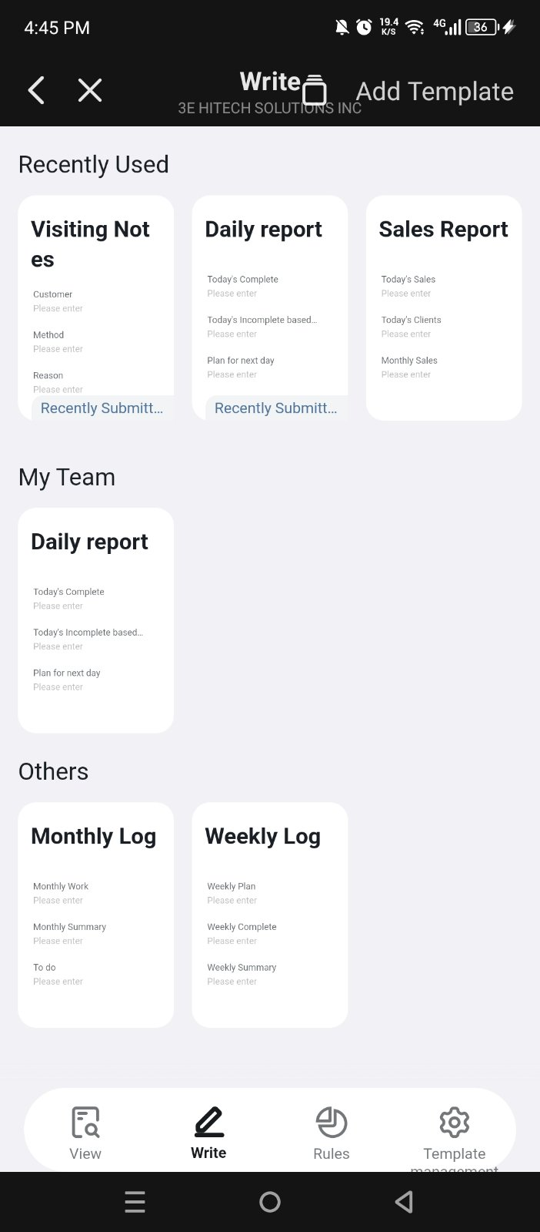
STEP 3
Access the Visiting Notes Feature
What You'll See
List of Reports feature
📋
→
🔍
Search bar/View, Write, Rules & Template
Write – choose Visiting Notes as a report
➕
🏷️
View – for Submitted reports & comments
◄ Tap “Write“ Tab

Slide 6
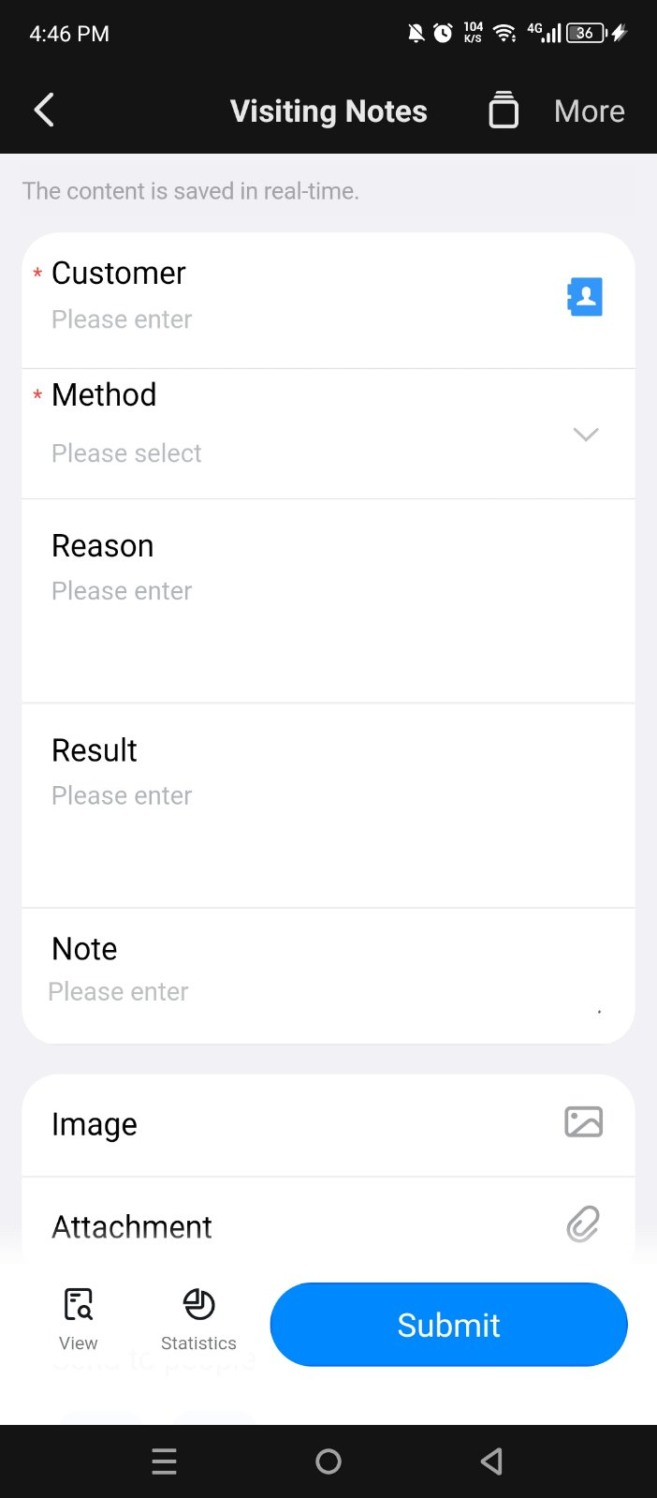
STEP 4
Create Visiting Notes/Report
📋 Information Inside a Visiting Note
Customer Name
Name of the company or contact visited
Method
When the visit took place (Online, Phone, Online, Other)
Reason
Reason: demo, follow-up, negotiation, etc.
Result
State the outcome of the visit.
Notes
Key discussion points and summary.
Image
Supporting documentation
Attachment
Document attachments open for reviews

Slide 7
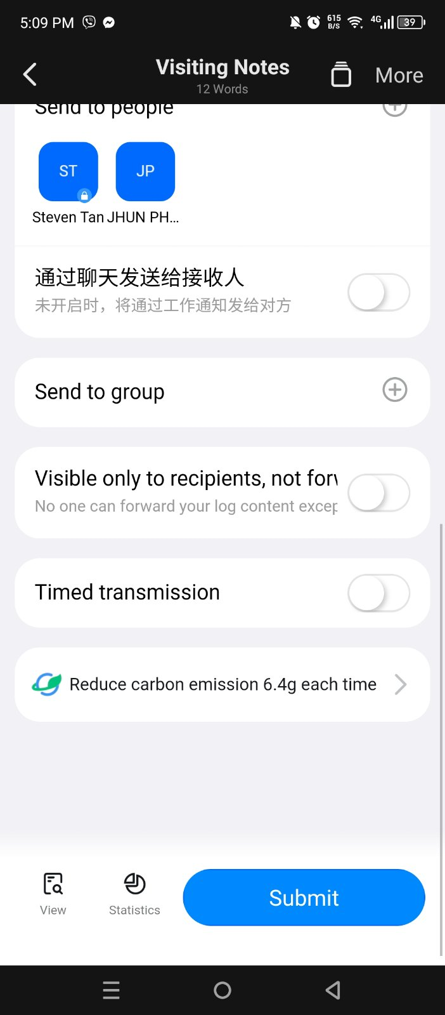
STEP 4
Create Visiting Notes/Report
📋 Information Inside a Visiting Note
Send to People
Choose if need to specify the receiver
Send to group
Has an option to share to everyone inside of the organizations group
Timed Transmission
Automated logging of visit/check-in stamps.

Slide 8
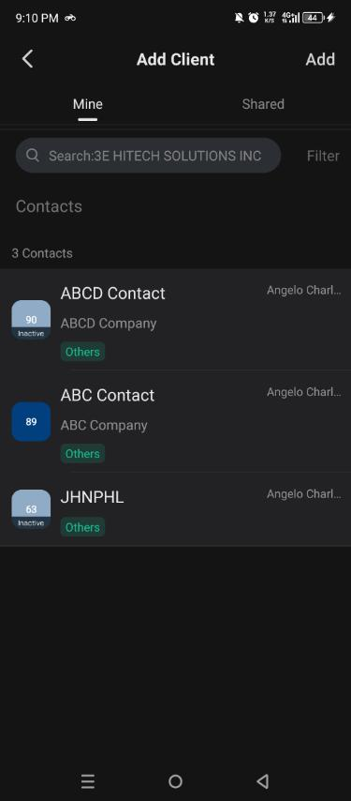
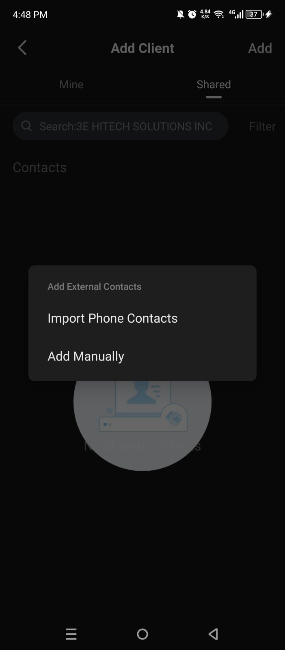
STEP 5
Create a New Visiting Note
→
→
Find the “Add” button
Click the Contact Icon
→
Go to Add Manually

Slide 9
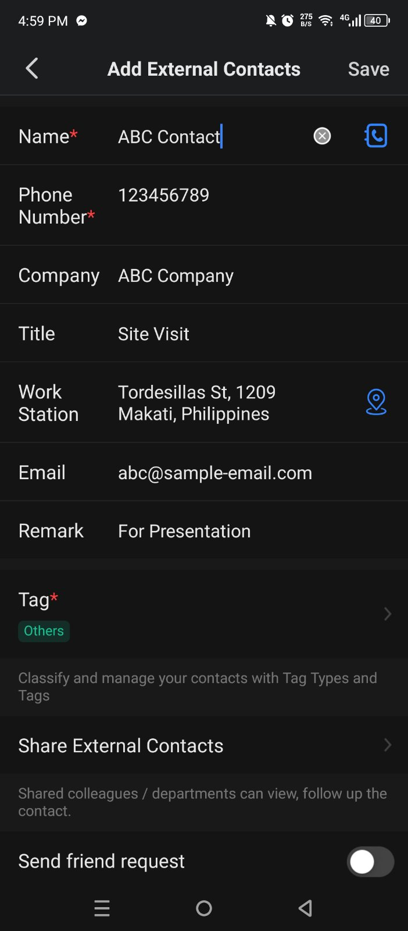
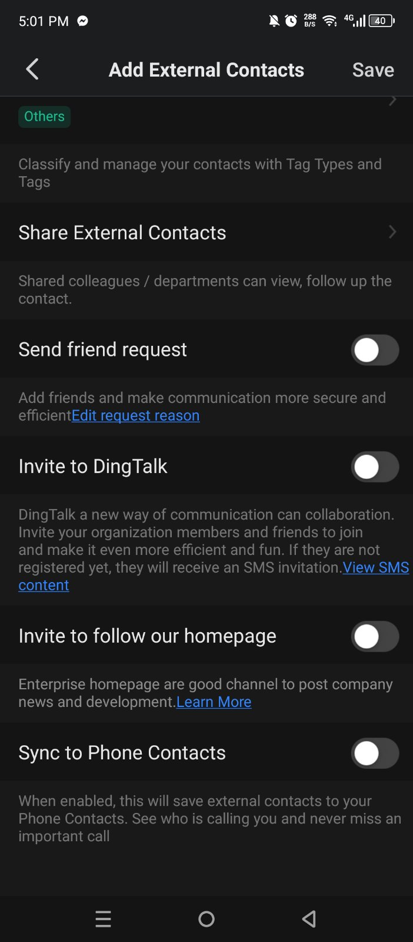
STEP 5
Create a New Visiting Note
Click “Save” once
done.
Find the “Add” button
→
→
This section at the bottom part is just optional
Fill the Information needed for adding Customer/
Client

Slide 10
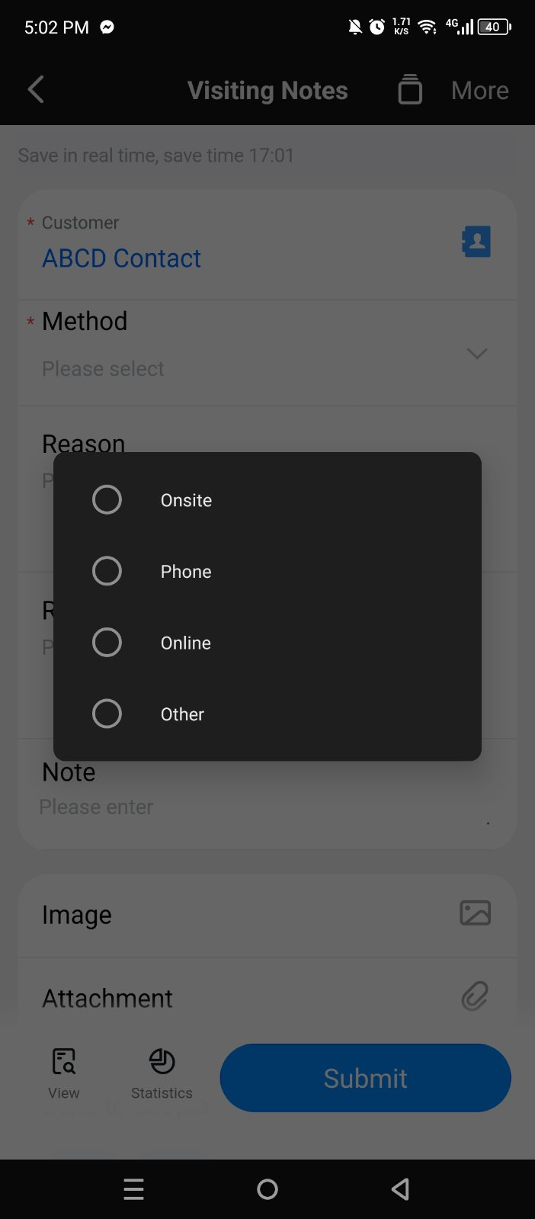
STEP 5
Create a New Visiting Note
Find the “Add” button
For Reason, Result & Note.
State the Summary/detailed
needed for Visiting Note.
→
→
This section at the bottom part is just optional
Fill the Information needed for adding Customer/
Client
Choose the mode of visit/
appointment
For Image & Attachment.
Include those files that are
connected for the Visiting
Report.

Slide 11
STEP 5
Create a New Visiting Note
Send to People:
If it need to send only on specific member
of organization.
Send to group:
Let everyone view the Visit Report.
Fill the Information needed for adding Customer/
Client
Choose the mode of visit/
appointment
Once done, Click “Submit”.

Slide 12
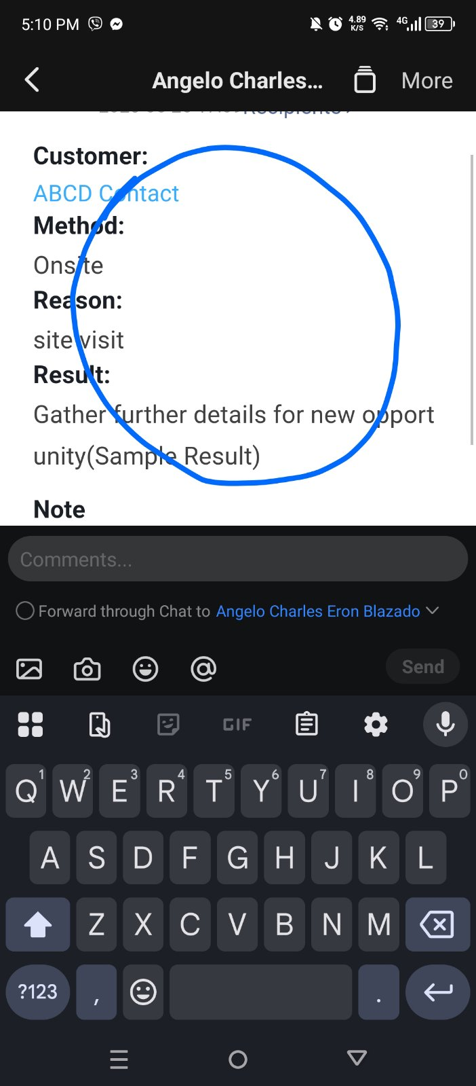
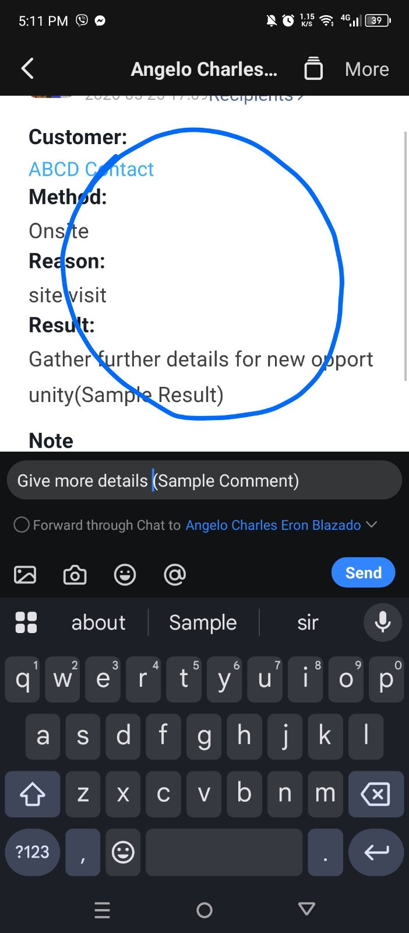
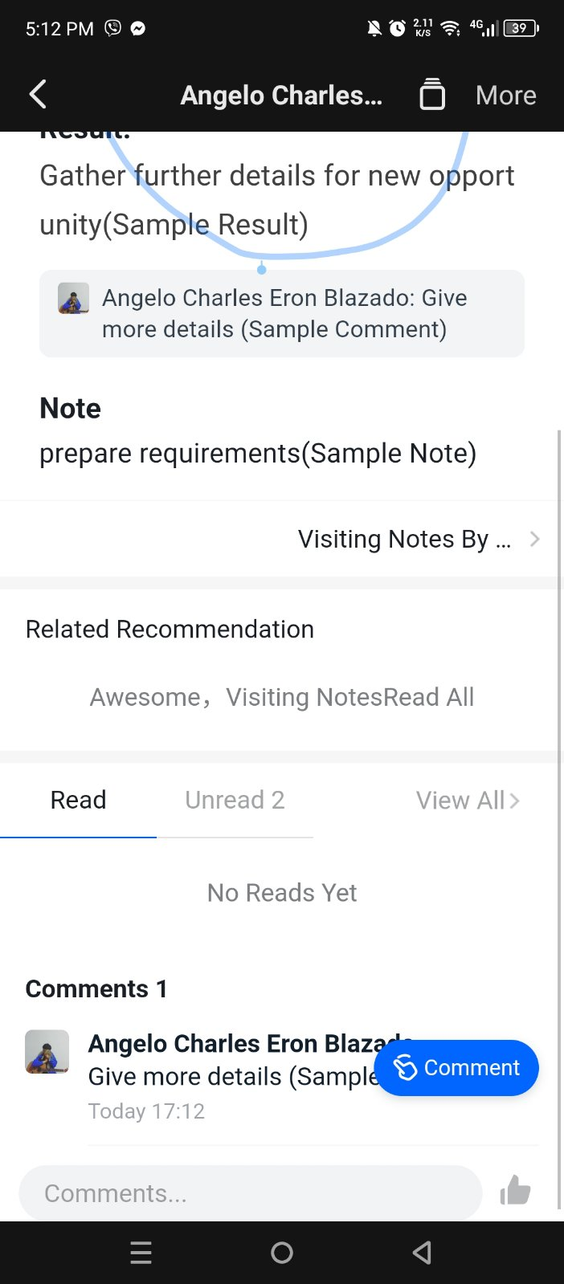
STEP 6
View & Comment Visiting Note
Go to “View”,
To see the
submitted
Reports.
→
→
To Comment,
Circle the text to
enable
Comment.
Fill the Information needed for adding Customer/
Client
Choose the mode of visit/
appointment

Slide 13
💡 Pro Tips & Reminders
📷
Attach Photos
🔍
Search & Filter
📍
Auto GPS
Tap the camera icon to attach photos from the visit as proof.
Filter notes by date, customer, rep, or status easily.
Enable location to auto-fill visit address for accuracy.
🔔
Set Reminders
📊
View Reports
Add follow-up reminders directly from a visiting note.
Manager can see all visit reports under CRM Analytics.

Slide 14
You're All Set! 🎉
Here's a quick recap of the steps to use Visiting Notes on DingTalk Mobile:
1️⃣ Open DingTalk and log in
4️⃣ Browse or search existing notes
2️⃣ Go to Workplace → Reports
5️⃣ Tap Visiting note and fill in all fields
3️⃣ Tap "Visiting Notes"
6️⃣ Save & Submit your note
Questions? Contact your IT Dept.

