Slide 1
J GOKUL RAJA
412721205012
TAGORE ENGINEERING COLLEGE
1

Slide 2
PROJECT TITLE
HAND SIGN NUMBER DETECTION USING DEEP LEARNING
3/21/2024 Annual Review

Slide 3


AGENDA
Briefly introduce the project objective and its significance. Provide background information on hand sign recognition and its relevance.
Discuss the dataset used and any preprocessing steps applied. Explain the chosen deep learning model architecture for the task.
Describe the training process including optimization techniques. Evaluate model performance using appropriate metrics.
3/21/2024 Annual Review

Slide 4

PROBLEM STATEMENT
Develop a deep learning model capable of accurately detecting and classifying hand signs representing numbers using image data. The objective is to create a robust system that can recognize hand signs for numbers in real-time applications. The model should be trained on a suitable dataset and optimized to achieve high accuracy and efficiency in classification.

Slide 5

PROJECT OVERVIEW
Acquire a suitable dataset of hand sign images representing numbers. Preprocess the data by resizing, normalizing, and augmenting the images to enhance the robustness of the model.
This system will find applications in various domains including human-computer interaction, mental health monitoring, and sentiment analysis in social media.
It aims to give the accurate results for users.

Slide 6

WHO ARE THE END USERS?
Individuals with Hearing Impairments
Educators and Students
Developers of Accessibility Tools
General Public
Researchers and Innovators
3/21/2024 Annual Review

Slide 7

YOUR SOLUTION AND ITS VALUE PROPOSITION
The developed system will employ state-of-the-art deep learning techniques, such as convolutional neural networks (CNNs), to accurately recognize and classify hand signs for numbers.
Accessibility and Inclusivity
Educational Aid
Versatility and Adaptability
Ease of Integration

Slide 8

THE WOW IN YOUR SOLUTION
The ability of the system to recognize hand signs for numbers in real-time, enabling instantaneous communication without delays or interruptions, is impressive and impactful.
The system serves as a valuable educational aid for both learners and educators in sign language instruction. Its interactive nature allows learners to practice and reinforce their sign language skills in a dynamic and engaging way, leading to more effective learning outcomes.
Leveraging state-of-the-art deep learning techniques, such as convolutional neural networks, for hand sign recognition showcases technological innovation and sophistication. The application of advanced AI algorithms to solve real-world problems in the domain
3/21/2024 Annual Review

Slide 9
MODELLING
Data Collection and Preparation
Model Selection
Model Design and Architecture
Training and Optimization
Evaluation and Fine-tuning
Deployment and Integration
Monitoring and Maintenance

Slide 10
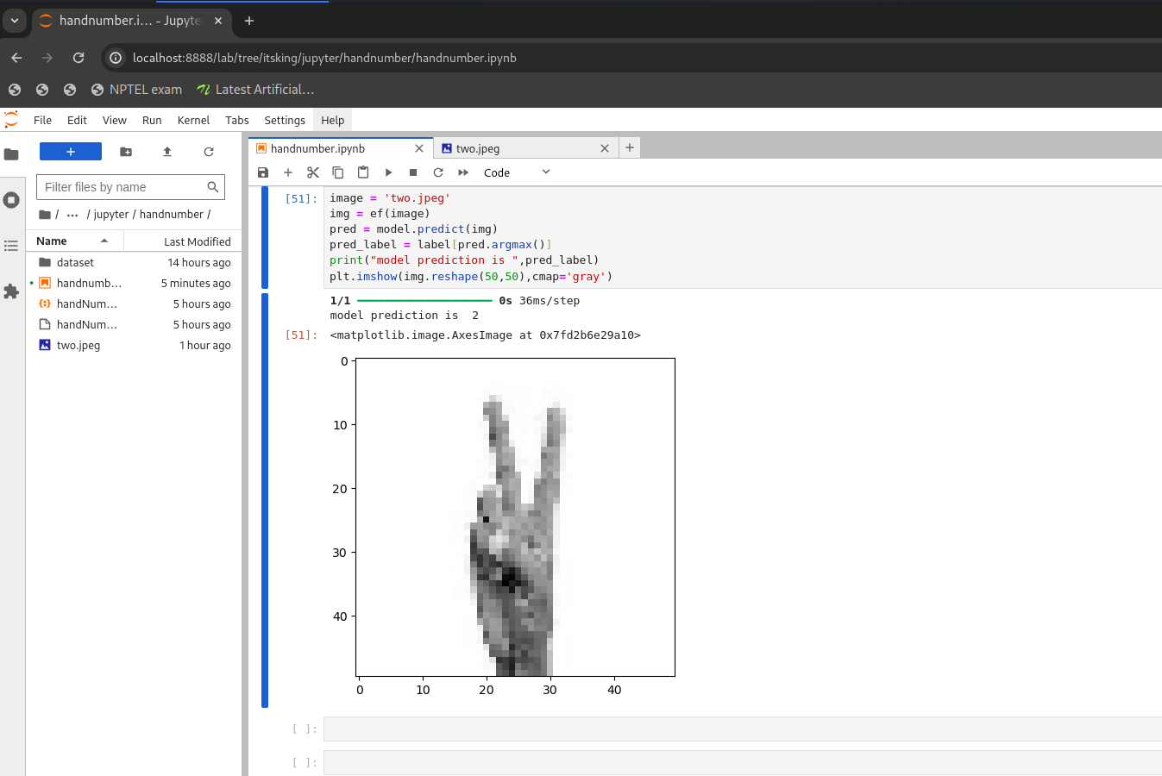
RESULTS

