Slide 1
National Institute of Technology Tiruchirappalli
Lunar South Pole Digital Twin Internship Workplan
Multi-sensor fusion, uncertainty, rover-accessible science planning, and mission resilience
18 May 2026
03 July 2026
Prepared for guide discussion and intern onboarding
RESEARCH PROGRESS PRESENTATION

Slide 2
Internship Objective
Problem
Approach
Outcome
Different lunar datasets measure different physical quantities.
Use feature-level fusion and preserve sensor-specific meaning.
Reusable maps, tables, models, and scenario results.
The internship work supports construction of a lunar south-pole digital twin. Each intern will work on a separate module using existing outputs and student reports. The focus is not file organization; the focus is research-grade modules for fusion, confidence, science-priority planning, and mission resilience.
RESEARCH PROGRESS PRESENTATION

Slide 3
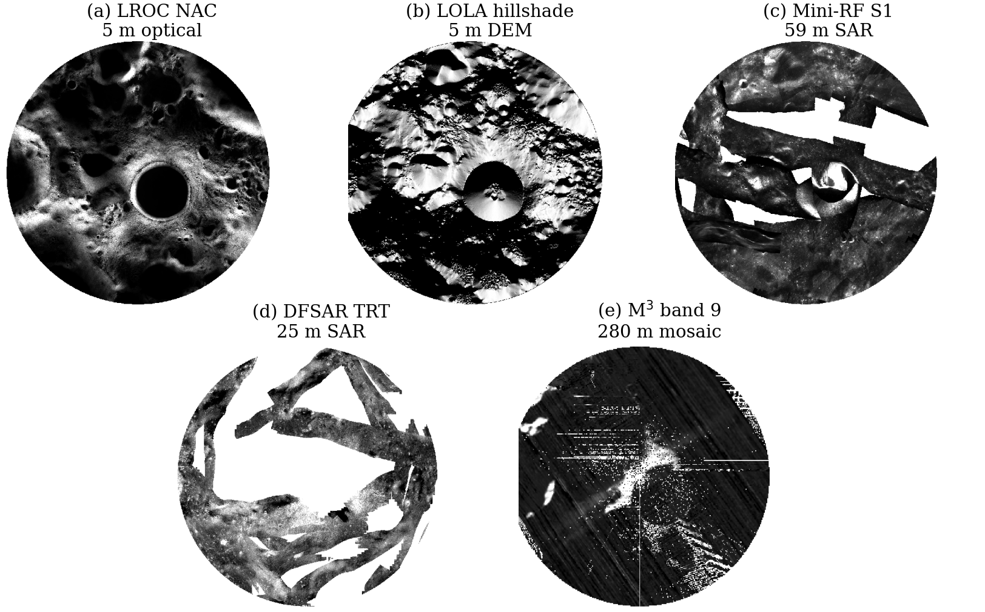
Starting Inputs
Core datasets
LROC, LOLA, Mini-RF, DFSAR, M3, GRAIL
Existing outputs
registered layers, masks, q-score, radar/M3/GRAIL diagnostics
Student reports
M3 probability, traversability, rover simulation
RESEARCH PROGRESS PRESENTATION

Slide 4
Research Questions
Intern 1
Intern 2
How can LROC, LOLA, Mini-RF, DFSAR, M3, and GRAIL features be fused without forcing false pixel-level equivalence?
Which parts of the digital twin should the rover trust, and which parts are uncertain?
Intern 3
Intern 4
Which scientifically interesting targets are actually reachable by a rover?
How robust is a rover mission under different failure and uncertainty conditions?
RESEARCH PROGRESS PRESENTATION

Slide 5
Four Parallel Modules
Feature-Level Fusion
Trust and Uncertainty
Intern 1
Intern 2
multi-sensor fusion without false pixel equivalence
confidence and uncertainty for digital-twin layers
Reachable Science Priority
Mission Resilience
Intern 3
Intern 4
rank targets by science value and rover access
test mission policies under failures and uncertainty
RESEARCH PROGRESS PRESENTATION

Slide 6
Intern 1: Feature-Level Fusion
Research question
How can LROC, LOLA, Mini-RF, DFSAR, M3, and GRAIL features be fused without forcing false pixel-level equivalence?
Datasets
Reports
Deliverable
LROC, LOLA, Mini-RF, DFSAR, M3, GRAIL
Sarthak Rawat + Harsh Kumar Singh
fusion comparison and semantic maps
Main work
Outputs
Build feature vectors from existing layers.
Compare weighted fusion, PCA/UMAP, and autoencoder or attention-based fusion.
Preserve native scale and physical meaning.
Feature dictionary.
Fusion-method comparison table.
Terrain-resource zones.
Radar-terrain agreement zones.
Science-accessibility zones.
RESEARCH PROGRESS PRESENTATION

Slide 7
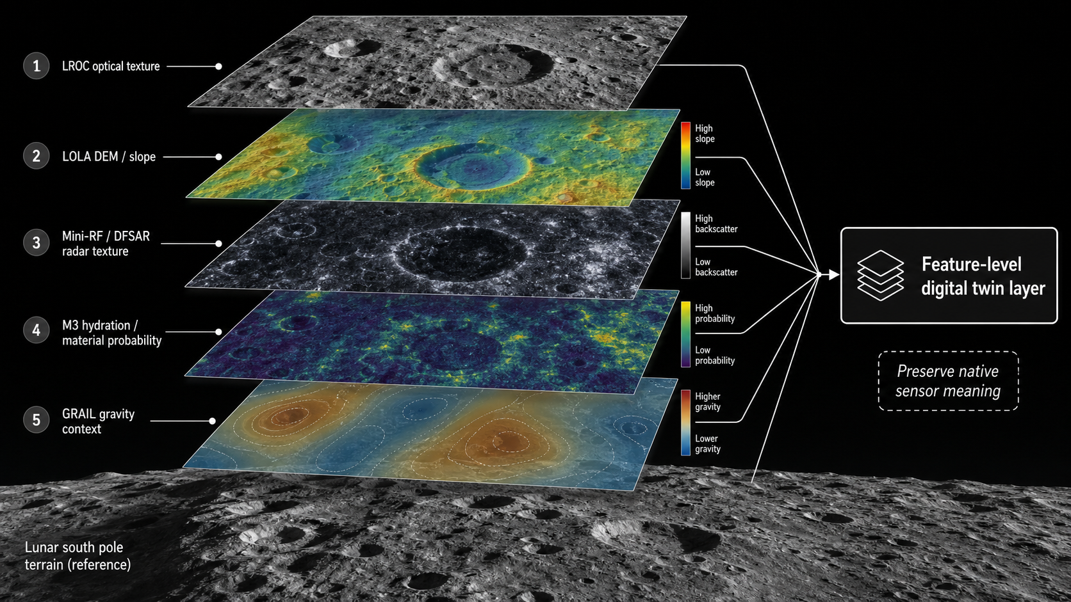
Intern 1: Feature-Level Fusion Workflow
Feature-level fusion across sensor-specific evidence layers
RESEARCH PROGRESS PRESENTATION

Slide 8
Intern 1: Method Comparison
Weighted fusion
PCA / UMAP
Autoencoder / attention
transparent baseline using expert weights
latent structure with explicit scale limits
nonlinear representation with feature checks
RESEARCH PROGRESS PRESENTATION

Slide 9
Intern 2: Trust and Uncertainty
Research question
Which parts of the digital twin should the rover trust, and which parts are uncertain?
Datasets
Reports
Deliverable
LROC/LOLA masks, radar coverage, M3 source/overlap, GRAIL context
Sarthak Rawat + LunarRover simulation report
trust model, confidence table, uncertainty schematic
Uncertainty sources
Confidence classes
registration residuals and q-score support
sensor coverage, nodata, shadow, and PSR masks
native resolution mismatch
M3 seam/overlap support and GRAIL regional scale
High: usable for local planning.
Medium: usable with caution.
Low: contextual support only.
Invalid: not used for decisions.
RESEARCH PROGRESS PRESENTATION

Slide 10
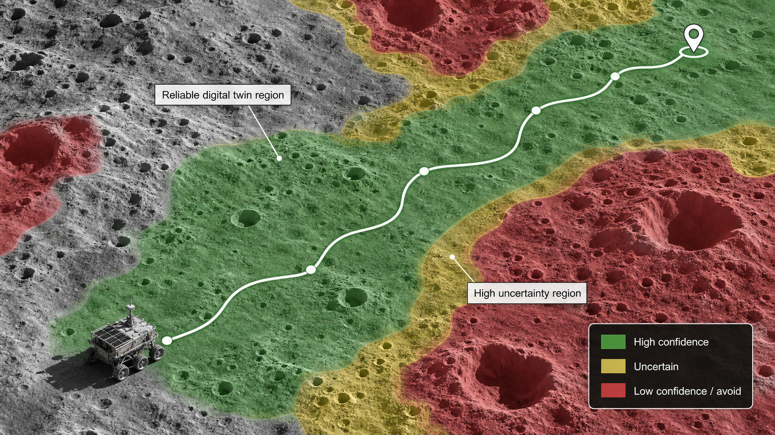
Intern 2: Trust and Uncertainty Workflow
Confidence-aware terrain interpretation for rover planning
RESEARCH PROGRESS PRESENTATION

Slide 11
Intern 3: Reachable Science Priority
Research question
Which scientifically interesting targets are actually reachable by a rover?
Datasets
Reports
Deliverable
LROC, LOLA, M3, Diviner if available, Mini-RF/DFSAR, GRAIL
Sarthak Rawat + Harsh Kumar Singh
ranked rover-accessible science targets
Score components
Strategies
science value and resource probability
terrain safety and path cost
shadow/thermal risk
confidence penalty
science-only
safety-only
weighted science-safety
Pareto front target selection
use resource-priority or volatile-relevance language
RESEARCH PROGRESS PRESENTATION

Slide 12
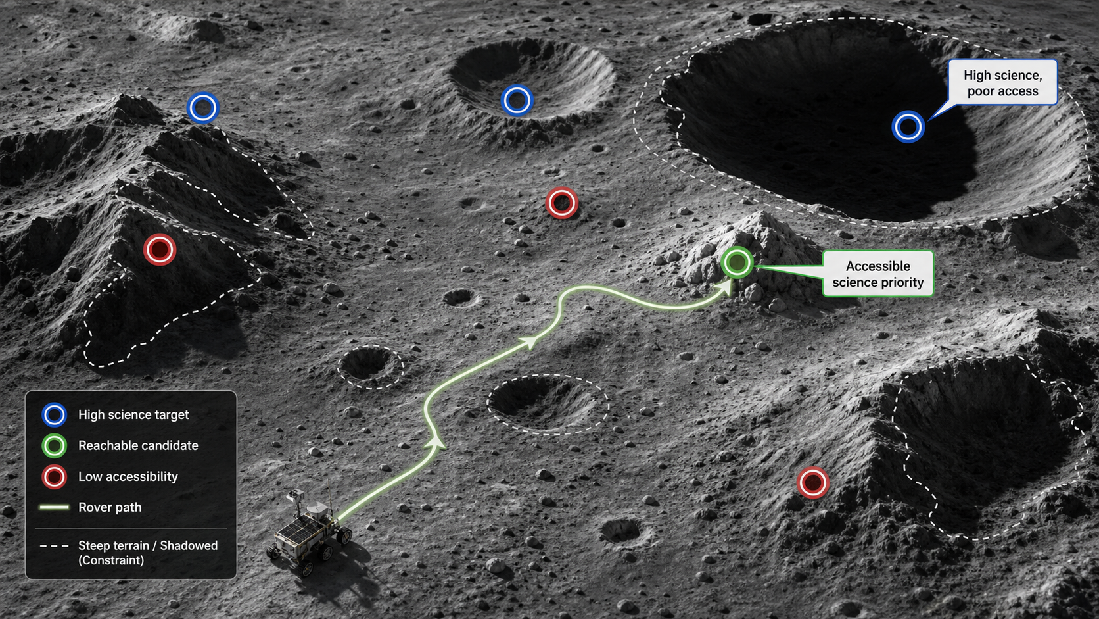
Intern 3: Rover-Accessible Science Workflow
Science-priority targets filtered by traversability and access constraints
RESEARCH PROGRESS PRESENTATION

Slide 13
Intern 4: Mission Resilience
Research question
How robust is a rover mission under different failure and uncertainty conditions?
Datasets
Reports
Deliverable
LOLA terrain, LROC texture/shadow, resource-priority layer, traversability map
LunarRover + Harsh Kumar Singh + Sarthak Rawat
scenario tests and mission-resilience metrics
Scenario tests
Policies and metrics
sensor dropout
increased terrain uncertainty
wrong resource estimate
blocked path or limited energy
communication delay
shortest, safest, science-priority, and uncertainty-aware policies
success rate, distance, hazard exposure, science return, energy proxy, recovery after failure
RESEARCH PROGRESS PRESENTATION

Slide 14
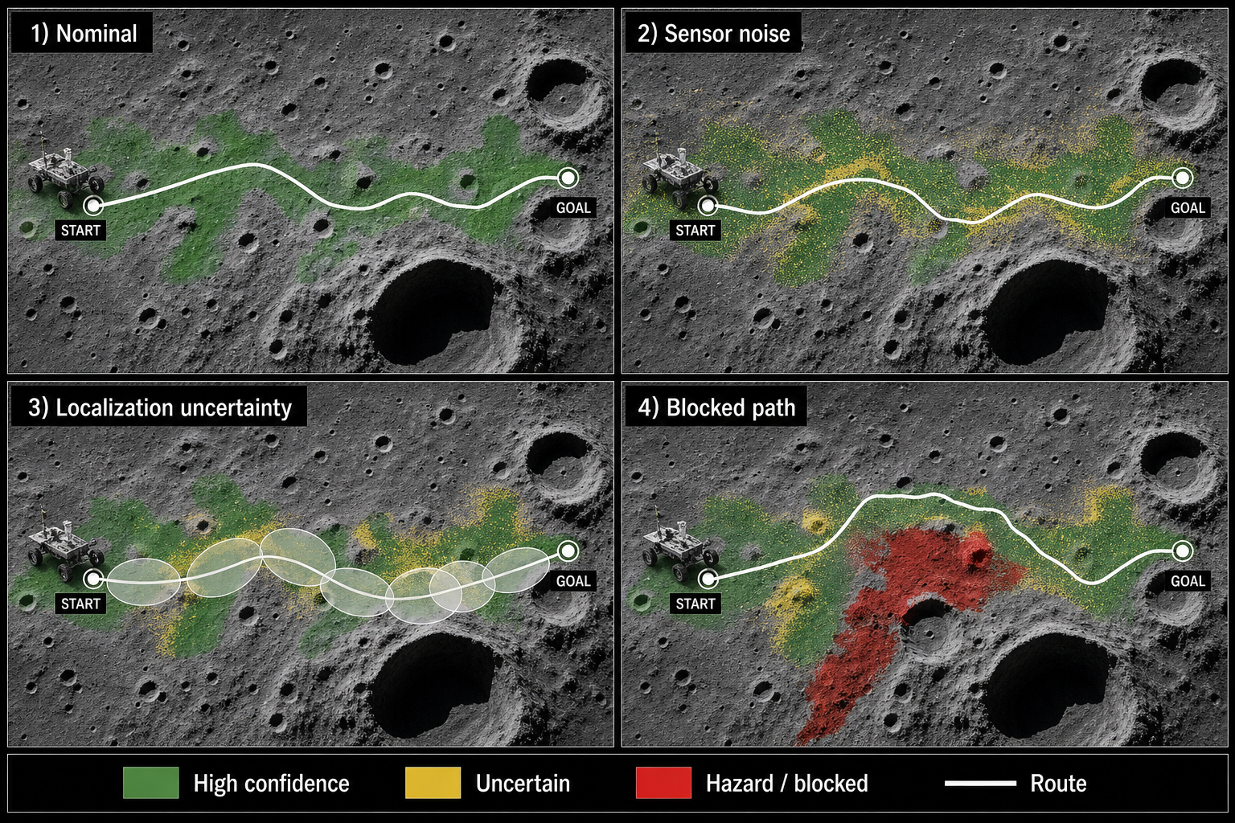
Intern 4: Mission Resilience Workflow
Scenario-based route robustness under mission uncertainty
RESEARCH PROGRESS PRESENTATION

Slide 15
Common Working Rules
Use
Preserve
Avoid
overview, datasets, frozen outputs, and reports
sensor resolution and physical interpretation
unvalidated water-ice or pixel-level claims
The unpublished manuscript does not need to be shared. Interns should receive a short overview, allowed outputs, dataset descriptions, and relevant M.Tech reports. All modules should remain separate during the internship and can be combined after the final review.
RESEARCH PROGRESS PRESENTATION

Slide 16
Internship Timeline
Week 1: 18-22 May
Week 2: 25-29 May
Week 3: 01-05 Jun
orientation, problem definition, input list
baseline method and first output
comparison setup and early results
Week 4: 08-12 Jun
Week 5: 15-19 Jun
Week 6: 22-26 Jun
method refinement and documentation
final experiments or scenario tests
module report and final outputs
Week 7: 29 Jun-03 Jul
presentation and submission
RESEARCH PROGRESS PRESENTATION

Slide 17
Final Expected Outcome
Fusion
Trust
Planning
feature-level digital twin representation
confidence and uncertainty layer
reachable targets and resilience metrics
Together, the four modules should move the work toward a multi-resolution, confidence-aware lunar south-pole digital twin for rover-accessible science planning and mission-resilience analysis.
RESEARCH PROGRESS PRESENTATION

Slide 18
