Slide 1
Software Testing Life Cycle
Anant Dubey
Avinash B
Shreyash Dwivedi
Vishal S K

Slide 2
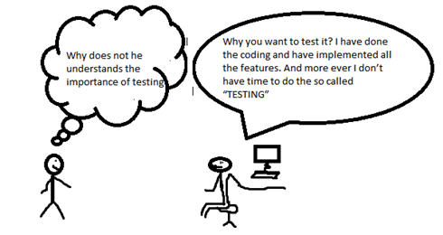
Software testing …
1960’s Trend:

Slide 3
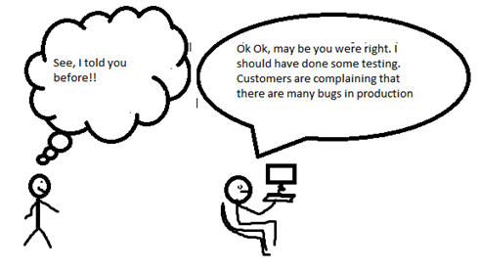
Software testing …
1990’s Trend

Slide 4
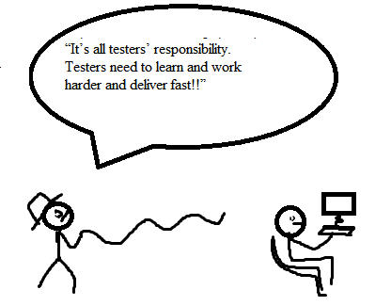
Software testing …
2000’s Trend:

Slide 5
STLC – Software Testing Life Cycle
refers to a testing process which has specific steps to be executed in a definite sequence to ensure that the quality & goals have been met.
It’s the part of SDLC , in SDLC we develop the software, and in STLC we test the software
Each phase has different goals and deliverables.
Different organizations have different phases in STLC; however the basis remains the same.

Slide 6
Flowchart of STLC
Requirement Analysis
Test Planning
Test Case Development
Environment Setup
Test Execution
Test Closure

Slide 7
Requirement analysis
include high-level business needs, architectural requirements that detail how the feature will be designed and supported, and detailed system requirements from which developers build the product.
Here we understand the testing approach & how the testing should be done, covering all the levels of testing.
often includes brainstorming sessions, identifying blind spots or unclear areas in the requirements.

Slide 8
Test Planning
A document which derives all the future activities of testing.
determines what resources and efforts will evaluate the release.
The documentation both informs testers and other departments how the testing work will commence, keeping everyone on the same page.
The focus of the document is :
What to test
What cannot be tested
Tools used for testing
Resources
Test duration
Risks and contingencies planning

Slide 9
Test Case Development
Starts to write test cases for their respective assigned scenarios
testers can exert their skills and creativity in how they achieve this task.
goal should be to validate functionality within the allotted time and scope, especially core functionality.
test cases be identifiable and repeatable, as developers will add new functionality to the product over time, requiring tests to run again.

Slide 10
Environment Setup
Decides what are the hardware & software to be used for testing, called parameters.
testers adjust these environment parameters depending on what the test case requires.
Smoke tests within these test environments provide a very early and rudimentary check that the software is ready for more comprehensive testing.
Example : the majority of a product’s users might be on an Android device, use a certain version of a Chrome browser and have a certain amount of processing power on those devices — these are parameters the test environment would include.

Slide 11
Test Execution
testers execute all of the test cases, or as many as is possible within the allotted time.
testers will identify and report detailed bugs that arise from test case execution and log the system’s performance compared to its requirements.
it’s important to make use of test automation where possible to achieve the test coverage and velocity you need.
As developers make fixes, testers often retest the product to make sure new defects don’t materialize.

Slide 12
Test Closure
testing team provides a test closure report, which summarizes and communicates its findings with the rest of the team
includes summaries of the testing work and results, an assessment of the testing and the manager’s approval.
checks its deliverables, which include details relevant to the testing work, such as the test strategy, test case documents, automated test scripts and test results.
complete and close incident reports
archive the resources it used during testing for later use

Slide 13
Note to Anant : the next slide is just an additional info, u can decide whether or not to keep it lol.
If not keeping : then delete this slide and that.
Else : delete this slide
}

Slide 14
Agile affects the software testing life cycle
an Agile testing team might not file a report or an assessment of the testing work — the release would simply be planned for delivery.
Agile testing places an emphasis on shift-left and shift-right testing to alleviate QA bottlenecks.
Agile testing might place a higher priority on methods like in-sprint testing and test-driven development, results in cleaner and simpler bits of code.
In short, the STLC phases we mentioned here, might change slightly depending on the organization’s development and testing philosophies.
*Information found on the web.

Slide 15

Thank you.
Questions….lets discuss

