Slide 1
Selenium Versions

Slide 2
Selenium 2
Selenium2 is nothing but integration of WebDriver with Selenium RC(Selenium1).
Selenium 1 is a well-established framework that supports various many browsers due to its JavaScript implementation.
To step out of JavaScript Sandbox, WebDriver is developed for each browser which provides a headless browser emulator which is very speedy.
The strengths of both WebDriver and Selenium 1 are imbibed in Selenium2 which also helps in getting rid of their respective drawbacks.

Slide 3
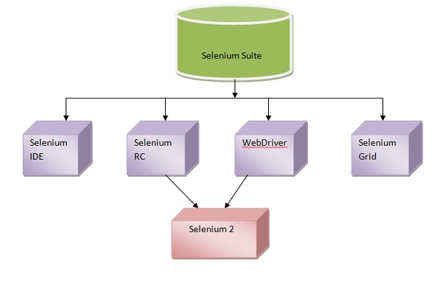
Selenium V2

Slide 4
Selenium 3
For users of WebDriver API’s, this is a drop-in replacement.
The major change being, removing the core and replacing it with the back-end WebDriver. Selenium 3.0 has become a W3C (world wide web consortium) standard.
Also, Selenium 3 would be majorly looking to be a choice of software testing tool for both web and mobile-based applications.

Slide 5
Advantages of Selenium V4
1) Usage Of WebDriver Manager: Selenium 4 has come with the biggest advantage with the use of WebDriver Manager, In the selenium 4 release there is no need to download the latest executable for an individual browser, we can write a single line code that can download the latest version for the specified driver.
2) Relative or Friendly Locator: There are different locators available to locate the Web Element on the web, in addition, selenium 4 has come up with new relative locators below are some:
toLeftOf(): Find the element to the left of a specified element.
toRightOf(): Find the element to the right of the specified element.
above(): Find the element above with respect to the specified element.
below(): Find the element below with respect to the specified element.
near(): Find the element is at most 50 pixels far away from the specified element. The pixel value can be modified.

Slide 6
Cont..
3) Capture screenshots of a specific Web Element: In selenium 3 we can capture screenshots of the entire page but with the help of selenium 4, we can capture screenshots of a specific web element.
4) Stability: With the help of Selenium 4 we can achieve stability.

Slide 7
Selenium V3 and V4
In Selenium 3, the chrome driver class directly extends to the Remote Web Driver. But In Selenium 4 Chrome driver class extends to Chromium Driver, which has some predefined methods to access the dev tool.
In Selenium 3, JSON Wire Protocol plays an important role in communication, and its the major mode of communication between the test code and the browser.
Selenium 3 and Selenium 4 are different from each other in their own way, selenium 4 comes up with different and beautiful features by Using a web driver where there is no need to download the executable you can just use Web Driver Manger class to set up the driver, also there is different relative locator available in selenium 4 by using that you can find the web element on a webpage.

Slide 8
Selenium V4 (How to open the tab)
Selenium 4 provides new ways to handle a window. We have better control by opening a new window then automatically switching to the window.
The new API is convenient because it simplifies our code. Now, we write fewer lines of code to interact with an element.

Slide 9
How to use the new tab ?
import org.openqa.selenium.WindowType;
(This import has to be added into the import sections)
WebDriver newWindow = driver.switchTo().newWindow(WindowType.TAB);
Essentially the word TAB is indicating that a new tab will be opened.
And we can control which tab we want to open
newWindow.get("https://f1.com");
With this line of code we toggle to f1.com in a new tab

Slide 10
Question and Answer Session
Thanking You,
Anant, Avinash,Vishal,Vishal :)

