Slide 1
Web scraping with Scrapy
Tomáš Bartek, Pycon.cz 2019

Slide 2
Goals of the workshop
1) write own spider
2) have a good idea how Scrapy works

Slide 3
Plan
Scrapy installation (docker/direct installation)
Scrapy architecture
XPath
Quotation spider - http://quotes.toscrape.com/

Slide 4
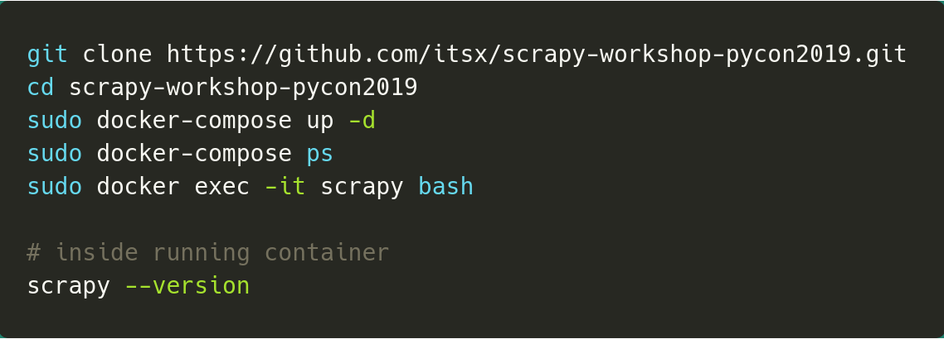
Scrapy installation
Github repo:
https://github.com/itsx/scrapy-workshop-pycon2019

Slide 5
Scrapy installation (direct install)
https://docs.scrapy.org/en/latest/intro/install.html

Slide 6
Scrapy scope
Requests – just requests
Beautiful Soup – extraction of html
Scrapy (since 2009) – requests, extraction, and more ...

Slide 7
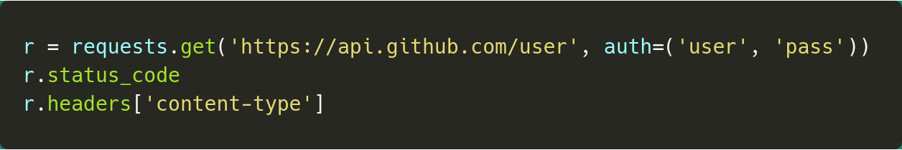
Request

Slide 8
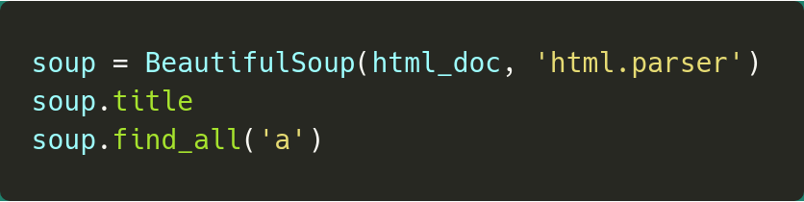
Beautiful Soup

Slide 9
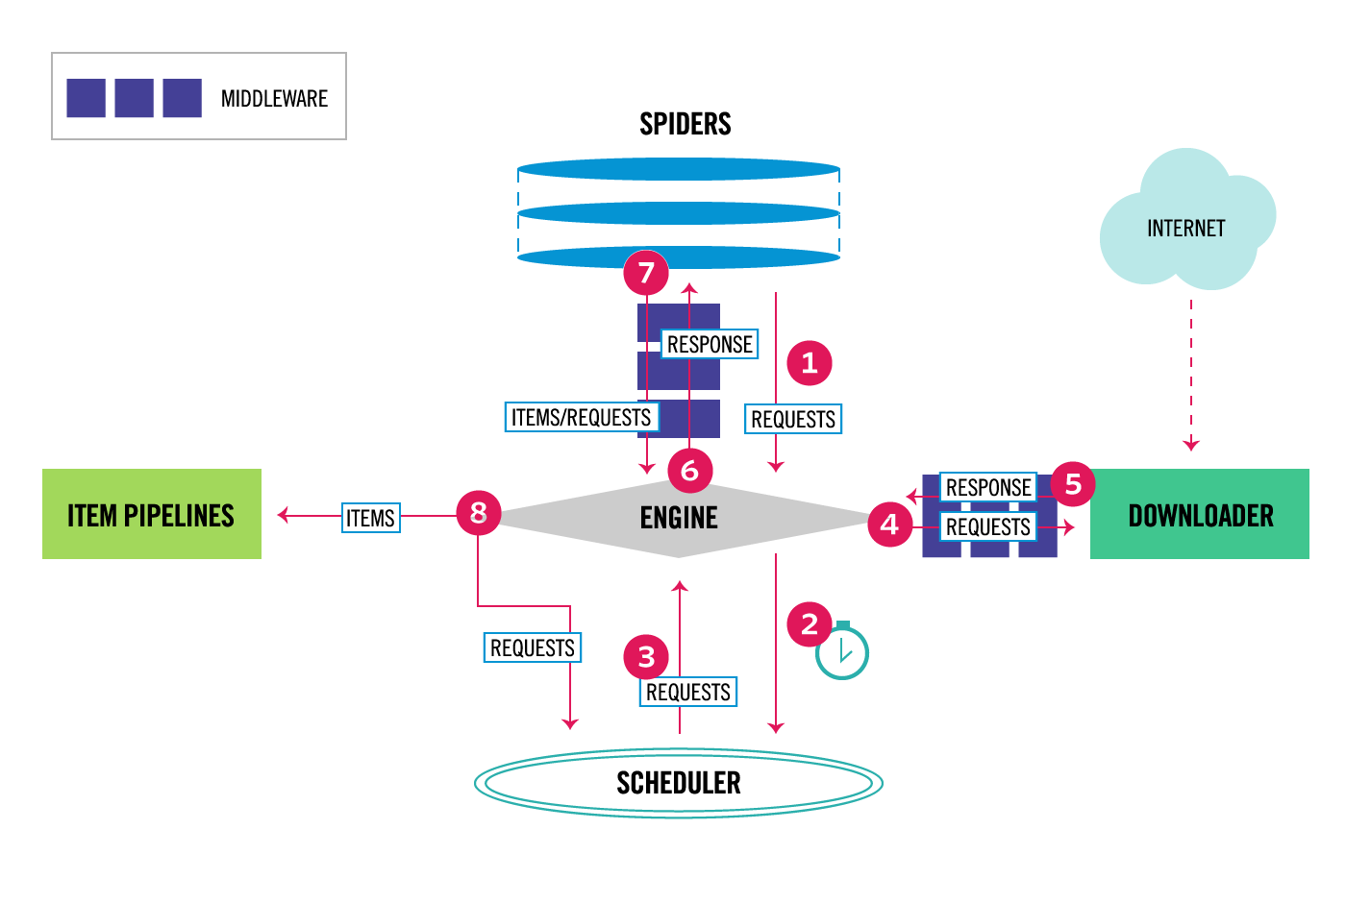
Scrapy architecture
https://docs.scrapy.org/en/latest/topics/architecture.html

Slide 10
Why Scrapy?
Open source: https://scrapy.org/
Handles complete scraping process
User can focus only on his domain specific code
Very fast (asynchronous http requests)
Simple
Extensible
Huge community
Can be deployed to a cloud (scrapinghub)

Slide 11
Scrapy architecture -spiders
Place for domain (web page) specific code
Basic spider:
- scrapy.Spider
Generic spiders:
- CrawlSpider
def parse(self, response):

Slide 12
Quotes spider
http://quotes.toscrape.com/
scrapy genspider toscrape-xpath quotes.toscrape.com
scrapy shell quotes.toscrape.com
Use devtool in a browser – F12 key
scrapy crawl toscrape-xpath -o items.json --output-format=json

Slide 13
Extraction from html
Both Css selectors and XPaths
Css selectors selects nodes according html structure
Xpaths can select node also according values
(for example value of a html link)

Slide 14
XPath basics
A query language for selecting nodes from an XML (and HTML) document
Select nodes on a specific xml path

Slide 15
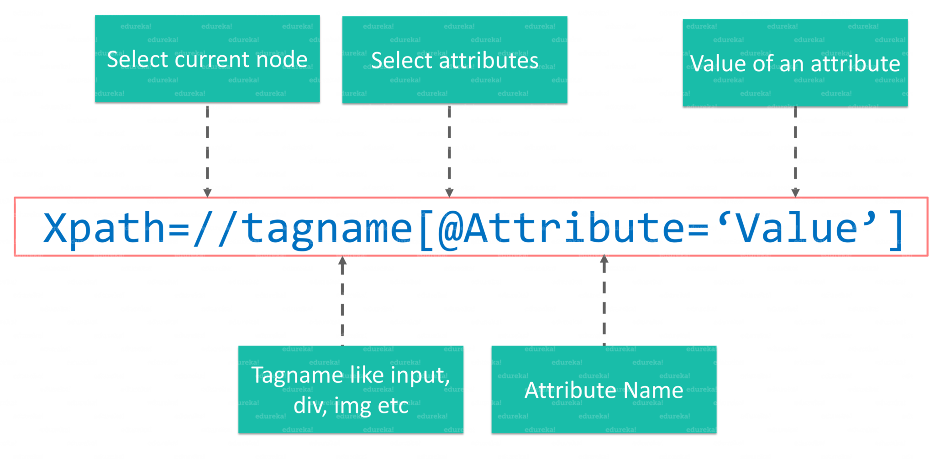
XPath anatomy - simplified
https://www.edureka.co/blog/xpath-in-selenium/

Slide 16
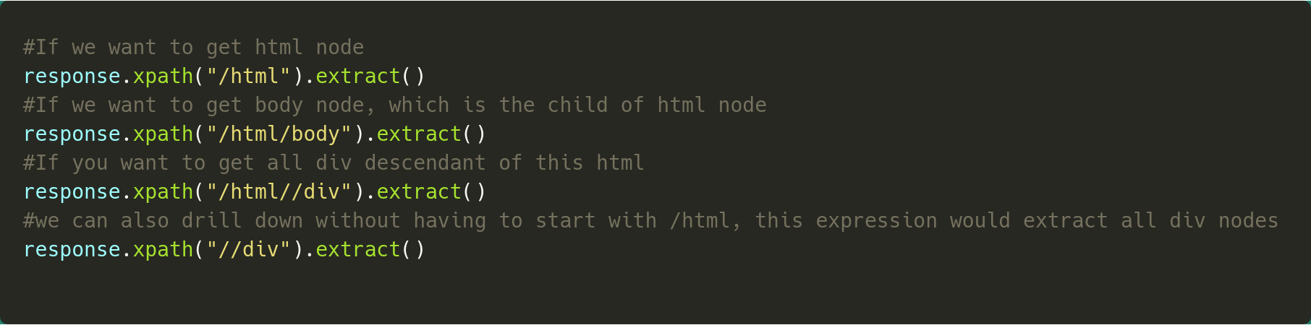
XPath selectors

Slide 17
Resources - Scrapy
Scrapinghub:
https://github.com/scrapinghub/sample-projects
Scrapinghub:
https://github.com/scrapinghub
https://docs.scrapy.org/en/latest/
https://scrapy.org/community/
https://blog.scrapinghub.com/

Slide 18
Resources - XPath
Nice tutorial:
http://www.zvon.org/comp/r/tut-XPath_1.html#Pages~List_of_XPaths

