Slide 1
Forecasting Market Volatility (VIX) with Federal Reserve Language Zoe Tomlinson | DSCI 410

Slide 2
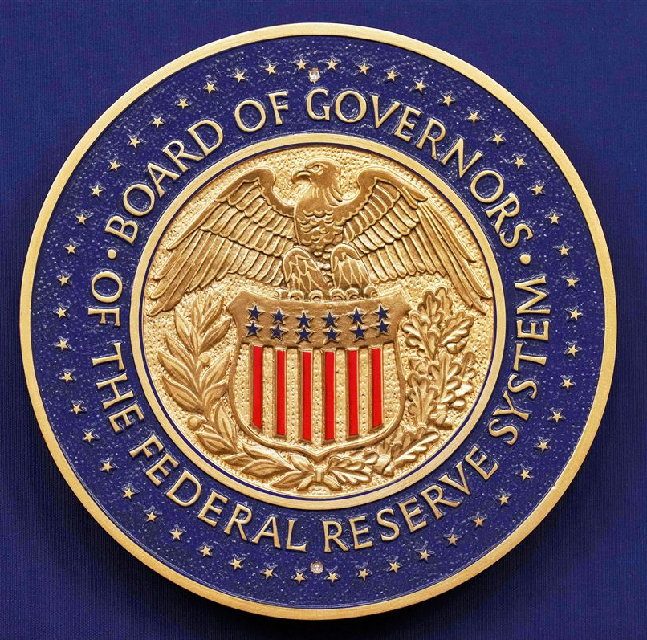
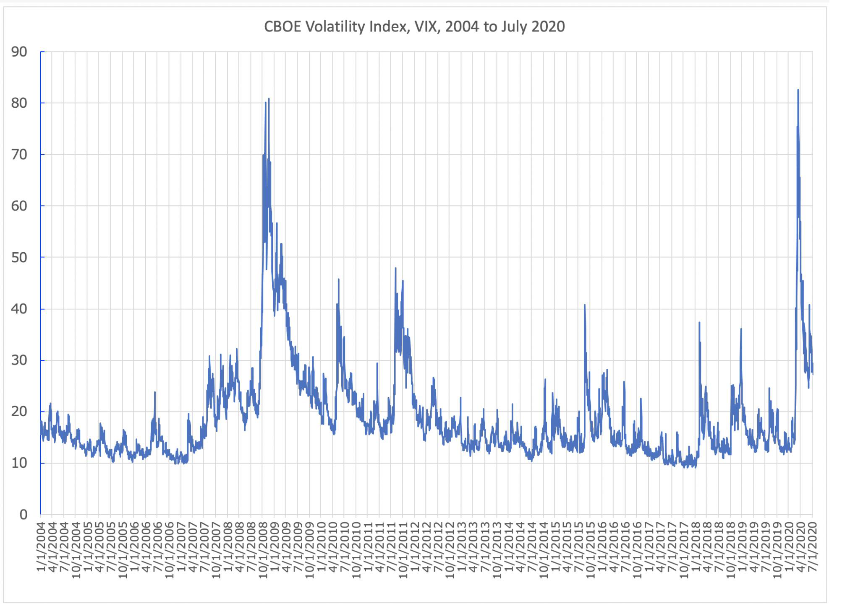
Introduction
Goal: Train a DL model on Federal Reserve text to identify language patterns predictive of the 10-day forward change in the VIX
The Federal Reserve (Fed): U.S. central bank
Sets interest rates and monetary policy in financial markets
Independent of politics, but Chair is presidentially appointed
The VIX: S&P 500’s 30-day implied volatility
widely known as the “fear gauge”
Personal Interest: how politics affect the stock market?
Difference in the Trump vs Biden regimes?
Hypothesis: when Fed text is surprising or hawkish, expected volatility moves
Prior work shows Fed text moves Treasury yields and equities, limited research on VIX

Slide 3
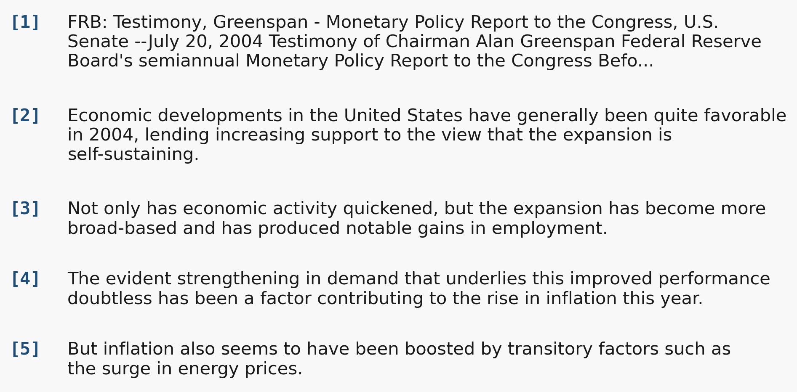
Dataset: 326 Fed documents (1993-2026)
Sources from federalreserve.gov (5-10k words per doc)
Federal Open Market Committee (FOMC) minutes (268)
committee that meets 8 times a year and decides monetary policy
Humphrey-Hawkins testimony (58)
twice-yearly testimony Fed Chair reports to Congress on monetary policy
Preprocessing
First 80 sentences to best capture the policy rationale
Target: 10-day forward change in CBOE VIX (FRED VIXCLS)
Aligned to next trading day to avoid look-ahead leakage
Example Humphrey-Hawkins testimony 2004-07-20
Train on pre-2017 data; test on three later eras
2017-01-20
Trump 1 inaug.
2021-01-20
Biden inaug.
2025-01-20
Trump 2 inaug.
splits
TRAIN (1993-2014) - 198 docs
VAL
35
TEST R1
40 docs
TEST R2
40 docs
R3
13
President
Clinton
G. W. Bush
Obama
Trump 1
Biden
Trump 2
Fed Chair
Greenspan (1987-2006)
Bernanke (2006-2014)
Yellen (2014-2018)
Powell (2018-present)
1993
2001
2009
2017
2021
2025

Slide 4
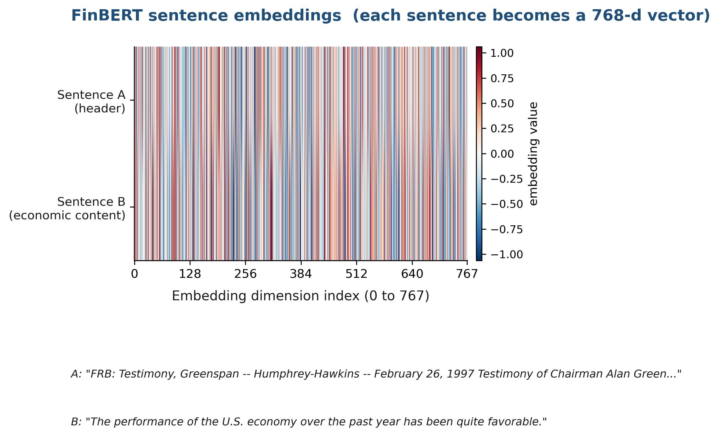
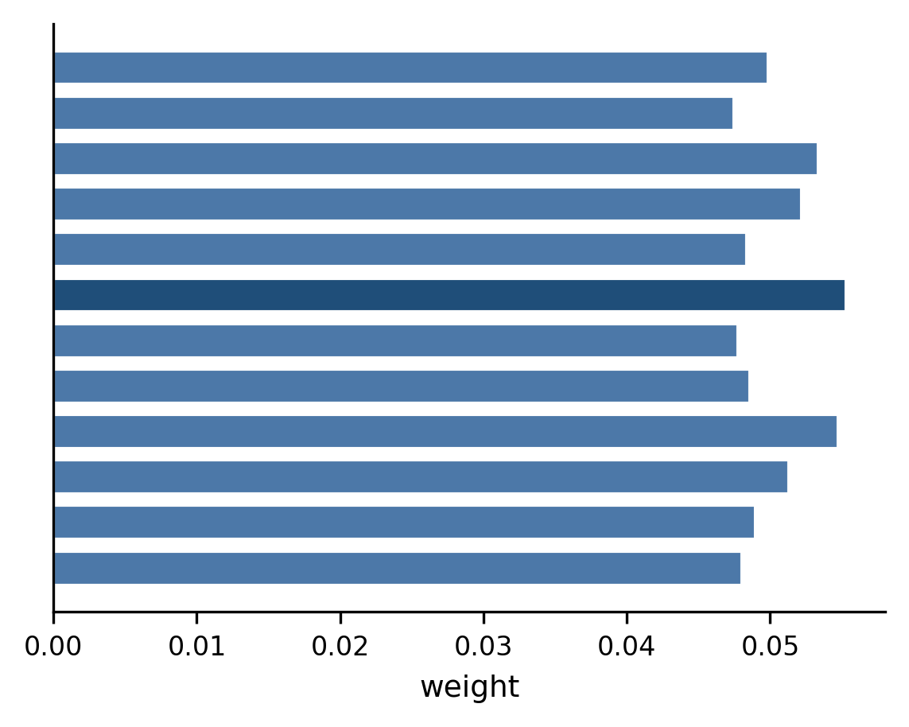
Model
Document (80 sentences)
[1] FRB Testimony header / FOMC Minutes header
[2] The performance of the U.S. economy has been quite favorable.
[3] Real GDP growth picked up to more than three percent ...
[4] Employers added more than two-and-a-half million workers ...
[5] (... 75 more sentences)
FinBERT Encoder
BERT-architecture transformer
Pre-trained on 4.9 billion words of finance text by masked language modeling (learning by predicting hidden words)
Frozen: its 110M weights never update. 198 documents is too small to fine-tune that many parameters
768-d sentence embeddings
frozen (no gradients)
Linear Regression Head
Maps document embedding to the predicted 10-day VIX change
y = w*d + b
Trained jointly with the attention by gradient descent on MSE loss to minimize average squared error
one linear layer, kept minimal to avoid overfitting on small data
Attention weight
Sentence Attention Layer
Additive (Bahdanau) attention: a small MLP gives each sentence embedding a relevance score
A softmax converts the scores into weights that sum to 1 (a probability distribution over the sentences)
The document embedding is their weighted sum, so high-weight sentences dominate
predicted
10-day
VIX change
TF-IDF + Ridge baseline (for comparison)
Bag-of-words features, no deep learning
Same temporal splits as the model
Fixed alpha = 1.0, no inner cross-validation
trained (about 100k params)

Slide 5
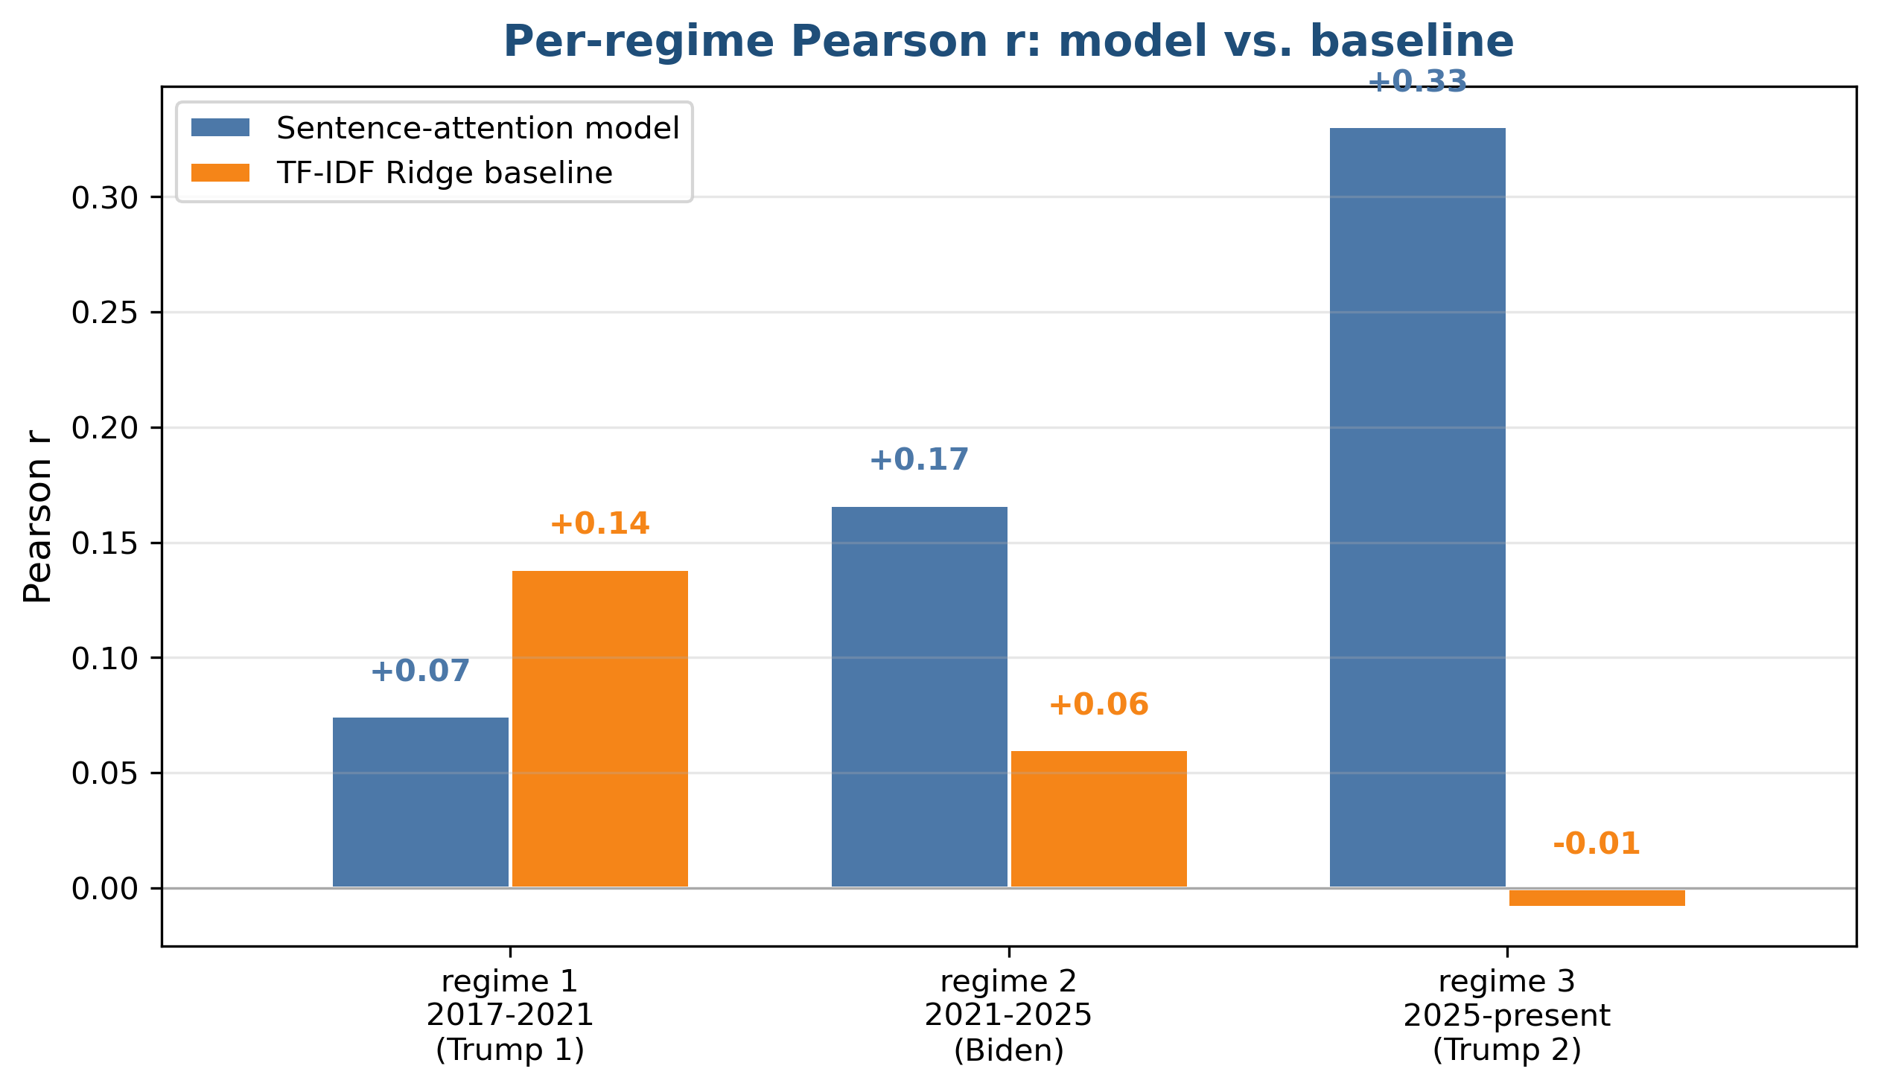
Results
Evaluation Metric
Pearson r and p-value
Predicted-vs-actual correlation (r) and probability it's just noise (p)
Results
No regime is statistically significant (all p > 0.05)
no reliable out-of-sample prediction
Accuracy changes across regimes
weakest in regime 1 (r = +0.07)
strongest in regime 3 (r = +0.33)
opposite of what we expected
Beats the TF-IDF baseline in regimes 2 and 3, but not in regime 1
Regime 3 has only n = 13 documents (regimes 1 and 2 have 40 each)
So the strong recent result is most likely small-sample noise, not a real trend.

Slide 6
Conclusions
What I found
No signal: Fed minutes did not predict the 10-day VIX change
Even FinBERT + sentence attention, both strong, established methods, found no predictive signal
A simple TF-IDF baseline did just as well…
Where signal might be (future work)
Use FOMC statements (same-day), not minutes (3 weeks late)
Predict intraday VIX to catch the immediate reaction, not 10-day change
Try richer text: statements, speeches, press conferences

