Slide 1
Forecasting Market Volatility (VIX) with Federal Reserve Language Zoe Tomlinson | DSCI 410

Slide 2
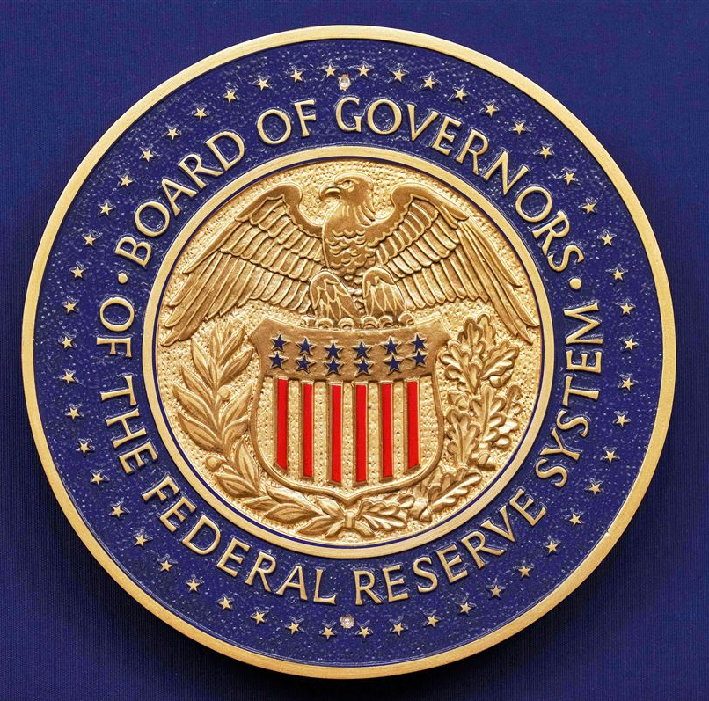
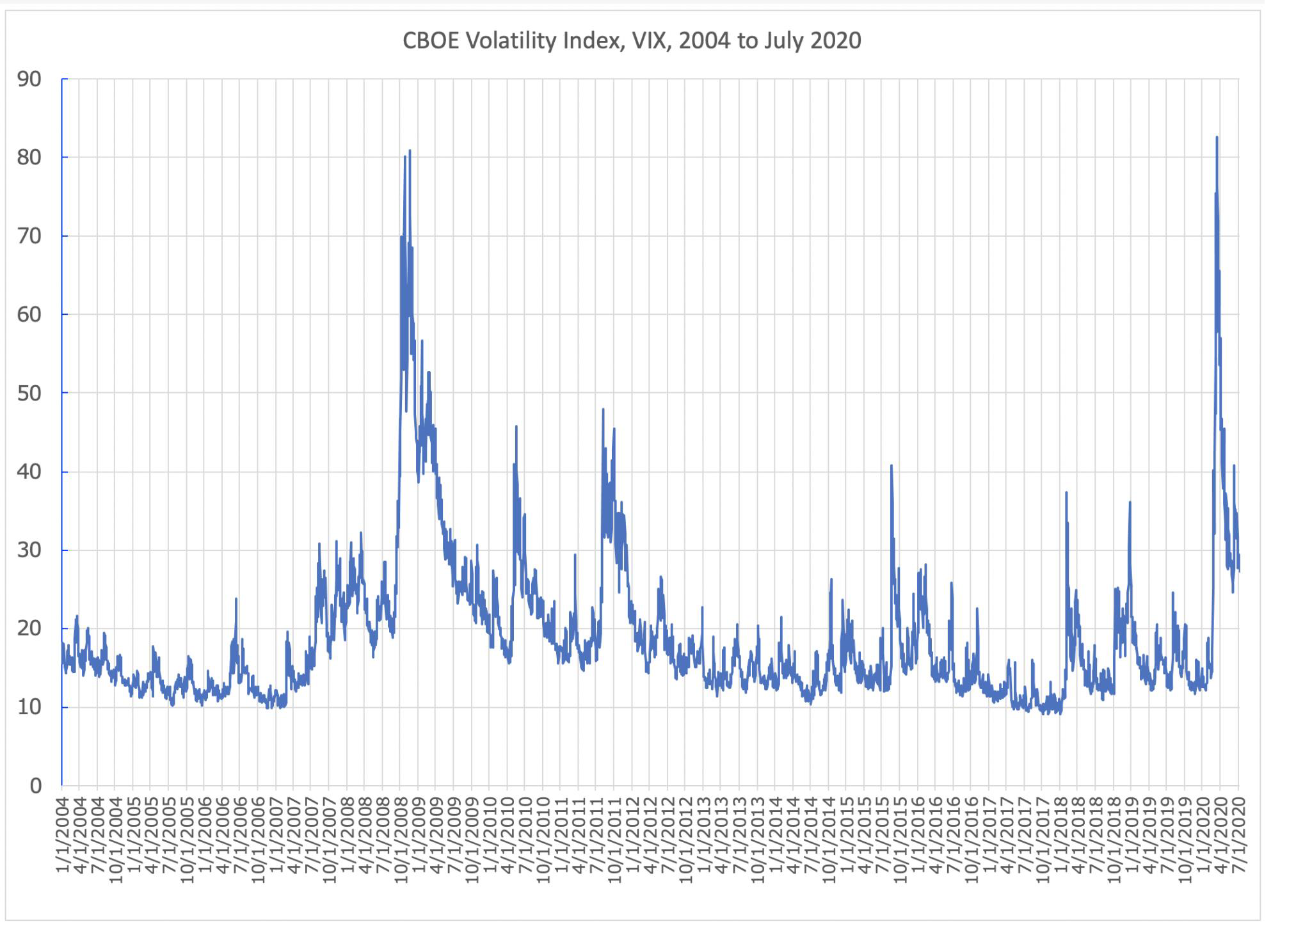
Introduction
Goal: Train a DL model on Federal Reserve text to identify language patterns predictive of the 10-day forward change in the VIX
The Federal Reserve (Fed): U.S. central bank
Sets interest rates and monetary policy in financial markets
Independent of politics, but Chair is presidentially appointed
The VIX: S&P 500’s 30-day implied volatility
widely known as the “fear gauge”
Personal Interest: how politics affect the stock market?
Difference in the Trump vs Biden regimes?
Hypothesis: when Fed text is surprising or hawkish, expected volatility moves
Prior work shows Fed text moves Treasury yields and equities, limited research on VIX

Slide 3
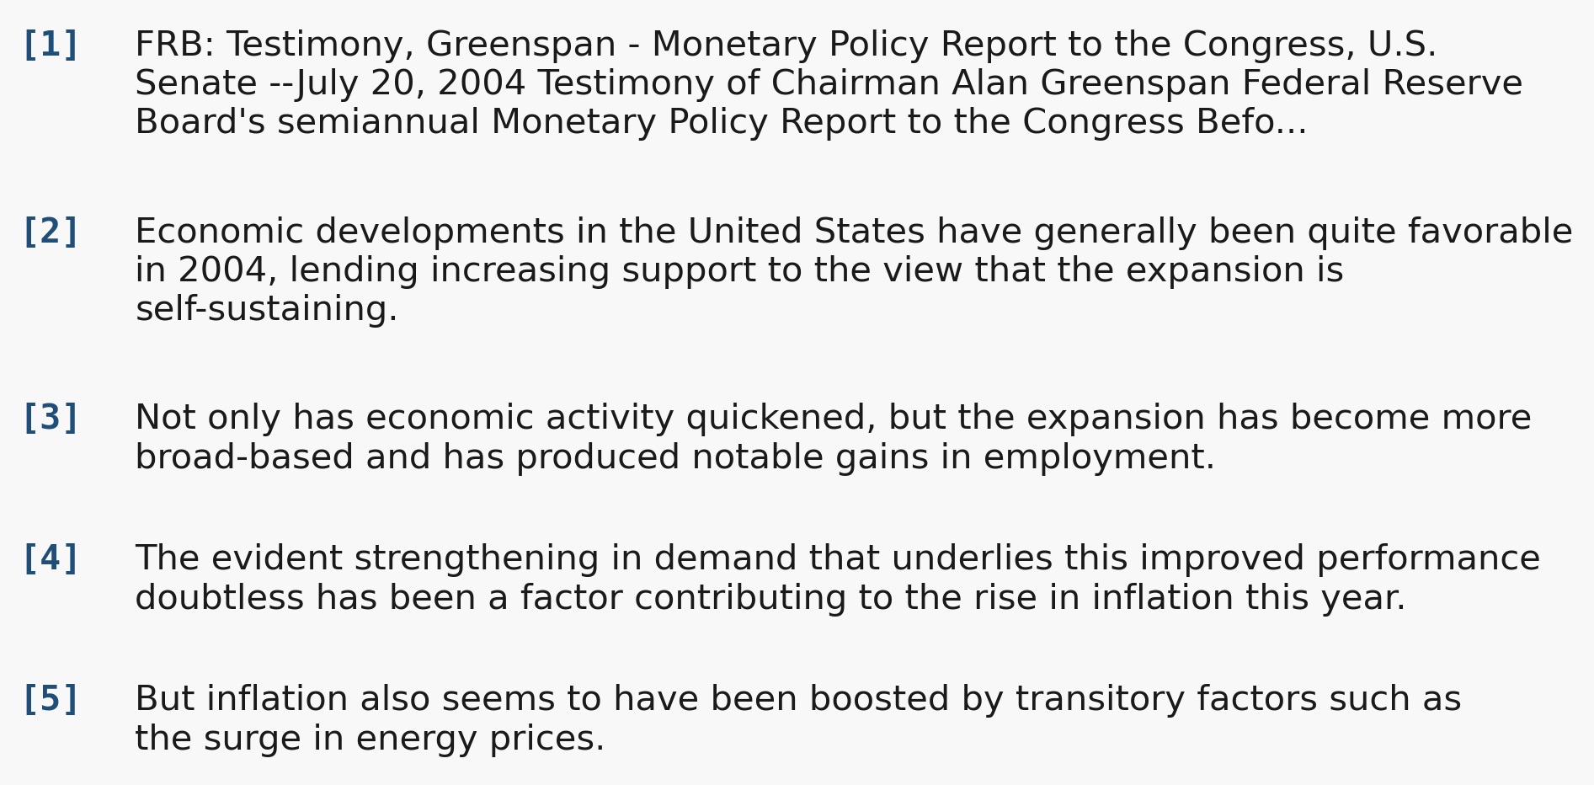
Dataset: 326 Fed documents (1993-2026)
Sources from federalreserve.gov (5-10k words per doc)
Federal Open Market Committee (FOMC) minutes (268)
committee that meets 8 times a year and decides monetary policy
Humphrey-Hawkins testimony (58)
twice-yearly testimony Fed Chair reports to Congress on monetary policy
Preprocessing
First 80 sentences to best capture the policy rationale
Target: 10-day forward change in CBOE VIX (FRED VIXCLS)
Aligned to next trading day to avoid look-ahead leakage
Example Humphrey-Hawkins testimony 2004-07-20
Train on pre-2017 data; test on three later eras
2017-01-20
Trump 1 inaug.
2021-01-20
Biden inaug.
2025-01-20
Trump 2 inaug.
splits
TRAIN (1993-2014) - 198 docs
VAL
35
TEST R1
40 docs
TEST R2
40 docs
R3
13
President
Clinton
G. W. Bush
Obama
Trump 1
Biden
Trump 2
Fed Chair
Greenspan (1987-2006)
Bernanke (2006-2014)
Yellen (2014-2018)
Powell (2018-present)
1993
2001
2009
2017
2021
2025

Slide 4
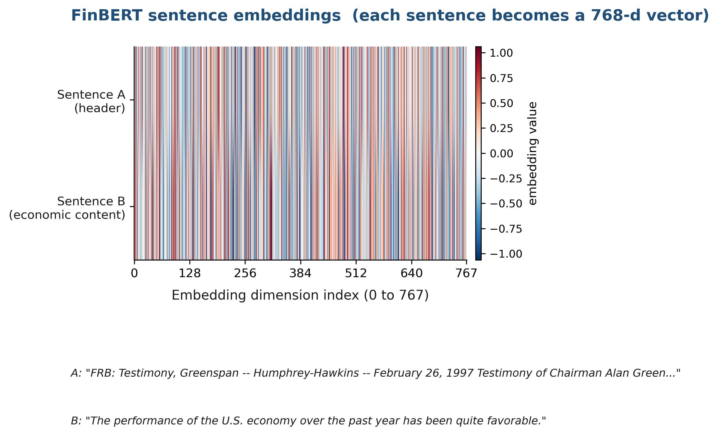
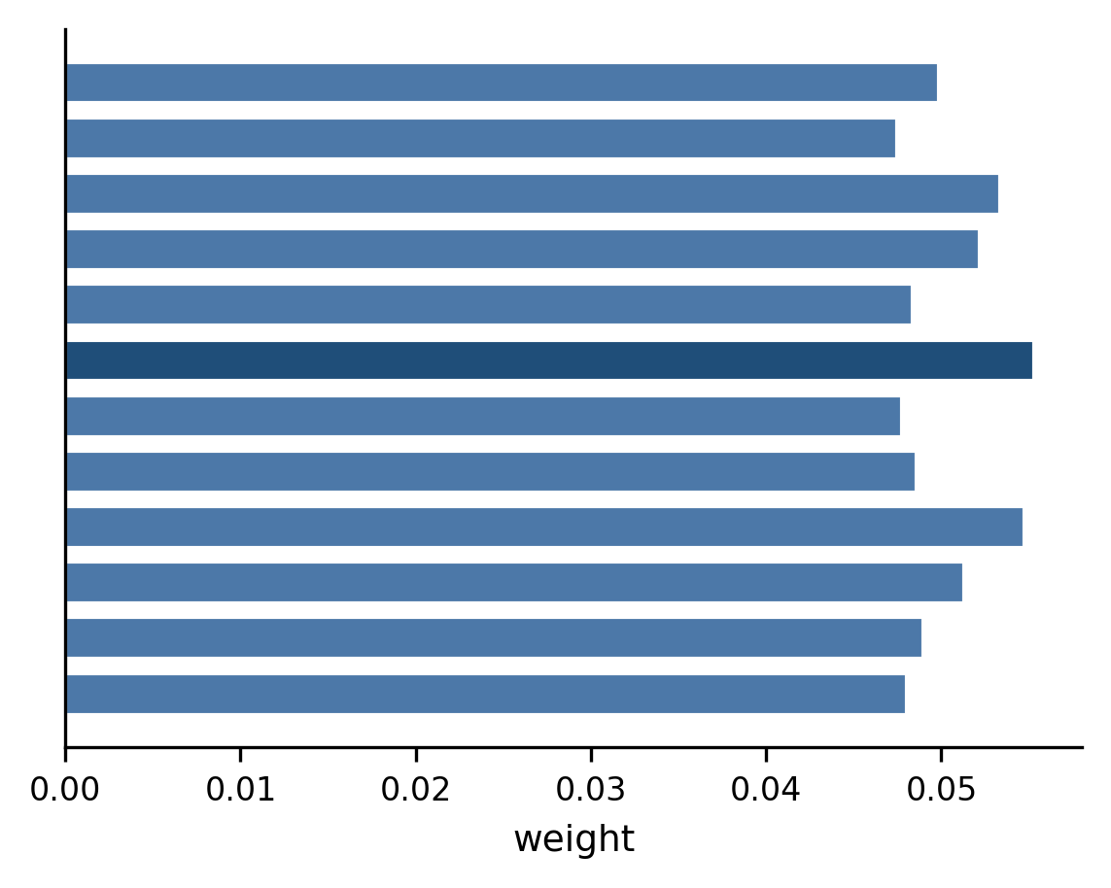
FinBERT + Sentence Attention + Linear Head
Document (80 sentences)
[1] FRB Testimony header / FOMC Minutes header
[2] The performance of the U.S. economy has been quite favorable.
[3] Real GDP growth picked up to more than three percent ...
[4] Employers added more than two-and-a-half million workers ...
[5] (... 75 more sentences)
FinBERT (frozen)
- Frozen pretrained encoder
- Pretrained on 4.9B financial tokens, so it generates better Fed embeddings than generic BERT
- Frozen because 233 docs is too few to fine-tune 110M parameters
768-d sentence embeddings
frozen (no gradients)
Linear head (trained)
Maps the 768-d document vector to one scalar
y = w*d + b
Smallest possible head to prevent overfitting on small data
Trained jointly with the attention layer by gradient descent on MSE loss
Attention weight
Additive attention (trained)
Takes a weighted sum over the 80 sentence embeddings to make one document vector
A small MLP scores each sentence; softmax turns scores into weights; weighted sum is the doc vector
Trainable (~99k parameters), gives interpretable per-sentence weights
predicted
10-day
VIX change
TF-IDF + Ridge baseline (for comparison)
Bag-of-words features, no deep learning
Same temporal splits as the model
Fixed alpha = 1.0, no inner cross-validation
trained (about 100k params)

Slide 5
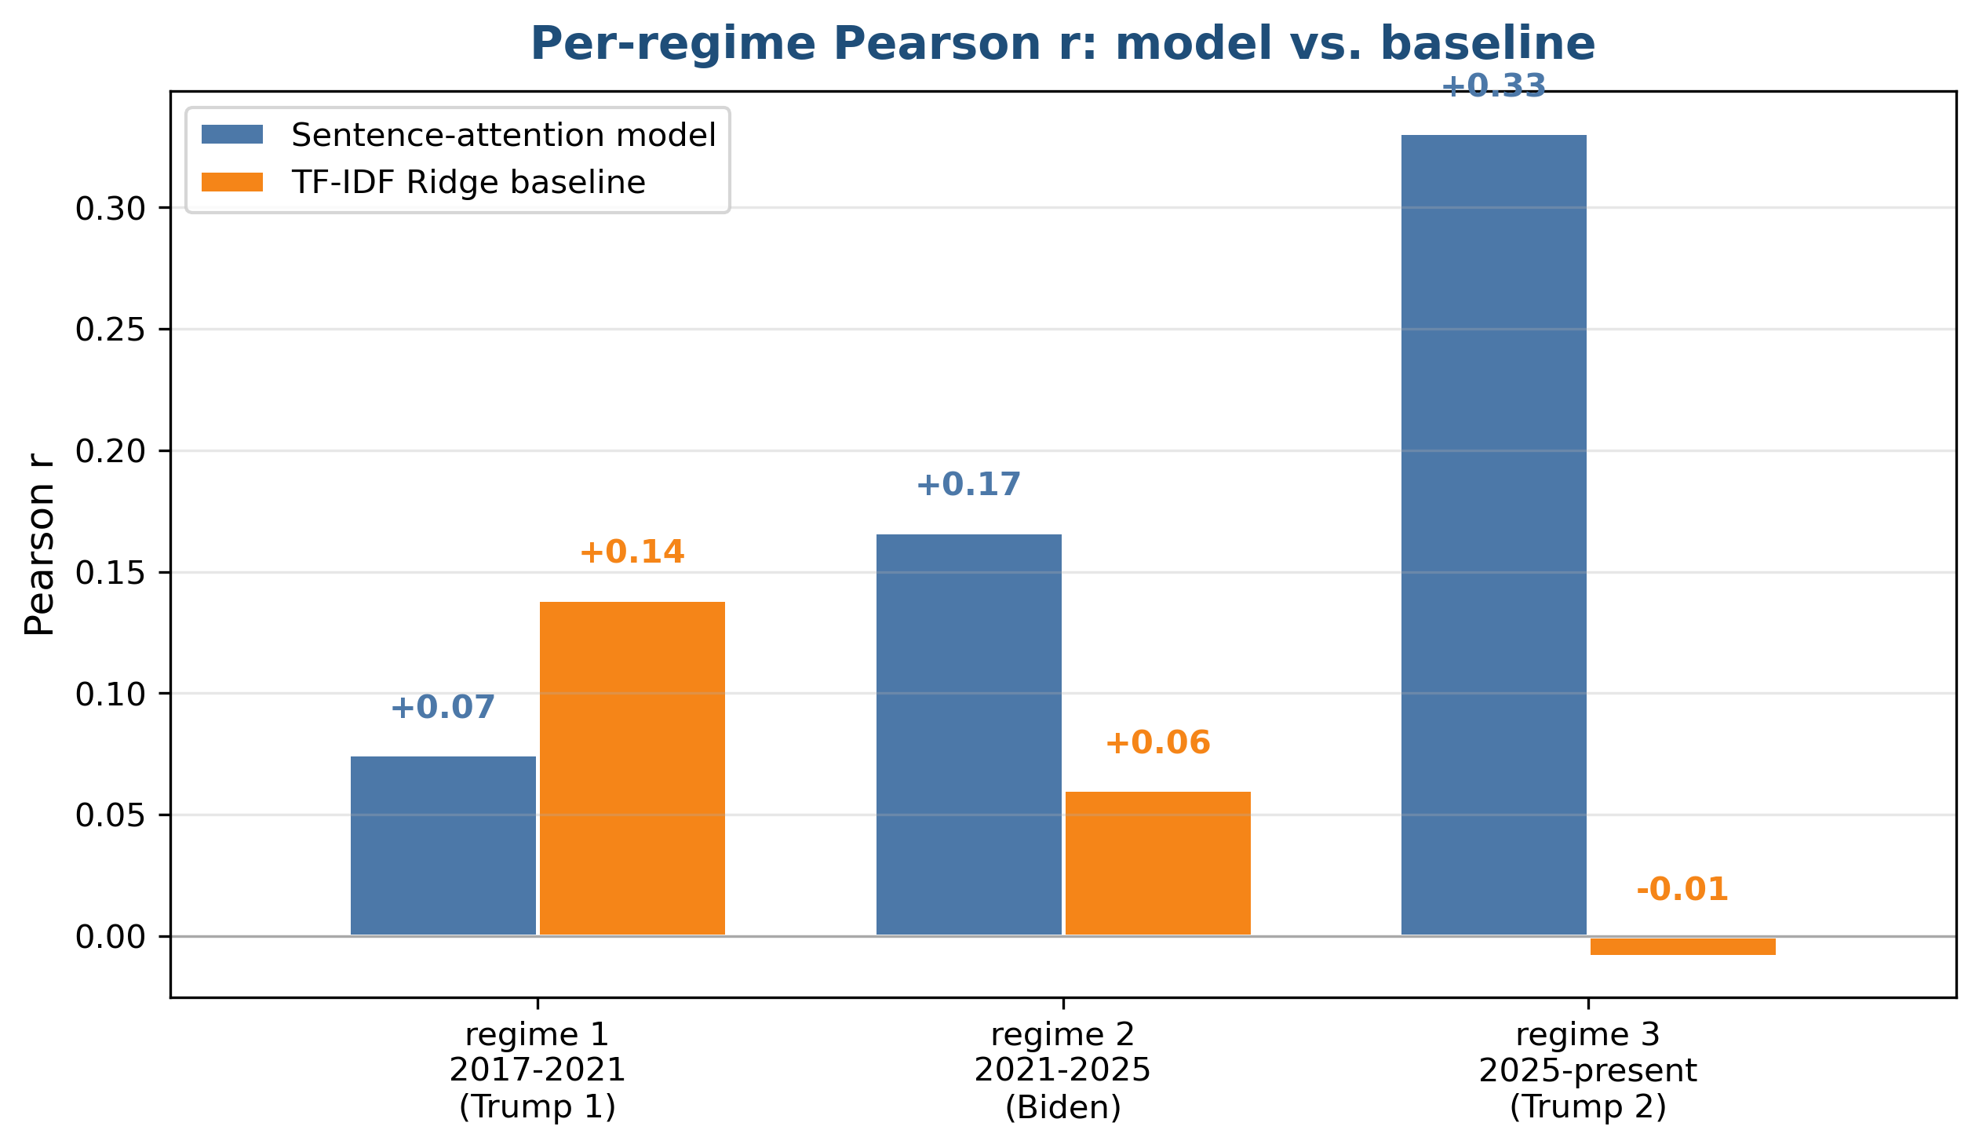
Results
Evaluation Metric
Pearson r and p-value
Predicted-vs-actual correlation (r) and probability it's just noise (p)
Results
Validation set: r = +0.34, p = 0.045
Model holds up across three later eras it never saw in training
Beats TF-IDF Ridge baseline in regime 2 (Biden) and regime 3 (Trump 2)
Regime 3 shows strongest signal: model r = +0.33 vs baseline r = -0.01
Caveat: regime 3 has only n = 13 documents, whereas 1 and 2 have 40
Wider confidence interval
regime 3's strong score could partly be noise from the small sample

Slide 6
Conclusions
What worked
Biggest finding: target horizon mattered more than the architecture.
Switching from 3-day to 10-day moved the result from null to statistically significant
Using frozen FinBERT for pretrained financial embeddings on small data
Attention pooling gave interpretable weights
Anything you would do differently
FOMC statements (same-day release) instead of minutes (3-week delay)
Intraday VIX target to capture the immediate market reaction
More data, especially to firm up the recent regimes

