Slide 1
Forecasting VIX with Federal Reserve Language
Zoe Tomlinson - DSCI 410/510

Slide 2
Introduction
Project: a deep-learning model that reads Federal Reserve text and predicts the 10-day forward change in the VIX.
Why I am interested: how politics and policy affect financial markets.
The Federal Reserve (Fed)
U.S. central bank; sets interest rates and is the single largest source of monetary-policy signal.
Formally independent, but the Chair is presidentially appointed.
Different presidents have very different relationships with the Fed (e.g., Trump publicly pressured, Biden hands-off).
The VIX ("investor fear gauge", Whaley 2000)
S&P 500's 30-day implied volatility; moves when traders update what they expect for future volatility.
Hypothesis: when Fed text is surprising or hawkish, expected volatility should move.
Why deep learning: not much numerical data per release; signal lives in the language. Prior work (Hansen, McMahon & Prat 2018; Lucca & Trebbi 2009) shows Fed text moves Treasury yields and equities.

Slide 3
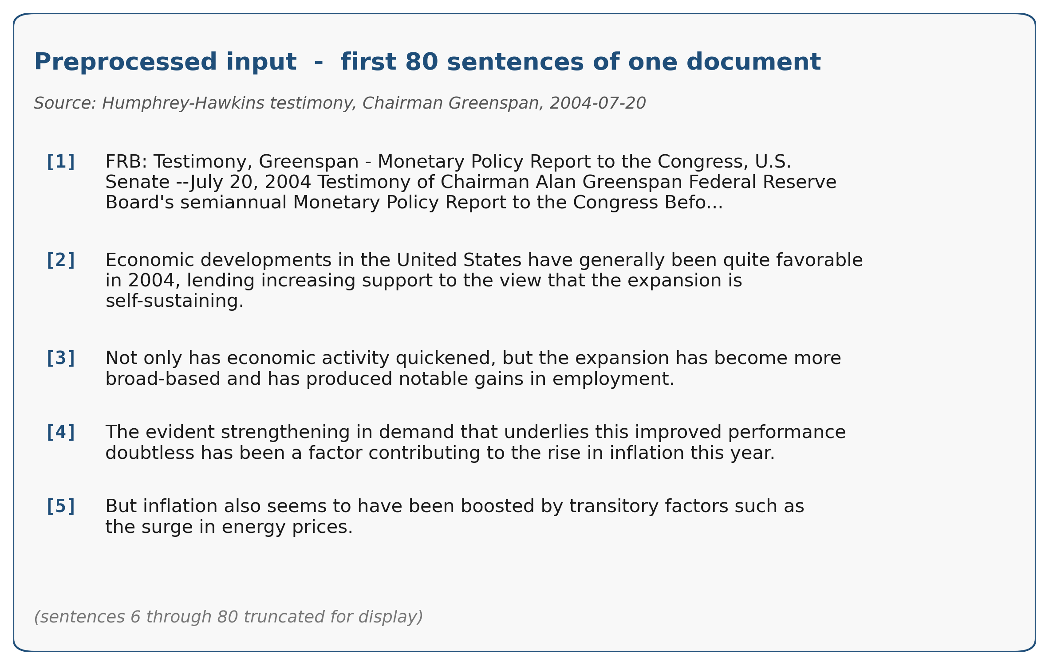
Dataset: 326 Fed documents (1993 to 2026)
Sources (federalreserve.gov)
FOMC minutes (268): released ~3 weeks after each meeting.
Humphrey-Hawkins testimony (58): Fed Chair to Congress, twice-yearly.
Each document
5,000 to 10,000 words; capped to first 80 sentences (Punkt segmenter).
Opening sections carry the policy rationale (Hansen et al. 2018).
Target
10-day forward change in CBOE VIX (FRED VIXCLS).
Aligned to next trading day -> no look-ahead leakage.
Splits: strictly temporal, anchored to U.S. inauguration days.
Test on three later eras -> temporal generalization.
Limitation: 326 docs is small. FOMC statements + intraday VIX would carry more signal but were out of scope.
Train on pre-2017 data; test on three later eras
2017-01-20
Trump 1 inaug.
2021-01-20
Biden inaug.
2025-01-20
Trump 2 inaug.
splits
TRAIN (1993-2014) - 233 docs
VAL
35
TEST R1
40 docs
TEST R2
40 docs
R3
13
President
Clinton
G. W. Bush
Obama
Trump 1
Biden
Trump 2
Fed Chair
Greenspan (1987-2006)
Bernanke (2006-2014)
Yellen (2014-2018)
Powell (2018-present)
1993
2001
2009
2017
2021
2025

Slide 4
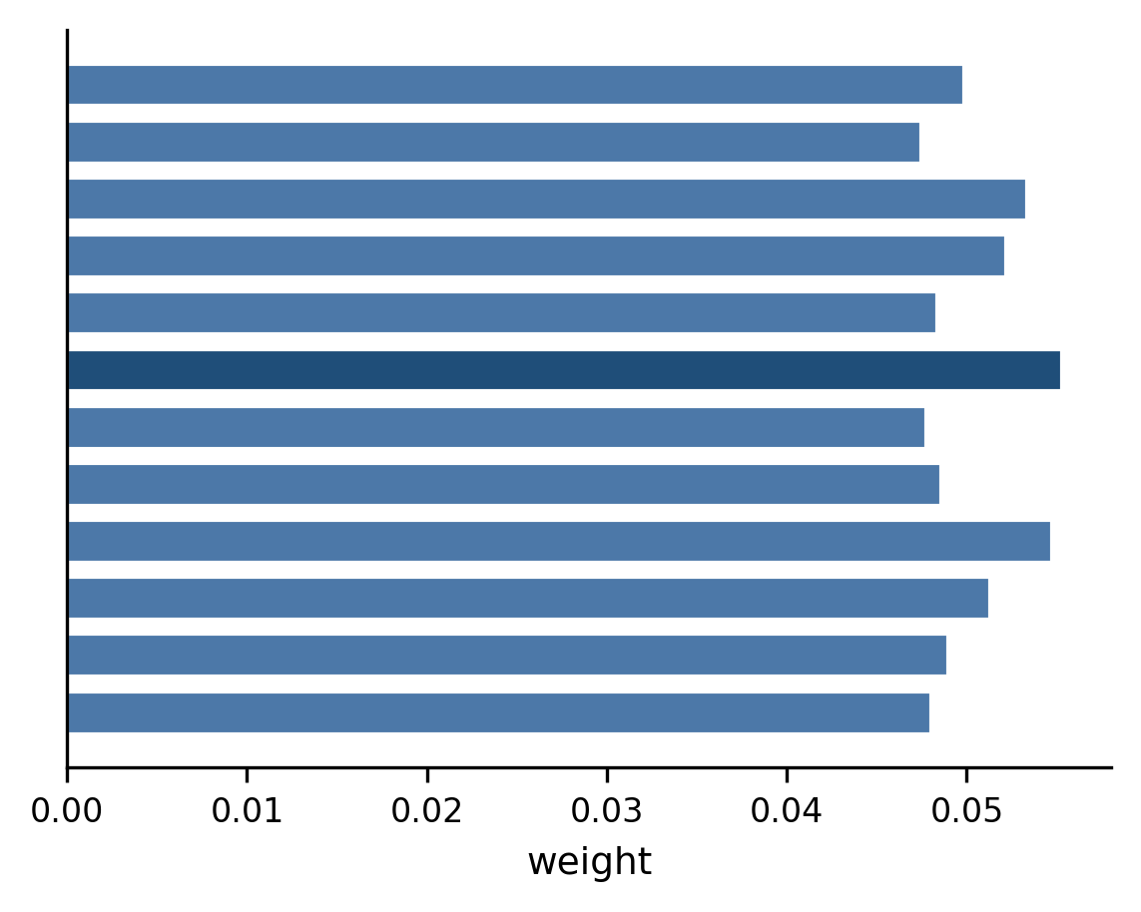
Model: frozen FinBERT + sentence attention + linear head
Pipeline: text -> embeddings -> attention -> prediction
Document (80 sentences)
[1] Minutes of the FOMC Meeting ...
[2] The performance of the U.S. economy has been quite favorable.
[3] Real GDP growth picked up to more than three percent ...
[4] Employers added more than two-and-a-half million workers ...
[5] (... 75 more sentences)
FinBERT
(frozen)
110M params
domain-pretrained
on financial text
768-d sentence embeddings
Additive
attention
(trained)
~99k params
learns one
weight per
sentence
Attention weight per sentence
Sentence A (1997: "favorable")
Linear
head
(trained)
y = w*d + b
Sentence B (2004: "inflation")
different sentences -> different vectors
predicted
10-day
VIX change
frozen (no gradients)
trained (about 100k params)
FinBERT (frozen) | what: BERT pretrained on 4.9B financial tokens (Yang, Uy & Huang 2020). | why: better Fed embeddings than generic BERT. | how: kept frozen (Peters et al. 2019); too few docs to fine-tune 110M params.
Additive sentence attention (trained) | what: weighted sum over 80 sentence embeddings (Yang et al. 2016, HAN). | why: documents are not uniform; lets the model focus on policy-rationale sentences. | how: a small MLP scores each sentence; softmax gives weights; weighted sum is the doc vector.
Linear regression head (trained) | what: y = w*d + b on the 768-d doc vector. | why: smallest possible head, prevents overfitting on 233 docs. | how: trained jointly with attention by gradient descent on MSE loss.
TF-IDF + Ridge baseline | what: bag-of-words, no deep learning. | why: honest comparison. | how: same temporal splits, fixed alpha = 1.0, no inner CV.

Slide 5
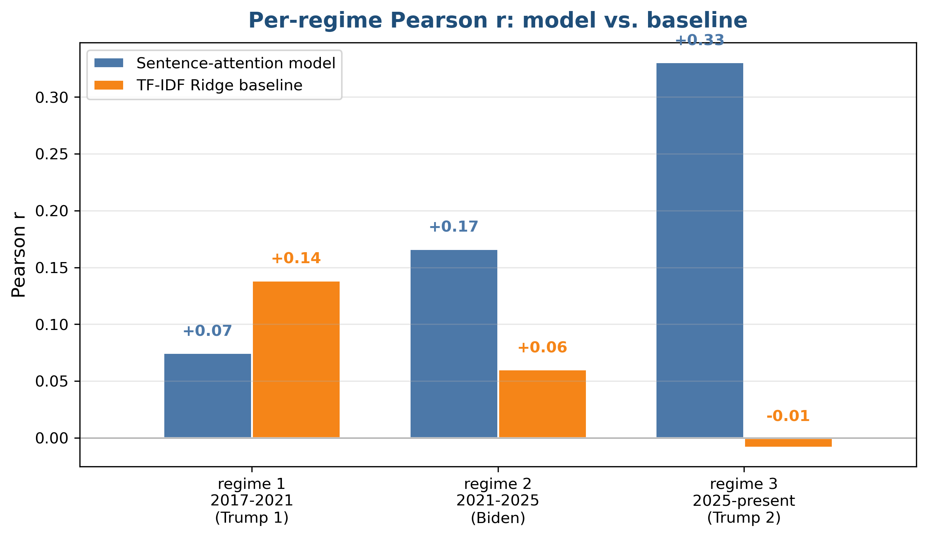
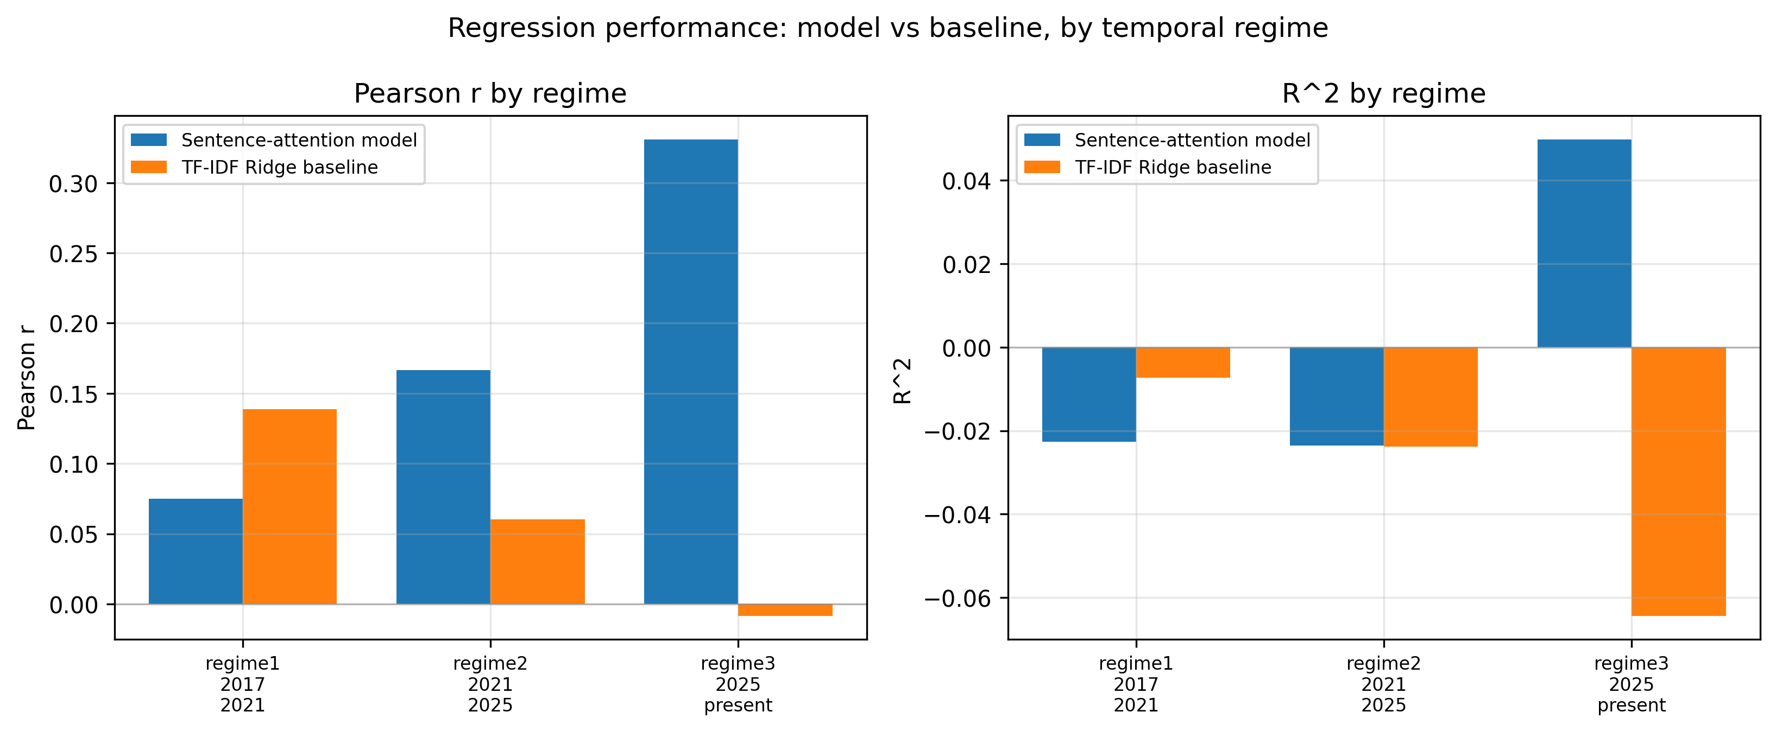
Results: Pearson r = 0.34 on validation (p = 0.045)
Pearson r: correlation between predicted and actual VIX change.
Range -1 to +1. Positive = predictions and reality move together.
p-value: probability of a result this strong by chance if the model truly had zero relationship with the target.
p < 0.05 is the conventional 'unlikely to be chance' threshold.
Validation set (n = 35): r = +0.34, p = 0.045. Statistically significant.
Temporal generalization (figure, right)
Model holds up across three later eras it never saw in training.
Beats TF-IDF Ridge baseline in regime 2 (Biden) and regime 3 (Trump 2).
Regime 3 shows strongest signal: model r = +0.33 vs baseline r = -0.01.
Caveat: regime 3 has only n = 13 documents. Small n means a wide confidence interval, so the r = +0.33 could be far from the true value. Direction is interesting but not formally significant on its own (p = 0.27).
Methodological note: initial 3-day target gave a null result (p = 0.38); extending to 10 days made the signal significant.

Slide 6
Conclusions
What worked
Frozen FinBERT + sentence attention + linear head. ~100k trained params.
Statistically significant on held-out validation (r = 0.34, p = 0.045).
Beat the TF-IDF baseline in 2 of 3 test regimes.
Methodological finding: horizon matters more than architecture.
3-day target was a null result. 10-day target was significant.
On temporal generalization
Relationship learned on 1993-2017 data still applies in 2017+ data.
Strongest in the most recent regime (Trump 2), but n = 13 limits certainty.
What I would do with more time
FOMC statements (same-day release) instead of minutes (3-week delay).
Intraday VIX target to capture the immediate market reaction.
Larger corpus, especially to firm up the recent regimes.

